Slide 1

A lightweight dataflow analysis to support source code reading
Takashi Ishio
Shogo Etsuda, Katsuro Inoue
Osaka
University

Slide 2
Research Background
Developers often read source code written by other developers.
Software Inspection:
to find potential problems
Code Search:
to find reusable components
in a software repository.

Slide 3
Program slicing is promising …
Program slicing has been applied to debugging and program comprehension.
We implemented a program slicing tool for Java based on Soot framework.
Soot is a Java bytecode analysis framework developed by McGill University.

Slide 4
… but, not so effective?
The slicing tool takes 40 minutes to construct SDG for JEdit 4.2 (140 KLOC).
few seconds to compute a program slice
Developers in a company said:
“It is much faster than our previous tool!”
but “it is still impractical for daily work.”
Their source code is frequently updated.

Slide 5
Our Approach: Simplified Data-flow Analysis
Imprecise, but efficient
Control-flow insensitive
Object insensitive
Inter-procedural
Target: Java Programs

Slide 6
Variable Data-flow Graph
A directed graph
Node: variable, statement
Edge: apporximated control- and data-flow
We directly extract a data-flow graph from AST.
without a control-flow graph

Slide 7
Data-flow Extraction
lhs = rhs; is regarded as
a dataflow rhs ➔ lhs.
A statement “a = b + c;” is translated to:
<<Variable>>
b
data
<<Statement>>
a = b + c;
data
<<Variable>>a
data
<<Variable>>
c

Slide 8
Control-flow Insensitivity
The same graph may be extracted from different code.
(a) X = Y; (b) Y = Z;
(b) Y = Z; (a) X = Y;
No Data
Dependence
Data
Dependence
<<Variable>>
Z
(b)
<<Statement>>
Y = Z;
(b)
<<Variable>>
Y
(a)
<<Statement>>
X = Y;
(a)
<<Variable>>
X
The transitive path Z ➔ X is infeasible for the left code.

Slide 9
Approximated Control-Dependence
An if statement controls its then/else blocks.
“if (X) { Y = Z; }” is translated to:
<<Variable>>
X
control
<<Variable>>
Z
data
<<Statement>>
Y = Z;
data
<<Variable>>
Y

Slide 10
A method graph
dataflow
from callsites
x
y
x > y
static int max ( int x, int y ) {
int result = y ;
if ( x > y )
result = x ;
return result ;
}
result = x
result = y
result
return result;
<<return>>
to callsites

Slide 11
Inter-procedural Edges
Method Call
Field Access
A field is also a variable vertex.
Object-insensitive
<<invoke>>
max(x, y)
x
y
return
<<Method>>
max(x, y)
x
y
<<return>>
<<Field
Write>>
<<Field>>
size
<<Field
Read>>
obj
size
obj
return

Slide 12
Graph Traversal
max(…)
C.p
class C {
void m() {
int size = max(p, q);
y.setSize(size);
}
}
<<invoke>>
max(int,int)
arg1
arg2
ret
C.q
size
C.y
<<invoke>>
setSize()
obj
arg
class D {
void setSize (int s) {
this.size = s;
}
….
}
(this)
s
<<Field Write>>
obj
arg
D.size

Slide 13
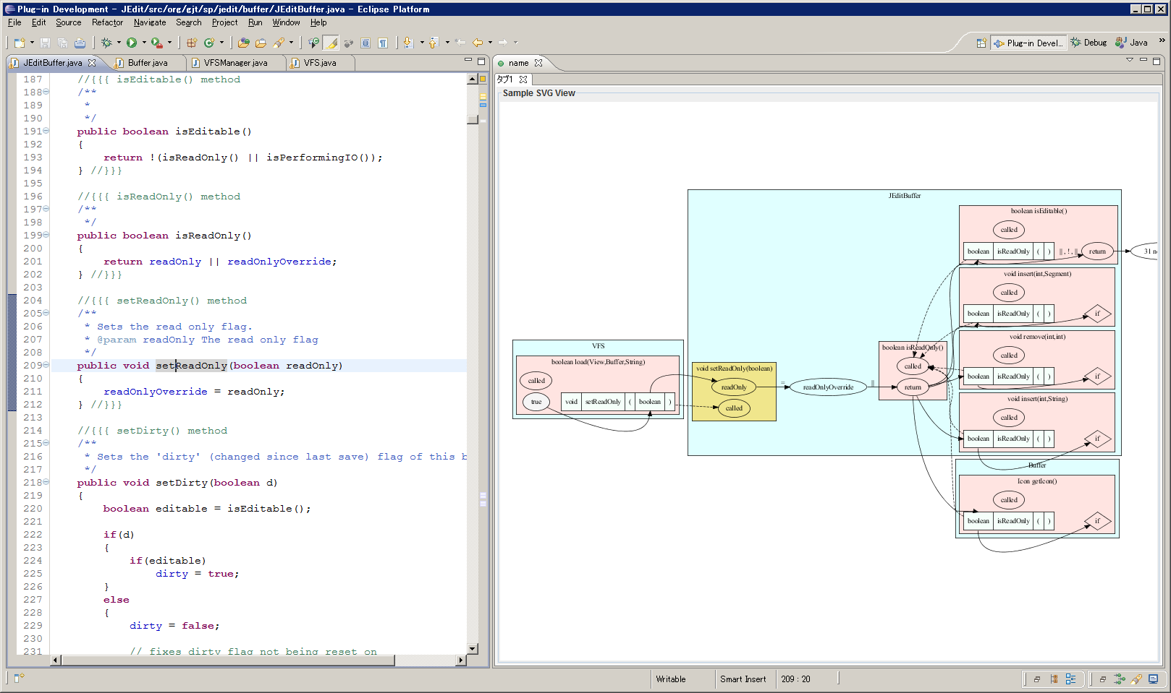
Implementation (1/2)
Graph Construction: a batch system
Viewer: an Eclipse plug-in
Data-flow edges are automatically traversed from a method where the caret is located.

Slide 14
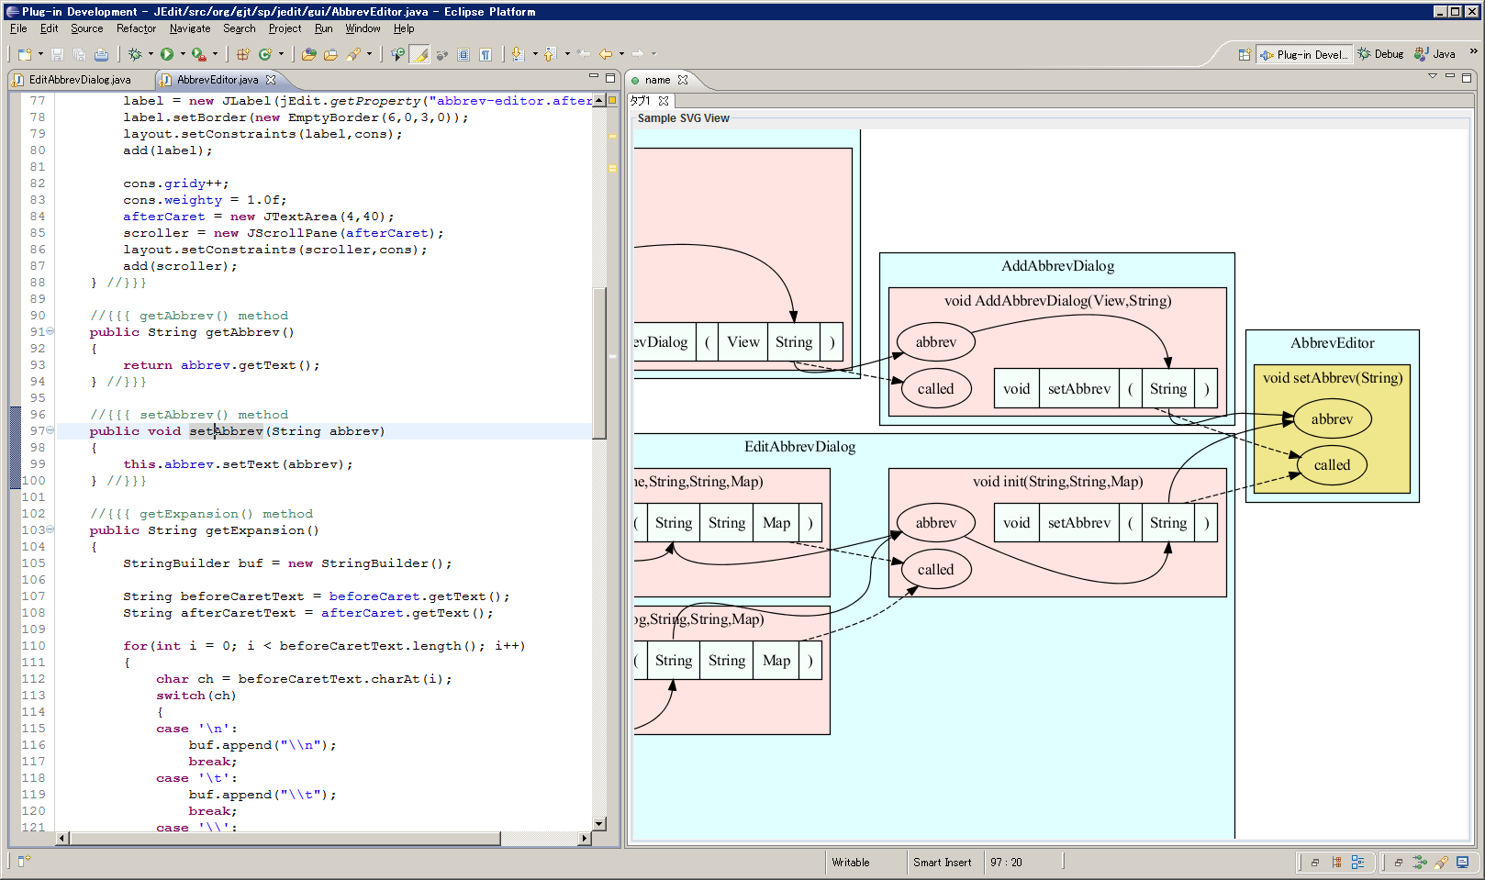
Implementation (2/2)
Only method calls, parameters and fields are visible.

Slide 15
Tradeoff
Simplified analysis
AST and symbol table
Class Hierarchy Analysis
No control-flow graph, no def-use analysis
Infeasible paths, unrealizable paths
Because of control-flow insensitivity

Slide 16
Experiment
Is it efficient?
Analyzed several Java programs
Is it effective for program understanding?
We have assigned program understanding tasks to graduate students.

Slide 17
Performance Measurement
Software | Size (LOC) | Time to construct AST and symbol table (sec.) | Time to analyze dataflow (sec.) | Total Time (sec.)
ANTLR 3.0.1 | 71,845 | 39 | 11 | 50
JEdit 4.3pre11 | 168,872 | 108 | 17 | 125
Apache Batik 1.6 | 297,320 | 155 | 33 | 188
Apache Cocoon 2.1.11 | 505,715 | 490 | 71 | 561
Azureus 3.0.3.4 | 552,295 | 353 | 115 | 468
Jboss 4.2.3GA | 696,761 | 703 | 348 | 1,051
JDK 1.5 | 885,887 | 1,054 | 1,001 | 2,055
on Windows Vista SP2, Intel® Core2 Duo 1.80 GHz, 2GB RAM

Slide 18
Program Understanding Tasks
Identify how a user’s action makes a sound beep
in JEdit.
EditAbbervDialog.java, Line 153 (Task A)
JEditBuffer.java, Line 2038 (Task B)
30 minutes for each task (excluding graph construction)
Participant 1, 2 | Participant 3, 4 | Participant 5, 6 | Participant 7, 8
Task A with Tool | Task A w/o Tool | Task B with Tool | Task B w/o Tool
Task B w/o Tool | Task B with Tool | Task A w/o Tool | Task A with Tool
“w/o Tool” means a regular Eclipse SDK without our plug-in.

Slide 19
Task A: JEdit sounds beep at EditAbbervDialog.java: line 153
The correct answer is defined as a data-flow subgraph.
public void actionPerformed(ActionEvent evt) {
if (evt.getSource() == ok) {
if (editor.getAbbrev() == null || editor.getAbbrev().length() == 0) {
getToolkit().beep();
return;
}
if (!checkForExistingAbbrev()) return;
isOK = true;
}
dispose();
}
A return value of JTextField.getText()
The argument of setText(String)
The argument of
AbbrevEditor.setAbbrev(String)
“Add” Button Clicked
AbbrevsOptionPane.
actionPerformed is called.
(omitted)

Slide 20
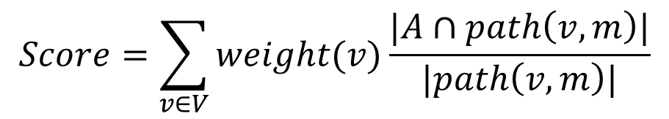
Correctness of answer
$$Score=\sum_{v∈V}{weight(v)\frac{|A∩path\left(v,m\right)|}{|path\left(v, m\right)|}}$$
v1
v2
0.5
0.5
[Example]
Correct Answer: V = {v1, v2}
A participant identified two red edges.
Score =
path(v1, m): 0.5 * (1 edge / 2 edges) +
path(v2, m): 0.5 * (2 edge / 2 edges) = 0.75
m

Slide 21
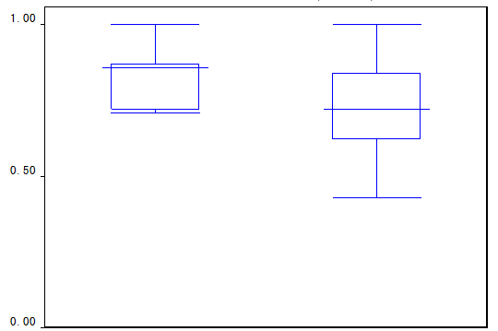
Result
Average Score:
with tool: 0.83
w/o tool: 0.73
t-test (a=0.05)
shows the difference
is significant.
with Tool without tool

Slide 22
Observation
No problem caused by infeasible paths.
Participants might manually investigate meaningful paths in the interactive view.
We need to evaluate how infeasible paths affect automated analysis.
Detailed Analysis is still ongoing.

Slide 23
Related Work
Execution-After Relation [Beszédes, ICSM2007]
Control-flow based approximation of SDG
GrouMiner [Nguyen, FSE2009]
API Usage Mining based on Graph Mining
Each method is translated to a “groum” that approximates control- and data-flow.
Intra-procedural analysis

Slide 24
Conclusion
Simplified data-flow analysis
Much faster than regular dependence analysis
The analysis may generate infeasible paths, but it is still effective.
Future Work
Detailed analysis on the result
A replicated study with industrial developers
Comparison with Program Slicing

Slide 26
Threats to Validity
Just a single case study.
The effectiveness of an interactive view is included in the study.
Score definition is fair?
t-test assumes normal distribution of score.

