Slide 1
Towards a Collection of Refactoring Patterns Based on Code Clone Categorization
Masayuki Tokunaga†, Norihiro Yoshida † †, Kazuki Yoshioka †, Makoto Matsushita †, Katsuro Inoue †
† : Osaka university
††: Nara Institute of Science and Technology

Slide 2
Research Background (1/2)
What is Code Clone ?
  Code fragments in a source code that are identical or similar to each other
    Created by copy-and-paste
    Makes software maintenance more difficult
    Merged into one module though refactoring
code clone
copy-and-paste

Slide 3
Research Background (2/2)
What is refactoring pattern?
  Pattern of the refactoring process
    Decrease the efforts of refactoring
    Can be applied to the experimental modification
  Typical refactoring pattern
    Fowler’s Pattern[1]
      Categorize code clone characteristics into five categories
      Propose processes of refactoring for each code clone category
    [1]Martin Fowler, “Refactoring Improving the design of existing code”

Slide 4
Probrem(1/2)
Pattern
  Extract method
Categories of code clone characteristics
  clone in the same classes
Pattern
  Extract method
Categories of code clone characteristics
  clone in the same classes（+ having differences）
uncategorized characteristics
Clone Pair
Clone Pair
void printOwing(double amount){
printButton();
System.out.print(_name);
System.out.print(amoujnt);
}
void printAssets(double amount){
printBanner();
System.out.print(_name);
System.out.print(amount);
}
void printOwing(double amount){
printButton();
System.out.print(_name);
System.out.print(amount);
}
void printAssets(double amount){
printBanner();
System.out.print(_name);
System.out.print(amount+100);
}
difference
according to
detailed processes
related in clone characteristics
according to process
in the proposed pattern
void printOwing(double amount){
printButton();
printDetail(amount);
}
void printAssets(double amount){
printBanner();
printDetail(amount);
}
Easy for beginner
void printDetail(double amount){
System.out.print(name);
System.out.print(amount);
}
void printDetail(double amount){
System.out.print(name);
System.out.print(amount);
}
Can’t apply
Need an additional work by developer’s decision

Slide 5
Problem(2/2)
There are uncategorized clones in detail on existing patterns
It is difficult to apply the refactoring pattern for beginners by necessity of developer’s additional work
Detailed categorization of clone characteristics
→ Help beginner by decreasing uncertain processes

Slide 6
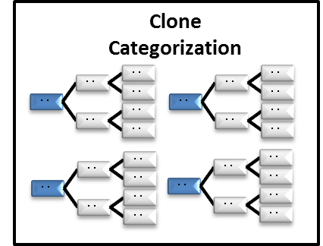
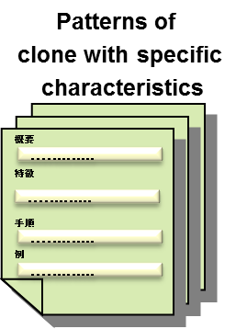
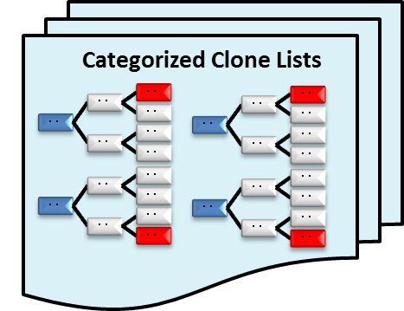
Our Research
Creating refactoring patterns based on the detailed categorization of clone characteristics
Define
categorization
Auto-add
categorization
information
Detected
Clones
Create
of patterns

