Slide 1

An Investigation into the Impact of Software Licenses on Copy-and-Paste Reuse among OSS Projects
Yu Kashima†, Yasuhiro Hayase††, Norihiro Yoshida†††,
Yuki Manabe† , Katsuro Inoue†
† : Osaka University ††：Tsukuba University
†††: Nara Institute of Science and Technology
Notes:
I am Yu Kashima from Osaka university.
Let me talk about an investigation in to the impact of software licenses on coy-and-paste reuse among oss projects.

Slide 2

Software License and Copy-and-Paste
Open Source Software(OSS)
BSD3
GPLv2
BSD3
GPLv2
Copy-and
-Paste
Copy-and
-Paste
BSD3
GPLv2
3-Clause BSD License(BSD3)
GNU Public License Version 2 (GPLv2)
Require copy right notice,
  list of conditions,
  and disclaimer of warranties
Require derivative work must be distributed under GPLv2
OSS developers
When determining the license, we need to quantitative foundation, but…
Software license determine reuse situation and frequency
There is no quantitative study for relationship between reuse frequency and software license
Notes:
Open Source software provides many available source code.
And it is protected by software license.
Software license require various condition to derivative work.
For example, 3-Clause BSD License require copy right notice, list of conditions, and disclaimer of warranties.
On the contrast, GNU Public License Version 2 require derivative work must be distributed under GNU Public License Version 2.
So, source code under BSD3 can be copy-and-pasted to source code under GPLv2.
On the other hand, source code under GPLv2 cannot be copy-and-pasted to source code under BSD3.
As these example, software license determine reuse situation and situation.
Therefore, to determine the license, developers need to quantitative foundation about license and reuse,
but, there is no quantitative study for relationship between reuse and software license.
So, we perform this investigation.

Slide 3

Research Question
RQ1
RQ2
The reuse frequency
>
Under Permissive License
Under Restrictive License
frequently
Imported into
Under a license
Under …
Notes:
To clear the point, we make research questions.
Research question 1 is, Is source code distributed under a permissive license reused more frequently than that distributed under a restrictive license?
Research question 2 is, Which type of licensed source code more frequently imports source code of other OSS products?

Slide 4
Overview of Experiments
Code clone is a fragment similar to other fragments, and typically generated by copy-and-paste.
Detecting code clones
created by copy-and-paste
Experiment 1
Investigate the reuse count and the frequency of each license
License A
License A
Correspond to RQ1 and RQ2
Code
Clone
Detection
License B
License B
License
Detection
Source File Set
Experiment 2
unknown
Filter out:
Examine the impact of the license on copy-and-paste count statistically
Use of
Ninka[1]
Use of
CCFinderX
[2]
Language Dependent Clones
Overlapped Clones
[1] D. M. German, Y. Manabe, and K. Inoue, “A sentence-matching method for automatic license identification of source code files,” in Proc. of ASE, 2010, pp. 437–446
[2] T. Kamiya, “CCFinder Official Site,” http://www.ccfinder.net/ccfinderx.html
Code Clones not created by copy-and-paste
Notes:
This is an overview of experiments.
First, detect license of source file.
And, exclude source files which license cannot be detected.
Next, detect copy-and-paste.
However, detecting copy-and-paste directly is too difficult.
So, we use code detection.
Code clone is a fragments similar to other fragment, and typically generated by copy-and-paste.
Detecting code clone created by copy-and-paste approximates copy-and-paste detection.
So, we perform code clone detection and filtering code clone which is not create by copy-and-paste. Next, perform two experiments.
Experiment 1, investigate the reuse and frequency of each license.
This experiment corresponds to RQ1 and RQ2.
Experiment 2, examine the impact of the license on copy-and-paste count statistically.
The experiment confirm the impact of software license.

Slide 5
Experimental Target
Packages in Debian/GNU Linux 5.0.2 main section (C/C++)
Packages randomly selected from Sourceforge.net (C/C++)
  The number of commits larger than 10
Representation of widely used OSS products
Representation of all OSS products in the world
 | Debian/GNU Linux 5.0.2 | Sourceforge.net
#Packages | 6,472 | 1,070
#Files | 776,289 | 425,830
LOC | 286 M | 121 M
Notes:
Experimental targets are packages in debian/gnu linux 5.0.2 main section, and packages randomly selected from sourceforge.net which the number of commits larger than 10.
These packages represent widely used OSS product and all OSS product in the world.
This table shows the size of these target.

Slide 6
Overview of Experiment 1
Focusing on various licenses, investigate the reuse count and the frequency
Apache License Version 2(Apachev2), BSD3,
GPLv2 or any later(GPLv2+), MIT/X11 License (MIT/X11)
#Clones related to the files under License A
#Clones related to the files under License B
#Clones related to the files under License C
License B
License A
License B
License C
License A
License B
License C
License A
License C
Divide #clones of a license by
(#files under focused license) x (#files under the license)
Divide the sum of #clones by #files under focused license
Tendency to be reused of files under focused license
The expected #clones between a certain license and focused license
 | (#Clones) /(#Files)
License A | 10
License B
License C
 | Focused License
 | License A | License B | License C
License A | 7.2
License B | 1.4
License C | 3.4
1.5
3.5
2.9
2.4
2.2
5.1
3
6
Notes:
This is an overview of experiment 1.
Experiment 1, focus a license, and investigate the number of copy-and-paste and then compare the reuse frequency of each license.
We focused four popular and representative licenses, Apache license version 2, BSD3, GPLv2 or any later, MIT/X11 license.
In this figure, First, extract code clone including source code under focused license,
and simply count code clone grouped by license.
This value shows the number of copy-and-paste per license which is related to source code under focused license.
To compare the reuse frequency of each license, we perform two normalization.
First normalization is dividing the sum of the number of clones of all license by the number of files under focused license.
This value shows tendency to be reused of files under focused license.
Second normalization is dividing the number of clones of a license by the product of the number of files under focused license and the number of files under the license.
This value shows the expected the number of clones between a certain license and focused license.
These steps are performed to other focused license.
Then, compare the result of each license.

Slide 7
Result of Experiment 1
(Debian GNU Linux 5.0.2)
Apachev2
GPLv2+
BSD3
MIT/X11
Notes:
This is result of experiment 1
This graph shows the #Clones related to green colored license.
In all result, # of GPLv2+ clones is ranked first.
Focused license is ranked first or second.

Slide 8
Result of Experiment 1
(Sourceforge.net)
Apachev2
GPLv2+
Source code under the four focused licenses is mostly imported to:
  Source code under the same license
  Source code under GPLv2+
BSD3
MIT/X11
Notes:
This is the result of sourceforge.net.
Similarly, in all result, GPLv2+ clones is ranked first or second.
Focused license is ranked first or second.
These results indicate that source code under a license is mostly imported to:
Source code under the same license.
Source code under GPLv2+.

Slide 9

Normalized Result
Debian/GNU Linux 5.0.2
Tendency to be reused of focused license files
Sourceforge.net
 | (#Clones) / (#Files)
Apachev2 | 22.0
BSD3 | 22.6
GPLv2+ | 7.48
MIT/X11 | 26.4
 | (#Clones) / (#Files)
Apachev2 | 3.87
BSD3 | 5.78
GPLv2+ | 2.66
MIT/X11 | 8.62
Source code is frequently copy-and-pasted to source code under the same license
The frequency of reuse:
BSD3
MIT/X11
>
GPLv2+ has the substantial impact
because of their huge number of files.
GPLv2+
The expected #clones related to the focused licenses and a certain license
 | Focused License
 | Apachev2 | BSD3 | GPLv2+ | MX11
Apachev2 | 84.5 | 3.30 | 0.83 | 3.72
BSD3 | 4.28 | 46.5 | 1.11 | 5.13
GPLv2+ | 5.03 | 4.44 | 2.50 | 5.01
MX11 | 5.91 | 5.90 | 1.42 | 61.5
 | Focused License
 | Apachev2 | BSD3 | GPLv2+ | MX11
Apachev2 | 24.1 | 3.23 | 1.06 | 4.00
BSD3 | 2.09 | 37.9 | 1.32 | 3.88
GPLv2+ | 2.13 | 3.47 | 3.60 | 6.33
MX11 | 1.64 | 2.82 | 1.49 | 82.8
( $×{10}^{−5}$)
( $×{10}^{−5}$)
Notes:
This is the normalized result.
These tables show the result of first normalization.
This result shows the frequency of reuse, BSD3 and MIT/X11 is larger than GPLv2+.
The below tables show the result of second normalization.
If the value is higher, the cell is deeper colored.
This result indicates source code is frequently copy-and-pasted to source code under the same license,
Except GPLv2+ case.
But GPLv2+ has the substantial impact because of their huge number of files.

Slide 10
Overview of Experiment 2
Examine the impact of the license on copy-and-paste count statistically comparing with the other reusability factors
Compare the prediction accuracy of three regression models
#Clones related to a file
Reusability
metrics
M1
=
#Clones related to a file
Reusability
metrics
M2
=
+
License of the file
M3
#Clones related to a file
Reusability
metrics
+
+
Interaction of Metrics and License
=
License of the file
software license has the impact to the number of copy-and-paste
#Clones estimated by the models including license will address the real #clones
Notes:
This is an overview of experiment 2.
This experiment examine the impact of the license on copy-and-paste count statistically comparing with the other reusability factors.
To do this, compare the prediction accuracy of three regression models.
All models expect the number of clones related to a certain file.
Model 1 expects by the file metrics only.
Model 2 expects by the file metrics and license of the file.
Model3 includes the file metrics, license of the file, and interaction of metrics and license.
If software license has the impact to the number of copy-and-paste, the model including license will be more accurate.

Slide 11
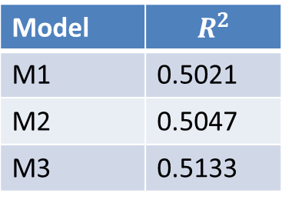
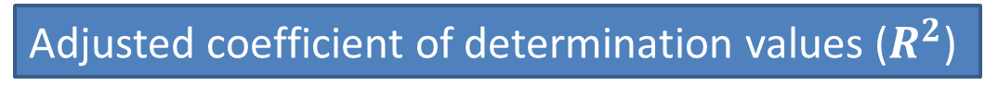
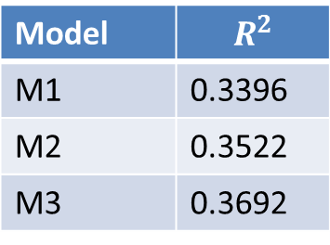
Result of Experiment 2
Adjusted coefficient of determination values ($R^{2}$)
Debian/GNU Linux 5.0.2
Sourceforge
Model | $$R^{2}$$
M1 | 0.5021
M2 | 0.5047
M3 | 0.5133
Model | $$R^{2}$$
M1 | 0.3396
M2 | 0.3522
M3 | 0.3692
higher
higher
The prediction accuracy
M1 < M2 < M3
Software license significantly affects the number of copy-and-paste
Notes:
This is the result.
This table shows the adjusted coefficient of determination values.
If this value is high, the prediction accuracy is also high.
This table indicates Model 2 is more accurate than model 1, and model 3 is more accurate than model 2.
We can indicate from this result, software license significantly affects the number of copy-and-paste.

Slide 12
Answer to Research Question
RQ1
RQ2
Yes.
The reuse frequency
>
Under Permissive License
Under Restrictive License
GPLv2+ files has the substantial impact to reuse count because of huge #files.
Frequently
imported into
Imported
into
Under the same license
Under a license
Under GPLv2+
Notes:
Answer to research question 1 is, Yes. source code under a permissive license reused more frequently than that under a restrictive license.
Next, answers to research question 2 has two conclusions.
Source files that are distributed under a license are the most frequently imported into ones distributed under the same license.
GPLv2+ files have a substantial impact on the reuse count because of available huge number of GPLv2+ files.

Slide 13
Conclusion and Future Work
Conclusion
  Presents the impact of software license on Copy-and-Paste reuse in C/C++ files
Future Work
  Investigation of the cases of other reuse methods, e.g., reuse by library linking
  Investigation of the direction of copy-and-paste
Notes:
This is conclusion and future work.
We presents the impact of software license on copy-and-paste reuse in C/C++ files.
Future work is, investigation of the case of another reuse method, e.g., library linking reuse;
and investigation of the direction of copy-and-paste.

Slide 14
Distribution of License
+ : “or any later”
Red Colored License : Interesting License
Debian/GNU Linux
Sourceforge.net
License | #Files
GPLv2+ | 178,174
LibraryGPLv2+ | 28,000
LesserGPLv2.1+ | 24,540
GPLv2 | 22,840
GPLv3+ | 18,372
GPLv2orLGPLv2.1,MPLv1_1 | 15,897
BSD3 | 11,933
MIT/X11 | 11,715
LesserGPLv2+ | 10,537
boostV1 | 9,275
GPLnoVersion | 5,354
Apachev2 | 4,297
LibraryGPLv2 | 4,187
BSD2 | 4,123
LesserGPLv2.1 | 3,709
License | #Files
GPLv2+ | 44,558
boostV1 | 13,461
GPLv3+ | 12,037
LesserGPLv2.1+ | 8,765
LibraryGPLv2+ | 6,705
GPLv2 | 6,674
Apachev2 | 6,220
BSD3 | 4,784
LesserGPLv2+ | 3,543
LesserGPLv2.1 | 2,943
MIT/X11 | 2,478
BSD2 | 2,408
LesserGPLv3+ | 1,227
FreeType | 961
subversion+ | 868
Notes:
アニメーションで，GPLv2+ -> BSD3 -> MITX11noNotice … とかやれたらいいよね

Slide 15
Counting method of experiment 2
  Method of Counting related Code Clone
Product A
Product B
Product C
# of related Clones = 2
Counting Target

Slide 16
Employed Metrics
Employ metrics according to Poulin’s classification[3]
Pouiln’s classification | Employed Metrics
Complexity | lines of code excluding comment sum of McCabe’s cyclomatic complexity
Documentation | lines of comment
External Dependencies | # of called functions defined in external # of used variables defined in external
Proven Reliability | elapsed seconds since the file was created
[3] J. Poulin, “The search for a general reusability metric,” in Proc. of the Workshop on Reuse and the NASA Software Strategic Plan, 1996.
Notes:
このままだと，Poulin’s classificationとは何かをいう必要がある．．．．
6個のメトリクスを選んだとだけ言う？

Slide 17
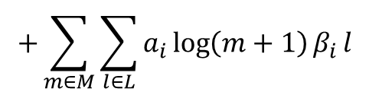

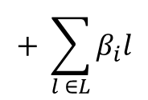
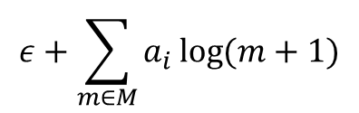
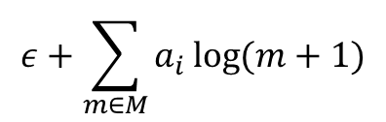
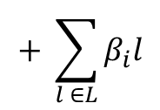
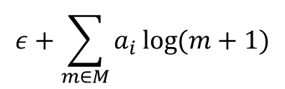
Regression Models
M: Metrics; L: top 15 popular license
  $$\log{(\# of related clones+1)}=$$
Metrics
$$ε+\sum_{m∈M}{a_{i}\log{(m+1)}}$$
M1
Metrics
License
$$ε+\sum_{m∈M}{a_{i}\log{(m+1)}}$$
$$+ \sum_{l ∈L}{β_{i}l}$$
M2
Metrics
License
Interaction of Metrics and License
$$ε+\sum_{m∈M}{a_{i}\log{(m+1)}}$$
$$+ \sum_{l ∈L}{β_{i}l}$$
$$+\sum_{m∈M}{\sum_{l∈L}{a_{i}\log\left(m+1\right)β_{i }l}}$$
M3

