Slide 1
A Tool Support to Merge Similar Methods with a Cohesion Metric COB
○ Masakazu Ioka¹, Norihiro Yoshida²,
Tomoo Masai¹,Yoshiki Higo¹, Katsuro Inoue¹
¹Osaka University
²Nara Institute of Science and Technology

Slide 2

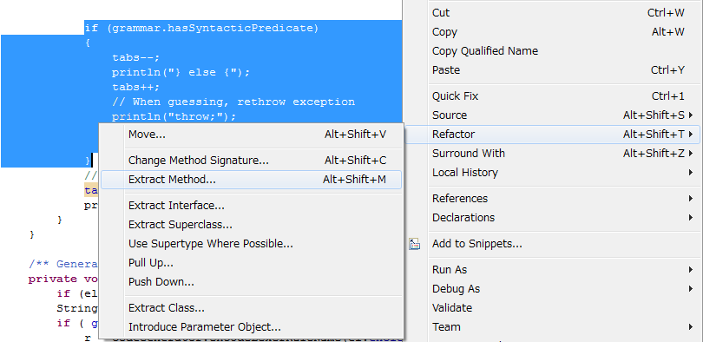
Refactoring with Eclipse
It is easy to perform extract method refactoring by using Eclipse.

Slide 3
Refactoring for Similar Code Fragments
Developers would like to merge similar code fragments for refactoring.
  Developers need to modify only one code fragment after merging
However, Eclipse doesn’t support
this code modification.
Modify
Modify
Merge

Slide 4
An Example of Similar Code Fragments
float answer() {
int a = getAve();
int b = getBase();
float ans;
if(a > b) {
ans = a / b;
print(ans);
} else {
ans = b / a;
print(ans);
}
return ans;
}
float answer() {
int a = getMax();
int b = getBase();
float ans;
if(a > b) {
ans = a / b;
print(ans);
} else {
ans = b / a;
print(ans);
}
return ans;
}

Slide 5
Refactoring Candidate 1
float answer() {
int a = getAve();
int b = getBase();
float ans;
if(a > b) {
ans = a / b;
print(ans);
} else {
ans = b / a;
print(ans);
}
return ans;
}
float answer() {
int a = getMax();
int b = getBase();
float ans;
if(a > b) {
ans = a / b;
print(ans);
} else {
ans = b / a;
print(ans);
}
return ans;
}

Slide 6
Refactoring Candidate 2
float answer() {
int a = getAve();
int b = getBase();
float ans;
if(a > b) {
ans = a / b;
print(ans);
} else {
ans = b / a;
print(ans);
}
return ans;
}
float answer() {
int a = getMax();
int b = getBase();
float ans;
if(a > b) {
ans = a / b;
print(ans);
} else {
ans = b / a;
print(ans);
}
return ans;
}
Extracted methods will be similar methods

Slide 7
Motivation
It is difficult to decide which part is extracted.
If similar code fragments include multiple differences, it is more difficult.
Show better candidates.
Which is better?
Cand.1
Cand.2
Cand.3

Slide 8
Form Template Method
Refactoring pattern based on Template Method pattern [1].
  Merge similar code fragments including differences.
Merge
[1] M. Fowler. Refactoring: Improving the Design of Existing Code.
Addison Wesley, 1999.

Slide 9
Template Method
Subclass A
Override
// merge sort
void sort();
void select() ｛
input();
sort();
output();
}
Subclass B
Override
// quick sort
void sort();
Override
Subclass C
// bubble sort
void sort();

Slide 10
An Example of Form Template Method
Site
ResidentialSite
LifelineSite
getBillableAmount()
getBillableAmount()
…
double base = _units*_rate;
double tax = base*Site.TAX_RATE;
return base + tax;
…
double base = _units*_rate*0.5;
double tax = base*Site.TAX_RATE*0.2;
return base + tax;

Slide 11
An Example of Form Template Method
Step1: Detection of Primitive Processes
Site
Detecting primitive processes from differences
ResidentialSite
LifelineSite
Detecting differences
Primitive processes
getBillableAmount()
getBillableAmount()
…
double base = _units*_rate;
double tax = base*Site.TAX_RATE;
return base + tax;
…
double base = _units*_rate*0.5;
double tax = base*Site.TAX_RATE*0.2;
return base + tax;

Slide 12
An Example of Form Template Method
Step2: Extracting Primitive Processes
Site
ResidentialSite
LifelineSite
getBillableAmount()
getBaseAmount()
getTaxAmount()
getBillableAmount()
getBaseAmount()
getTaxAmount()
Extracting as methods
…
double base = getBaseAmount();
double tax = getTaxAmount();
return base + tax;
…
double base = getBaseAmount();
double tax = getTaxAmount();
return base + tax;

Slide 13
An Example of Form Template Method
Step3: Pulling-Up Similar Methods
…
double base = getBaseAmount();
double tax = getTaxAmount();
return base + tax;
Site
getBillableAmount()
getBaseAmount()
getTaxAmount()
Pulling-Up to super class
Defining abstract methods at super class
ResidentialSite
LifelineSite
getBaseAmount()
getTaxAmount()
getBaseAmount()
getTaxAmount()

Slide 14
A Problem of Form Template Method
It is difficult for developers to identify the common parts and the primitive processes from similar code fragments.
  Developers need experience of Form Template Method and knowledge of software.
Which is better?
Cand.1
Cand.2
Cand.3

Slide 15
Research Goal
Showing candidates of Form Template Method in order of high cohesion.
  When a method has high cohesion, the method may have a single functionality.

Slide 16
Proposed Approach
Input: Similar methods
Output: Ranked candidates of Form Template Method
1st
3rd
2nd
Step1
Cand.1
Cand.2
Cand.3
Similar Methods
COB = 0.9
COB = 0.2
COB = 0.75
Step2
Cand.1 is better!!
Rank based on COB [2]
[2] T. Miyake et al. “A software metric for identifying extract
method candidates”, IEICE Trans. Inf.& Syst.(Japanese Edition) , 2009

Slide 17
Step1: Detecting Differences between Similar Methods
generate
Detect
A
C
Compare
A
C
a
d
e
a
d
e
Similar methods
Differences on
source code
Differences
on AST
generate
Detect
B
C
B
C
b
e
b
e

Slide 18
Step1: Generating Candidates of Form Template Method
Verify extractable
using Eclipse JDT
Differences on
source code
Developers don’t know
which candidate is better.
Filter out wide range extraction candidates

Slide 19
Conditions of Appropriate Divisions
It is necessary for Form Template Method to be exact match methods after extracting differences (Cond.1, 2).
A method should have a single functionality (Cond.3).
Conditions of division on this research
  Cond.1: Each primitive process is extractable as method.
  Cond.2: A pair of similar code fragments is match after
  extraction.
  Cond.3: Extracted method has functionality for each
  developer.

Slide 20
An Example of
Unsatisfying Any Conditions
Different code fragment
void initTriangle(int x) {
．．．
if(z > 0) {
s = getArea();
t = s * getRate();
result = calc(s, t);
print(result);
}
draw();
．．．
}
void initRectangle (int x) {
．．．
if(z > 0) {
s = getBase();
t = getRate();
result = calc(s, t);
print(result);
}
draw();
．．．
}
Unsatisfied division of Cond.3
    Cond.3: Extracted method has functionality for each developers.

Slide 21
An Example of
Satisfying All Conditions
Different code fragment
void initTriangle(int x) {
．．．
if(z > 0) {
s = getArea();
t = s * getRate();
result = calc(s, t);
print(result);
}
draw();
．．．
}
void initRectangle (int x) {
．．．
if(z > 0) {
s = getBase();
t = getRate();
result = calc(s, t);
print(result);
}
draw();
．．．
}
Satisfied division of Cond.3
    Cond.3: Extracted method has functionality for each developers.

Slide 22
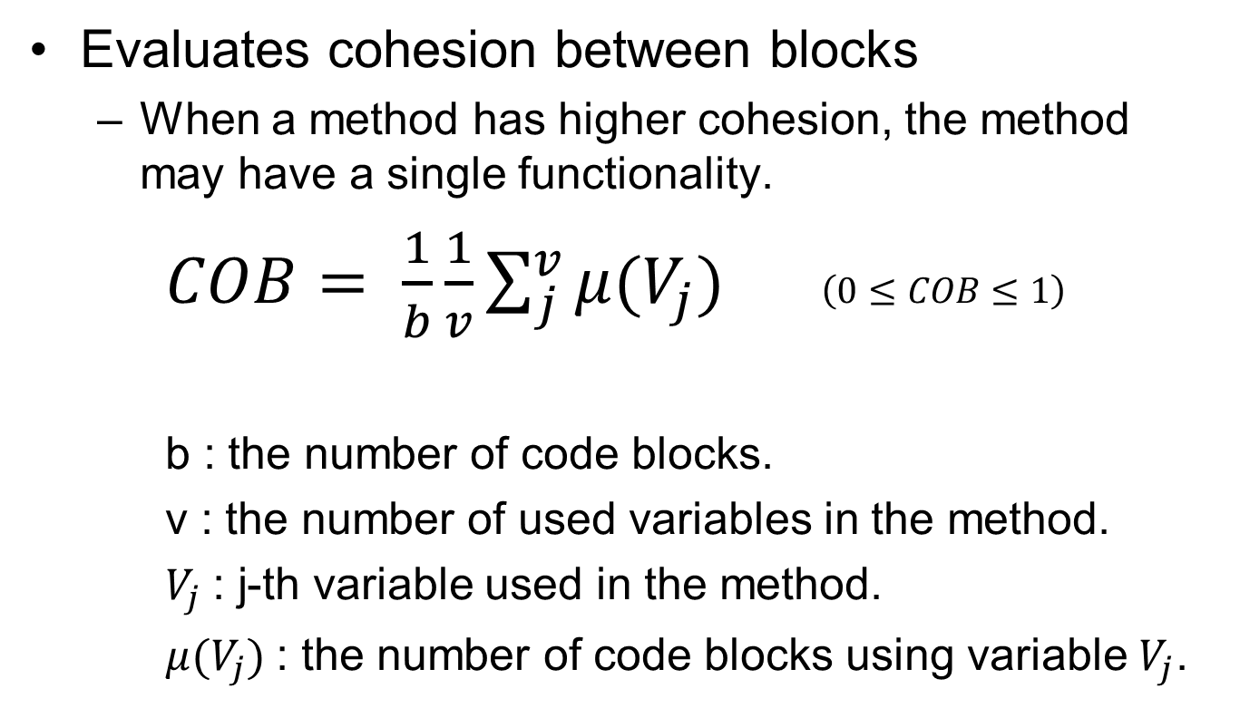
COB: Cohesion Of Blocks
Evaluates cohesion between blocks
  When a method has higher cohesion, the method may have a single functionality.
$COB= \frac{1}{b}\frac{1}{v}\sum_{j}^{v}{μ(V_{j})}$ $\left(0≤COB≤1\right)$
  b : the number of code blocks.
  v : the number of used variables in the method.
  $V_{j}$: j-th variable used in the method.
  $μ(V_{j})$: the number of code blocks using variable $V_{j}$.

Slide 23
An Example of Low COB
void method() {
int v1, v2, v3, v4;
BLOCK1 {
v1 = v1 + v2;
}
BLOCK2 {
v2 = v1++;
}
BLOCK3 {
v3 = v3 * v4;
}
BLOCK4 {
v4 = v3 + 1;
}
}
 | v１ | v2 | v3 | v4
BLOCK1 | ✓ | ✓
BLOCK2 | ✓ | ✓
BLOCK3 |  |  | ✓ | ✓
BLOCK4 |  |  | ✓ | ✓
COB = 0.5

Slide 24
An Example of High COB
void method() {
int v1, v2, v3;
BLOCK1 {
v1 = v1 + v2;
}
BLOCK2 {
v2 = v1++;
}
BLOCK3 {
v3 = v3 * v1;
}
BLOCK4 {
v1 = v3 + 1;
}
}
 | v１ | v2 | v3 | v4
BLOCK1 | ✓ | ✓
BLOCK2 | ✓ | ✓
BLOCK3 | ✓ |  | ✓
BLOCK4 | ✓ |  | ✓
Replaced v4 with v1
COB = 0.66
Replaced v4 with v1

Slide 25
Step2: Ranking Candidates of Form Template Method
1st
2nd
3rd
COB = 0.4
COB = 0.2
COB = 0.8
Calculate COB

Slide 26
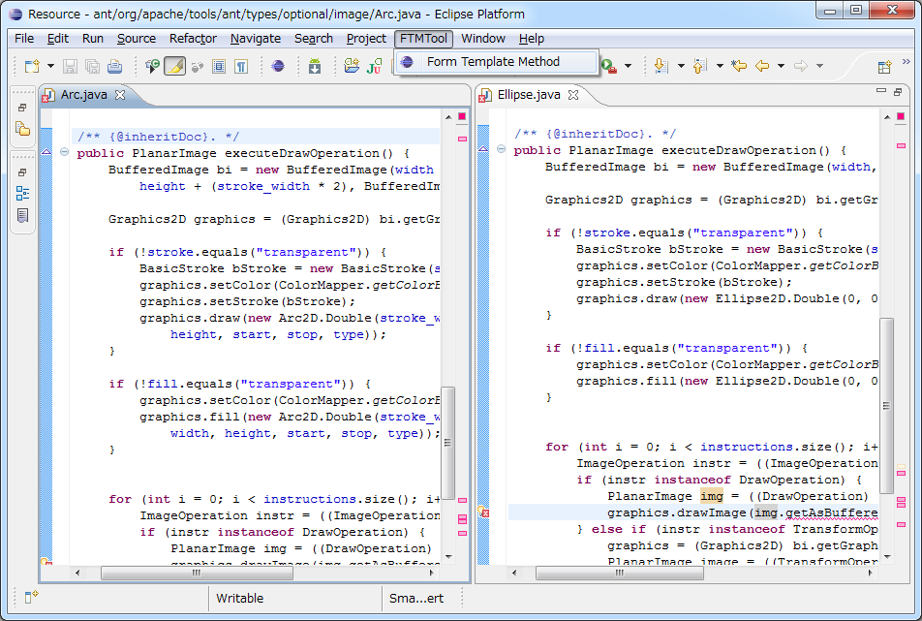
Demonstration
Select menu
Target methods
Input: Two methods
Output: Ranked candidates of Form Template Method
25

Slide 27
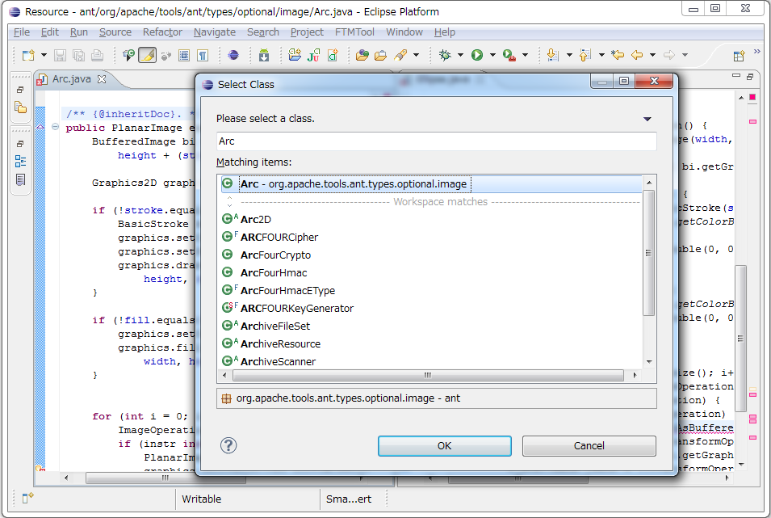
Demonstration - Select Target Class -
Select target class
26

Slide 28
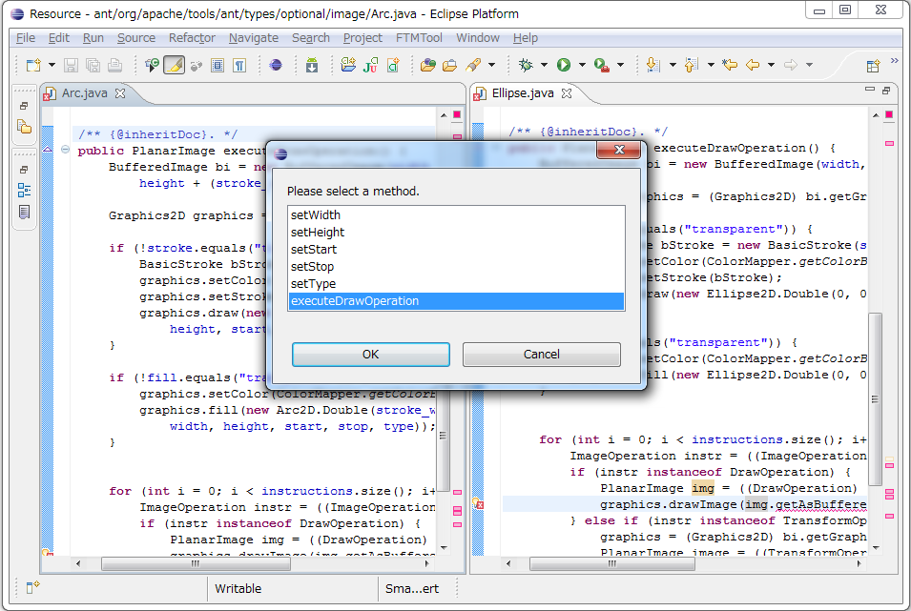
Demonstration - Select Target Method -
Select target method
Select another method in the same way
27

Slide 29
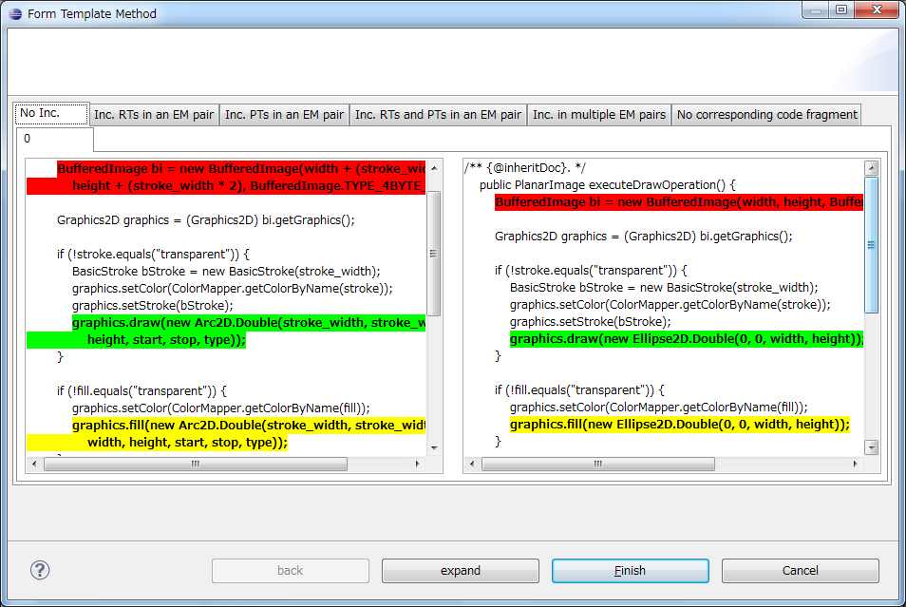
Demonstration - First Candidate-
Corresponding extraction code fragments
Generating all candidates
Extracting into children classes as same name method

Slide 30
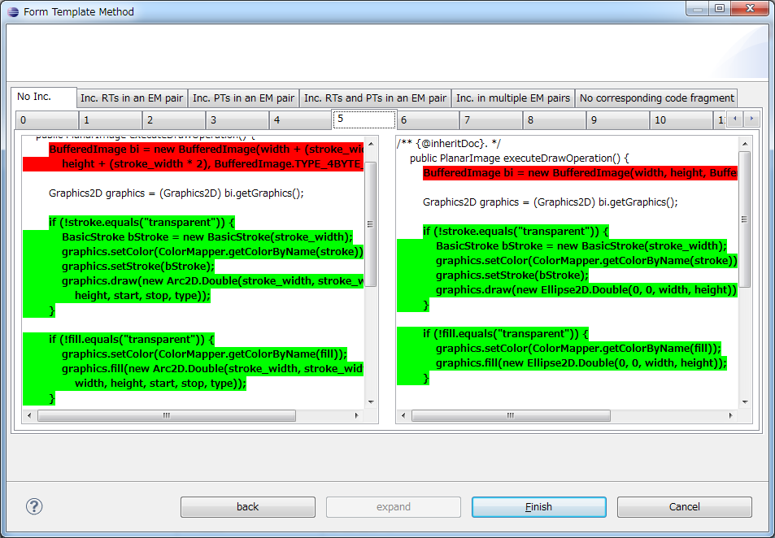
Demonstration - All Candidates-
Caption of each tab means the order of rank based on metric COB.
29

Slide 31
Related Work (1/3)
Juillerat et al. proposed an approach of automatic “Form Template Method” [3].
[3] N. Juillerat et al.
Toward an Implementation of the “Form Template Method” Refactoring, 2007.

Slide 32
Related Work (2/3)
[○, □, a, A, □, ○,
□, d, e, C, □, □]
A
C
Compare
a
d
e
Similar methods
Differences on
source code
[○, □, b, B, □, ○,
□, e, C, □, □]
B
C
b
e
Our approach compares abstract syntax trees.

Slide 33
Related Work (3/3)
Only one candidate
Differences on
source code
Our approach shows many candidates in order of COB.

Slide 34
Conclusion and Future Work
Conclusion
  We proposed the tool that shows Good Candidates of Form Template Method by cohesion metric COB.
Future Work
  How to decide a threshold for filtering.

Slide 35
Thank You for Listening

Slide 38
Refactoring Candidate 3
float answer() {
int a = getAve();
int b = getBase();
float ans;
if(a > b) {
ans = a / b;
print(ans);
} else {
ans = b / a;
print(ans);
}
return ans;
}
float answer() {
int a = getMax();
int b = getBase();
float ans;
if(a > b) {
ans = a / b;
print(ans);
} else {
ans = b / a;
print(ans);
}
return ans;
}

Slide 39
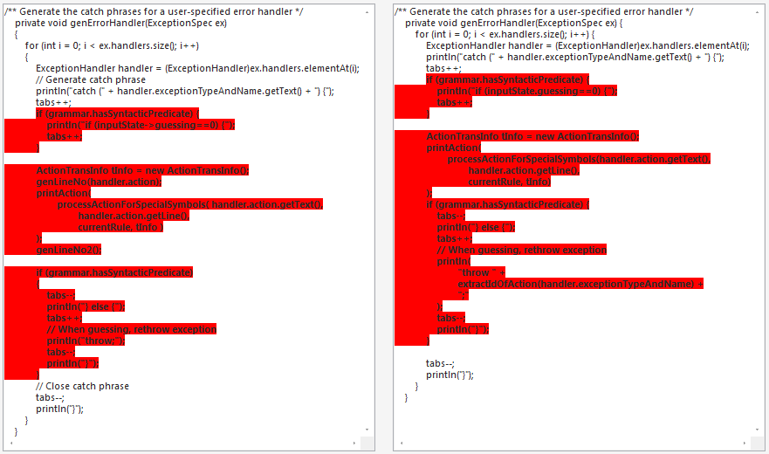
Demonstration - Eliminated Candidate -
Extraction ranges are about 70% against the methods

Slide 40
Merging Similar Method
Including Differences
It is possible to merge similar methods including differences by applying Template Method pattern[1].
  However, it is difficult to apply it except for experts.
[1] E. Gamma, R. Helm, R. Johnson, and J. M. Vlissides.
Design Patterns: Elements of Reusable Object-Oriented Software.
Addison Wesley, 1995.

Slide 41
Template Method Pattern
Common process is defined into super class
  Each primitive process is implemented into children classes respectively.
  It is easy to understand common processes.
It is easy to add some children classes.
It is possible to restrict places of bug.

Slide 42
An Example of
Template Method Pattern
public …
templateMethod｛
…
this.method1()
…
this.method2()
…
}
Define common process into super class
AbstractClass
#method1()
#method2()
+templateMethod()
Adding child class only by overriding abstract methods
ConcreteClass1
ConcreteClass2
NewClass
#method1()
#method2()
#method1()
#method2()
#method1()
#method2()
Implementing each process into child class respectively

Slide 43
Proposed Approach
Generating candidates of Form Template Method from given pair of similar methods.
Ranking candidates based on a cohesion metric.
  The higher cohesion, the more functional a method has.
  We use a metric COB proposed by Miyake et al. for evaluating cohesion of code fragment[3].
[3] T. Miyake et al. “A software metric for identifying extract method candidates”, 2009.

Slide 44
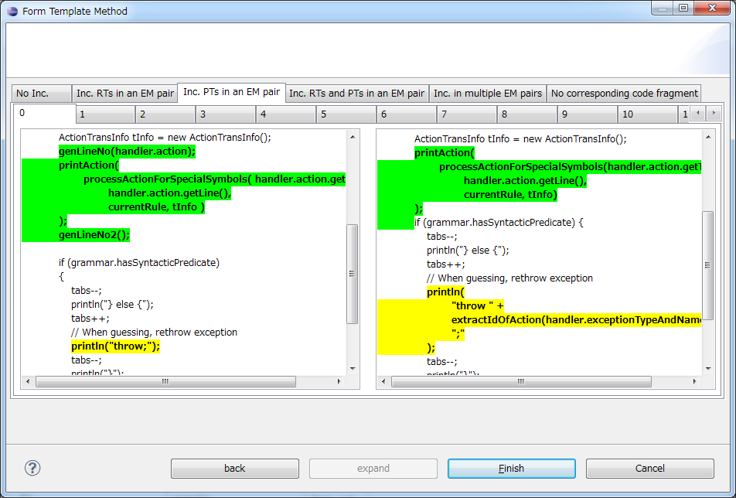
Demonstration - Other Example -
One of call statements is
not match after extraction

Slide 45
Related Work
Juillerat et al. proposed an approach of automatic “Form Template Method”[4].
  Detects different sub-trees by comparing sequences of abstract syntax tree nodes that are generated by using post-order traversal.
  Shows only one candidate of “Form Template Method”.
[4] N. Juillerat et al.
Toward an Implementation of the “Form Template Method” Refactoring, 2007.

