Slide 1

A Pluggable Tool for Measuring Software Metrics from Source Code
Yoshiki Higo,
Akira Saitoh,
Goro Yamada,
Tatsuya Miyake,
Shinji Kusumoto,
Katsuro Inoue

Slide 2
Background –Software Metrics-
What for
evaluating quality
grasping characteristics
managing progress
Measured from
source code
UML diagram
bug database

Slide 3
Metrics Measurement from Source Code
Various Metrics
CK metrics suite
coupling, cohesion
fan-in, fan-out
cyclomatic complexity, Halstead’s software science
duplicate ratio
Defined on conceptual modules
conceptual module: file, class, method
can be measured from multiple programming language

Slide 4
Problems on Code Metrics
Implementation difficulty
Implementing source code analyzer requires much effort
Most of existing measurement tools handle only a single programming language
Ambiguous definition
Different tools implement details in different ways
Measurement results are different from tools [1]
Reuse difficulty
Different tools use different information of source code
[1] R. Lincke, J. Lundberg, and W. Lowe, “Comparing Software Metrics Tools,” in Proc. of International Symposium on Software Testing and Analysis, July. 2008, pp. 131–141.

Slide 5
Functional Requirement for Metrics Measurement Tool
Multilingualization
A tool can be applied to multiple programming languages that are widely used
Unified Definition of a Metric
A metric can be measured with exactly the same logic from multiple programming languages
Pluggable Interface
A tool can measure any kinds of metrics

Slide 6
Development of MASU
We have developed plug-in platform for metrics measurement
Metrics Assessment plug-in platform for Software Unit

Slide 7
Input, Output, Features of MASU
Input
Source code
Output
Metrics measurement result
Features
Metrics measurement units are plug-ins
multiple programming languages (Java, C#)
Providing static analysis result for other purposes

Slide 8
Overview of MASU
Source
Code
Main Module
Result of Analysis
Source Code
Analysis Component
Result of Analysis
API for Providing
Result of Analysis
End
Analysis
Execution
Plug-in Management Component
Plug-in1
Plug-in2
Plug-in3
End
Plug-in
Execution
API for Receiving
Metrics Values
Metrics Collecting Component
Metrics Values
Metrics Values
Result of Metrics Measurement
Data Flow
Process Flow

Slide 9
MASU Plug-in
A plug-in measures a single metric
4 measurement units
file, class, method, field
Working process
obtains source code information from MASU
measures the metric
stores the measurement result to MASU

Slide 10
Architecture Related to Plug-ins
MASU Main Module
AbstractPlugin
・・・・・・・
(API for providing analyzed information)
AbstractClassMetricPlugin
AbstractMethodMetricPlugin
・・・・・・・
・・・・・・・
measureClassMetric Method
measureMethodMetric Method
MASU Plug-in Module
CBOPlugin
CyclomaticPlugin
・・・・・・・
・・・・・・・
・・・・・
measureClassMetric Method
（Implements measurement logic）
measureMethodMetric Method
（Implements measurement logic）
Deploy
AOASIA3
Plugins Directory
CBOPlugin.jar
CyclomaticPlugin.jar
・・・・・
SES2008
2011/11/10

Slide 11
Plug-in Example: RFC
A member of CK metrics suite
Represent Responsibility For Class
sum of the numbers of local methods and remote methods
local: methods defined in the class
remote: methods invoked in local methods
Require caller-callee relationship

Slide 12
Plug-in Example: RFC
56 LOC

Slide 13
Plug-in Example: RFC
Implementation of RFC metric measurement logic
public class RFCPlugin extends AbstractClassMetricPlugin {
@Override
protected Number measureClassMetric(TargetClassInfo targetClass) {
final Set<CallableUnitInfo> rfcMethods =
new HashSet<CallableUnitInfo>();
final Set<MethodInfo> localMethods =
targetClass. getDefinedMethods() ;
rfcMethods.addAll(localMethods);
for (final MethodInfo m : localMethods){
rfcMethods.addAll(MethodCallInfo.getCallees(m.getCalls()));
}
return new Integer(rfcMethods.size());
}

Slide 14
Plug-in Example: RFC
Overriding other methods
@Override
protected String getDescription() {
return "Measuring the RFC metric.";
}
@Override
protected String getDetailDescription() {
return DETAIL_DESCRIPTION;
}
@Override
protected String getMetricName() {
return "RFC";
}
@Override
protected boolean useMethodInfo() {
return true;
}
@Override
protected boolean useMethodLocalInfo() {
return true;
}

Slide 15
Plug-in Example: RFC
Building a string for DETAIL_DESCRIPTION
private final static String DETAIL_DESCRIPTION;
static {
StringWriter buffer = new StringWriter();
PrintWriter writer = new PrintWriter(buffer);
writer.println("This plugin measures the RFC (Response for a Class) metric.");
writer.println();
writer.println("RFC = number of local methods in a class");
writer.println(" + number of remote methods called by local methods");
writer.println();
writer.println("A given remote method is counted by once.");
writer.println();
writer.flush();
DETAIL_DESCRIPTION = buffer.toString();
}

Slide 16
Size and Coding Time of Plug-ins
Metrics | #All lines (including comment line) | #Main logic lines | Time (min)
WMC | 31(74) | 2 | 10
DIT | 35(81) | 8 | 20
NOC | 36(73) | 1 | 10
CBO | 61(121) | 29 | 20
RFC | 56(117) | 7 | 15
LCOM | 114(221) | 48 | 40
Cyclomatic | 52(115) | 21 | 25

Slide 17
Example of APIs (1/2)
jp.ac.osaka_u.ist.sel.metricsltool.main.data.target.ClassInfo
java.util.SortedSet<TargetConstructorInfo> | getDefinedConstructors() Returns SortedSet of defined constructors in this class．
java.util.SortedSet<TargetFieldInfo> | getDefinedFields() Returns SortedSet of defined fields in this class.
java.util.SortedSet<TargetMethodInfo> | getDefinedMethods() Returns SortedSet of defined methods in this class.
java.util.Set<VariableInfo<? extends UnitInfo>> | getDefinedVariables() Returns Set of defined variables in this class.
java.util.SortedSet<TargetInnerClassInfo> | getInnerClasses() Returns SortedSet of inner classes in this class．
boolean | isInterface() Returns true if this class is declared as interface.

Slide 18
Example of APIs (2/2)
jp.ac.osaka_u.ist.sel.metricstool.main.data.target.MethodInfo
java.lang.String | getMethodName() Returns the method name.
java.util.SortedSet<MethodInfo> | getOverridees() Returns SortedSet of methods that are overridden by this method.
java.util.SortedSet<MethodInfo> | getOverriders() Returns methods that override this method.
TypeInfo | getReturnType() Returns the type of this method.
java.lang.String | getSignatureText() Returns the signature of this method as string.

Slide 19
Not only for Metrics Measurement
Can be used for other purposes
Several tools using MASU
control flow graph builder
program dependency graph builder
code clone detection tool
extract method support tool
template method support tool
Great contributions to our research group
more than 5 journal papers
more than 10 conference papers

Slide 20
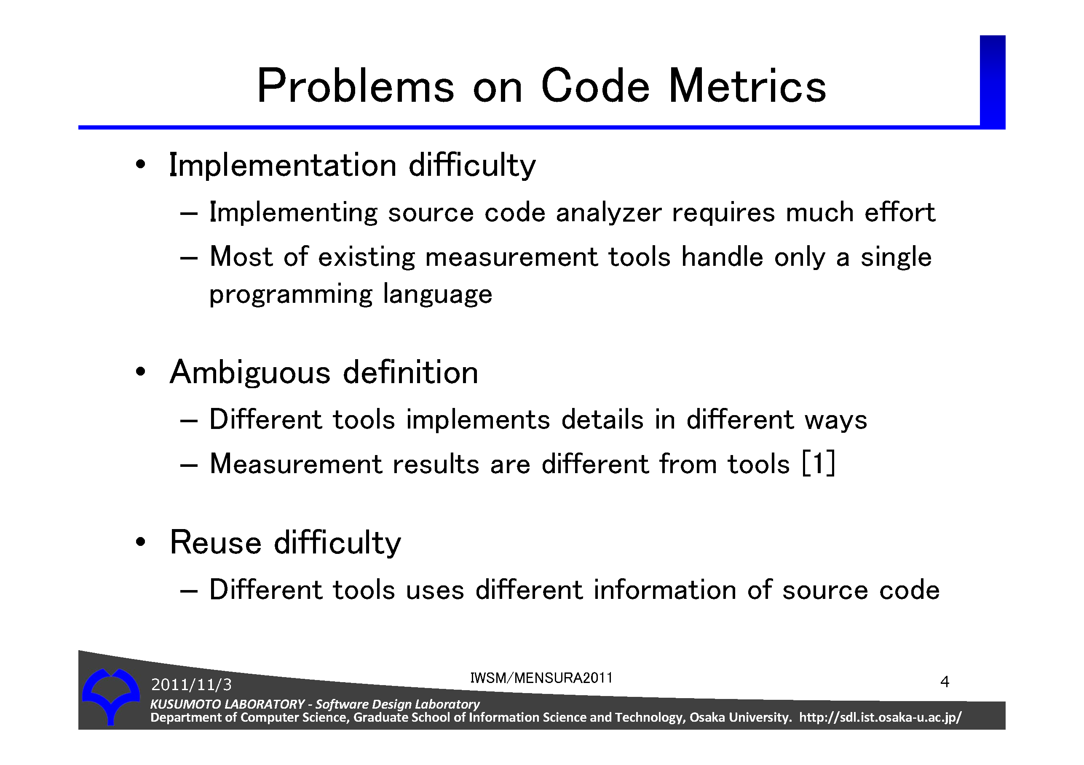
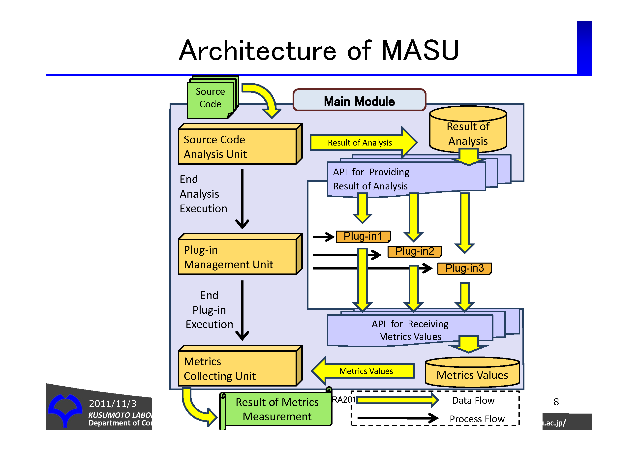
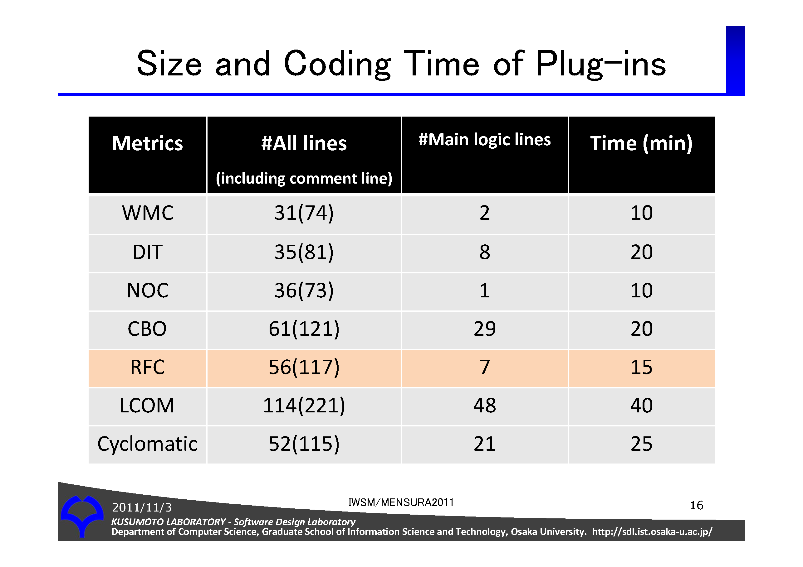
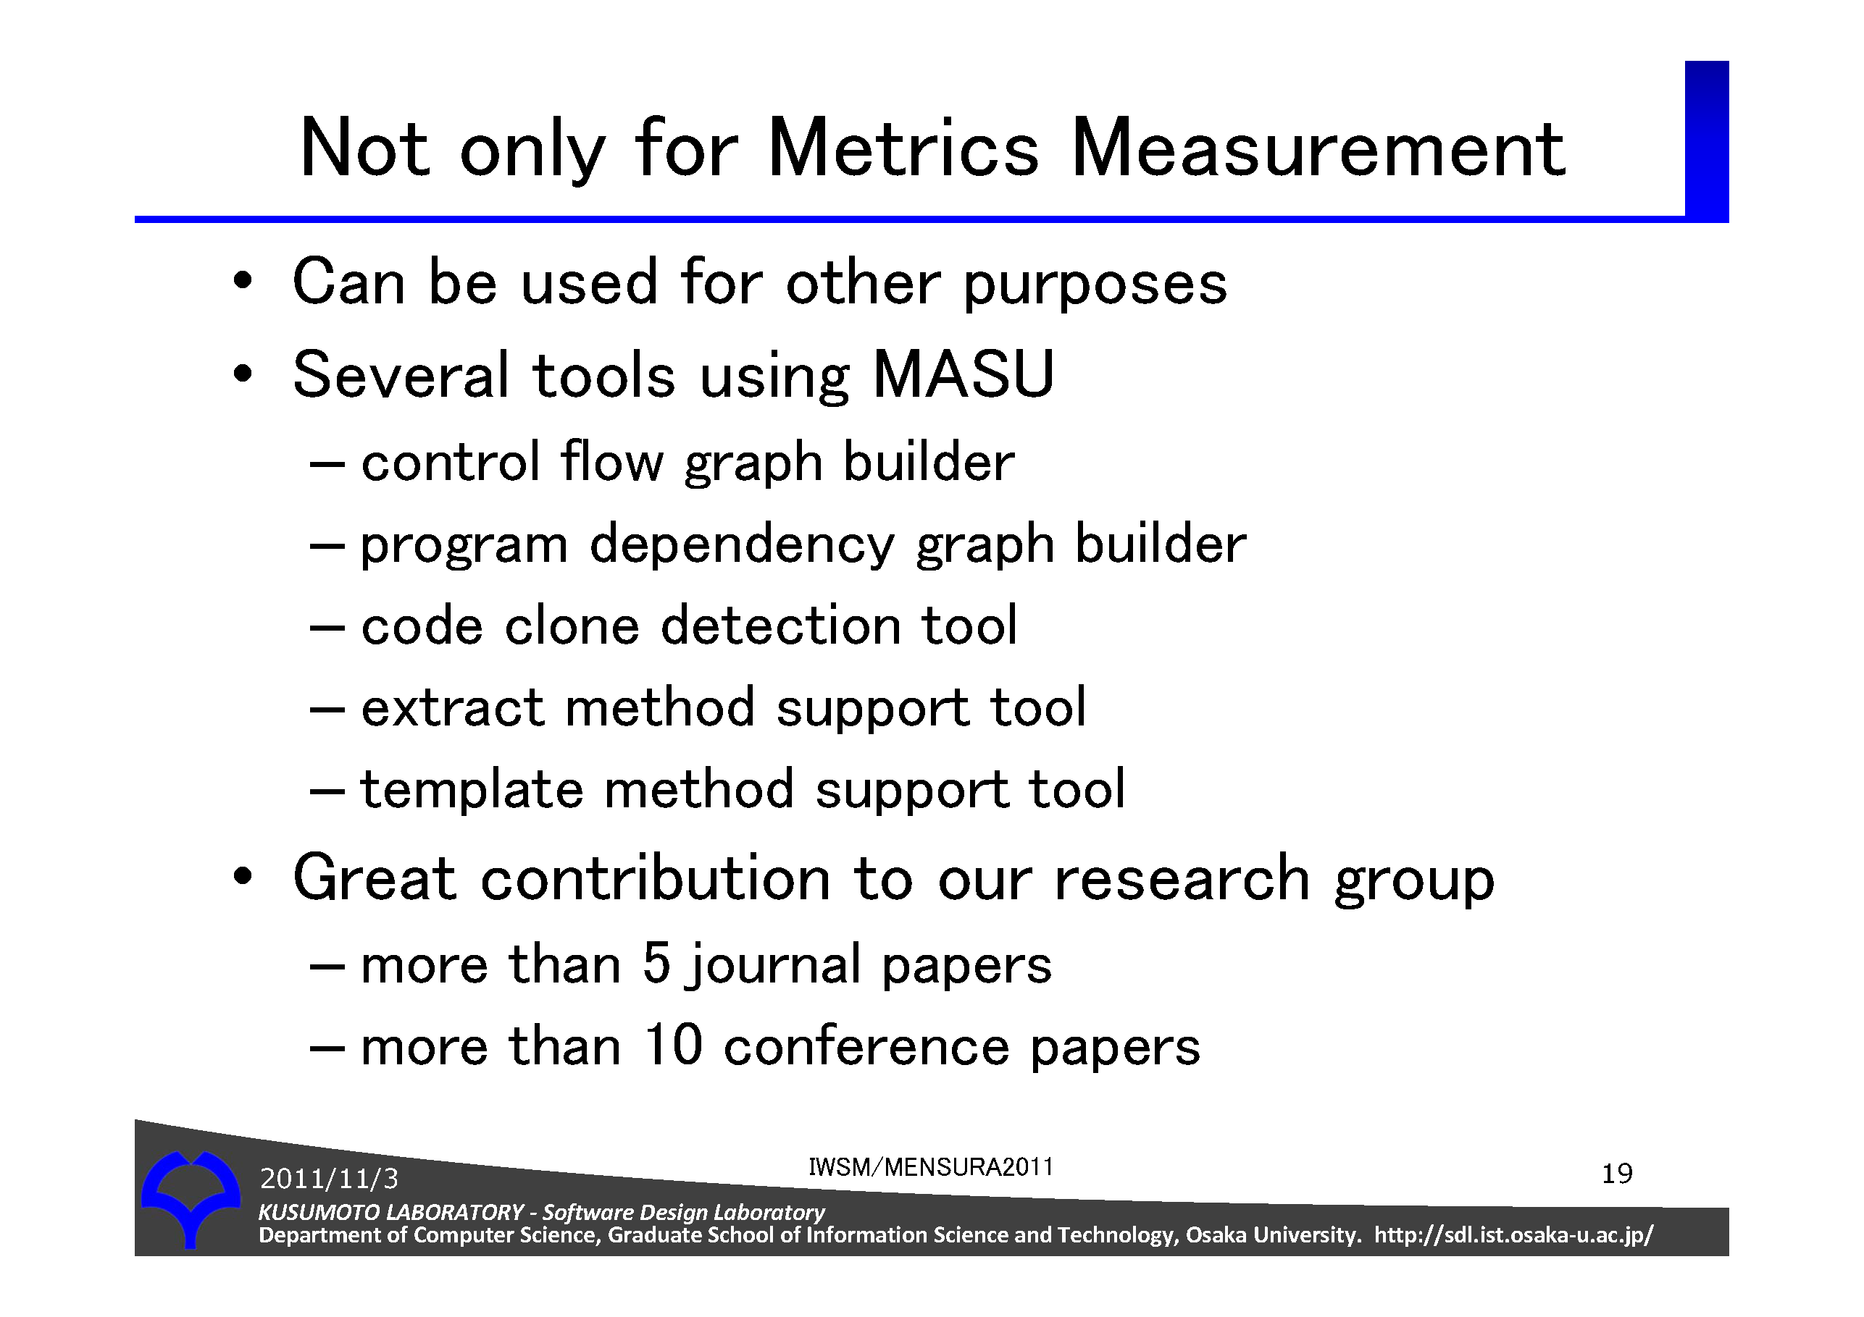
Conclusion

Slide 22
Source Code Analysis Component
Language independent AST
Source code
CLASS_DEFINITION
NAME
SampleClass
INHERITANCE
SuperClass
CLASSBLOCK_START
METHOD_DEFINITION
MODIFIERS
public
RETURN_TYPE
void
NAME
sample
PARAMETERS
METHOD_PARAM_DEF
TYPE
String
NAME
arg
BLOCK_START
EXPRESSION
METHOD_CALL
・
・
class SampleClass extends SuperClass{
public void sample(String arg) {
System.out.println( arg );
}
}
Source Code Analysis Component
Java
Class SampleClass Inherits SuperClass
Public Sub Sample(arg as String)
Console.WriteLine( arg )
End Sub
End Class
VB
class SampleClass : SuperClass {
public void sample(String arg){
Console.WriteLine( arg );
}
}
C#
Notes:
それではＡＳＴ構築部でどのように言語非依存な抽象ＡＳＴを構築しているかを説明します．

Slide 23
言語間の差異の吸収
構文的差異の吸収
共通ノードを定義
トークンの違いを吸収
状態定義ノードの埋め込み
出現順の違いを吸収
意味的に等価な異なる概念の差異を吸収
異なる部分木を等価な部分木に変換
例
C#やVBのプロパティ ＞ アクセサメソッド
C#などのストラクチャ ＞ データ管理クラス
VBのサブルーチン ＞ void 型のメソッド
Notes:
「ＡＳＴ構築の際に言語間の差異をどのように吸収しているか説明します」

Slide 24
構文的差異の吸収例～共通ノードを定義～
言語非依存なAST
ソースコード
CLASS_DEFINITION
NAME
SampleClass
INHERITANCE
SuperClass
CLASSBLOCK_START
METHOD_DEFINITION
MODIFIERS
public
RETURN_TYPE
void
NAME
sample
PARAMETERS
METHOD_PARAM_DEF
TYPE
String
NAME
arg
BLOCK_START
EXPRESSION
METHOD_CALL
・
・
class SampleClass extends SuperClass{
public void sample(String arg) {
System.out.println( arg );
}
}
Java
ＡＳＴ構築部
Class SampleClass Inherits SuperClass
Public Sub Sample(arg as String)
Console.WriteLine( arg )
End Sub
End Class
VB
class SampleClass : SuperClass {
public void sample(String arg){
Console.WriteLine( arg );
}
}
トークンの
違いを吸収
C#
Notes:
さらっと行う

Slide 25
構文的差異の吸収例～状態定義ノードの埋め込み～
型 > 名前の順で定義
METHOD_PARAM_DEF
String
arg
言語非依存なAST
ソースコード
CLASS_DEFINITION
NAME
SampleClass
INHERITANCE
SuperClass
CLASSBLOCK_START
METHOD_DEFINITION
MODIFIERS
public
RETURN_TYPE
void
NAME
sample
PARAMETERS
METHOD_PARAM_DEF
TYPE
String
NAME
arg
BLOCK_START
EXPRESSION
METHOD_CALL
・
・
class SampleClass extends SuperClass{
public void sample(String arg) {
System.out.println( arg );
}
}
Java
ＡＳＴ構築部
Class SampleClass Inherits SuperClass
Public Sub Sample(arg as String)
Console.WriteLine( arg )
End Sub
End Class
VB
名前 > 型の順で定義
METHOD_PARAM_DEF
arg
String
class SampleClass : SuperClass {
public void sample(String arg){
Console.WriteLine( arg );
}
}
記述順序の
違いを吸収
C#
Notes:
さらっという

