Slide 1
Experience of Finding
Inconsistently-Changed Bugs in Code Clones of Mobile Software
Katsuro Inoue†, Yoshiki Higo†, Norihiro Yoshida†,
Eunjong Choi†, Shinji Kusumoto†,
Kyonghwan Kim‡, Wonjin Park‡ and Eunha Lee‡
†Osaka University, Japan
‡Samsung Electronics Co, S. Korea
IWSC2012
June 4, 2012

Slide 2

Features of Mobile Software
releases a new model in regular and rapid rushed intervals
adapts to various country constraints
  Many code clones are generated and embedded

Slide 3

Brief Summary of CP-Miner (1/2)
Detecting Copy-Paste Related Bugs ^{[Li 2006]}
  Find and present inconsistent renaming of identifiers between clone pairs
[Li 2006] Z. Li, S. Lu, S. Myagmar and Y. Zhou. CP-Miner: Finding Copy-Paste and Related Bugs in Large-Scale Software Code. IEEE Transactions on Software Engineering, 32: pages 176-192, 2006

Slide 4
Brief Summary of CP-Miner (2/2)
Compute UnchangedRatio (UR)
  Smaller UR except for 0 means that the renaming is suspicious.
Clone C1 | Clone C2
… = b; b++; for (p=0; p<10; p++) { x += p; } a(x); a(x); | … = c; c++; for (q=0; q<10; q++) { y += p; } a(x); a(z);
ID in C1 | ID in C2 | count | UR
a | a | 2 | 1
b | c | 2 | 0
p | p | 1 | 0.25
 | q | 3
x | x | 1 | 0.20
 | y | 2
 | z | 2
4

Slide 5
Brief Summary of CP-Miner (2/2)
Compute UnchangedRatio (UR)
  Smaller UR except for 0 means that the renaming is suspicious.
Clone C1 | Clone C2
… = b; b++; for (p=0; p<10; p++) { x += p; } a(x); a(x); | … = c; c++; for (q=0; q<10; q++) { y += p; } a(x); a(z);
ID in C1 | ID in C2 | count | UR
a | a | 2 | 1
b | c | 2 | 0
p | p | 1 | 0.25
 | q | 3
x | x | 1 | 0.20
 | y | 2
 | z | 2
5

Slide 6
Brief Summary of CP-Miner (2/2)
Compute UnchangedRatio (UR)
  Smaller UR except for 0 means that the renaming is suspicious.
Clone C1 | Clone C2
… = b; b++; for (p=0; p<10; p++) { x += p; } a(x); a(x); | … = c; c++; for (q=0; q<10; q++) { y += p; } a(x); a(z);
ID in C1 | ID in C2 | count | UR
a | a | 2 | 1
b | c | 2 | 0
p | p | 1 | 0.25
 | q | 3
x | x | 1 | 0.20
 | y | 2
 | z | 2
6

Slide 7
Brief Summary of CP-Miner (2/2)
Compute UnchangedRatio (UR)
  Smaller UR except for 0 means that the renaming is suspicious.
Clone C1 | Clone C2
… = b; b++; for (p=0; p<10; p++) { x += p; } a(x); a(x); | … = c; c++; for (q=0; q<10; q++) { y += p; } a(x); a(z);
ID in C1 | ID in C2 | count | UR
a | a | 2 | 1
b | c | 2 | 0
p | p | 1 | 0.25
 | q | 3
x | x | 1 | 0.20
 | y | 2
 | z | 2
7

Slide 8
Brief Summary of CP-Miner (2/2)
Compute UnchangedRatio (UR)
  Smaller UR except for 0 means that the renaming is suspicious.
Clone C1 | Clone C2
… = b; b++; for (p=0; p<10; p++) { x += p; } a(x); a(x); | … = c; c++; for (q=0; q<10; q++) { y += p; } a(x); a(z);
ID in C1 | ID in C2 | count | UR
a | a | 2 | 1
b | c | 2 | 0
p | p | 1 | 0.25
 | q | 3
x | x | 1 | 0.20
 | y | 2
 | z | 2
Leave unchanged
8

Slide 9
Our Approach: New Filtering Criterion
x seems intentionally renamed to different symbols
Criterion Conflict (CF)
  true if the identifier mapped into two or more other identifiers
  false otherwise
ID in C1 | ID in C2 | count | UR | CF
a | a | 2 | 1 | false
b | c | 2 | 0 | false
p | p | 1 | 0.25 | false
 | q | 3
x | x | 1 | 0.20 | true
 | y | 2
 | z | 2

Slide 10

Overview of Clone Inspector
A tool to fit to the development environment of mobile software in SAMSUNG
  Detect inconsistent changes in code clones
    Using CCFinder and two metrics
  Handle a large size input

Slide 11


Applications
{
Feature : Communication
Language : C
Size(LOC) : 4,275,952
Bug Candidates: 63
True Bug : 25
A
{
Feature : Application
Language : C
Size(LOC) : 136,554
Bug Candidates: 5
True Bug : 1
B

Slide 12
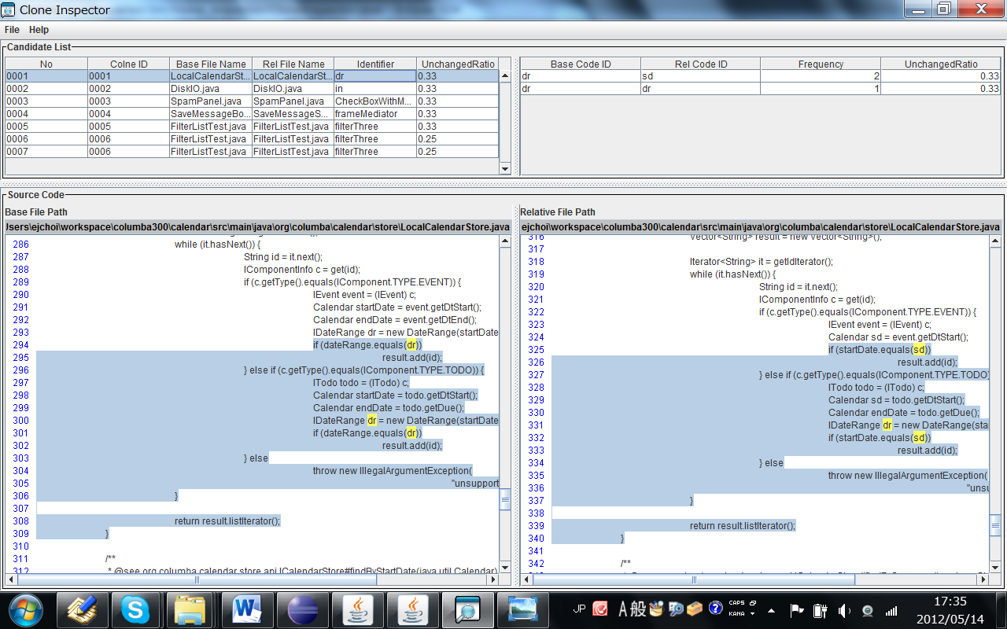
Snapshot of Clone Inspector
Inconsistences Candidate List
Information of Selected Inconsistences Candidate
Source Code View

