Slide 1
Where Does This Code Come from and Where Does It Go? - Integrated Code History Tracker for Open Source Systems -
Katsuro Inoue, Yusuke Sasaki, Pei Xia, and Yuki Manabe
Osaka University

Slide 2

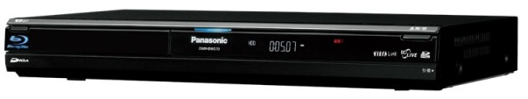
Reuse of Open Source Code
Essential to recent electric products
Blu-ray HDD recorder
Panasonic DMR-BW570
Linux and associated applications under GPL and lesser GPL
Open SSL
UC Berkeley software
JPEG group’s software
Without reuse of OSS, product cost would increase drastically

Slide 3

Developer’s Concerns
Existing Project
Origin
- Who?
- When?
- License?
- Copyright?
Evolution
- Maintenance?
- Popularity?
- Newer version?
…
Concerns
Code Fragment
Reusable?
New Project
Developer
To ease concerns, a support system is needed

Slide 4

Code History Tracking System
Code Fragment in Question
?
Copy Source
Proj. C
Descendants
Proj. F
Proj. B
License: X
Copyright: Y
Modify
Proj. E
Proj. A
Proj. G
Ancestor
Modify
Copy
Proj. D
License: X /Copyright: Y
Proj. H
License: X’
Copyright Y’
Time
OSS Repositories

Slide 5
Overview of Research
Proposing code history tracking model
Prototype of code history tracking system, Ichi Tracker Integrated Code History
Case studies of using Ichi Tracker
Discussions and related works
i chi
位置
Location in Japanese

Slide 6
Code History Tracking Model and Ichi Tracker

Slide 7
Design Policy of Ichi Tracker
OSS repository
Target many OSS projects from old to new ones
No crawling, no maintenance
→ Do not have local repository, but use external code search engines
Output quality
Find not only exactly same code fragments, but also similar ones
Lower false positive results
No real-time response
→ Use code clone filtering to improve the output quality

Slide 8
Code History Tracking Model
Input Query Q
Output Results R
Code Clones
Code Fragment
Code Fragment
q_{c}
Integrated Code History Tracker Ichi Tracker
attribute 1: ...
attribute 2: ...
...
Code Attributes
Code Attributes
(Optional)
attribute 1: ...
attribute 2: ...
...
Search Query SQ
Search Results SR
attribute 1: ...
attribute 2: ...
...
Code Search Engines
SPARS/R
Google Code Search
Koders
Internet
attribute 1: ...
attribute 2: ...
...
Open Source Repositories

Slide 9
Input Query Code q_{c}
public void write(JMEExporter e) throws IOException {
OutputCapsule capsule = e.getCapsule(this);
capsule.write(imageLocation, "imageLocation", null);
if (storeTexture) {
capsule.write(image, "image", null);
}
capsule.write(blendColor, "blendColor", null);
capsule.write(borderColor, "borderColor", null);
capsule.write(translation, "translation", null);

Slide 10
1: Word Extraction
public void write(JMEExporter e) throws IOException {
OutputCapsule capsule = e.getCapsule(this);
capsule.write(imageLocation, "imageLocation", null);
if (storeTexture) {
capsule.write(image, "image", null);
}
capsule.write(blendColor, "blendColor", null);
capsule.write(borderColor, "borderColor", null);
capsule.write(translation, "translation", null);

Slide 11
2: Keyword Selection
public void write(JMEExporter e) throws IOException {
OutputCapsule capsule = e.getCapsule(this);
capsule.write(imageLocation, "imageLocation", null);
if (storeTexture) {
capsule.write(image, "image", null);
}
capsule.write(blendColor, "blendColor", null);
capsule.write(borderColor, "borderColor", null);
capsule.write(translation, "translation", null);
word freq.
capsule 6
write 6
image 2
translation 2
image_ocation 1
imageLocation 1
public 1
…
- Words with 5 or more characters
- No reserved words

Slide 12
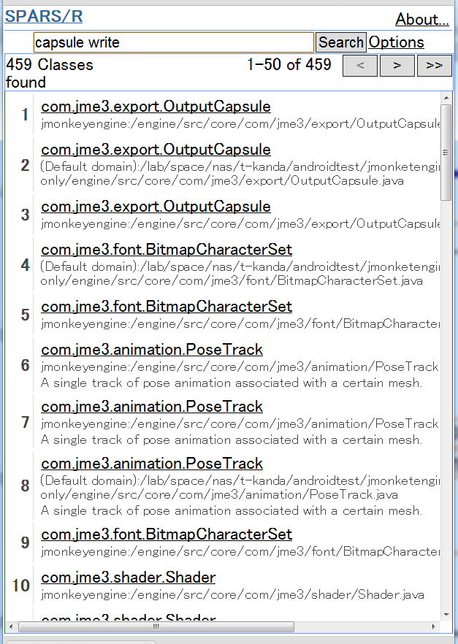
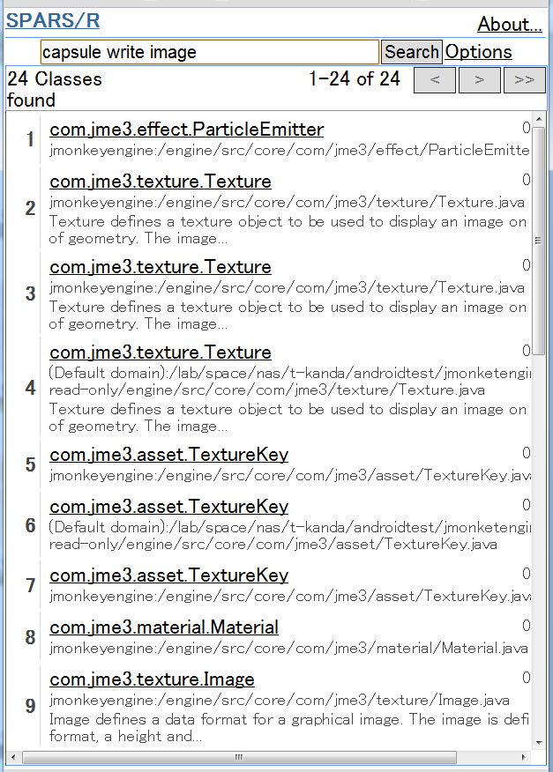
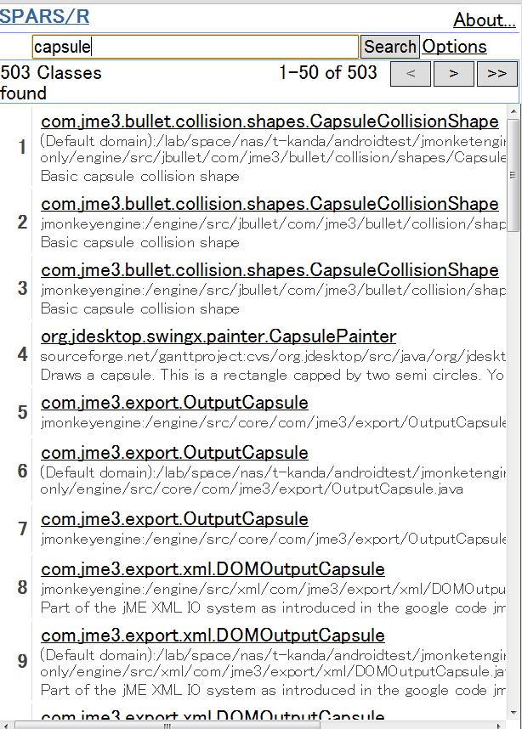
3: Query Generation and Result Check
503
24
459
word freq.
capsule 6
write 6
image 2
translation 2
image_ocation 1
imageLocation 1
public 1
…
+
Search Keywords
Header List
+
Code Search Engines
SPARS/R
Google Code Search
Koders
Internet
Open Source Repositories

Slide 13
4: Download and Code Clone Filtering
24
6
5
5
4
4
3
Code Clone Filter
2
1
CCFinder
1
…
private void renderFromControl(RenderManager rm, ViewPort vp) {
Camera cam = vp.getCamera();
OutputCapsule capsule = e.getCapsule(this);
capsule.write(imageLocation, "imageLocation", null);
…
…
private void renderFromControl(RenderManager rm, ViewPort vp) {
Camera cam = vp.getCamera();
OutputCapsule capsule = e.getCapsule(this);
capsule.write(imageLocation, "imageLocation", null);
…
public void write(JMEExporter e) throws IOException {
OutputCapsule capsule = e.getCapsule(this);
capsule.write(imageLocation, "imageLocation", null);
…
Downloaded Source Code Files
Files with Sufficient Shared Code
Query Code Fragment q_{c}

Slide 14
Cover Ratio
Similarity metrics between query and result
Ratio of shared code clone size over the query size
1: all query code appears in the result
0: no query code appears in the result
Filtering threshold
Used 0.4 in the following case studies
Query q_{c}
Result ri_{c}
x
x
Clone Pair
Cover Ratio： di = |x| / |q_{c}|

Slide 15
Case Studies

Slide 16
Objectives of Case Studies
Case Studies A, B, and C
Does Ichi Tracker work properly as we have expected?
Does Ichi Tracker provide useful information for developers?

Slide 17
Case Study A
texture.java
1,600 LOC java file to define a graphic texture object in game programs, and used by many 3D games
Developed by a game engine project jMonkeyEngine
Good code to reuse? → Code evolution
Conditions of all case studies
Feb. 2011 and May 2011
Dual Xeon (X5550 2.66GHz) with 24GB main memory
Osaka University internet environment

Slide 18
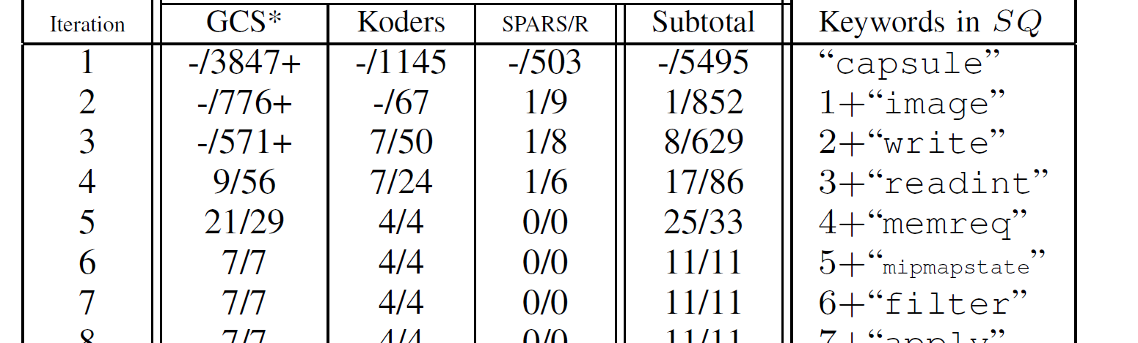
Keywords and Number of Results
|R| : Number of output results
|SR|: Number of headers from external code search engines
With 2~5 trials, we had the total result 29/62

Slide 19
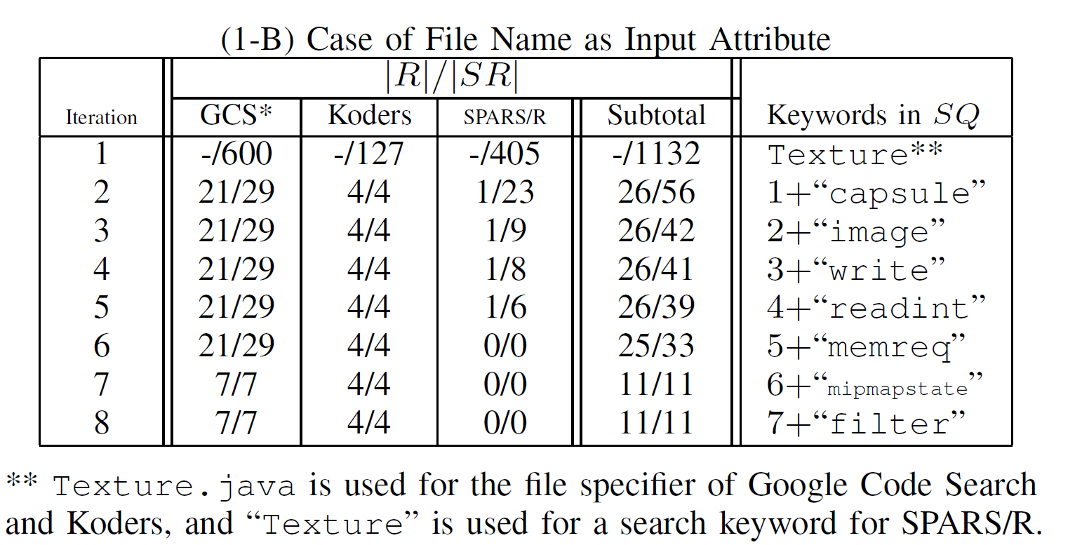
Keywords with File Name
With only 2 trials, we had the total result 26/56

Slide 20
Evolution Pattern of Texture.java
jMonkeyEngine R3800
R3448
R4099

Slide 21
Case Study B
kern_malloc.c
1082 LOC C function, to allocate a specified-size memory block in the kernel address space
Developed for 4.4 BSD and Mach, and taken over by many other projects
Good code to reuse? → Code evolution
We were able to get the output results 67/75 with 1~4 trials (without file name option)

Slide 22
Evolution Pattern of kern_malloc
2

Slide 23
Case Study C
SSHTools
Suite of Java SSH (SSH API, terminal, …)
Ver. 0.2.9 (June, 23, 2007)
442 files in total
We have selected 339 files larger than 2 KB
Each selected file was used as the input of Ichi Tracker
Can we safely reuse these files in the same manner?

Slide 24
Number of Similar Files Found
Total 339

Slide 25
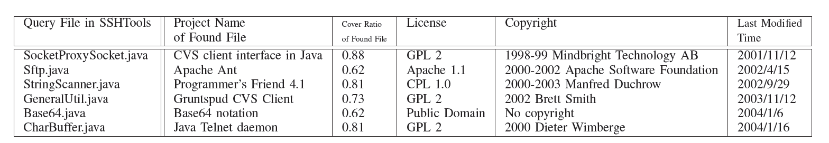
Oldest Files Found for Each Query File
SSHTools (all 339 files)
License: GPL 2
Copyright: 2002-2003 Lee David Painter and Contributors
Last Modified Time: 2007/6/23
We have found many cases of different projects, different licenses and different copyrights
-> We need to check very carefully when we reuse SSHTools code

Slide 26
Discussions and Related Works

Slide 27
Usefulness
With simple check of the output of Ichi Tracker, we can get useful information for the history and evolution of code
Concerns
Origin
- Who?
- When?
- License?
- Copyright?
Evolution
- Maintenance?
- Popularity?
- Newer version?
…
Reusable?
EASE
Ichi Tracker
Results

Slide 28
Approach and Process
Choosing good code search engines is a key to get high quality results
GCS >> Koders > SPARS/R
(GCS, Koders, SPARS/R) >> (Google, Bing)
Need good code search engine available!
Keyword selection strategy:
Incremental strategy: try 1, 2, … keywords until the header list becomes less than 50
Decrement strategy, random, less frequently-used keywords, comment keywords, short keywords, …
Less effective

Slide 29
Other Issues
Performance
Case Studies A and B: 1 to 4 min.
Heavily depend on the code search engines and network performance
Acceptable as non-interactive support system
Quality of search result
Non-removed rate at the code clone filtering is an indicator of effectiveness of keyword search e.g., 0.46 (Case Study A(1) default setting)
The final output contains no false positives results

Slide 30
Related Works
Clone Tracker by Duala-Ekoko et.al. [7]
Track clones with clone region descriptors
Software Bertillonage by Davies et. al. [6]
Determine origin with anchored signature matching method
Code Broker by Ye et. al. [35]
Interactively provide complete code from partial code fragment
Need local repositories
PARSEWeb by Thummalapenta et. al. [33]
Use code search engines to generate method invocation sequences
No code clone filtering
Black Duck and Palamida
Proprietary systems using local repositories

Slide 31
Conclusions
Proposed code history tracking model
Developed prototype system Ichi Tracker
Showed case studies using Ichi Tracker
Ichi Tracker provides useful information for OSS reuse to ease developer's concerns
Choose alternative code search engines
Improve user interface to allow more interactive operation
Try other keyword selection algorithms, e.g., TF/IDF, ...

Slide 32
Thank you!
Questions?

Slide 34
Process of Ichi Tracker
Keywords
Header List/
Files

Slide 35
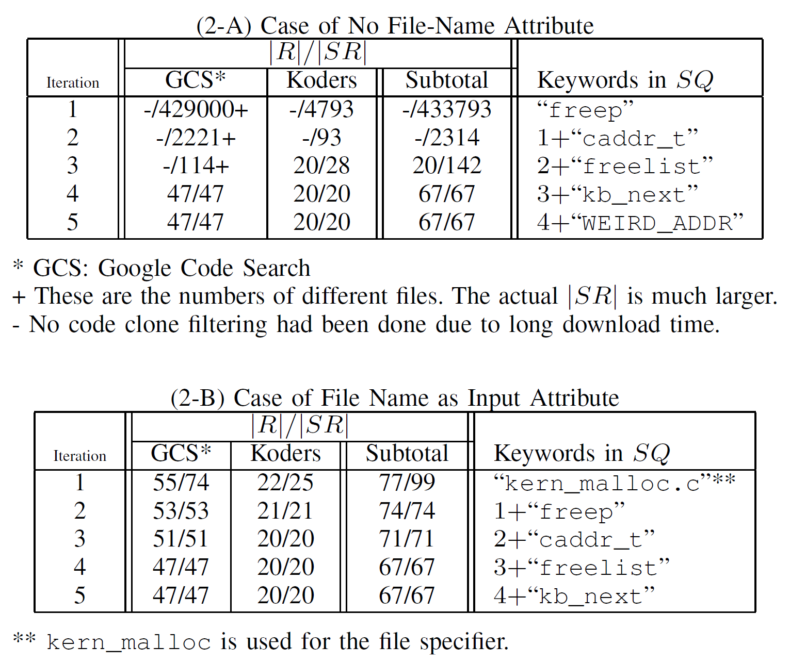
Keywords and Convergence

Slide 36
Precision and Recall
Precision
|R|/ |SR| : 0.46 (case A(1) and A(2))
0.89 (case B(1)), 0.95 (case B(2))
Output results : 1.0 (no fault positive)
Recall
No information of GCS and Koders
SPARS/R: 0.725 (case of random 100 files)

Slide 37
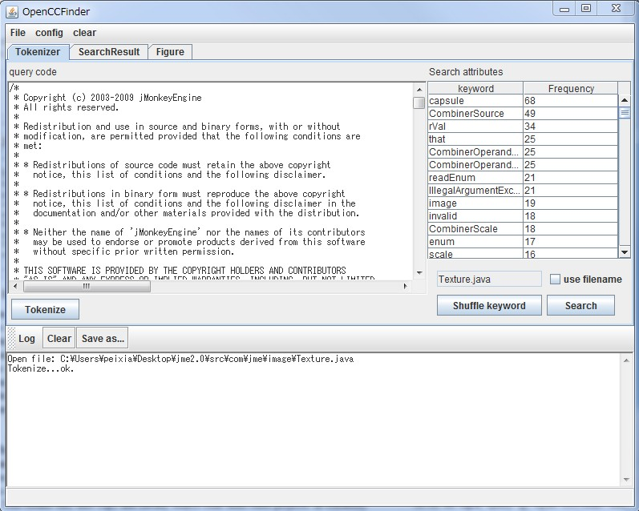
2) Keyword Selection

Slide 38
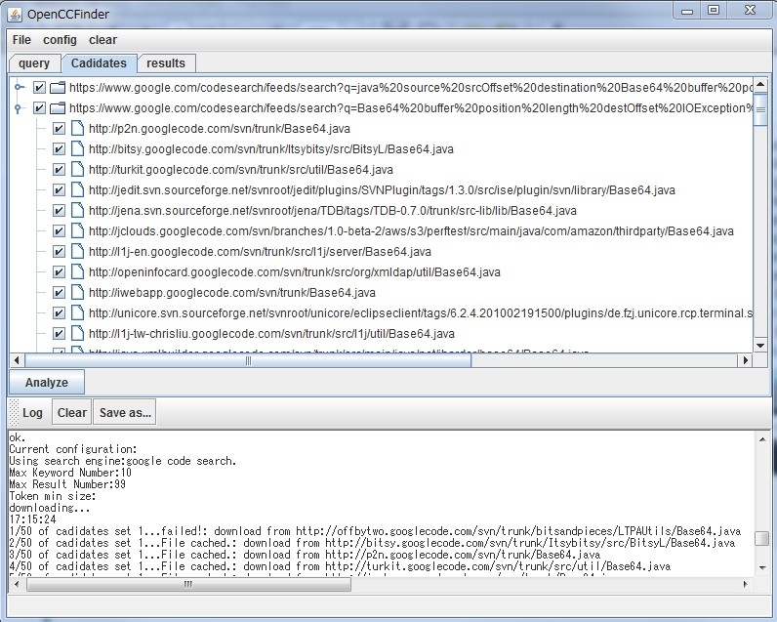
5) Search Result Analysis

Slide 39
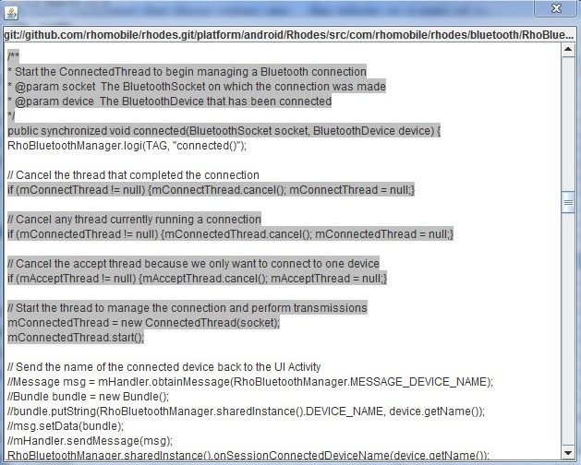
6) Code Clone Filtering
Use CCFinder with the maximum token length 10

Slide 40
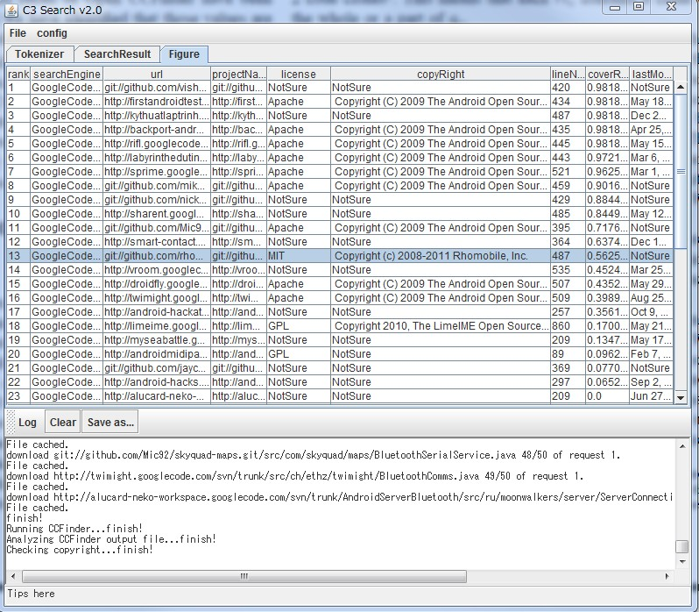
7) Result Forming

