Slide 1
Where Does This Code Come from and Where Does It Go?
- Integrated Code History Tracker for Open Source Systems -
Katsuro Inoue, Yusuke Sasaki, Pei Xia, and Yuki Manabe
Osaka University

Slide 2

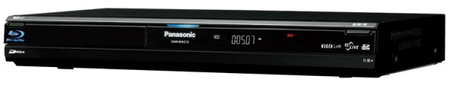
Reuse of Open Source Code
Essential to recent electric products
Blu-ray HDD recorder
  Panasonic DMR-BW570
    Linux and associated applications under GPL and lesser GPL
    Open SSL
    UC Berkeley software
    JPEG group’s software
Without reuse of OSS, product cost would increase drastically
Notes:
Last year, I bought …
I read the manual of this recorder, but of course, there is no description of OS, or software systems.
But there is notification of software licenses.
So I can guess that it uses …
This product heavily depends on such OSS
This is just one simple example, but many recent electric products reuse OSS heavily.

Slide 3

Developer’s Concerns
Existing Project
Origin
  - Who?
  - When?
  - License?
  - Copyright?
Evolution
  - Maintenance?
  - Popularity?
  - Newer version?
  …
Concerns
Code Fragment
Reusable?
New Project
Developer
To ease concerns, a support system is needed
Notes:
When we reuse OSS, developers may have various kinds of concerns.
There is one code fragment in an existing project.
The developer wants to reuse this code into a new project.
In such situation, the developer would have various kinds of concerns.
One major issue is its origin.
Who made this, when was it made, what is the license, and who is the copyright holder.
Another issue is the evolution.
Who maintains this code, and how often is the maintenance performed, how popular is this code, and is there newer or better versions?
These are examples of concerns.

Slide 4

Code History Tracking System
Code Fragment
in Question
?
Copy Source
Proj. C
Descendants
Proj. F
Proj. B
License: X
Copyright: Y
Modify
Proj. E
Proj. A
Proj. G
Ancestor
Modify
Copy
Proj. D
License: X /Copyright: Y
Proj. H
License: X’
Copyright Y’
Time
OSS Repositories
Notes:
So we’d like to have a code history tracking system.
When a developer has a concern on a code fragment, he/she will give that code into the system as a query.
The system contains various OSS in its repository, and answer various kind of information on the query and its similar code.
In this case, the system answers that the query code fragment comes from proj. C with license X and copyright Y.
Also, an ancestor of this code fragment is found in Proj. A with the same license and copyright, and that code is copied to Proj. B, and then modified and used in Proj. C.
This code is copied into Poj. D, and then modified to Proj. E. And from E, there are many copies in Proj. F, G, and H, with license X’ and Copyright Y’.
This kind of information is very important to ease the developer’s concerns.
This is the motivation of our research here.

Slide 5
Overview of Research
Proposing code history tracking model
Prototype of code history tracking system,
Ichi Tracker
Integrated Code History
Case studies of using Ichi Tracker
Discussions and related works
i chi
位置
Location in Japanese

Slide 6
Code History Tracking Model and Ichi Tracker

Slide 7
Design Policy of Ichi Tracker
OSS repository
Target many OSS projects from old to new ones
No crawling, no maintenance
→ Do not have local repository,
but use external code search engines
Output quality
Find not only exactly same code fragments, but also similar ones
Lower false positive results
No real-time response
→ Use code clone filtering to improve the output quality

Slide 8
Code History Tracking Model
Input Query Q
Output Results R
Code Clones
Code Fragment
Code Fragment
q_{c}
Integrated Code
History Tracker
Ichi Tracker
attribute 1: ...
attribute 2: ...
...
Code Attributes
Code Attributes
(Optional)
attribute 1: ...
attribute 2: ...
...
Search
Query SQ
Search
Results SR
attribute 1: ...
attribute 2: ...
...
  Code Search Engines
SPARS/R
Google
Code
Search
Koders
Internet
attribute 1: ...
attribute 2: ...
...
  Open Source Repositories
Notes:
Here, we propose code history tracking model.
Ichi Tracker takes an input query Q, which is composed of a code fragment and optional code attributes.
File names, project names, time stamp, are example of code attribute.
Ichi tracker analyzes the query, and sends search query to external search engines.
Here we use 3 search engines.
SPRARS/R is our own code search engine specially for Java. Its repository is not so big.
GCS is a powerful code search engine provided by Google. However, Google suddenly announced its termination last October, and actually its service terminated this Jan. 15. We cannot use GCS now.
Koders is also powerful code search engine provided by Black Duck. However, Koders does not allow meta search activities like Ichi Tracker, so we simulated this process by giving search queries with our hand.
Ichi Tracker received the serach results from the search engines, and makes the output results, composed of a code fragment, which shares code with query code, associated with code attribute.

Slide 9
Input Query Code q_{c}
public void write(JMEExporter e) throws IOException {
OutputCapsule capsule = e.getCapsule(this);
capsule.write(imageLocation, "imageLocation", null);
if (storeTexture) {
capsule.write(image, "image", null);
}
capsule.write(blendColor, "blendColor", null);
capsule.write(borderColor, "borderColor", null);
capsule.write(translation, "translation", null);
Notes:
Now I’ll show the detailed process with a simple example.
This is a java code fragment we want to investigate, and this is given to Ichi Tracker as an input.

Slide 10
1: Word Extraction
public void write(JMEExporter e) throws IOException {
OutputCapsule capsule = e.getCapsule(this);
capsule.write(imageLocation, "imageLocation", null);
if (storeTexture) {
capsule.write(image, "image", null);
}
capsule.write(blendColor, "blendColor", null);
capsule.write(borderColor, "borderColor", null);
capsule.write(translation, "translation", null);
Notes:
The system tokenizes this input code, first.

Slide 11
2: Keyword Selection
public void write(JMEExporter e) throws IOException {
OutputCapsule capsule = e.getCapsule(this);
capsule.write(imageLocation, "imageLocation", null);
if (storeTexture) {
capsule.write(image, "image", null);
}
capsule.write(blendColor, "blendColor", null);
capsule.write(borderColor, "borderColor", null);
capsule.write(translation, "translation", null);
word freq.
capsule 6
write 6
image 2
translation 2
image_ocation 1
imageLocation 1
public 1
…
- Words with 5 or more characters
- No reserved words
Notes:
Next, the number of occurrences of each word is counted.
In this case, “capsule” appears 6 times here.
We pick up the words with 5 or more characters.
And we do not pick up reserved words.

Slide 12
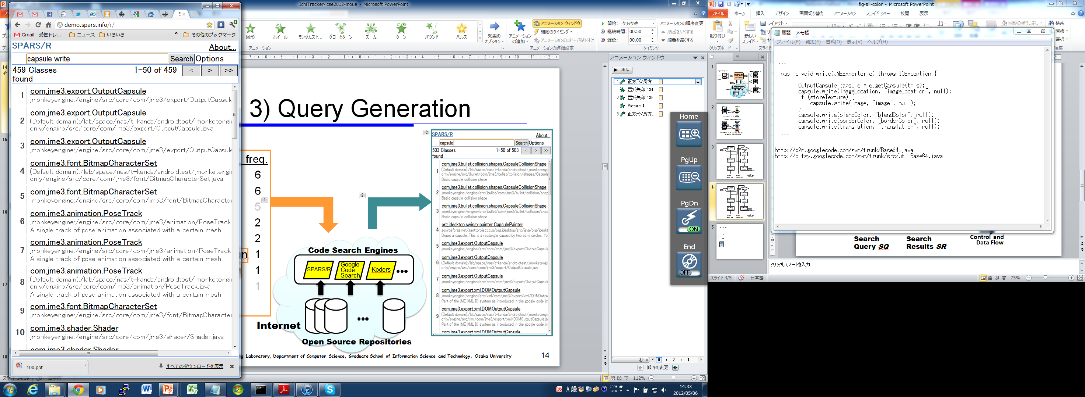
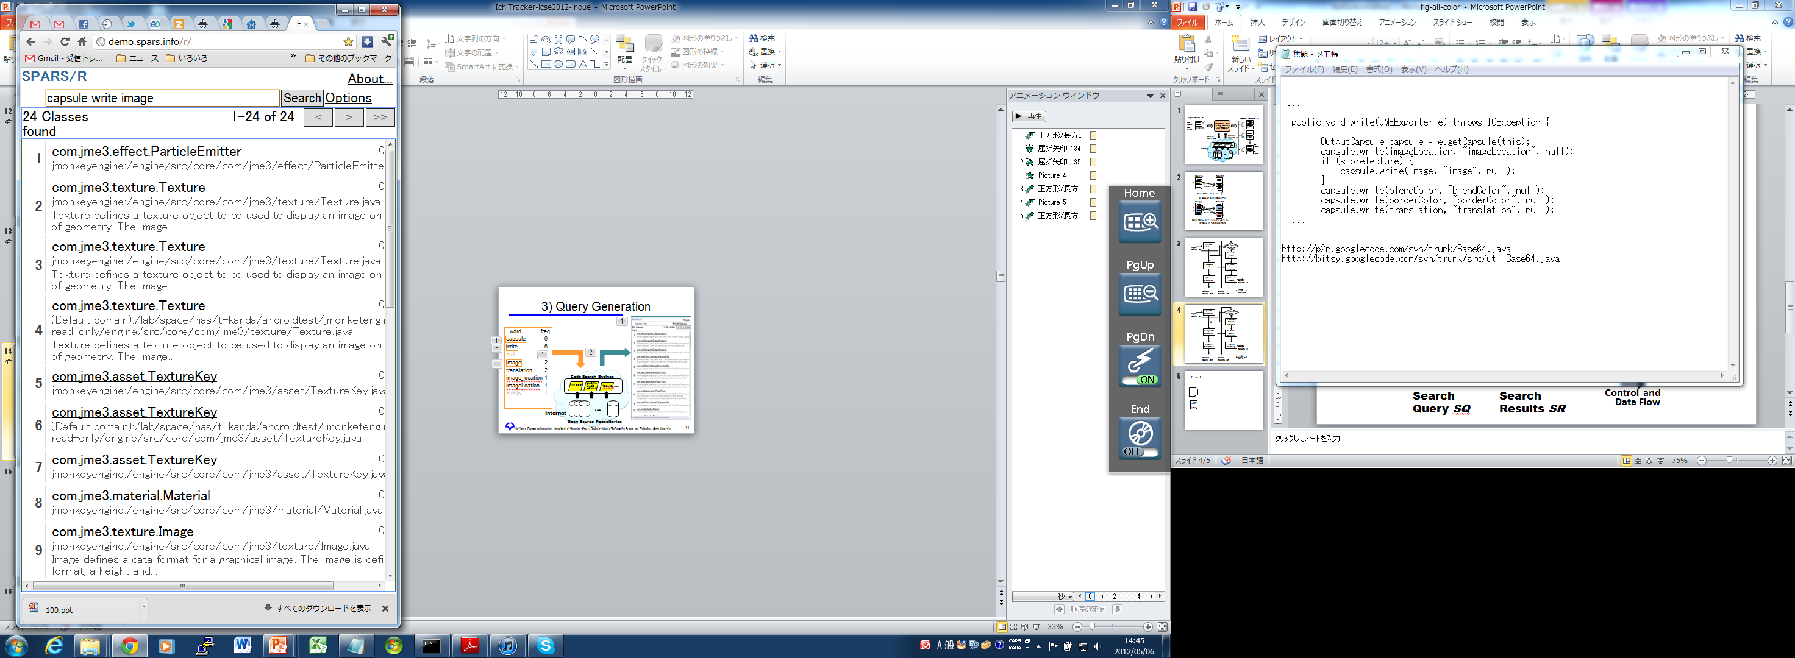
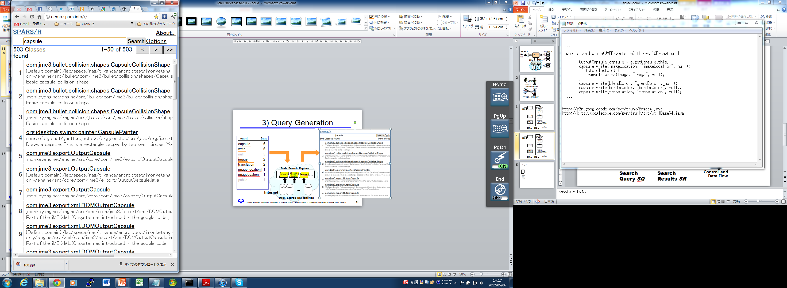
3: Query Generation and Result Check
503
24
459
word freq.
capsule 6
write 6
image 2
translation 2
image_ocation 1
imageLocation 1
public 1
…
+
Search Keywords
Header List
+
  Code Search Engines
SPARS/R
Google
Code
Search
Koders
Internet
  Open Source Repositories
Notes:
The next step is query generation and result check.
First, “Capsule” is sent to the 3 external search engines, and the header list from each search engine is checked.
In this case, Spars/R replies the header list of 503 files.
It’s too broad to download all, so we give more keyword, “write”. So “capsule” and “write” are sent to SPARS/R again.
Then, we get 459, and still too broad. So we give an extra keyword, “image”, then we get 24.
This is acceptable narrow result so we download 24 files from SPARS/R.

Slide 13
4: Download and Code Clone Filtering
24
6
5
5
4
4
3
Code Clone Filter
2
1
CCFinder
1
…
private void renderFromControl(RenderManager rm, ViewPort vp) {
Camera cam = vp.getCamera();
OutputCapsule capsule = e.getCapsule(this);
capsule.write(imageLocation, "imageLocation", null);
…
…
private void renderFromControl(RenderManager rm, ViewPort vp) {
Camera cam = vp.getCamera();
OutputCapsule capsule = e.getCapsule(this);
capsule.write(imageLocation, "imageLocation", null);
…
public void write(JMEExporter e) throws IOException {
OutputCapsule capsule = e.getCapsule(this);
capsule.write(imageLocation, "imageLocation", null);
…
Downloaded Source
Code Files
Files with Sufficient
Shared Code
Query Code Fragment q_{c}
Notes:
After downloading files from all engines, we check if those downloaded files contains sufficient shared code with the input query code.
For this purpose, we use a code clone detector CCFinder.
In this case, this area and this area are code clones, so we keep file 1 in the output. Otherwise, we remove those files without code clones.
In this way, all the downloaded files are checked and filtered with the code clone detector.

Slide 14
Cover Ratio
Similarity metrics between query and result
  Ratio of shared code clone size over the query size
    1: all query code appears in the result
    0: no query code appears in the result
Filtering threshold
  Used 0.4 in the following case studies
Query q_{c}
Result ri_{c}
x
x
Clone Pair
Cover Ratio： di = |x| / |q_{c}|
Notes:
In the following case studies, we set the cover ratio 0.4. This is determined by our experiment.

Slide 15
Case Studies

Slide 16
Objectives of Case Studies
Case Studies A, B, and C
Does Ichi Tracker work properly as we have expected?
Does Ichi Tracker provide useful information for developers?
Notes:
We have performed 3 case studies, A, B, and C
Through these case studies, we have investigated if …
Also, we have explored if …

Slide 17
Case Study A
texture.java
  1,600 LOC java file to define a graphic texture object in game programs, and used by many 3D games
  Developed by a game engine project jMonkeyEngine
  Good code to reuse? → Code evolution
Conditions of all case studies
  Feb. 2011 and May 2011
  Dual Xeon (X5550 2.66GHz) with 24GB main memory
  Osaka University internet environment
Notes:
Texture.java is …, …
We were wondering if it is good code to reuse. So we try to see code evolution.

Slide 18
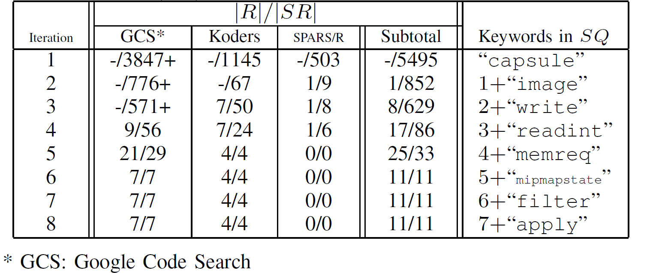
Keywords and Number of Results
|R| : Number of output results
|SR|: Number of headers from external code search engines
With 2~5 trials, we had the total result 29/62
Notes:
This table shows the relation between the keywords Ichi Tracker sent and the number of results.
First the system sent “capsule” to 3 engines, and get the header lists from those engines.
For example, GCS replies more than 3000 headers.
It’s too big, so keywords, "image", "write", "readint", and "memreq“ were added incrementally.
When the header size becomes 29, less than 50, it actually download all of them and performs the code clone filter, generating 21 results.
In the same way, the system got the header lists from Koders and SPRARS/R, and downloaded the files, and filter out non-cloned files.
With 2~5 trials, ...

Slide 19
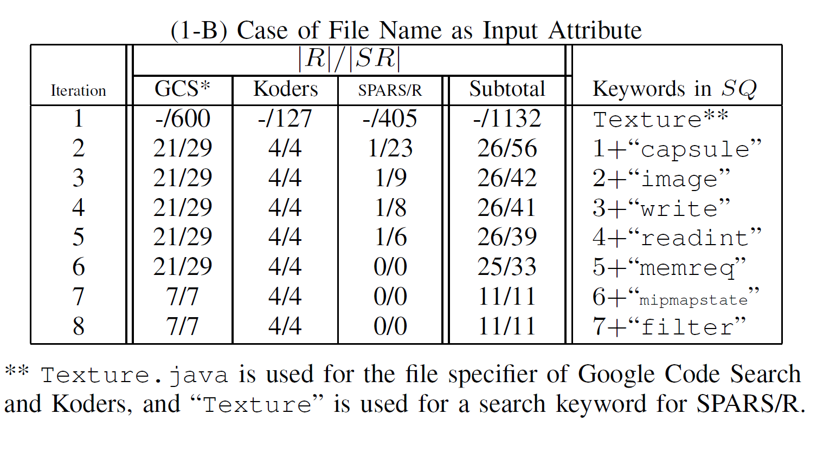
Keywords with File Name
With only 2 trials, we had the total result 26/56
Notes:
This is the case with an optional file name “Texture”.
Compared with last case, the convergence is very fast.
With only ...

Slide 20
Evolution Pattern of Texture.java
jMonkeyEngine R3800
R3448
R4099
Notes:
This is a scatter plot of these 26 files found by this case study.
X axis shows the last modified time
Y axis is the cover ratio to the query code.
Each squre represents a found file in various projects.
The query code, texture.java, is easily identified as jMonkeyEngine R3800.
There are several projects holding the very similar files, which makes a single cluster C.
We found an ancestor project R3448, whose cover ratio is about 0.7, and some projects may reuse those code, making cluster A.
Also, we found descendant project R4099, and its code is heavily reused in many other projects in cluster B
From these results, if we need to reuse this code, texture.java, we would consider to reuse R4099, instead of R3800, since this is newer, and reused by may other projects recently.

Slide 21
Case Study B
kern_malloc.c
  1082 LOC C function, to allocate a specified-size memory block in the kernel address space
  Developed for 4.4 BSD and Mach, and taken over by many other projects
  Good code to reuse? → Code evolution
  We were able to get the output results 67/75 with 1~4 trials (without file name option)

Slide 22
Evolution Pattern of kern_malloc
2
Notes:
This is scatter plot of this case study.
Query code probably has come from Lites 1.0 project.
No clear cluster of similar files, as previous case study.
It seems that each project modified the code independently over the years.
So the cover ratio from the query code generally decrease over the years.
Another finding is that some recent projects use new BSD license, instead of original BSD license
The query code is fairly old, so developer would like to use newer ones, but there is some sort of diversity in the recent files, so she/he needs to check the distinction of each file and choose an appropriate one carefully.

Slide 23
Case Study C
SSHTools
Suite of Java SSH (SSH API, terminal, …)
Ver. 0.2.9 (June, 23, 2007)
442 files in total
  We have selected 339 files larger than 2 KB
  Each selected file was used as the input of Ichi Tracker
Can we safely reuse these files in the same manner?

Slide 24
Number of Similar Files Found
Total 339
Notes:
34 out of 339 files have no similar files found by Ichi Tracker.
Other files have at least one similar file, and some have many similar files, but most of those have less than 10 similar files.

Slide 25
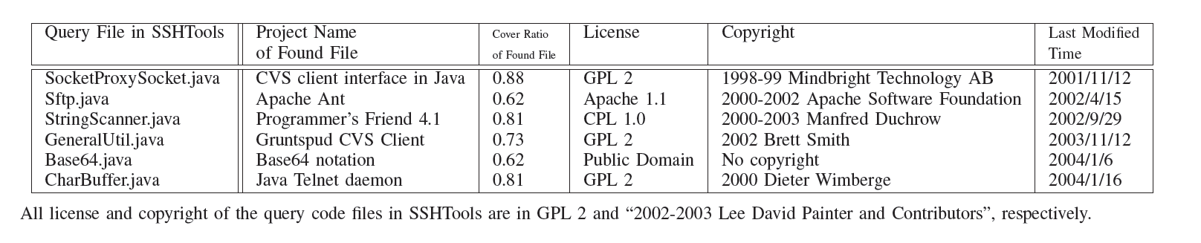
Oldest Files Found for Each Query File
SSHTools
(all 339 files)
License: GPL 2
Copyright: 2002-2003 Lee David Painter and Contributors
Last Modified Time: 2007/6/23
We have found many cases of different projects, different licenses and different copyrights
-> We need to check very carefully when we reuse SSHTools code
Notes:
This table shows some of the oldest file found for each query file.
As you can see, there are many different projects, licenses, and copyrights for each file in SSHTools.
So, we have ...

Slide 26
Discussions and Related Works

Slide 27
Usefulness
With simple check of the output of Ichi Tracker, we can get useful information for the history and evolution of code
Concerns
Origin
  - Who?
  - When?
  - License?
  - Copyright?
Evolution
  - Maintenance?
  - Popularity?
  - Newer version?
  …
Reusable?
EASE
Ichi Tracker
Results
Notes:
As you can see these case studies, by simple check of …
- We don't say all the developers concerns can be solved automatically by Ichi Tracker, but those can be eased by checking the output of Ichi Tracker.

Slide 28
Approach and Process
Choosing good code search engines is a key to get high quality results
  GCS >> Koders > SPARS/R
  (GCS, Koders, SPARS/R) >> (Google, Bing)
Need good code search engine available!
Keyword selection strategy:
  Incremental strategy: try 1, 2, … keywords until the header list becomes less than 50
  Decrement strategy, random, less frequently-used keywords, comment keywords, short keywords, …
  Less effective
Notes:
- GCS was much better than Koders, and Koders was better than SPARS/R
GCS, Koders, and SPARS/R are independently or totally better than text search engines, Google or Bing

Slide 29
Other Issues
Performance
  Case Studies A and B: 1 to 4 min.
  Heavily depend on the code search engines and network performance
  Acceptable as non-interactive support system
Quality of search result
  Non-removed rate at the code clone filtering is an indicator of effectiveness of keyword search
  e.g., 0.46 (Case Study A(1) default setting)
  The final output contains no false positives results

Slide 30
Related Works
Clone Tracker by Duala-Ekoko et.al. [7]
  Track clones with clone region descriptors
Software Bertillonage by Davies et. al. [6]
  Determine origin with anchored signature matching method
Code Broker by Ye et. al. [35]
  Interactively provide complete code from partial code fragment
Need local repositories
PARSEWeb by Thummalapenta et. al. [33]
  Use code search engines to generate method invocation sequences
No code clone filtering
Black Duck and Palamida
Proprietary systems using local repositories
Notes:
Software Bertillonage (ソフトウェア ベルチョン）

Slide 31
Conclusions
Proposed code history tracking model
Developed prototype system Ichi Tracker
Showed case studies using Ichi Tracker
Ichi Tracker provides useful information for OSS reuse to ease developer's concerns
Choose alternative code search engines
Improve user interface to allow more interactive operation
Try other keyword selection algorithms, e.g., TF/IDF, ...

Slide 32
Thank you!
Questions?

Slide 34
Process of Ichi Tracker
Keywords
Header List/
Files
Notes:
This is a detailed process of Ichi Tracker.
First, it gets the query input and, words are extracted from it.
Then keywords for query candidates are selected from those words,
Next, these candidate keywords are sent to the external search engines.
The header list of the search results from the external search engine has benn checked if it is sufficiently narrow result. If not, it will try from the keyword selection again.
If it is OK, Ichi Tracker downloads the actual files from the search engines.
The downloaded files are check if they contains sufficient code clone with the input query code.
The final results are generated.

Slide 35
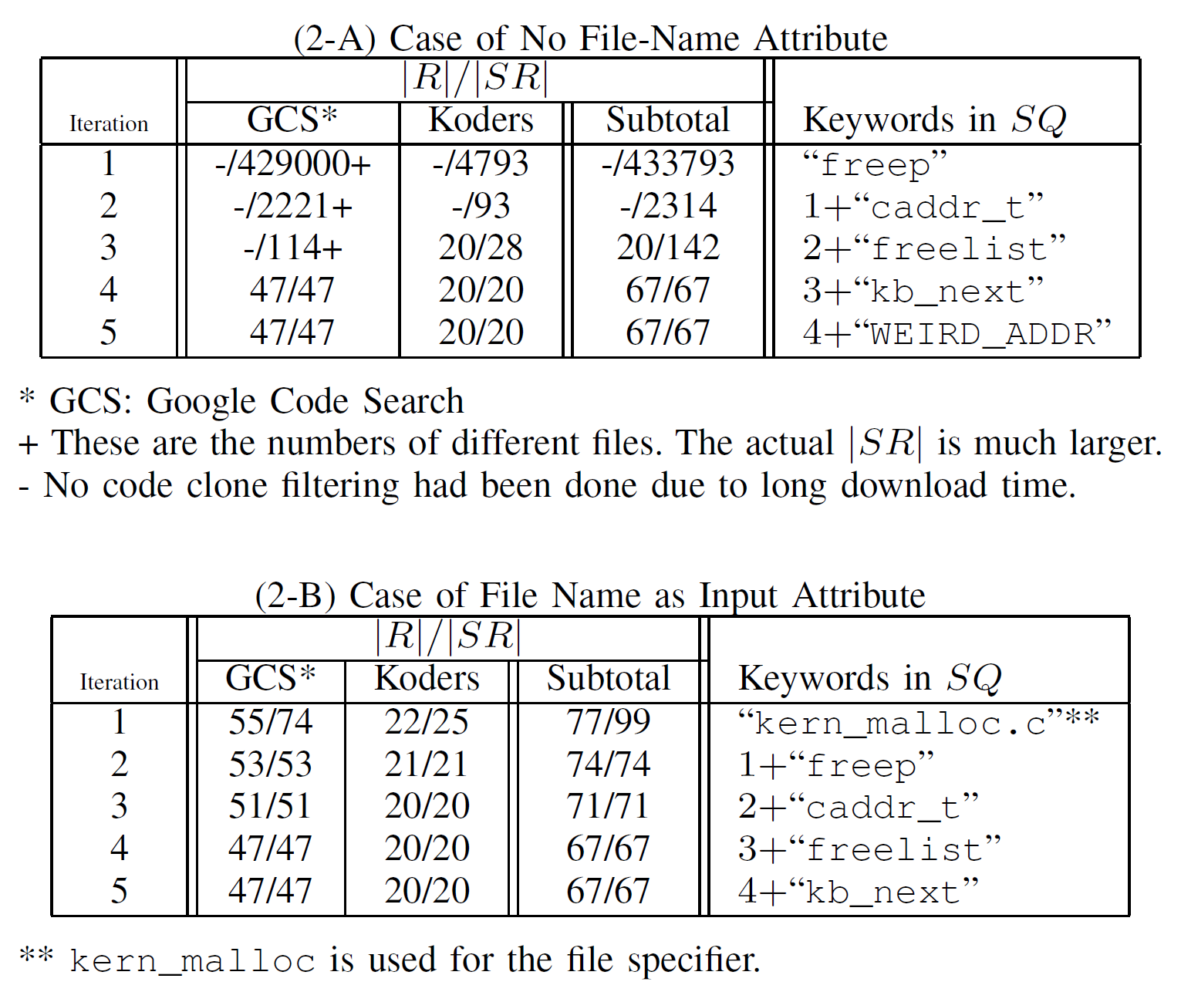
Keywords and Convergence
Notes:
In this case, keywords, “freep”, “caddr_t”, “freelist”, are used as query.
As the last case study, this case also shows the fast convergence of the iteration with file name attribute, but the final output results from the system are the same, which are 67 outputs.

Slide 36
Precision and Recall
Precision
  |R|/ |SR| : 0.46 (case A(1) and A(2))
  0.89 (case B(1)), 0.95 (case B(2))
  Output results : 1.0 (no fault positive)
Recall
  No information of GCS and Koders
  SPARS/R: 0.725 (case of random 100 files)

Slide 37
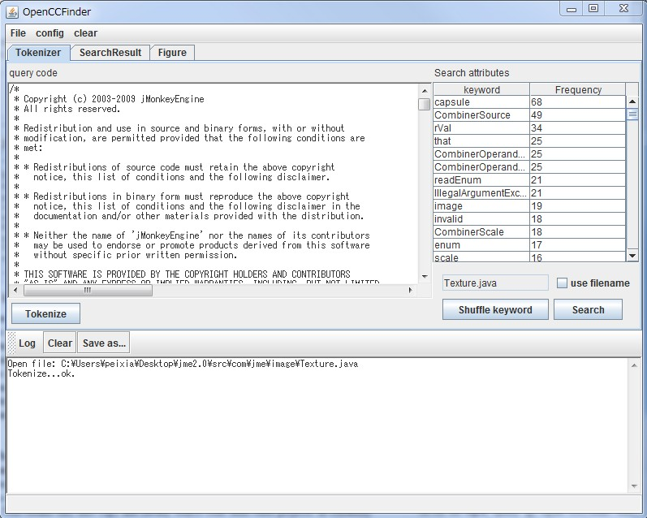
2) Keyword Selection

Slide 38
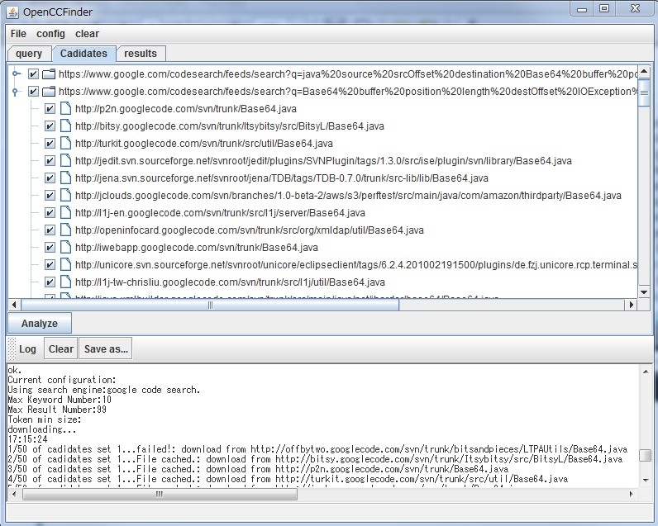
5) Search Result Analysis

Slide 39
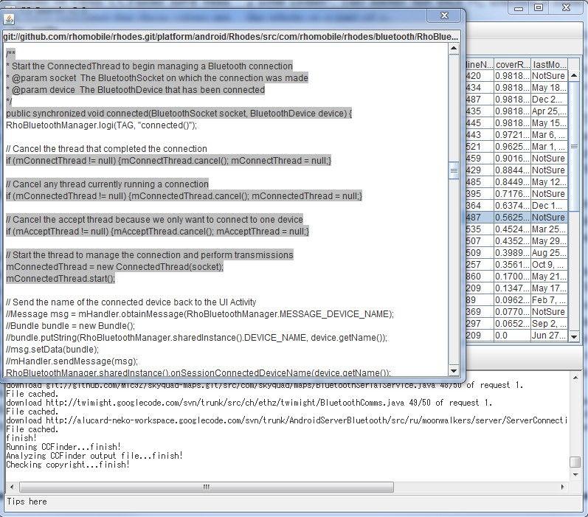
6) Code Clone Filtering
Use CCFinder with the maximum token length 10

Slide 40
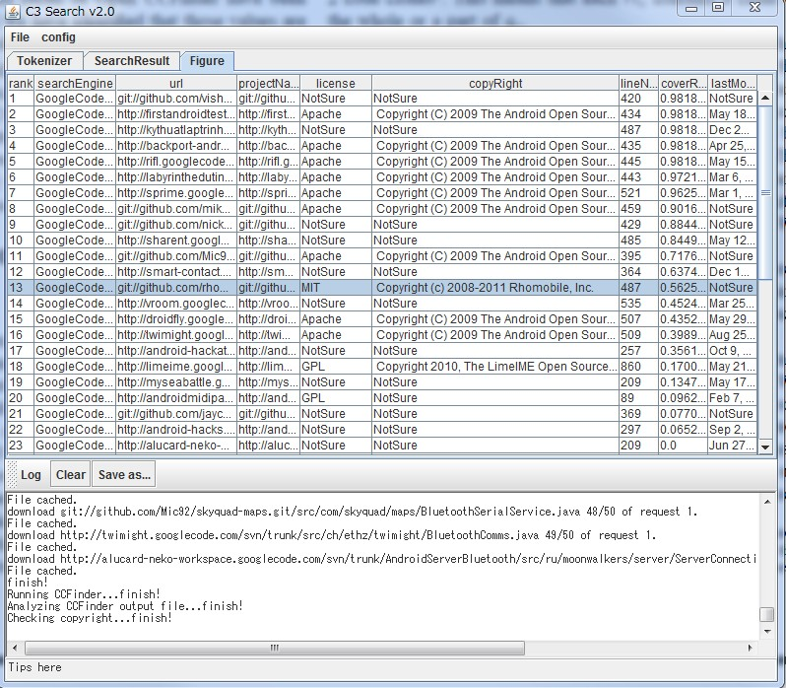
7) Result Forming

