Slide 1

A Lightweight Visualization of Interprocedural Data-Flow Paths for Source Code Reading
Takashi Ishio
Shogo Etsuda
Katsuro Inoue
Osaka
University

Slide 2
Research Background
Modularization techniques often decompose a single feature into a number of modules.
Developers have to investigate method calls and field access among the modules.
  Maybe time-consuming if there are many modules

Slide 3
Example in JEdit
Looks simple, but …
depends on 13 methods in 4 classes
public class JEditBuffer {
public void undo(TextArea textArea) {
if (undoMgr == null) return;
if (!isEditable()) {
textArea.getToolkit().beep();
return;
}
try {
writeLock();
...
A return value of isEditable()
A return value of
isPerformingIO()
A return value of isReadOnly()
[omitted]
Field
readOnly
Field
readOnlyOverride
Method
jEdit.openFile
[omitted]
3 methods
An argument of
setFileReadOnly(boolean)
[omitted]
a path from
load method
A return value of
VFS._getFile(…)
A return value of
VFSFile.isWritable

Slide 4
Visualizing data-flow graph for source code reading
Call graph is popular but too coarse-grained.
  Developers have to read each method to identify the data-flow paths related to the current tasks.
System dependence graph [Horwitz, 1990] is also applicable but too complex to visualize.
  SDG includes all statements of a program.

Slide 5
Our Approach
An intermediate-level visualization
  Inter-procedural data-flow: method calls and field access
  + Summarized intra-procedural data-flow among method parameters and fields
  Two components:
  Simplified data-flow analysis
    Extracting a graph representing an entire Java program
  Interactive Viewer
    Visualizing a part of the graph related to a selected program element.

Slide 6
Data-flow Analysis
Extracting Variable Data-flow Graph
  Nodes: variables and statements
  Edges: control/data-flow among the nodes
Control-flow insensitive, object insensitive, inter-procedural analysis
  A rule-based transformation of ASTs using variable tables, a class hierarchy tree and a call graph
  We do not use a control-flow graph.

Slide 7
Data-flow Extraction
lhs = rhs; is regarded as
a dataflow rhs ➔ lhs.
A statement “a = b + c;” is translated to:
<<Variable>>
b
data
<<Statement>>
a = b + c;
data
<<Variable>>a
data
<<Variable>>
c

Slide 8
Control-flow Insensitivity
Our analysis may generate infeasible edges.
  (a) X = Y; (b) Y = Z;
  (b) Y = Z; (a) X = Y;
No Data
Dependence
Data
Dependence
<<Variable>>
Z
(b)
<<Statement>>
Y = Z;
(b)
<<Variable>>
Y
(a)
<<Statement>>
X = Y;
(a)
<<Variable>>
X
The transitive path Z ➔ X is infeasible for the left code.

Slide 9
Translating methods
from
callsites
x
y
static int max ( int x, int y ) {
int result = y ;
if ( x > y )
result = x ;
return result ;
}
if (x > y)
result = x
result = y
result
return result;
<<return>>
to callsites

Slide 10
Connecting inter-proc. data-flow
class C {
int size;
void setSize(int w, int h) {
int s = max(w, h);
this.size = s;
}
}
this
w
h
<<invoke>>
max(int,int)
arg1
arg2
ret
s
<<Method>>
max(x, y)
x
y
<<return>>
<<Field Write>>
obj
arg
obj
Method body
arg
<<Field>>
C.size
Method calls: Between formal/actual parameters
Field access: Between writers/readers
Field Readers

Slide 11
Summarizing intra-proc. data-flow
class C {
int size;
void setSize(int w, int h) {
int s = max(w, h);
this.size = s;
}
}
this
w
h
<<invoke>>
max(int,int)
arg1
arg2
ret
<<Method>>
max(x, y)
x
y
<<return>>
<<Field Write>>
obj
arg
obj
arg
Summary edges
<<Field>>
C.size
Summary edges directly connect among method parameters and fields
Field Readers

Slide 12
Graph Traversal for Visualization
class C {
int size;
void setSize(int w, int h) {
int s = max(w, h);
this.size = s;
}
}
this
w
h
<<invoke>>
max(int,int)
arg1
arg2
ret
<<Method>>
max(x, y)
x
y
<<return>>
<<Field Write>>
obj
arg
obj
arg
Summary edges
<<Field>>
C.size
A backward graph traversal
extracts data-flow paths.
Field Readers

Slide 13
Graph Traversal with Fractal Value
Fractal value [Koike, 1995] to focus on a small subgraph.
  A graph traversal starts with the initial value: 1.0.
  A fractal value of a node is divided to the next nodes.
  If the value is less than threshold, the traversal is terminated.
  A backward traversal is likely terminated at a large fan-in node
    Global Variables
    Utility Methods
Fractal Value = 1.0
A return value of isEditable()
0.5
0.5
A return value of
isPerformingIO()
A return value of isReadOnly()
0.25
0.25
Field
readOnly
Field
readOnlyOverride
0.0625
[omitted]
3 methods
A return value of
VFS._getFile(…)

Slide 14
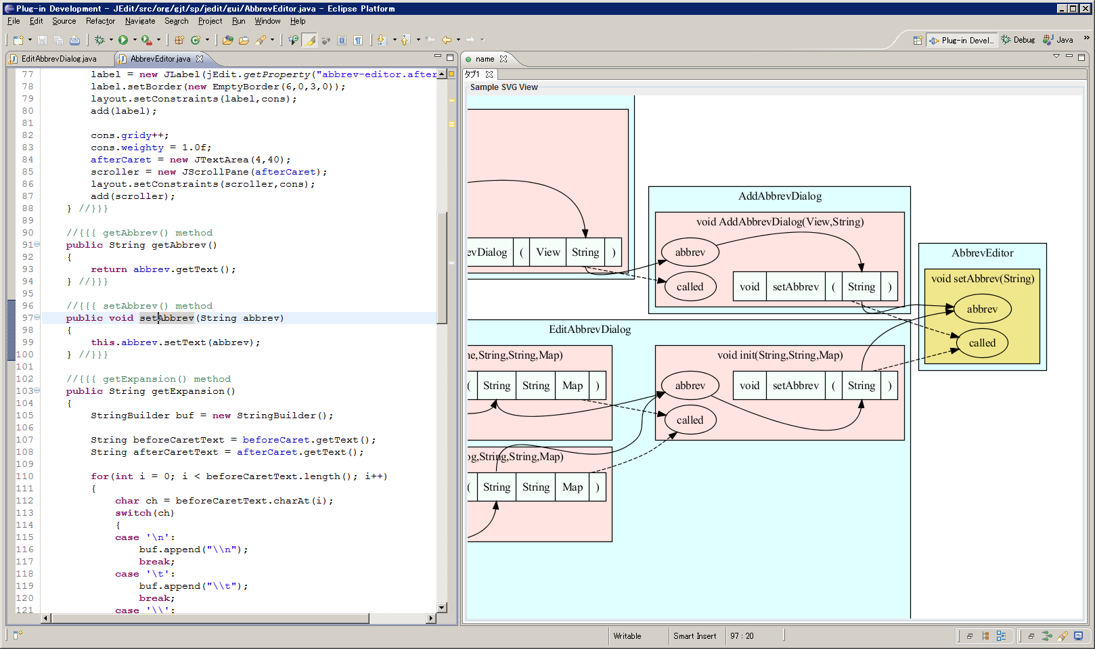
Screenshot
Graph Construction: a batch system
Viewer: an Eclipse plug-in
  A click on a method name executes a graph traversal.

Slide 15
Experiment
Is it effective for program understanding?

Slide 16
Experiment of Program Understanding
16 participants (4 industrial + 12 graduate)
30 minutes for each task (excluding graph construction)
Identify preconditions for two GUI operations in JEdit.
EditAbbervDialog.java, Line 153 (Task A)
JEditBuffer.java, Line 2038 (Task B)
Group 1 | Group 2 | Group 3 | Group 4
Task A with Tool | Task A w/o Tool | Task B with Tool | Task B w/o Tool
Task B w/o Tool | Task B with Tool | Task A w/o Tool | Task A with Tool
“w/o Tool” means a regular Eclipse SDK without our plug-in.

Slide 17
Answer as a data-flow graph
Each data-flow path starts with a user’s action on GUI or the state of a file system.
We have evaluated how many edges in the answer graphs are identified.
Task A: “Is a dialog closable?”
“add” button is pushed.
IF statement: A string is null or “”.
AbbrevsOptionPane.
actionPerformed is called.
The string is a return value of
AbbrevEditor.getAbbrev().
The second argument of
new EditAbbrevDialog
The value is a return value of JTextField.getText()
The first argument of
EditAbbrevDialog.init
The value is the argument of JTextField.setText(String)
The argument of
AbbrevEditor.setAbbrev(String)

Slide 18
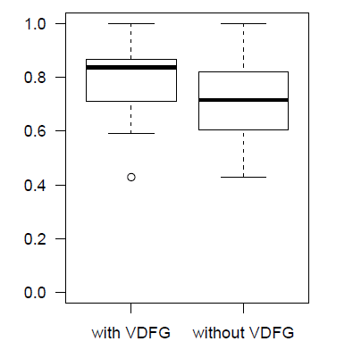
Result
Average Score:
with tool: 0.79
w/o tool: 0.71
t-test (a=0.05)
shows the difference
is significant.

Slide 19
Observation
  Participants managed their progress using graphs.
  Which modules were already investigated?
  No problem caused by infeasible edges.
  An infeasible edge actually appeared in a graph view
    Participants took only a few seconds to confirm source code.
  Only 2% of methods include infeasible summary edges. [Section IV-B]
  A few incorrect methods are involved in answers.

Slide 20
Related Work
Program Slicing using SDG [Horwitz, 1990]
  Our data-flow graph is a control-flow insensitive approximation of SDG.
  Our approach is applicable to a system/component whose control-flow information is not fully available.
Execution-After Relation [Beszédes, 2007]
  Control-flow-based approximation of SDG

Slide 21
Conclusion
Simplified data-flow analysis
  Extracting a data-flow graph w/o control-flow analysis
  The analysis may generate infeasible paths, but:
    No problem has been observed.
    It is effective for data-flow investigation tasks.
Future Work
  Comparison with Execution-After Relation as an approximation of program slicing
  Comparison with other visualization tools

Slide 23
Performance Measurement
on Windows Vista SP2, Intel® Core2 Duo 1.80 GHz, 2GB RAM
Software | Size (LOC) | Time to extract ASTs, variables, a class hierarchy tree, and a call graph (sec.) | Time to extract a data-flow graph (sec.) | Total Time (sec.)
JEdit 4.3pre11 | 168,872 | 108 | 17 | 125
Apache Batik 1.6 | 297,320 | 155 | 33 | 188
Apache Tomcat 6.0.14 | 322,971 | 181 | 50 | 231
Spring Framework 2.5.5 | 487,177 | 358 | 120 | 478
Azureus 3.0.3.4 | 552,295 | 353 | 115 | 468

Slide 24
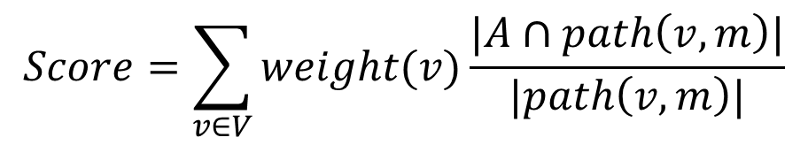
Correctness of answer
How many edges in a correct answer are identified?
$$Score=\sum_{v∈V}{weight(v)\frac{|A∩path\left(v,m\right)|}{|path\left(v, m\right)|}}$$
v1
v2
0.5
0.5
[Example]
Correct Answer: V = {v1, v2}
A participant identified two red edges.
m
Score =
path(v1, m): 0.5 * (1 edge / 2 edges) +
path(v2, m): 0.5 * (2 edge / 2 edges) = 0.75

Slide 25
Heuristic edges
Library classes are ignored.
Heuristic edges between set/get methods
    Example: Actual-parameter of setText(String)
    ➔ a return value of getText()

Slide 26
Threats to Validity
Just a single case study.
The effectiveness of an interactive view is included in the study.
t-test assumes normal distribution of score.

Slide 27
Task A: When JEdit sounds beep at EditAbbervDialog.java: line 153?
The correct answer is defined as a data-flow subgraph.
public void actionPerformed(ActionEvent evt) {
if (evt.getSource() == ok) {
if (editor.getAbbrev() == null || editor.getAbbrev().length() == 0) {
getToolkit().beep();
return;
}
if (!checkForExistingAbbrev()) return;
isOK = true;
}
dispose();
}
A return value of JTextField.getText()
The argument of setText(String)
The argument of
AbbrevEditor.setAbbrev(String)
“Add” Button Clicked
AbbrevsOptionPane.
actionPerformed is called.
(omitted)

