Slide 1
What kind of and how clones are refactored? A case study of three OSS projects WRT2012 June 1, 2011
Eunjong Choi†, Norihiro Yoshida‡, Katsuro Inoue† †Osaka University, Japan ‡Nara Institute of Science and Technology, Japan
Notes:
My name is Eunjong Choi, a PhD student of Osaka University.
The title of my presentation is “What kind of and how clones are refactored? A case study of three OSS projects“

Slide 2
Code Clone
A code fragment that has similar or identical code fragments in source code
for(unsigned int i = 0; i < children.size(); i++)
if(children[i] != NULL)
delete children[i];
...
for(unsigned int i = 0;
i < nodes.size(); i++)
if(nodes[i] != NULL)
delete nodes[i];
Code Clone
(A Clone Pair)
Notes:
At first, I explain about background of our research.
Code clone represents a code fragment that has similar or identical code fragments in source code.
A well-known reason for introducing code clones to
software is copying an existing code fragment and pasting
it with or without modification.
This source code is an example of code clone.
We call a pair code clones, a clone pair

Slide 3
Cause of Code Clone
Code clones make software more difficult to be maintained
should be inspected
A defect is contained
Source File 1
Source File 2
Notes:
However, code clones make software more difficult to be maintained because
If a defect is contained in a code fragment of code clone, all of
its cloned code fragments should be inspected for the same defect.

Slide 4
An Example of Clone Refactoring
Code clones can be merged into a single method by performing refactoring
Refactoring
call
Before
After
Notes:
Code clones typically can be merged into a single method by performing refactoring
This figure is an example of clone refactoring.
In this figure, code clones are merged into a single method and old code clones
are replaced by call statements of a new method after performing refactoring.

Slide 5
Present Tools for Clone Refactoring
Tools for clone refactoring are NOT commonly used
Developers of tools for clone refactoring need to understand actual clone refactoring
For the development of more widely-used tools for clone refactoring
Notes:
However, currently, tools for clone refactoring are not commonly used.
For the development of more widely-used tools for clone refactoring,
developers of tools for clone refactoring need to understand actual clone refactoring

Slide 6

Motivation of This Study
We investigate following items in three Java OSS projects.
Characteristics of refactored code clones
Applied refactoring patterns
Notes:
Therefore, we Investigate characteristics of refactored code clones
and applied refactoring patterns In three java OSS projects

Slide 7
Research Questions
Q1. Which refactoring pattern is the most applied to code clones?
Q2. Are character sequence pairs of refactored clone pairs similar to each other?
Q3. Are lengths of character sequences in refactored clone pairs different each other?
Q4. Are classes which contain refactored clone pairs spread in the class hierarchy?
Notes:
Our investigation focused on following four research questions;
Q1 is Which refactoring pattern is the most applied to code clones?
Q2 is Are character sequence pairs of refactored clone pairs similar to each other?
Q3 is Are lengths of character sequences in refactored clone pairs different each other?
Q4 is Are classes which contain refactored clone pairs spread in the class hierarchy?
Among them, Which refactoring pattern is the most applied to code clones?
is for investing how code clones were refactored.
And
Are character sequence pairs of refactored clone pairs similar to each other?
Are lengths of character sequences in refactored clone pairs different each other?
Are classes which contain refactored clone pairs spread in the class hierarchy?
are for investing what kind of code clones were refactored.

Slide 8

Overview of Investigation
Investigate
Software repository
Source code
Identified non-clone
refactoring
Identified clone refactoring
Refactoring identification
tool
Identify code clones
Step 2
Step1
Step4
Step3
Notes:
Next, I explain about steps of our investigation.
The steps of our investigation comprised of four steps, as you can this this figure.
Hereafter, I will explain the detailed of each step.

Slide 9
Step 1. Extract Verstions of OSS Projects
Software repository
Extract
Old version New version
Notes:
Firstly, we extracted old and new version source code of OSS projects from software repositories.

Slide 10
Step 2. Identify Refactoring
Refactoring identification tool
Identify refactoring
Refactoring
Refactoring
Old version New version
Notes:
Secondly, we identified refactoring between old and new versions using a refactoring identification tool.

Slide 11
Step 3. Identify Code Clones among Refactoring
Similar measurement
Identify code clones
Refactored code clone
Refactoring
Old version New version
Notes:
Thirdly, we selected pairs of code fragments in the old version which had performed refactoring into
the same code fragment in the new version based on the information from refactoring identification tool,
and then, we identified code clones among the pairs of refactored code fragments using similarity measurement.

Slide 12
Step 4. Investigate Characteristics of Refactored Code Clones
Investigate
Refactored code clone
Refactoring
Old version New version
Notes:
Finally, we investigated characteristics of refactored clone pairs.

Slide 13
Target Projects
Release and revision pairs are selected from three Java OSS projects ^{[Prete2010]}
2 release pairs from jEdit
2 reversion pairs from CAROL
6 reversion pairs from Columba
[Prete2010] K. Prete, N. Rachatasumrit, N. Sudan, and M. Kim. Template-based reconstruction of complex refactorings. In Proc. of ICSM, pages 1-10, 2010
Notes:
Next, I will explain about the design of our investigation.
As a target projects, we selectred release and revision pairs from
three Java OSS projects from their software repositories.
We selected 2 release pairs from jEdit
2 revision pairs from CAROL
and 6 revision pairs from Columba.
We selected them because their refactoring information from used refactoring identification tool
were validated with high acurracy in Prete`s paper.

Slide 14
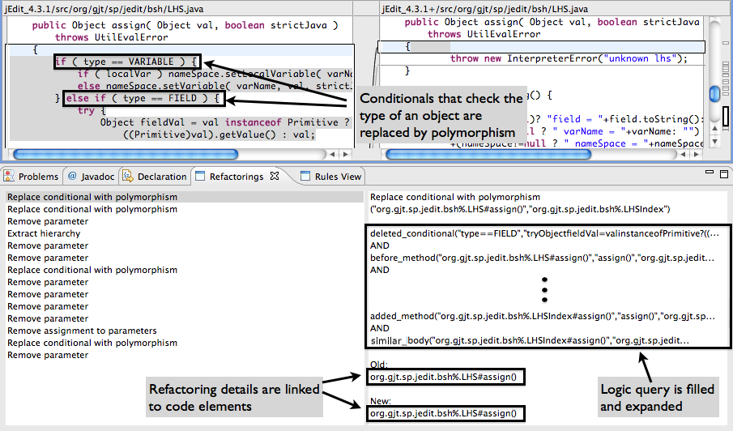
Refactoring Identification Tool (1/2)
Ref-finder : A tool that Identifies refactoring between two program versions
ref-finder can identify many refactoring patterns
outputs of ref-finder are validated with high accuracy.
[Prete2010] K. Prete, N. Rachatasumrit, N. Sudan, and M. Kim, Template-based reconstruction of complex refactorings. In Proc. of ICSM, pages 1-10, 2010
Notes:
As a refactoring identification tool, we used ref-finder,
a tool that identifies refactoring between two program versions.
This figure is a snapshot of ref-finder.
The reason why we selected ref-finder is ref-finder can cover many Folwer’s refactoring patterns.
Moreover, its outputs werevalidated with high accuracy in the case study of Prete’s paper..

Slide 15
Target of Refactoring Patterns
Extract Class(EC)
Extract Method(EM)
Extract Superclass(ES)
Form Template Method(FTM)
Parameterize Method(PM)
Pull Up Method(PUM)
Replace Method with Method Object(RMMO)
Notes:
We selected 7 refactoring patterns which can be applied to clone refactoring according to Folwer’s book.
The are EC, EM. ES, FTM, PM, PUM and RMMO

Slide 16
Target of Refactoring Patterns
Extract Class(EC)
Extract Method(EM)
Extract Superclass(ES)
Form Template Method(FTM)
Parameterize Method(PM)
Pull Up Method(PUM)
Replace Method with Method Object(RMMO)
Notes:
Between them, I explain about clone refactoring using RMMO

Slide 17
Example of RMMO
Code clones that use local variables are merged into single method in a new class
Class Order...
double price(){
double PrimaryBasePrice;
double secondaryBasePrice;
double tertiaryBasePrice;
..........
}
double discount(){
double PrimaryBasePrice;
double secondaryBasePrice;
double tertiaryBasePrice;
..........
}
Order
PriceCalculator
primaryBasePrice
secondaryBasePrice
tertiaryBasePrice
price()
discount()
Compute()
return new PriceCalculator(this).compute()；
Before
After
Notes:
This figure is an example of ROOM to a clone pair.
In this figure before refactoring, cloned methods use local variables exist,
but after applying RMMO, coded methods are merged into a single method in its own object and all
these local variables are moved into fields on the new class.

Slide 18
Problem of Identifying Code Clone (1/2)
Programmers sometimes perform refactoring between low-similar code clones
.... int compare(int i, int j){
if (i > j) { i = i / 2;
i++;
} else {
i = i+ 1 ;
}
return i;
}
....
.... if (i > j) { i = i / 2;
i++;
}
....
if (i =< j) {
i = i + 1 ;
} ....
Refactoring
Before
After
Notes:
Several code clones detection tools have been proposed.
However, existing code clone detection tools have their own limitation.
I will explain about the limitation of existing tools with CCFinder, a token-based code clone detection tool
We assumed that developers sometimes merge low similar code clones into a single method after much thought.
This figure is an example of clone refactoring between low-similar code clones.

Slide 19
Problem of Identifying Code Clone (2/2)
It is difficult for CCFinder^{[Kamiya2002]} to detect these code clones
.... int compare(int i, int j){
if (i > j) { i = i / 2;
i++;
} else {
i = i+ 1 ;
}
return i;
}
....
.... if (i > j) { i = i / 2;
i++;
}
....
if (i =< j) {
i = i + 1 ;
} ....
Refactoring
Before
After
[Kamiya2002] T. Kamiya, S. Kusumoto and K. Inoue. CCFinder: A Multilinguistic Token-Based Code Clone Detection System for Large Scale Source Code. IEEE TSE, 28: 654-670, 2002
Notes:
In this figure, a code clone is created by copying existing code fragment with modification.
However, due to this modification, code clones like this cannot be detected by CCFinder.

Slide 20
Identifying Code Clone (1/2)
usim ^{[Mende2010]} : determine the similarity between two character sequences.
Using Levenshtein distance
Measuring the amount of difference between two character sequences
Levenshtein distance between survey and surgery is 2 ^{[B-yates]}
+1
+1
survey → surgey → surgery
[Mende2010] T. Mende, R. Koschke, and F. Beckwermert. An evaluation of code similarity identification for the grow-and-prune model. Journal of Software Maintenance, 21(2): 143-169, 2009
[B-yates] R. Baeza-Yates and B. Ribeiro-Neto.Modern. Information Retrieval: The Concepts and Technology behind Search (2nd Edition). Addison Wesley, 2010.
Notes:
In this study, to overcome this limitation, we used undirected
similarity to identify low similar code clones as well as high similar code clones.
Usim is originally used to identify method-unit clone in Mende’s paper.
Usim uses the Levenshtein distance which measures the
amount of difference between two character sequences.
Levenshtein distance between survey and surgery is 2.
Because from survey, v is changed to g and r is added.

Slide 21
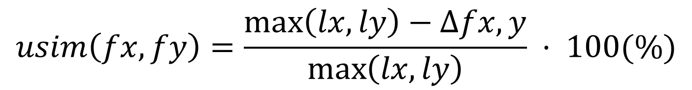
Identifying Code Clone (2/2)
$$usim\left(fx, fy\right)=\frac{\max\left(lx, ly\right)−∆fx,y}{\max\left(lx, ly\right)} · 100(\%)$$
Levenshtein distance between two character sequences is normalized by the maximum size between them
If the usim value is over 40% between a pair of code fragments, we define it as a clone pair.^{[Mende2010]}
[Mende2010] T. Mende, R. Koschke, and F. Beckwermert. An evaluation of code similarity identification for the grow-and-prune model. Journal of Software Maintenance, 21(2): 143-169, 2009
Notes:
This equation computes usim, It means that Levenshtein distance between two character
sequences is normalized by the maximum size between them.
If the usim value is over 40% between a pair of code fragments, we define it as a clone pair
40% is also used in Mende’s paper to identify code clones.

Slide 22

Measurement of the Characteristics (1/2)
Character sequence similarity between refactored clone pairs
Use usim
Character sequence length difference between refactored clone pairs
Investigate the characteristics of refactored clone pairs in the past
Notes:
We investigated the characteristics of refactored clone pairs based on applied refactoring pattern.
We measured the character sequence similarity between them using usim
This information indicates about which refactoring pattern could be performed according to
Character sequence similarity between clone pairs.
We also measured Character sequence length difference between them.
This information indicates about which refactoring pattern could be performed according to
The length difference of character sequence of clone pairs

Slide 23

Measurement of the Characteristics (2/2)
Class distance between classes which contain refactored clone pairs
in terms of RMMO
To investigate location of refactored clone pairs in the past
Notes:
Moreover, we investigated the location of refactored clone pairs.
However, except for RMMO, our selected 6 refactoring patterns have constraints of
locations of clone pairs in the old version.
Therefore, we investigated class distance in terms of RMMO.
This information indicates about applying RMMO according to the location information of clone pairs.

Slide 24
Q1. Which refactoring pattern is the most applied to code clones?
4 refactoring patterns were applied to clone pairs from overall target projects
RMMO is the most frequently applied refactoring pattern
Notes:
Next, I will explain about results of our investigation.
As a result of investigation, 31 refactored clone pairs clones are identified from overall target projects.
This graph represents applied the number of refactoring
patterns of identified clone pairs..
In this graph, green part represents EM, sky part represents ES,
Purple part represents FTM, and Red part represents RMMO.
And As you can see this graph, RMMO is the most frequently applied refactoring pattern.

Slide 25
Q2. Are character sequence pairs of refactored clone pairs similar to each other?
Frequency
usim (%)
Low similarity : EM, RMMO
Notes:
This graph represents character sequence similarity between refactored clone pairs in each refactoring pattern..
As you can see this graph, EM and RMMO are applied to low-similar clone pairs.

Slide 26
Q2. Are character sequence pairs of refactored clone pairs similar to each other?
Frequency
usim (%)
High similarity : FTM, ES
Notes:
Whereas, FTM, and ES are applied to high-similar clone pairs.

Slide 27
Q3. Are lengths of character sequences in refactored clone pairs different each other?
Frequency
Various character sequence length difference : RMMO
Notes:
This graph represents character sequence length differences between
refactored clone pairs on each refactoring pattern.
As you can see this graph, RMMO is applied to various character sequence length different clone pairs.

Slide 28
Q3. Are lengths of character sequences in refactored clone pairs different each other?
Frequency
Little character sequence length difference : EM, ES, FTM
Notes:
Meanwhile, EM, ES, and FTM are applied to little character sequence length different clone pairs.

Slide 29
Q4. Are classes which contain refactored clone pairs spread in the class hierarchy?
Frequency
RMMO is the most frequently applied to clone pairs in the same package
Notes:
This graph represents class distances in terms of RMMO.
As you can see this graph, RMMO is the is the most frequently applied to clone pairs in the same package.

Slide 30
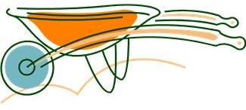
Revisiting Results (1/3)
Tools to support RMMO refactoring to clone pairs are needed.
17 refactored clone pairs are applied RMMO among 31 identified clone pairs
Notes:
Next, I will explain our suggestion of tools for clone refactoring with revisiting results of investigation..
We suggest that Tools to support RMMO refactoring to clone pairs are needed.
Because we found that 17 clone pairs are applied RMMO among 34 identified clone pairs

Slide 31
Revisiting Results (2/3)
support clone refactoring for clone pairs spread into not only in the same class but also the same package
15 clone pairs are spread into same package among 17 identified clone pairs.
support clone refactoring for clone pairs consisting of different size of character sequences
Notes:
These tools should support clone refactoring for clone pairs
spread into not only in the same class but also the same package.
Because we found that 15 clone pairs are distributed in same
package among 17 identified clone pairs.
Also, they should support clone refactoring for clone pairs consisting
of different size of character sequence.

Slide 32
Revisiting Results (3/3)
support clone refactoring for clone pairs that include different character sequence
Notes:
Moreover, they should support clone refactoring for clone pairs that include different character sequence

Slide 33
An example of clone refactoring tools
If clone pairs which have
spread into not only in the same class but also the same package
consisting of different size of character sequences
including different character sequence
tools preferentially suggest to apply RMMO to these clone pairs.
Notes:
If clone pairs which have
spread into not only in the same class but also the same package
consisting of different size of character sequences
including different character sequence
are detected, tools of clone refactoring that preferentially suggest to apply RMMO to these clone pairs are necessary.

Slide 34
Threads to Validity
Our identification of code clone might inaccuracy.
Results of investigation are rely on used tools
Results might not generalize to other OSS projects.
Notes:
However, our investigation have several limitations;
Firstly, Because using Character Sequence similarity measurement, our identification of code clone might inaccuracy.
Secondly, the results of our investigation are rely on used tools.
Finally, results might not generalize to other OSS projects.
.
We will improve these limitations as our future work.

Slide 35
Related Work (1/2)
Kim et al. investigated the genealogies of code clones in OSS. ^{[Kim2005]}
They confirmed that refactoring long-lived clones are difficult.
They used CCFinder, which can detect only syntactically-equivalent code clones
We confirm that a lot of refactored and syntactically-different clones.
[Kim2005] M. Kim, and D. Notkin, Using a clone genealogy extractor for understanding and supporting evolution of code clones. In Proc. of MSR, pages 1-5, 2005
Notes:
Next, I introduce related work of this study.
Kim et al have investigated the genealogies of code clones in OSS and
They confirmed that refactoring long-lived clones are difficult using CCFinder, which can
detect only syntactically-equivalent code clones
However, we confirmed that a lot of refactored and syntactically-different clones using usim

Slide 36
Related Work (2/2)
Murphy-Hill et al. investigated refactoring activities in eight sets of data. ^{[Murphy-Hil2012]}
Results of their investigation can help the research community build better refactoring tools and techniques in the future.
Their investigation focused on general refactoring .
Our investigation focus on clone refactoring
[Murphy-Hil2012] E. Murphy-Hill, C. Parnin, and A. P. Black., How we refactor, and how we know it. . IEEE TSE, 38: pages 5-18, 2012
Notes:
Also, Murphy-Hill et al. investigated refactoring activities based on eight sets of data
and results of their investigation can help the research community build better refactoring tools and techniques in the future
However, their investigation focused on non-clone refactoring based,
but our investigation focus on clone refactoring

Slide 37
Summary (1/2)
Investigate the characteristics of refactored clone pairs
From 3 Java OSS projects
Use Rer-finder to identify refactoring
Use usim to identify code clones on refactoring
Notes:
As a summary, we Investigated the characteristics of pairs of refactored code clones
In terms of applied refactoring pattern, from 3 java OSS projects, We used ref-finder as a refactoring identification
tool and usim to identify code clones among refactoring.

Slide 38
Summary (2/2)
The most frequently applied refactoring pattern is RMMO.
clone pairs that include different character sequences
clone pairs consisting of different size of character sequences
clone pairs in the same package
Notes:
We have found that the most frequently applied refactoring pattern is RMMO.
And it usually applied to clone pairs that have different size of character sequences and
consisting of different size of character sequences in the same package.

Slide 39
Future Work
Identify code clone more accuracy.
apply token sequence similarity measurement.
Expand our investigation method
to more OSS projects and industrial software
Develop tools for clone refactoring
according to the result of futher investigation
Notes:
As a future work, we will Identify code clone more accuracy by applying
token sequence similarity measurement.
Next, we plan to expand our investigation method by
investigating more OSS projects and industrial software.
Also, we will develop tools for clone refactoring according to the result of our investigation.
Finally,

Slide 41
Related Work (2/2)
Burd and Bailey pointed out that the combination of various clone detection tools are needed to identify code clones
We confirmed the usefulness of combined tools for the identification of refactored clones.
Notes:
Differentを絶対いうべき

Slide 42
Research
What kind of code clones were performed refactoring in the past?
Similarity
Which refactoring patterns applied to code clones?
Refactoring patterns that were applied to code clones
Notes:
Similarity?

Slide 43
Refactoring Identification Tool (2/2)
It detected sixty five Fowler’s refactoring patterns. ^{[Prete2010]}
Its outputs were validated with high accuracy
[Prete2010] K. Prete, N. Rachatasumrit, N. Sudan, and M. Kim, Template-based reconstruction of complex refactorings. In Proc. of ICSM, pages 1-10, 2010

Slide 44
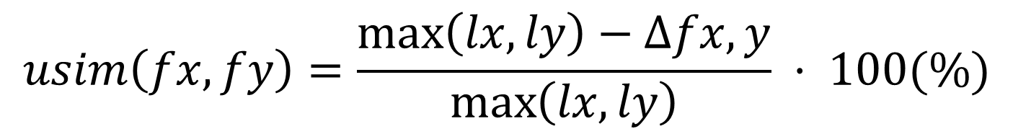



Identifying Code Clone (2/3)
$$usim\left(fx, fy\right)=\frac{\max\left(lx, ly\right)−∆fx,y}{\max\left(lx, ly\right)} · 100(\%)$$
$$sfx$$
: a normalized character sequence
$$lx=len(sfx)$$
: length of normalized character sequence
$$∆fx,y=LD(sfx, sfy)$$
: the number of items that have to be changed to turn function fx into fy
Notes:
This equation computes usim between two code fragments.
This equation represents that a maximum length of normalized character sequence
between two character sequence minus number of items that have to be changed to turn function fx
Into fy
dived by maximum length of normalized character sequence between two character sequences.

Slide 45
Target Projects
Release and revision pairs are selected from three Java OSS projects ^{[Prete2010]}
2 release pairs {(3.0, 3.0.1), (3.0.2, 3.1)} from jEdit
2 reversion pairs {(302, 352), (352, 449)} from CAROL
6 reversion pairs {(62, 63), (389, 421), (421, 422), (429, 430), (430, 480), (480, 481)} from Columba
[Prete2010] K. Prete, N. Rachatasumrit, N. Sudan, and M. Kim. Template-based reconstruction of complex refactorings. In Proc. of ICSM, pages 1-10, 2010
Notes:
Next, I will explain about the design of our investigation.
Release pairs and revision pairs are extracted from
three Java OSS projects from their software repositories.
We selected 2 release pairs from jEdit
2 revision pairs from CAROL
and 6 revision pairs from Columba.
We selected them because their results of refactoring from used refactoring identification tool
are validated in Prete`s paper.

