Slide 1
Investigation of Coding Patterns over Version History
Hironori Date, Takashi Ishio, Katsuro Inoue
Osaka University, Japan

Slide 2
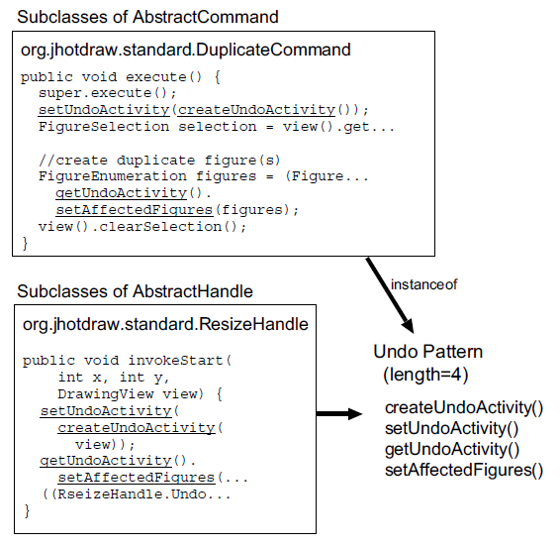
Coding Patterns
Frequent sequence of call elements and control elements
  Call element
    Method call element
    Constructor call element
  Control element
    IF, END-IF
    LOOP, END-LOOP
    etc…
Implement a particular kind of concerns
  spread around source code
JHotDraw Ver. 5.4b1

Slide 3
Previous Research [1]
Extracted coding patterns from 5 applications
Coding pattern type
  API usage patterns
  Application-specific Patterns
Coding patterns are candidates of reusable code
[1] T. Ishio, H. Date, T. Miyake, and K. Inoue, “Mining coding patterns to detect crosscutting concerns in java programs,”
in Proceedings of the 15th Working Conference on Reverse Engineering, 2008, pp. 123–132.

Slide 4
Previous Research [1]
Similar Patterns
<a(), b()>
<a(), b(), c()>
<a(), c(), b()>
<IF, a(), b(), END-IF>
??
??
Which patterns are easier to reuse?
Assumption:
Stable patterns are reusable

Slide 5
Research Question
To answer this question …
  Extract coding patterns from multiple versions of applications
  Investigate the life-span of coding patterns
    Life-span: the number of versions where we find the identical pattern
RQ
Are the coding patterns generally stable
over the version history?

Slide 6
Outline of Experiment
Ver. 1
Ver. 2
Ver. N
.java
Source Code
.java
.java
.java
.java
.java
…
.java
.java
.java
Mining coding patterns
  Normalization of source code
  Sequential pattern mining for each version
Tracking coding patterns
  Compute life-span of each pattern
Mining Coding Patterns
(using Fung)
Coding Patterns
.xml
.xml
…
.xml
Tracking Coding Patterns
 | Ver. 1 | Ver. 2 | … | Ver. N | Life-span
Pat. 1 | 3 | 4 | … | 3 | 6
Pat. 2 | 0 | 0 | … | 2 | 4
… | … | … | … | … | …
Pat. M | 3 | 0 | … | 2 | 3
Life-span

Slide 7
Outline of Experiment
Ver. 1
Ver. 2
Ver. N
.java
Source Code
.java
.java
.java
.java
.java
…
.java
.java
.java
Mining coding patterns
  Normalization of source code
  Sequential pattern mining for each version
Tracking coding patterns
  Compute life-span of each pattern
Mining Coding Patterns
(using Fung)
Coding Patterns
.xml
.xml
…
.xml
Tracking Coding Patterns
 | Ver. 1 | Ver. 2 | … | Ver. N | Life-span
Pat. 1 | 3 | 4 | … | 3 | 6
Pat. 2 | 0 | 0 | … | 2 | 4
… | … | … | … | … | …
Pat. M | 3 | 0 | … | 2 | 3
Life-span

Slide 8
Outline of Experiment
Ver. 1
Ver. 2
Ver. N
.java
Source Code
.java
.java
.java
.java
.java
…
.java
.java
.java
Mining coding patterns
  Normalization of source code
  Sequential pattern mining for each version
Tracking coding patterns
  Compute life-span of each pattern
Mining Coding Patterns
(using Fung)
Coding Patterns
.xml
.xml
…
.xml
Tracking Coding Patterns
 | Ver. 1 | Ver. 2 | … | Ver. N | Life-span
Pat. 1 | 3 | 4 | … | 3 | 6
Pat. 2 | 0 | 0 | … | 2 | 4
… | … | … | … | … | …
Pat. M | 3 | 0 | … | 2 | 3
Life-span

Slide 9
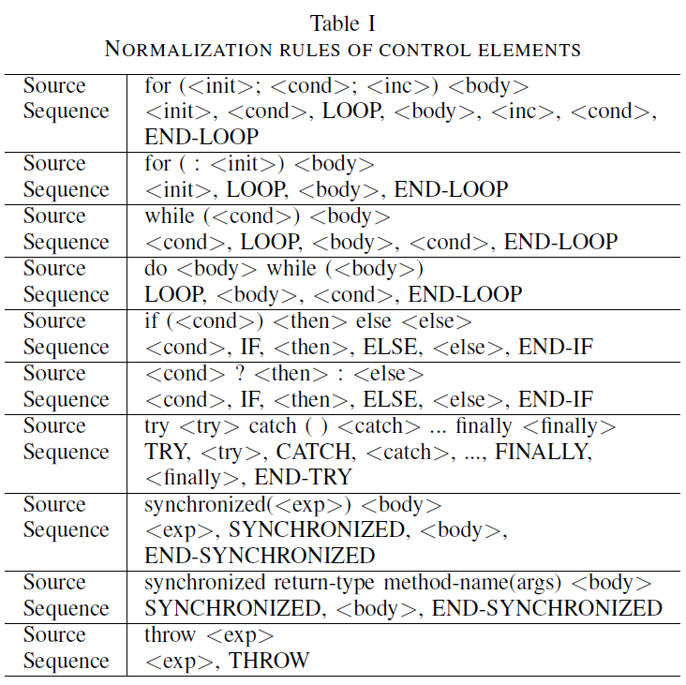
Normalization in Pattern Mining
Source File
Sequence Database
public class A {
void a() {
int i = x + y;
callA();
callB();
callB();
}
void b() {
if (cond()) {
callA();
callB();
}
}
}
Normalization
A.a()
<callA(), callB(), callB()>
A.b()
<cond(), IF, callA(), callB(), END-IF>
Translate each method into a sequence
  Call elements
  Control elements
Normalize control elements (Table I)

Slide 10
Sequential Pattern Mining
Source File
Sequence Database
public class A {
void a() {
int i = x + y;
callA();
callB();
callB();
}
void b() {
if (cond()) {
callA();
callB();
}
}
}
Normalization
A.a()
<callA(), callB(), callB()>
A.b()
<cond(), IF, callA(), callB(), END-IF>
Sequential Pattern
Mining
Parameters
Coding Pattern
Minimum Length: 2
threshold of #pattern element
Minimum Support: 2
threshold of #pattern instance
<callA(), callB()>
class A {
void a() {
…
}
}
class A {
void b() {
…
}
}

Slide 11
Identical Patterns Between Versions
Exact match of pattern sequence
Not care #instance
<a(), b(), c(), d()>
class A {
void a() {
…
}
}
class B {
void b() {
…
}
}
<a(), b(), c()>
<a(), b(), c()>
class A {
void a() {
…
}
}
class B {
void b() {
…
}
}
class A {
void a() {
…
}
}
class B {
void b() {
…
}
}
class C {
void c() {
…
}
}
…
…
Ver. X
Ver. Y

Slide 12
Identical Patterns Between Versions
Exact match of pattern sequence
Not care #instance
<a(), b(), c(), d()>
class A {
void a() {
…
}
}
class B {
void b() {
…
}
}
NOT Identical
<a(), b(), c()>
<a(), b(), c()>
class A {
void a() {
…
}
}
class B {
void b() {
…
}
}
class A {
void a() {
…
}
}
class B {
void b() {
…
}
}
class C {
void c() {
…
}
}
…
…
Ver. X
Ver. Y

Slide 13
Identical Patterns Between Versions
Exact match of pattern sequence
Not care #instance
<a(), b(), c(), d()>
class A {
void a() {
…
}
}
class B {
void b() {
…
}
}
<a(), b(), c()>
<a(), b(), c()>
class A {
void a() {
…
}
}
class B {
void b() {
…
}
}
Identical
class A {
void a() {
…
}
}
class B {
void b() {
…
}
}
class C {
void c() {
…
}
}
…
…
Ver. X
Ver. Y

Slide 14
Tracking Coding Patterns
List all of coding patterns from all versions
Look up #pattern instance in each version
Compute life-span
Ver. 1
Ver. 2
Ver. 3
.xml
Coding Patterns
.xml
.xml
Version
 | Ver. 1 | Ver. 2 | Ver. 3 | Life-span
<a(), b()> | 2 | 3 | 3 | 3
<IF, b(), c(), END-IF> | 0 | 0 | 2 | 1
<a(), IF, d(), ELSE, c(), END-IF> | 4 | 2 | 3 | 3
<d(), e(), f()> | 2 | 0 | 2 | 2
Pattern

Slide 15
Tracking Coding Patterns
List all of coding patterns from all versions
Look up #pattern instance in each version
Compute life-span
Ver. 1
Ver. 2
Ver. 3
.xml
Coding Patterns
.xml
.xml
Version
 | Ver. 1 | Ver. 2 | Ver. 3 | Life-span
<a(), b()>
<IF, b(), c(), END-IF>
<a(), IF, d(), ELSE, c(), END-IF>
<d(), e(), f()>
Pattern

Slide 16
Tracking Coding Patterns
List all of coding patterns from all versions
Look up #pattern instance in each version
Compute life-span
Ver. 1
Ver. 2
Ver. 3
.xml
Coding Patterns
.xml
.xml
Version
 | Ver. 1 | Ver. 2 | Ver. 3 | Life-span
<a(), b()>
<IF, b(), c(), END-IF>
<a(), IF, d(), ELSE, c(), END-IF>
<d(), e(), f()>
Pattern

Slide 17
Tracking Coding Patterns
V
<a(), b()>
class A {
void a() {
…
}
}
class B {
void b() {
…
}
}
class A {
void a() {
…
}
}
class B{
void b() {
…
}
}
class C {
void c() {
…
}
}
class A {
void a() {
…
}
}
class B{
void b() {
…
}
}
class C {
void c() {
…
}
}
2 instances
3 instances
3 instances
Ver. 1
Ver. 2
Ver. 3
Coding Patterns
Ver. 1
Ver. 2
Ver. 3
.xml
Coding Patterns
.xml
.xml
Version
 | Ver. 1 | Ver. 2 | Ver. 3 | Life-span
<a(), b()> | 2 | 3 | 3 | 3
<IF, b(), c(), END-IF>
<a(), IF, d(), ELSE, c(), END-IF>
<d(), e(), f()>
Pattern

Slide 18
Tracking Coding Patterns
V
<IF, b(), c(), END-IF>
Not Found
Not Found
class A {
void a() {
…
}
}
class B{
void b() {
…
}
}
2 instances
Ver. 1
Ver. 2
Ver. 3
Coding Patterns
Ver. 1
Ver. 2
Ver. 3
.xml
Coding Patterns
.xml
.xml
Version
 | Ver. 1 | Ver. 2 | Ver. 3 | Life-span
<a(), b()> | 2 | 3 | 3 | 3
<IF, b(), c(), END-IF> | 0 | 0 | 2 | 1
<a(), IF, d(), ELSE, c(), END-IF>
<d(), e(), f()>
Pattern

Slide 19
Tracking Coding Patterns
V
<a(), IF, d(), ELSE, c(), END-IF>
class A {
void a() {
…
}
}
class B{
void b() {
…
}
}
class C {
void c() {
…
}
}
class D {
void d() {
…
}
}
class A {
void a() {
…
}
}
class B{
void b() {
…
}
}
class A {
void a() {
…
}
}
class B{
void b() {
…
}
}
class C {
void c() {
…
}
}
4 instances
2 instances
3 instances
Ver. 1
Ver. 2
Ver. 3
Coding Patterns
Ver. 1
Ver. 2
Ver. 3
.xml
Coding Patterns
.xml
.xml
Version
 | Ver. 1 | Ver. 2 | Ver. 3 | Life-span
<a(), b()> | 2 | 3 | 3 | 3
<IF, b(), c(), END-IF> | 0 | 0 | 2 | 1
<a(), IF, d(), ELSE, c(), END-IF> | 4 | 2 | 3 | 3
<d(), e(), f()>
Pattern

Slide 20
Tracking Coding Patterns
V
<d(), e(), f()>
class A {
void a() {
…
}
}
class B{
void b() {
…
}
}
Not Found
class A {
void a() {
…
}
}
class B{
void b() {
…
}
}
2 instances
2 instances
Ver. 1
Ver. 2
Ver. 3
Coding Patterns
Ver. 1
Ver. 2
Ver. 3
.xml
Coding Patterns
.xml
.xml
Version
 | Ver. 1 | Ver. 2 | Ver. 3 | Life-span
<a(), b()> | 2 | 3 | 3 | 3
<IF, b(), c(), END-IF> | 0 | 0 | 2 | 1
<a(), IF, d(), ELSE, c(), END-IF> | 4 | 2 | 3 | 3
<d(), e(), f()> | 2 | 0 | 2 | 2
Pattern

Slide 21
Experiments
Target applications
  download source archive of release versions from project web sites
  dnsjava
    Version: 0.1 to 2.0.1 (51 versions)
  JmDNS
    Version: 0.2 to 3.4.1 (20 versions)
Pattern mining parameters
  Minimum length: 2
    Threshold of the number of elements of a pattern sequence
  Minimum support: 2
    Threshold of the number of pattern instances

Slide 22
Result of Experiment
LOC and the number of patterns
  Figure 2 and Figure 3
Distribution of life-span
  Figure 4 and Figure 5
Distribution of life-span and pattern length
  Figure 6 and Figure 7
Show sample code of patterns with longest life-span
  Picked up from Table III and Table IV

Slide 23
LOC and the Number of Patterns in dnsjava (Figure 2)
LOC
#Pattern
Version
51 versions
5,084 LOC to 33,330 LOC
512 to 4,405 patterns (in single version)
17,284 patterns in total (no duplication)
The correlation coefficients (LOC & #Pattern): 0.912

Slide 24
LOC and the Number of Patterns in JmDNS (Figure 3)
LOC
#Pattern
Version
20 versions
3,408 LOC to 17,252 LOC
237 to 2,419 patterns (in single version)
8,625 patterns in total (no duplication)
The correlation coefficients (LOC & #Pattern): 0.721

Slide 25
Life-span of Patterns in dnsjava (Figure 4)
Total 17,284 patterns
Median: 3
in 51 versions
Frequency
Unstable Pattern
Stable Pattern
14 patterns appear in all versions
(Table III)
Life-span

Slide 26
Life-span of Patterns in JmDNS (Figure 5)
Total 8,625 patterns
Median: 2
in 20 versions
Frequency
Unstable Pattern
Stable Pattern
21 patterns appear in all versions
(Table IV)
Life-span

Slide 27
Life-span of Patterns
dnsjava (51 versions)
  A half of coding pattern disappeared within 3 versions (median is 3)
JmDNS (20 versions)
  A half of coding pattern disappeared within 2 versions (median is 2)
Life-span of coding pattern tends to be short

Slide 28
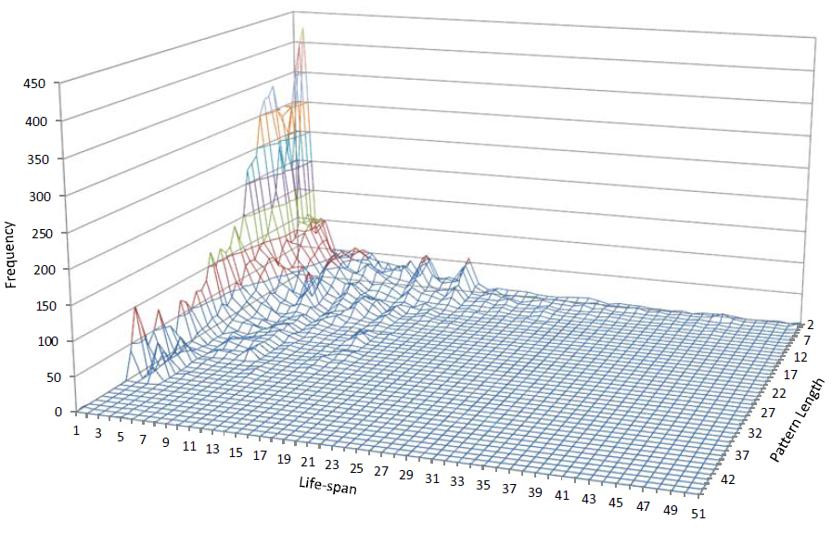
Life-span and Pattern Length dnsjava (Figure 6)
Coding patterns includes a large number of elements
survive only a short period
Coding patterns with short life-span include a small number of elements
Coding patterns with long life-span have short pattern length
No Patterns

Slide 29
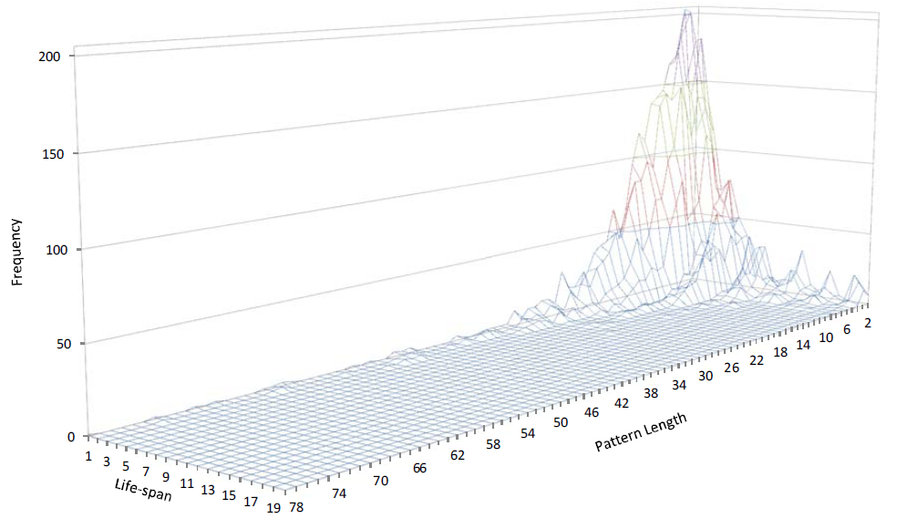
Life-span and Pattern Length
JmDNS (Figure 7)
A lot of patterns with short life-span include a small number of elements
Coding patterns with long life-span have short pattern length
Coding patterns includes a large number of elements
survive only a short period
No Patterns

Slide 30

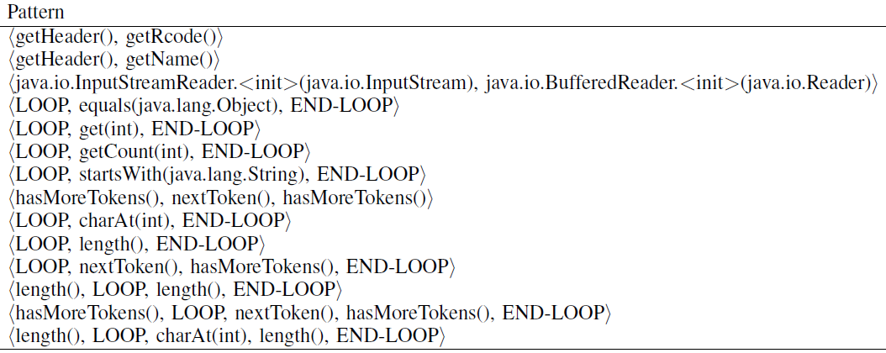
Stable Patterns in dnsjava

Slide 31
Stable Pattern in dnsjava
Application-specific pattern
<getHeader(), getRcode()> 5 instances in ver. 2.0.1
public SetResponse
addMessage(Message in) {
boolean isAuth = in.getHeader().getFlag(Flags.AA);
Record question = in.getQuestion();
Name qname;
Name curname;
int qtype;
int qclass;
int cred;
int rcode = in.getHeader().getRcode();
boolean haveAnswer = false;
...
}
org.xbill.DNS.Cache (ver. 2.0.1)

Slide 32
Stable Pattern in dnsjava
Object generation pattern
<java.io.InputStreamReader.<init>(java.io.InputStream),
java.io.BufferedReader.<init>(java.io.Reader)>
5 instances in ver. 2.0.1
private void
findResolvConf(String file) {
InputStream in = null;
try {
in = new FileInputStream(file);
}
catch (FileNotFoundException e) {
return;
}
InputStreamReader isr = new InputStreamReader(in);
BufferedReader br = new BufferedReader(isr);
...
}
org.xbill.DNS.spi.ResolverConfig (ver. 2.0.1)

Slide 33
Stable Pattern in dnsjava
Iteration related idiom
<hasMoreTokens(), LOOP, nextToken(), hasMoreTokens(), END-LOOP>
6 instances in ver. 2.0.1
protected DNSJavaNameService() {
...
if (nameServers != null) {
StringTokenizer st = new StringTokenizer(nameServers, ",");
String [] servers = new String[st.countTokens()];
int n = 0;
while (st.hasMoreTokens())
servers[n++] = st.nextToken();
try {
Resolver res = new ExtendedResolver(servers);
Lookup.setDefaultResolver(res);
}
catch (UnknownHostException e) {
...
}
}
...
}
org.xbill.DNS.spi.DNSJavaNameService (ver. 2.0.1)

Slide 34

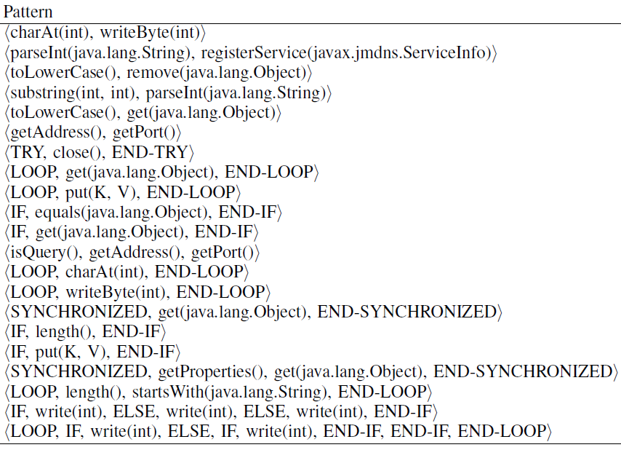
Stable Patterns in JmDNS

Slide 35
Stable Pattern in JmDNS
Multi-thread idiom with synchronized keyword
<SYNCHRONIZED, getProperties(), get(java.lang.Object), END-SYNCHRONIZED>
2 instances in ver.3.4.1
public synchronized String getPropertyString(String name) {
byte data[] = this.getProperties().get(name);
if (data == null) {
return null;
}
if (data == NO_VALUE) {
return "true";
}
return readUTF(data, 0, data.length);
}
javax.jmdns.impl.ServiceInfoImpl (ver. 3.4.1)

Slide 36
Answer the Research Question
RQ
Are the coding patterns generally stable
over the version history?
Answer
No,
The coding patterns are NOT generally stable.
Coding patterns with short life-span account for a large part
Few coding patterns with long life-span

Slide 37
Conclusion
Investigation of the stability of coding patterns across versions
  Method
    Extract coding patterns from versions of code
    Compute life-span
  Target
    dnsjava (51 versions)
    JmDNS (20 versions)
Result
  Coding patterns are not generally stable
    Coding patterns may not be suitable for reuse
Future work
  Further investigation with more applications

