Slide 1
How to extract differences from similar programs? : A cohesion metric approach
○Akira Goto¹, Norihiro Yoshida², Masakazu Ioka¹, Eunjong Choi¹, Katsuro Inoue¹
IWSC2013
¹Osaka University, Japan
²Nara Institute of Science and Technology, Japan

Slide 2

Addressing code clone problem
Remove
Code Clone
Manage
Ignore

Slide 3
Form Template Method
Refactoring pattern based on Template Method pattern [1].
2
Pull Up
Common Part
Class A
Similar Method A
Super Class
Extracted Method A
1
Merged Method
Difference
Extraction
Class B
Similar Method B
Extracted Method B
[1] M. Fowler. Refactoring: Improving the Design of Existing Code.
Addison Wesley, 1999.

Slide 4
Difference Extraction (1/2)
public PlanarImage executeDrawOperation() {
if (!stroke.equals(”transparent”)) {
BasicStroke bStroke = new BasicStroke(stroke_width);
graphics.setColor(ColorMapper.getColorByName(stroke));
graphics.setStroke(bStroke);
graphics.draw(new Arc2D.Double(stroke_width, stroke_width,
width, height, start, stop, type));
}
}
・・・
・・・
public PlanarImage executeDrawOperation() {
if (!stroke.equals(”transparent”)) {
BasicStroke bStroke = new BasicStroke(stroke_width);
graphics.setColor(ColorMapper.getColorByName(stroke));
graphics.setStroke(bStroke);
graphics.draw(new Ellipse2D.Double(0, 0, width, height));
}
}
・・・
・・・

Slide 5
Difference Extraction (2/2)
public void newMethod(Graphics2D graphics) {
graphics.draw(new Arc2D.Double(stroke_width,
stroke_width, width,height, start, stop, type));
}
public PlanarImage executeDrawOperation() {
if (!stroke.equals(”transparent”)) {
BasicStroke bStroke = new BasicStroke(stroke_width);
graphics.setColor(ColorMapper.getColorByName(stroke));
graphics.setStroke(bStroke);
newMethod(graphics);
}
}
・・・
?
・・・
public void newMethod(Graphics2D graphics) {
graphics.draw(new Ellipse2D.Double(0, 0,
width, height));
}
public PlanarImage executeDrawOperation() {
if (!stroke.equals(”transparent”)) {
BasicStroke bStroke = new BasicStroke(stroke_width);
graphics.setColor(ColorMapper.getColorByName(stroke));
graphics.setStroke(bStroke);
newMethod(graphics);
}
}
・・・
・・・

Slide 6
Extraction based on semantics (1/2)
public PlanarImage executeDrawOperation() {
if (!stroke.equals(”transparent”)) {
BasicStroke bStroke = new BasicStroke(stroke_width);
graphics.setColor(ColorMapper.getColorByName(stroke));
graphics.setStroke(bStroke);
graphics.draw(new Arc2D.Double(stroke_width, stroke_width,
width, height, start, stop, type));
}
}
・・・
・・・
Semantic Difference
public PlanarImage executeDrawOperation() {
if (!stroke.equals(”transparent”)) {
BasicStroke bStroke = new BasicStroke(stroke_width);
graphics.setColor(ColorMapper.getColorByName(stroke));
graphics.setStroke(bStroke);
graphics.draw(new Ellipse2D.Double(0, 0, width, height));
}
}
・・・
・・・

Slide 7

Extraction based on semantics (2/2)
public void drawOutline(Graphics2D graphics) {
BasicStroke bStroke = new BasicStroke(stroke_width);
graphics.setColor(ColorMapper.getColorByName(stroke));
graphics.setStroke(bStroke);
graphics.draw(new Arc2D.Double(stroke_width, stroke_width,
width, height, start, stop, type));
}
public PlanarImage executeDrawOperation() {
if (!stroke.equals(”transparent”)) {
drawOutline(graphics);
}
}
・・・
The extracted methods have a single functionality
・・・
public void drawOutline(Graphics2D graphics) {
BasicStroke bStroke = new BasicStroke(stroke_width);
graphics.setColor(ColorMapper.getColorByName(stroke));
graphics.setStroke(bStroke);
graphics.draw(new Ellipse2D.Double(0, 0, width, height));
}
public PlanarImage executeDrawOperation() {
if (!stroke.equals(”transparent”)) {
drawOutline(graphics);
}
}
・・・
・・・

Slide 8

Research Goal
Suggest semantic differences for merging similar methods to developers

Slide 9
Overview of Proposed Approach
Propose the concept of EM candidate
It means Extract Method candidate for merging similar methods
Detect all of EM candidates and rank them by slice-based cohesion metrics

Slide 10
EM candidate
Set of code fragments satisfies the following conditions.
Cond. 1
All of code fragments satisfy preconditions for extract method.
Cond. 2
Any two code fragments are not overlapped each other.
Cond. 3
For all differences, the code fragment exists that include it.
Cond. 4
After each code fragment is extracted, the similar methods are syntactically identical.

Slide 11
Examples of EM candidate
public PlanarImage executeDrawOperation() {
if (!stroke.equals(”transparent”)) {
BasicStroke bStroke = new BasicStroke(stroke_width);
graphics.setColor(ColorMapper.getColorByName(stroke));
graphics.setStroke(bStroke);
graphics.draw(new Arc2D.Double(stroke_width, stroke_width,
width, height, start, stop, type));
}
}
・・・
EM candidates can be extacted for merging similar methods
・・・
public PlanarImage executeDrawOperation() {
if (!stroke.equals(”transparent”)) {
BasicStroke bStroke = new BasicStroke(stroke_width);
graphics.setColor(ColorMapper.getColorByName(stroke));
graphics.setStroke(bStroke);
graphics.draw(new Ellipse2D.Double(0, 0, width, height));
}
}
・・・
・・・

Slide 12
Steps of Proposed Approach
Step1
Input : Similar methods
ASTs of the similar methods
Step2
1
Step3
Step4
2
Syntactic differences
3
EM candidates
Output :
Ranking of EM candidates

Slide 13
Step 1 : Generate ASTs
Step1
Input : Similar methods
ASTs of the similar methods
Step2
Generate ASTs of given similar methods using Eclipse JDT
1
Step3
Step4
2
Syntactic differences
3
EM candidates
Output :
Ranking of EM candidates

Slide 14
Step 2 : Comparing ASTs
Step1
Input : Similar methods
ASTs of the similar methods
Step2
1
Step3
Step4
Identify syntactic differences based on ASTs comparison
2
Syntactic differences
3
EM candidates
Output :
Ranking of EM candidates

Slide 15
Step2 : Comparing ASTs
Compare nodes depth-first order from root node
Find nearest parent node represents a statement
Different nodes
Different subtrees corresponds different statements

Slide 16
Step 3 : Detecting EM Candidates
Step1
Input : Similar methods
Detect EM candidates using ASTs
ASTs of the similar methods
Step2
1
Step3
Step4
2
Syntactic differences
3
EM candidates
Output :
Ranking of EM candidates

Slide 17
Step 3 : Detecting EM Candidates
Step 3-1 : Expand area of EM candidate
Step 3-2 : Check preconditions for Extract Method
Step 3-2 : Checking Preconditions
Step 3-1: Expansion
public void similarMethodA(){
finalBuffer.position(0);
transform(finalBuffer);
finalBuffer.position(0);
}
finalBuffer.putLong(length << 3);
finalBuffer.position(0);
transform(finalBuffer);
}
public void similarMethodB(){
finalBuffer.position(0);
transform(finalBuffer.array(),0);
finalBuffer.position(0);
}
finalBuffer.putLong(length << 3);
finalBuffer.position(0);
transform(finalBuffer.array(),0);
}
・・・
・・・
・・・
・・・

Slide 18
Step 4 : Ranking EM Candidates
Step1
Rank EM candidates based on slice-based cohesion metrics
Input : Similar methods
ASTs of the similar methods
Step2
1
Step3
Step4
2
Syntactic differences
3
EM candidates
Output :
Ranking of EM candidates

Slide 19
Slice-Based Cohesion Metrics (1/2)
Slice-based cohesion metrics [2].
Tightness, Coverage, Overlap
We modify these metrics for a method that has no output variable.
Argument variables can be slicing criteria.
FTightness, FCoverage, FOverlap
[2] Weiser: Program slicing, Proc. of ICSE1981

Slide 20
Slice-Based Cohesion Metrics (2/2)
Forward slices based on argument variables a and b
Intersection of all of the slices
SLa
SLb
SLresult
SLint
1
2
3
4
5
6
7
8
9
int permutation(int a, int b) {
int i;
int result = 1;
for (i = 0; i < b; i++) {
result = result * a;
a = a – 1;
}
return result;
}
|
|
|
|
|
|
|
|
|
|
|
|
|
|
|
|
FTightness = 0.500
FCoverage = 0.722
Backward slice based on output variable result
FOverlap = 0.750

Slide 21
Step 4 : Ranking EM Candidates
EM candidates are ranked in descending order of each metric.
3 rankings are generated by each metric
FTightness
FCoverage
FOverlap
1
2
3
・
・
・
・
・
・
・
・
・
・
・
・

Slide 22
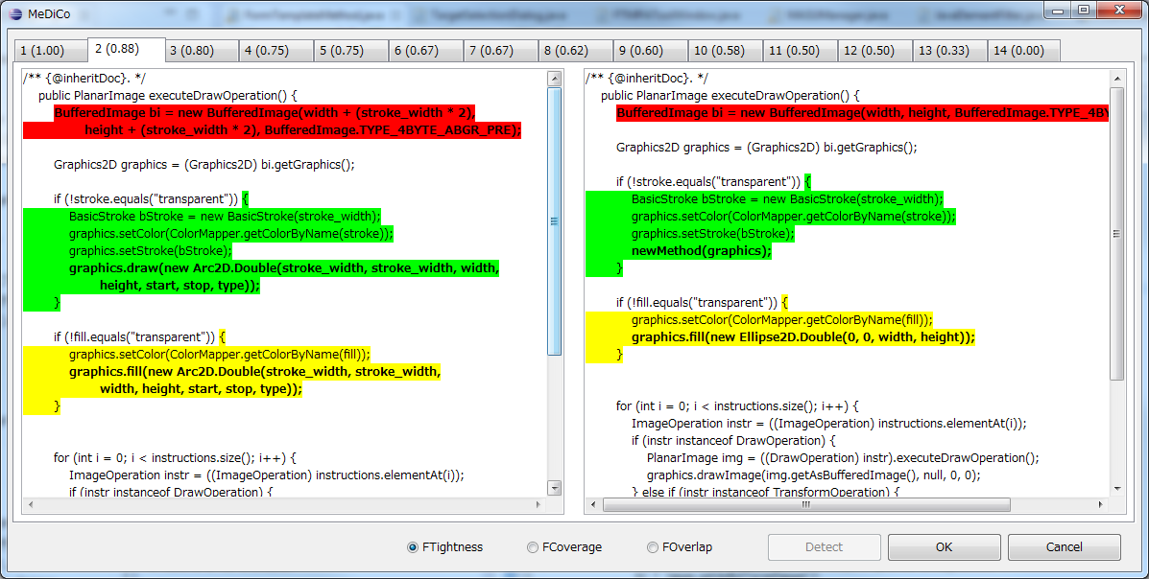
Proposed Tool : MeDiCo

Slide 23

Case Study
We perform refacotring using EM candidates ranked top 10 in cohesion based ranking
Target Similar Methods
FTightness
FCoverage
FOverlap
Apply
1
MeDiCo
2
・
・
・
・
・
・
・
・
・
・
・
・
Output
10
・
・
・
・
・
・
・
・
・
・
・
・

Slide 24
Target Similar Methods
Software : Apache Ant 1.7.0
Package : org.apache.tools.ant.types.optional.image
Class : Arc and Ellipse
Method : executeDrawOperation
Behavior preservation is confirmed by JUnit test suites in the Apache Ant.
Number of test cases : 1479

Slide 25
Evolution of Cohesion Metrics (1/2)
Calculate the slice-based cohesion metrics before and after refactoring.
Calculate increase rate of silice based metrics
Merged method
Target Similar Methods
Extracted differences

Slide 26
Evolution of Cohesion Metrics (2/2)
Increase rate of cohesion metrics
Both FTightness and FCoverage are always increased after refactoring.
FOverlap metric is unchanged from 1.0.
 |  | Increase rate of
 |  | FTightness |  |  | FCoverage |  |  | FOverlap
 |  | ave | max | min | ave | max | min | ave | max | min
Ranked by | FTightness | 22% | 54% | 5% | 22% | 54% | 5% | 0% | 0% | 0%
 | FCoverage | 17% | 25% | 5% | 17% | 25% | 5% | 0% | 0% | 0%
 | FOverlap | 22% | 54% | 5% | 22% | 54% | 5% | 0% | 0% | 0%

Slide 27
Conclusion & Future Work
Conclusion
Propose the approach to support merging similar methods using slice-based cohesion metrics.
Confirm the usefulness of the FTightness and FOverlap metrics in the case study.
Future work
Conduct larger case studies and ask developers to evaluate detected EM candidates by our approach

