Slide 1
Towards Generating Templates of Method Body Based on Method Name and Related Identifiers
Yuya Onizuka, Yasuhiro Hayase, Tetsuo Yamamoto, Yuki Kashiwabara, Takashi Ishio, Katsuro Inoue
Notes:
Thank you chairparson.
Today, I’d like to talk about タイトル.

Slide 2
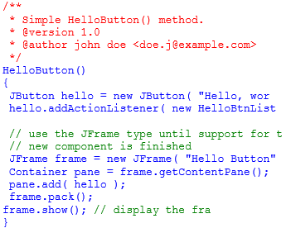
Problem
It is difficult to select appropriate APIs from software libraries
java.applet
java.awt
java.beans
java.io
java.lang
java.math
java.net
java.nio
java.rmi
java.security
java.sql
java.text
java.util
javax.crypto
javax.imageio
javax.jws
javax.naming
javax.rmi
javax.script
javax.sql
javax.swing
javax.tools
javax.xml
org.ietf.jgss
org.omg.CORBA
org.omg.Dynamic
org.omg.IOP
org.omg.Messaging
org.w3c.dom
Savepoint
SQLData
SQLInput
SQLOutput
Statement
Struct
Date
DriverManager
DriverPropertyInfo
SQLPermission
Time
public class DAO {
Connection conn;
public int update() {
_________________
_________________
_________________
_________________
}
}
Array
Blob
CallableStatement
Clob
Connection
DatabaseMetaData
Driver
?
APIs
Sample Code
Manual
Notes:
* Problem
In modern software development, developers have to use APIs of software libraries to create program.
However it is difficult to select appropriate APIs from a lot of APIs.
It takes a long time to read API reference manual or sample code to learn appropriate APIs.

Slide 3
Our approach
Suggests templates of method body to developers who decide the method name
Selected template is inserted in source code
Developers save time to learn appropriate APIs
public class DAO {
Connection conn;
public int update() {
}
}
createStatement()
executeUpdate()
close()
Notes:
Our approach
We thought that same context source code is written similar method body.
Now, we propose to suggests templates of method body to developers who decide the method name.
Suggested template is a set of APIs.
Selected template is inserted into source code, so developers can save time to learn appropriate APIs.

Slide 4
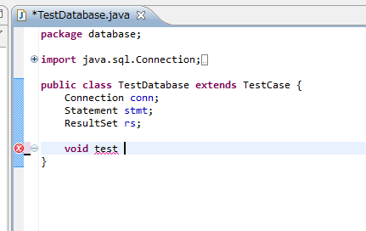
Screenshots
Developer writes method name.
A list of method body templates is shown by calling code completion.
Notes:
Our tool works in Eclipse IDE.
A developer writes method name.
Then the developer can show a list of method body templates by calling code completion.

Slide 5
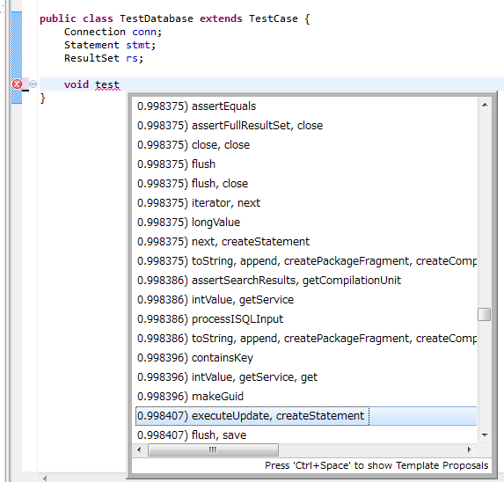
Screenshots
Developer selects templates on popup by typing cursor key.
The selected template is inserted by typing enter key
Notes:
The developer selects templates on popup by typing cursor key.
The developer can insert the selected template by typing enter key.

Slide 6
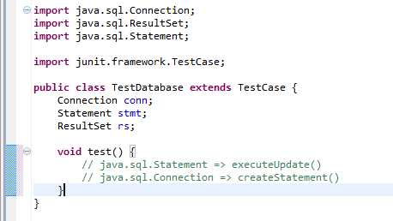
Screenshots
Selected template is inserted into source code
Developer writes the method body
by editing the template.
Notes:
The template is a few single line comments.
One single line comment suggests one method.
Single line comments are in random order.
The developer writes the method body by editing the template.

Slide 7
The implementation of our tool
The tool consists of two steps
Learning knowledge by source files
code completion using association rules
Step 1 is performed once in advance of Step 2
Step 1
Step 2
Association
rule learning
Identifiers related
to method body
Association rule DB
Source files
Templates of method body
Use identifiers related
to method body
Templates are created from rules matched source code
Notes:
* An overview of the implementation of our approach
This figure shows an overview of the tool of our approach.
The tool consists of two steps, step 1 and step 2.
Step 1 is performed once in advance of Step 2.
Step 1 is learning knowledge by source files.
This step extracts identifiers related to method body from a large set of source files.
Association rules from the identifiers to methods called in method body are extracted.
Step 2 is code completion using association rules.
This step collects identifiers related to method body from a source code edited by a developer.
After that, templates are created from rules matched the identifiers.

Slide 8
Current Status and Future Work
Current Status
Created the prototype
Future Work
Experiment
Compare generated templates of method body with original source code
questionnaire about the tool
Provide different type of data
the appropriate order of API usage
Notes:
* Future Work
Currently, we created the prototype of our tool.
This prototype hasn’t been tuned up yet.
We are planning two evaluation experiments.
One experiment evaluates the usefulness of suggested templates.
In the experiment, We compare generated templates of method body with original source code.
The other experiment asks subjective opinions.
Some Developers work on the tasks and answer questionnaire about the tool.
We are also planning to provide different type of data, for example the appropriate order of API usage.

