Slide 1

On the Effectiveness of Accuracy of Automated Feature Location Technique
Takashi Ishio Shinpei Hayashi
Hiroshi Kazato Tsuyoshi Oshima
Tokyo Institute of Technology
NTT DATA INTELLILINK Corp.
NTT Software Innovation Center

Slide 2
Feature Location
A first step of software maintenance
Which modules/functions/methods implement a feature?
How they interact?
Feature location process (for a Java program) [Wang, 2011]
A feature description ➔ A list of relevant methods
Search keywords to find seed methods
Explore the seed methods and their neighbors

Slide 3
Limited Accuracy
Industrial developers would like to locate a feature completely.
To make a plan for their maintenance task.
How to change, review and test the code
Manual feature location is not so precise.
It is required only when no one knows the complete implementation of a feature.
In [Wang, 2011], both precision and recall are at most 75%.

Slide 4




Automated Feature Location Techniques
Information retrieval (IR) is a popular approach.
Latent Semantic Indexing [Marcus, 2004]
+ Dynamic Analysis [Poshyvanyk, 2007]
+ Static Analysis [Eaddy, 2008]
Feaure Description
jEdit full-screen mode …
Search Result
JEditBuffer.setMode(String)
View.toggleFullScreen()
ViewOptionPane._init()
View.propertiesChanged()
…
Automated Feature
Location Tool
Developer
ViewOptionPane._save()

Slide 5

Can developers validate a result?
Manual validation problem in traceability area
[Cuddeback, 2010], [Kong, 2011], [Dekhtyar, 2012]
Analysts validated links between requirements and system tests.
REQ. | TEST1 | TEST2 | TEST3 | …
Req1 | X
Req2 |  |  | X
Req3 | X
Req4 | X
…
REQ. | TEST1 | TEST2 | TEST3 | …
Req1 | X
Req2 | X |  | X
Req3 |  | X
Req4 |  | X | X
…

Slide 6
Traceability Researchers’ Observations
High
REQ. | T1 | T2 | T3 | …
R1 | X |  | X
R2 | X | X
R3 |  | X | X
R4 | X | X | X
…
REQ. | T1 | T2 | T3 | …
R1 | X |  | X
R2 | X
R3
R4 |  | X | X
…
Remove invalid links
(and some true links)
REQ. | T1 | T2 | T3 | …
R1 | X
R2 | X
R3 |  | X
R4 |  | X | X
…
Accuracy decreased!
Recall
Identify missing links
(and some invalid links)
Significantly
improved
REQ. | T1 | T2 | T3 | …
R1 | X
R2 |  |  | X
R3 | X
R4 | X
…
REQ. | T1 | T2 | T3 | …
R1 | X |  | X
R2
R3
R4 |  | X
…
Low
Low
Precision
High

Slide 7
Our Experiment
Can developers locate a feature using a result of an automated feature location tool?
We asked subjects to locate a feature using a list of methods.
The accuracy of the lists is artificially controlled.
We measured precision, recall and F-measure.

Slide 8
Subjects and Dataset
20 subjects in three organizations
8 students in Osaka University,
8 students in Tokyo Institute of Technology,
4 developers in R&D Division of NTT
Java experience: 2—16 years
Dataset
Features and goldsets in Dit’s Benchmarks [Dit, 2013]
We have added feature descriptions.
Feature requests in the dataset do not explain the added features.

Slide 9
Tasks
Feature | Goldset | Accurate (Better) List |  |  | Less Accurate (Worse) List
 | #meth | #Gold | Prec. | Recall | #Gold | Prec. | Recall
muCommander 1 | 32 | 10 | 1.00 | 0.31 | 8 | 0.80 | 0.25
muCommander 2 | 6 | 6 | 0.60 | 1.00 | 3 | 0.30 | 0.50
jEdit 1 | 13 | 10 | 1.00 | 0.77 | 4 | 0.40 | 0.31
jEdit 2 | 6 | 6 | 0.60 | 1.00 | 3 | 0.30 | 0.50
jEdit 3 | 10 | 10 | 1.00 | 1.00
A pair of an accurate list and a less accurate list
Each list includes 10 methods, selected using LSI [Gethers, 2012].
Larger features have high precision, smaller ones have high recall.
A subject uses two accurate lists, two less-accurate lists.
30 minutes for each feature

Slide 10
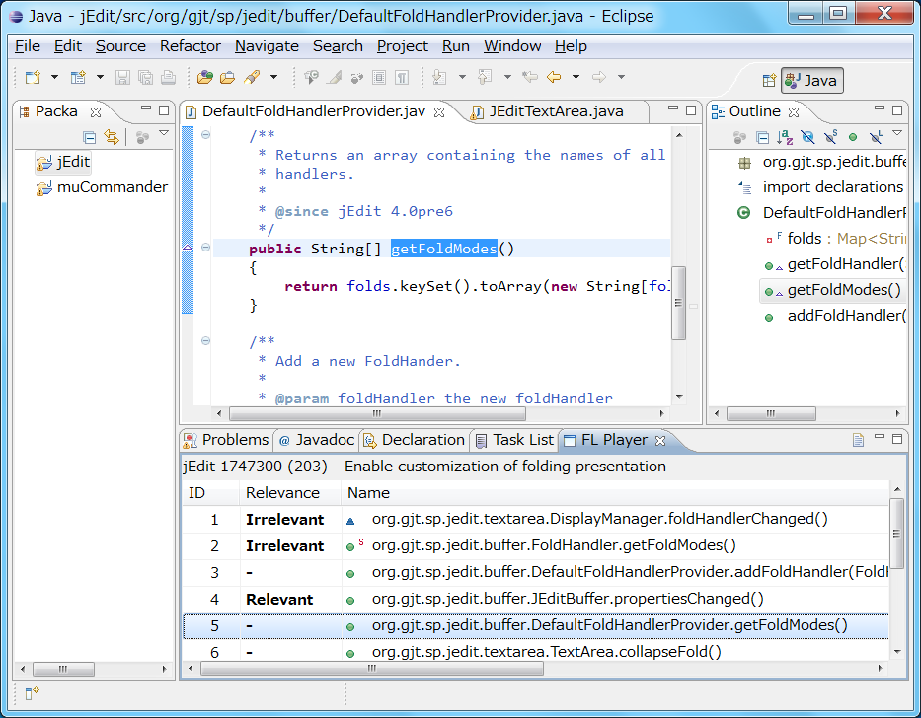
Environment
Eclipse enhanced with FL-Player plug-in
Double-clicking opens a method declaration.
A subject chooses either relevant or irrelevant.

Slide 11
Research Questions
RQ1. Do better initial precision and recall engender better performance in feature location by developers?
RQ2. Which option is more important: initial precision or recall?
RQ3. How do developers spend time to validate a list of methods?
RQ4. How does a validated list differ from its initial list?

Slide 12
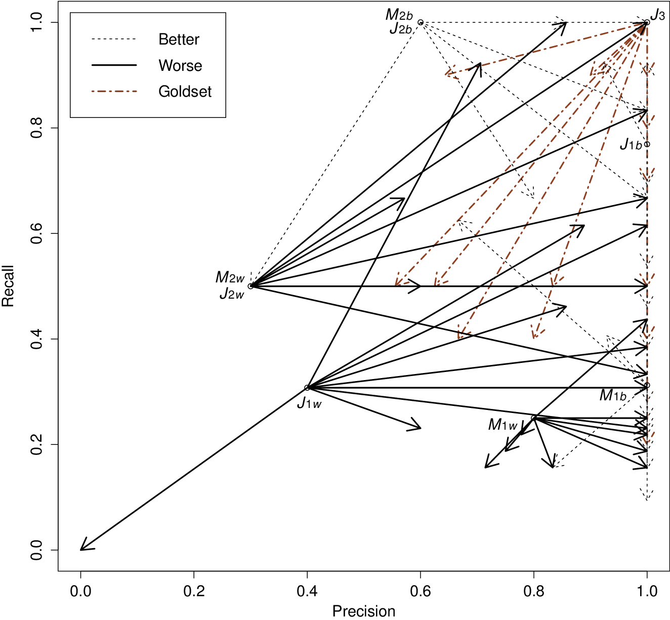
Result
Initial precision/recall
→feature location result

Slide 13
Result
Subjects improved
precision by removing
false positives.
Subjects tend to
decrease recall.

Slide 14
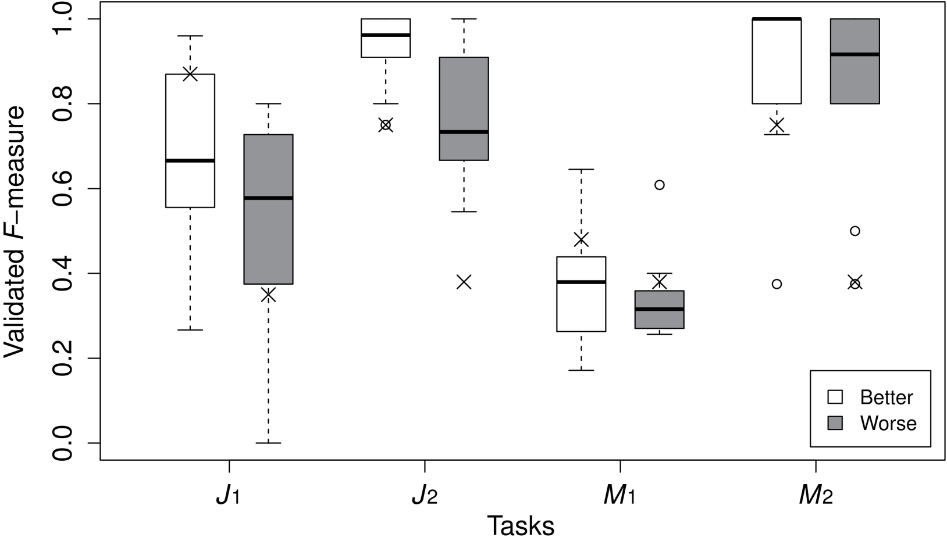
RQ1. Do better initial precision and recall engender better performance in feature location by developers?
Yes. Subjects given an accurate list performed better than subjects given a less accurate list.
An accurate feature location technique would be effective.
Paired t-tests rejected the null hypothesis. (p=0.0089)

Slide 15
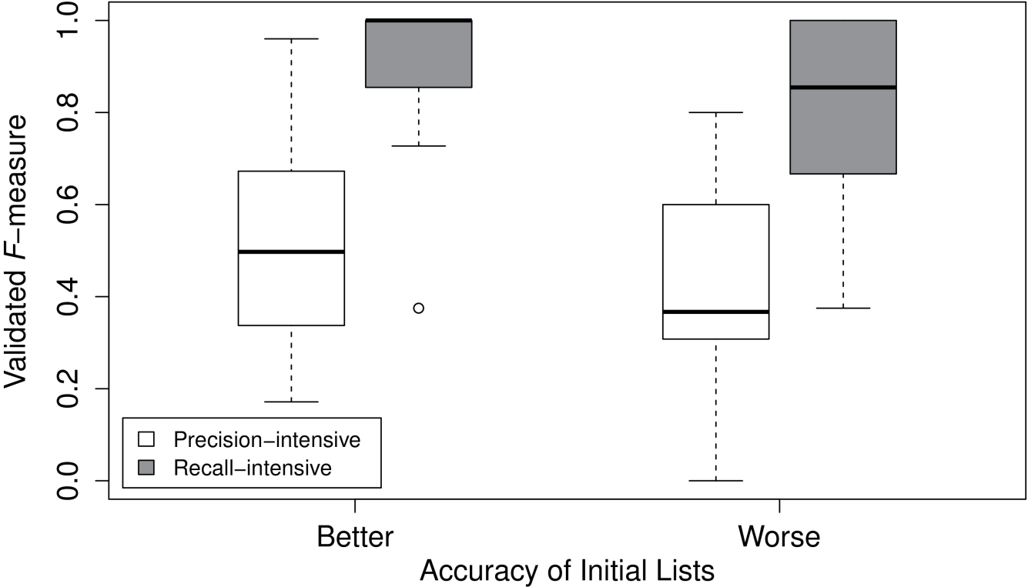
RQ2. Which is important: initial precision or recall?
Recall. Subjects given a high-recall list performed better than subjects given a high-precision list.
False positives are easier to identify than false negatives.
Wilcoxon signed rank test rejected the null hypothesis. (p<10⁻⁶)

Slide 16
Observations
Subjects took 20 minutes for each task.
No significant differences among subjects/tasks
Subject located a complete implementation in 17 of 100 tasks.
Much better than a manual feature location experiment [Wang, 2011].
Subjects tend to remove certain methods from lists.
An example is shown in the next slide.

Slide 17
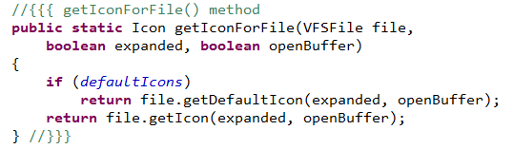


Example: jEdit’s default icons
A feature enables to choose either system icons or default icons used in a window. (Only system icons were available before the feature was introduced.)
13 of 20 subjects excluded getDefaultIcon from the list.
Because the code exists before the feature was introduced.
The benchmark regarded the method as a part of a feature, because the method was also affected by the feature.
Default Icons
System Icons

Slide 18
Threats to Validity
We have created method lists artificially.
The methods in the lists are picked up from a result of LSI, but they are not actual output of a tool.
Each list included only 10 methods.
To conduct the experiment in the limited time.
“Top-10” is a typical usage of a search tool.
Industrial developers might use a longer list.

Slide 19
Concluding Remarks
A controlled experiment of feature location tasks
Accurate feature location would be effective.
Recall is more important than precision.
Many subjects removed some relevant methods from lists.
A clearer feature description or some additional support may be important to avoid the problem.
Our next work is to analyze how feature descriptions affect feature location tasks.
Our dataset is online. http://sel.ist.osaka-u.ac.jp/FL/
It has been derived from Dit’s and Gethers’ dataset.
Feature descriptions, tasks and an Eclipse plug-in.

Slide 21
APPENDIX

Slide 22
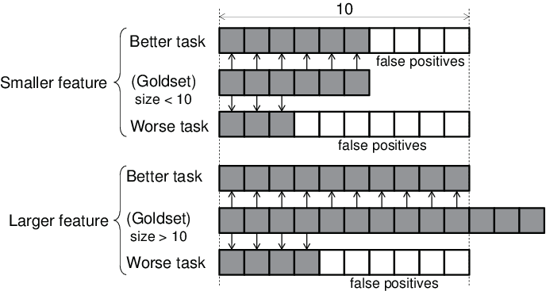
Artificially created lists
We first determined the number of relevant methods to be included in the list.

Slide 23
Curation of Goldset
Some list of goldset methods included non-existent methods.
It existed at the modified time, but removed until the release.
We manually removed such methods from the goldset.

Slide 24
Feature Description Refinement
Some long description in the original dataset does not explain the feature itself.
A fullscreen mode for jEdit would be very nice. Especially on netbooks with limited screen-size it is useful, to get rid of the titlebar and window-borders.

Slide 25
Additional Feature Description
Two paragraphs explain the basic behavior and the behavior of the feature.
The editor window of jEdit has a menu bar, a tool bar, and borders.
The new feature enlarges an editor window to full screen and hides its menu bar, a tool bar, and borders when the F11 key is pushed. Pushing the F11 key again in full screen mode transforms the window to a regular window mode. The General Options dialog allows users to enable menu, tool, and status bars in full screen mode.

