Slide 1
Analyzing the relationship between the license of packages and their files in Free and Open Source Software
Yuki Manabe*, Daniel M. German†,‡ and Katsuro Inoue†
*Kumamoto University, Japan
†Osaka University, Japan
‡University of Victoria, Canada
Notes:
<script>
I’ll be talking about “Analyzing the relationship between the license of packages and their files in Free and Open Source Software”.

Slide 2
Overview
Goal: discovering the relationship between the license of a source package, and the license of the files contained in the package
Extracting relations between license of package and license of the source files from packages in Fedora Core 19
Define Inclusion relation and license inclusion graph
Show license inclusion graph from source packages in Fedora Core 19
Notes:
<script>
In this study, To discover the relationship between the license of a source package, and the license of the files contained in the package, we extract relations between license of package and license of the source files from packages in Fedora Core 19.
To achieve this, we define Inclusion relation and license inclusion graph, and then show license inclusion graph from source packages in Fedora Core 19.
To start with I’ll provide background information.

Slide 3
Reuse
Libraries
Product
Linking
Compilation
Linking
Copied files
from other
projects
Original source files
reuse
by copy
Libraries
Project Hosting Site(GitHub etc.)
Notes:
<script>
One way to reduce software development cost is reuse. Reuse is utilizing a part or whole of existing software. We can reuse Libraries as blackbox-reuse, and source files which is a part of Library as white-box reuse via Project Hosting site such as GitHub.

Slide 4
Software License
Software License: Permissions of use, and requirements and conditions to get such Permission
Libraries
Product
Linking
License B
Compilation
Linking
Copied files
from other
projects
License C
Original source files
reuse
by copy
Libraries
License D
License A
License D
Notes:
<script>
However we can’t simply reuse libraries and source files which the other developed. To use them, we have to understand and follow each software License. Software license is a Permissions of use, and requirements and conditions to get such Permission.

Slide 5
Open Source Software License
software license which meets the definition of OSS.
and approved by Open Source Initiative
69 licenses
(Ex) Gnu General Public License version3(GPLv3), BSD 2-clauses License(BSD2)
Blackduck claims that the Black Duck Knowledge Base includes data related to over 2200 licenses
Some licenses have a variation
GPLv2, GPLv3, GPLv2+(v2 or later)
BSD 2, BSD3, BSD4
Notes:
<script>
Especially, Many open source software are distributed under open source software license.
Open source software license is a software license which meet the definition of OSS and approved by Open Source Initiative.
Now, 69 licenses are approved license as Open source license such as Gnu General Public License version3 and BSD-2clause License.
Note that Blackduck claims that the Black Duck Knowledge Base includes data related to over 2200 licenses.
In addition, Some of them have a variation. In this presentation “+” means “or later”.
For example, GPLv2+ can be regard as GPLv3.

Slide 6
Motivating Example
Which license for the product is compatible on Licenses A, B, C and D?
Libraries
Product
Linking
License B
Compilation
Linking
Copied files
from other
projects
License C
Original source files
reuse
by copy
Libraries
License D
License A
License D
Notes:
<script>
Let me refresh your memory on reuse. We consider to use these library and source files. Each component is under License A, B, C and D. Which license we should choice as a license of the product? In other word, Which license for the product is compatible on Licenses A, B, C and D? This is a motivation in this research. This is not easy.

Slide 7
Relationship between licenses
It is difficult for developer to choose a license from many licenses correctly
Many terms (#terms BSD2:2, Apachev2:9 GPLv3:17…)
Legal document
Developers need guideline of which licenses are compatible a license
Notes:
<script>
The reason is that relationships between licenses are complex. License have many terms and is described as a legal document. So, it is difficult for developer to choice a license from many licenses correctly.
Therefore, Developers need guideline which licenses are compatible a license.

Slide 8
Relationship between licenses
Some authors of licenses provide guidelines that try to clarify this
(Ex)The free software foundation shows relationship between the General Public License and other licenses[2].
Lack of empirical evidence
Developers can’t create other guideline for other license
Need for empirical evidence to create other guideline
[2]Free Software Foundation: Various license and comments about them
Notes:
<script>
As a related work, Some authors of licenses provide guidelines that try to clarify this. For example, The free software foundation shows relationship between the General Public License and other licenses. However, we don’t know empirical evidence. So, we need for empirical evidence to assist license choice by Developer.

Slide 9
Approach
Goal: To assist developers, license compliance officers, and lawyers in understanding how licenses are actually used.
Investigating how different software licenses are reused as white-box components in the software packages in Fedora
Define inclusion relation and proposed license inclusion graph
Show a license inclusion graph from source packages in Fedora Core 19
Notes:
<script>
To assist developers, license compliance officers and lawyers in understanding how licenses are actually used, we Investigate how different software licenses are reused as white-box components in the software packages in Fedora. To achieve this goal, we define inclusion relation and Proposed license inclusion graph and show a license inclusion graph from source packages in Fedora Core 19.

Slide 10
Definition of Inclusion Relation
A file under a license A is included in software that is licensed under license B
⇒ Inclusion of license A into license B
（Ex）A file of MIT/X11 license is included in packages under GPLv2
⇒Inclusion of license MIT/X11 into license GPLv2
GPLv2
MIT/X11
Source File
package
Notes:
<script>
We call a relation where a file under a license A is included in software that is licensed under license B as the inclusion of license A into license B.
For example, Such as this figure, a file under the MIT/X11 license is included in packages under GPLv2, The inclusion of license MIT/X11 into license GPLv2.

Slide 11
License Inclusion Graph
Edge: From declared license in a file to declared license in package including the file
Node: License name
Ex) Inclusion of license MIT/X11 into license GPLv2
MIT/X11
GPLv2
MIT/X11
GPLv2
Source File
package
Notes:
<script>
We represent this relation as graph. We call this graph license inclusion graph. The node is license name, the edge go from declared license in a file to declared license in package including the file. For example, if there is the inclusion of license MIT/X11 into license GPLv2, we can describe the following graph as license inclusion graph.

Slide 12
License inclusion graph of a package license
Same relations are aggregated to one edge
The number of files in each license is represented
as a label on edge
MIT/X11
MIT/X11
4
GPLv2
GPLv2
BSD2
3
BSD2
package
Source File
Notes:
<script>
In previous slide, we state the case of only one source file.
Usually each package consist of multiple files.
Same relations are aggregated to one edge. The number of files in each license is represented as label on edge.
In this case, when package include 3 files under MIT/X11 and 4 files under BSD2, we describe it as this.

Slide 13
Empirical Study
Research Question: What are the inclusion relationships between licenses of packages and licenses of source code?
Extracting a license relation graph from source packages in Fedora Core 19
Show only subgraphs on famous license
Subject: 2484 source packages
Notes:
<script>
To answer the question “What are the inclusion relationships between licenses of packages and licenses of source code?”, we conduct empirical study. In this empirical study we Extracting a license relation graph from source packages in Fedora Core 19. Especially, show subgraphs on famous license. As a subject, we use 2484 source packages in Fedora Core 19.

Slide 14
Methodology
Spec file
Source file
Source Package
Identifying declared package license from spec file
Identifying source file
License with Ninka
Identifying packages to remove
Creating license inclusion graph
License Inclusion graph
Notes:
<script>
What you see here is the methodology. In this empirical study, we create license inclusion graph from source packages.
First, we extract spec file and source files from each package in subject.
Then, we identify declared license package license from spec file. Second, we identify source file license with Ninka.
After that, we identify packages to remove. Finally, we create license inclusion graph with package license,
Source file license and packages to remove. On next slides, we explain spec file, Ninka and packages to remove.

Slide 15
Spec file
A file where metadata for the package are described
#% define beta_tag rc2
%define patchleveltag .45
%define baseversion 4.2
%bcond_without tests
Version: %{baseversion}%{patchleveltag}
Name: bash
Summary: The GNU Bourne Again shell
Release: 1%{?dist}
Group: System Environment/Shells
License: GPLv3+
Url: http://www.gnu.org/software/bash
Source0: ftp://ftp.gnu.org/gnu/bash/bash-%{baseversion}.tar.gz
# Official upstream patches
Example of spec file (bash)
Declared License Name
…
…
Notes:
<script>
Each source package include at least one spec file.
Spec file show metadata of the package such as version, name, description, license and so on.
To identify declared license, we extract line with “License” as the beginning.

Slide 16
Ninka[9]
Specific License Name(GPLv2 etc.)
or
None
Source File
The header does not include license related sentence
Compare
or
Unknown
Although the header includes license related sentence, Ninka can’t identify license because of lack of knowledge
Knowledge base
The accuracy is 93%
62.2% of packages include at least “UNKNOWN” file in Source Packages in Fedora Core 19.
[9] German, D. M., Manabe, Y., Inoue, K.: A sentence-matching method for Automatic license identification of source code files. In: Proc ASE2010
Notes:
<script>
To identify source file license, we use Ninka.
comparing the header to license knowledge base, Ninka identify license of source file.
Ninka output specific license name, “NONE” or “UNKNOWN”
NONE means The header does not include license related sentence
UNKNOWN means Although the header does not include license related sentence, Ninka can’t identify license because of lack of knowledge. This is not rare. 62.2% of packages include at least “UNKNOWN” file.

Slide 17
Identifying packages to remove
packages with no source file
packages with spec files with different licenses
packages with more than one spec file
packages where more than 50% of source files are “UNKNOWN”
Remove 1000 package
(2484⇒1475 package (#files: 511,308 files))
Notes:
<script>
We identify packages to remove. These package may make relations unclear.
Conditions which we determine the package to remove are the followings.
packages with no source file, packages with spec files with different licenses, packages with more than one spec file
And packages where more than 50% of source files are “UNKNOWN”
As a result, we remove 1000packages.

Slide 18
Methodology
Spec file
Source file
Package
Identifying declared package license from spec file
Identifying source file
License with Ninka
Identifying packages to remove
Creating license inclusion graph
License Inclusion graph
Notes:
<script>
We conduct empirical study along with the methodology.
we will show some interesting result from next slide.

Slide 19
Result (LesserGPLv2+)
Source files are in many licenses
Other variant of GPL, BSD and MIT/X11 are the same tendency
Inconsistency between GPLv2+ or GPLv3+ and LesserGPLv2+
GPLv2 or v3 is more strict than LesserGPLv2+
⇒These files are contained in directories “demo” and “test”
Notes:
<script>
This is the case of LesserGPLv2+.
This graph of left side is license of source file, and the right side is license of package.
Each node have the number of packages and files.
Each edge have the rate in terms of number of files.
We can see from this graph, Source files are in many licenses.
This is appeared in Other variant of GPL, BSD and MIT/X11.
In addition, we see GPLv2+ and GPLv3+ on the left side.
Usually these licenses are inconsistency with LesserGPLv3+ because these licenses are more strict than LesserGPLv2+.
We study files under GPLv2+ and GPLv3+. As a result these files are in “demo” or “test” directories.

Slide 20
Result (Perl, Variants of Apache)
Variants of Apache and perl have a inclusion relation with the same license
⇒Perl or Apache community do not seem to reuse code under other licenses?
Notes:
<script>
Next, we show result on perl, GPLv+ or artistic license and variants of apache.
We can see from these graph, these license have a inclusion relation with the same license.
It seems that Perl or Apache community do not seem to reuse code under other licenses.

Slide 21
Limitation and Threats to Validity
We do not consider how source files were used.
Extracting the relations between packages and unused source files
Ninka may not identify license correctly.
The accuracy is 93% in previous research
Spec files may not be correct.
Previous research[11] shows this data is mostly correct.
In very few cases, spec files were not upgraded when the package was upgraded.
We use only source package in Fedora Core 19.
Plan to analyze other repositories of FOSS
[11]German, D. M. et.al: Understanding and auditing the licensing of open source software Distributions, In: Proc. ICPC2010
Notes:
<script>
On this empirical study, We should consider some limitation and threats to validity.
At first, We do not consider how source files were used.
Extracting the relations between packages and unused source files. However, We believe that This effect is small.
Secondary, Ninka may not identify license correctly. The accuracy is 93% in previous research. So, we believe that
The effect is small. Thirdly, Spec files may not be correct. Previous research[11] shows this data is mostly correct.In very few cases, spec files was not upgraded when the package was upgraded. So, we can trust spec files mostly.
Finally, in this empirical study, We use only source package in Fedora Core 19. To generalize our result, we plan to analyze other repositories of FOSS

Slide 22
Summary
Extract the relationship between the licenses of packages and the licenses of the files composed of in the Fedora Core 19 distribution
Define inclusion relation and license inclusion graph
Files with inconsistency may not be included in the binary
The Apache and Perl community tend to contain files only under the same license
Future Work
Analyze the build-system of packages to determine which files are actually part of the binaries.
Repeat in other collections of FOSS
Notes:
<script>
Let me summarize my talk. we Extract the relationship between the licenses of packages and the licenses of the files are composed of in the Fedora Core 19 distribution. To achieve this, we define inclusion relation and license inclusion graph. As a result Files occur inconsistency may be not included in the binary, The Apache and Perl community tend to contain files only under the same license.
As a future work we Analyze the build system of packages to determine which files are actually part of the binaries and Repeat in other collections of FOSS.

Slide 24
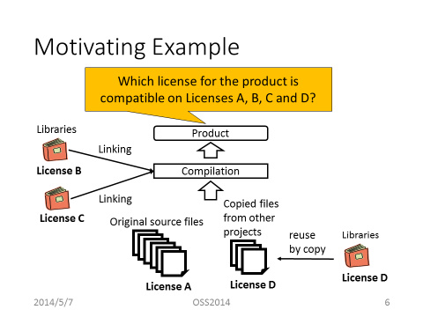
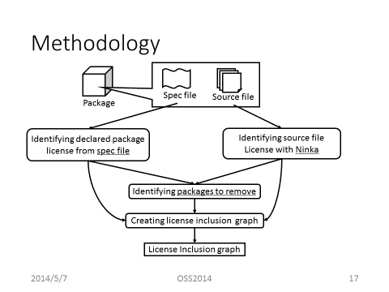
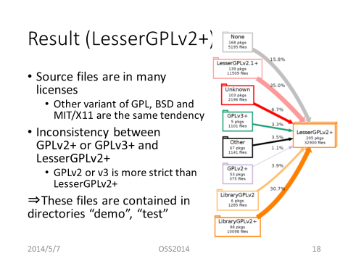
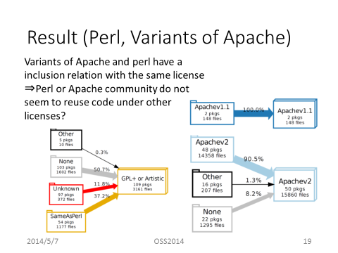

Slide 25
Supplemental Materials

Slide 26
Subject Detail
Package : 2484
Contain at lease one source file: 2013
# files per package: Median 60 files, Ave. 748, maximum 125,400
More than 50% “UNKNOWN”: 328
More than one spec file or spec file with different licenses: 210
Other: 1475

Slide 27
Ninka
Identify license from the header of source file[9]
Compare the header to license knowledge database
The accuracy is 93%
Output specific license name, “NONE” or “UNKNOWN”
NONE: The header does not include license related sentence
UNKNOWN: Although the header includes license related sentence, Ninka can’t identify license because of lack of knowledge
62.2% of packages include at least “UNKNOWN” file.
[9] German, D. M., Manabe, Y., Inoue, K.: A sentence-matching method for Automatic license identification of source code files. In: Proc ASE2010
Notes:
Ninkaは知識データベースを使ってライセンスを特定する．
Ninkaのアウトプットにはライセンス名以外にNONEとUNKNOWNがある
To identify source file license, we use Ninka.
Ninka identify license from the header of source file comparing the header to license knowledge database.
Ninka output Output specific license name, “NONE” or “UNKNOWN”
NONE means The header does not include license related sentence
UNKNOWN means Although the header does not include license related sentence, Ninka can’t identify license because of lack of knowledge. This is not rare. 62.2% of packages include at least “UNKNOWN” file.

Slide 29
Materials…

Slide 40
Result (Variants of GPL)
Variants of GPL have a inclusion relation with many other license
GPLv2
GPLv2+
LesserGPLv2+
GPLv3+
Notes:
GPLのバリエーションを見ると，どれも多様なライセンスのファイルからなっている．

