Slide 1
Identifying Source Code Reuse across Repositories using LCS-based Source Code Similarity
Naohiro Kawamitsu, Takashi Ishio,
Tetsuya Kanda, Raula Gaikovina Kula,
Coen De Roover and Katsuro Inoue

Slide 2
Background: Software Reuse
Developers often reuse existing source code.
  Clone-and-own approach
  Source code reuse reduces cost and enables quick software development.
Reused code may include vulnerability
  Developers have to keep the reused code up-to-date.

Slide 3
Motivation
It is important to keep track of the library version developers copied from.
  To keep files up-to-date
A study shows 18.7% of projects had no records of version of the third-party code.
diff command is often insufficient.
  Many copies are modified for project-specific enhancements.

Slide 4
Proposed method
Automatically extract source code reuse instances
Input
  Source repository: a library
  Destination repository: an application
Output
  Instances of reuse
    Original files and its versions (tags)
Source path | Tags | Destination Path | Commit
png.h | v1.5.7 | libpng/png.h | 58f9e77
pngrio.c | v1.0.52, v1.2.42 | libpng/pngrio.c | 101018d

Slide 5
Key Ideas
Two assumptions to identify reuse
  Timestamp
    A copy is younger than the original.
  Contents of file
    The most similar file revision is the original.
We use pairwise comparison using LCS-based similarity.
  LCS stands for Longest Common Subsequence

Slide 6
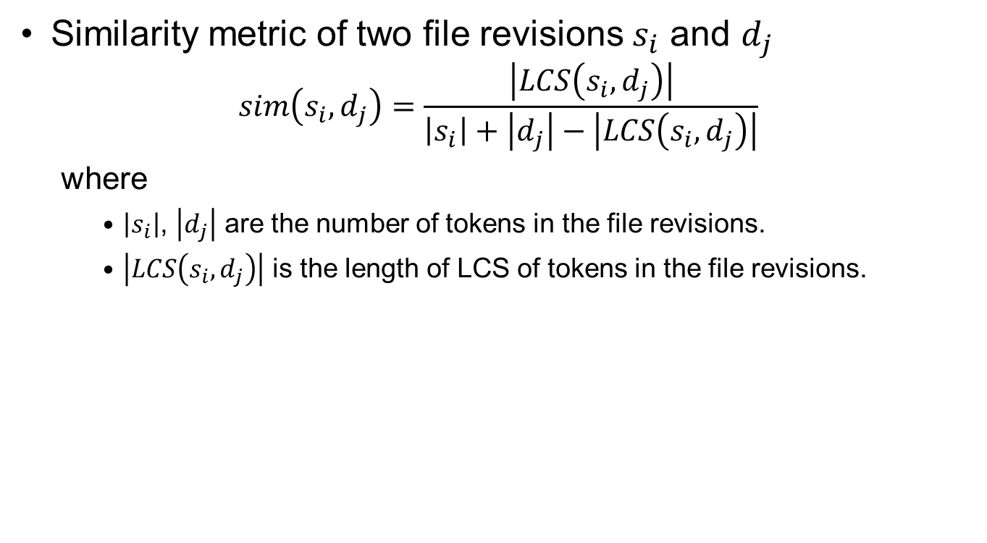
Similarity Metric
Similarity metric of two file revisions $s_{i}$ and $d_{j}$
  $$sim\left(s_{i},d_{j}\right)=\frac{\left|LCS\left(s_{i},d_{j}\right)\right|}{\left|s_{i}\right|+\left|d_{j}\right|−\left|LCS\left(s_{i},d_{j}\right)\right|}$$
  where
    $\left|s_{i}\right|$, $\left|d_{j}\right|$ are the number of tokens in the file revisions.
    $\left|LCS\left(s_{i},d_{j}\right)\right|$ is the length of LCS of tokens in the file revisions.

Slide 7
Why isn’t clone detection used?
The problem is ‘which is the most similar file revision?’.
Clone detection ignores small differences.
  Most revisions are considered as code clones.

Slide 8
Process
Computing pairs of similar file revisions
  To find reuse candidates
Filtering candidates by timestamp
  To remove instances which contradict to provided information
Identifying original revision
  To find which version is origin

Slide 9
1. Computing pairs of similar file revisions
Pair-wise comparison of each revision of each file with each revision of all other files
F
F
F
F
F
Repository A
X
X
X
X
X
G
G
G
Repository B
Y
Y
Y

Slide 10
An example result of step 1
Compute similarity between all pairs of revisions
  A pair of file revisions is considered as similar if similarity is higher than the threshold 0.8
File F
Source
F1
F2
F3
F4
F5
File G
Destination
G1
G2
G3

Slide 11
2. Filtering by timestamp
Extract pairs of revisions whose similarity is higher than the threshold 0.8
File F
Source
F1
F2
F3
F4
F5
: low similarity
: high similarity
File G
Destination
G1
G2
G3

Slide 12
2. Filtering by timestamp
Select the oldest revisions of F and G
File F
Source
F2
F3
F4
F5
: low similarity
: high similarity
File G
Destination
G1
G2
G3

Slide 13
2. Filtering by timestamp
Compare the timestamps of the revisions.
  Assumption: A copy is younger than the original
File F
Source
F2
G1 is younger than F2
identified as reuse
File G
Destination
G1

Slide 14
2. Filtering by timestamp
If the destination revision is older, the file pair is filtered out.
File X
Source
X
File Y
Destination
Y

Slide 15
3. Identifying of the original revision
For each revision of the destination file, identify its original revision.
Heuristic
  The revision of the source file that is the most similar to the destination is the original revision
File F
Source
F1
F2
F3
F4
F5
File G
Destination
G1
G2
G3

Slide 16
3. Identifying of the original revision
For each revision of the destination file, identify its original revision.
Heuristic
  The revision of the source file that is the most similar to the destination is the original revision
File F
Source
F1
F2
F3
F4
F5
:
the most similar
File G
Destination
G1
G2
G3

Slide 17
3. Identifying of the original revision
For each revision of the destination file, identify its original revision.
Heuristic
  The revision of the source file that is the most similar to the destination is the original revision
File F
Source
F1
F2
F3
F4
F5
:
the most similar
File G
Destination
G1
G2
G3

Slide 18
3. Identifying of the original revision
For each revision of the destination file, identify its original revision.
Heuristic
  The revision of the source file that is the most similar to the destination is the original revision
File F
Source
F1
F2
F3
F4
F5
:
the most similar
File G
Destination
G1
G2
G3

Slide 19
3. Identifying of the original revision
Result
  G1’s origin = F2
  G2’s origin = F4
  G3’s origin = F5
File F
Source
F1
F2
F3
F4
F5
File G
Destination
G1
G2
G3

Slide 20
3. Identifying of the original revision
Original revisions are identified into version numbers using tags in the source repository.
  G1’s origin’s version = 1.1
  G2’s origin’s version = 1.3
  G3’s origin’s version = 1.4
tags
1.0
1.1
1.2
1.3
1.4
File F
Source
F1
F2
F3
F4
F5
File G
Destination
G1
G2
G3

Slide 21
Evaluation
We evaluated the effectiveness of our approach.
  Evaluated with precision and recall
We compared reuse instances with version numbers recorded by developers.
Destination | Source
cocos2d-iphone | libpng
apitrace
guliverkli2
fs2open
v8monkey
Haiku-services-branch
Enemy-Territory | libcurl
doom3.gpl

Slide 22
Classes of instances of source code reuse
For evaluation of precision and recall, reported reuse instances are classified into four groups as follows
  Consistent
  Inconsistent
  Redundant
  Unrecorded

Slide 23
Consistent, Inconsistent and Unrecorded
1.2.0
1.3.0
1.3.1
1.4.0
1.5.0
Source
foo.c
recorded by developers
identified reuse instance
unrecorded
consistent
inconsistent
Destination
foo.c
Imported from 1.3.0
updated to 1.4.0

Slide 24
Redundant
Source
foo2.c
1.2.0
1.3.0
redundant
foo.c
Destination
consistent
foo.c
recorded by developers
identified reuse instance
Imported 1.3.0

Slide 25
Results
Precision = 0.901
Estimated recall = 0.943

Slide 26
An example of incorrectly recorded version number
Commit log:
Update to 1.2.31
Not Identical
1.2.31
1.0.38
Identical

Slide 27
Performance
We have employed an optimization to speed up.
  In the worst case, the method compares all file revision pairs.
Destination | Execution Time
cocos2d-iphone | 40min 51sec
apitrace | 55min 6sec
guliverkli2 | 38min 13sec
fs2open | 23min 43sec
v8monkey | 225min 33sec
Haiku-services-branch | 139min 45sec
Enemy-Territory | 5min 26sec
doom3.gpl | 4min 35sec

Slide 28
Conclusion
We proposed a method to extracting reuse instances.
  It is based on LCS-based source code similarity.
The results show that our method is enough accurate.
Our method can notify developers to update their copy of a library.

