Slide 1
Visualizing the Evolution of Systems and their Library Dependencies
VISSOFT2014,
Victoria, Canada
Raula Gaikovina Kula, Coen De Roover, Daniel German, Takashi Ishio and Katsuro Inoue
Osaka University,
Osaka, Japan
Vrije Universiteit Brussel,
Brussels, Belgium
University of Victoria,
Victoria, Canada

Slide 2






Building Systems with 3rd Party Software Libraries
MAVEN JVM Repository

Slide 3
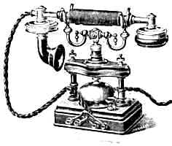
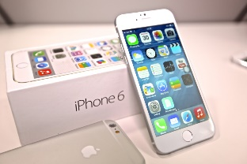

Why understand the evolution of system dependencies?
Software Maintenance
Patched vulnerabilities
New features
Roadblocks:
Newbie to a project
API Breakages
Cannot identify opportunities for upgrade
Current state of library
Documentation, maintenance

Slide 4
Motivation of the work
Lessons from history
Informed decision
Adoption, Diffusion of Innovation, Popularity: ‘Wisdom of the crowd’
We started with statistical plots, later then realized specialized plots are needed
Journey in Visualization
System evolution history
Library evolution history

Slide 5






Systems and Libraries
Library L
$$L_{1}$$
$$L_{2}$$
Library Centric
Depends(S,L)
System Centric
$$S_{1}$$
$$S_{2}$$
$$S_{3}$$
$$S_{4}$$
System S
Adopter
Idler
updater
(upgrader)
downgrader
(upgrader)
TIME

Slide 6
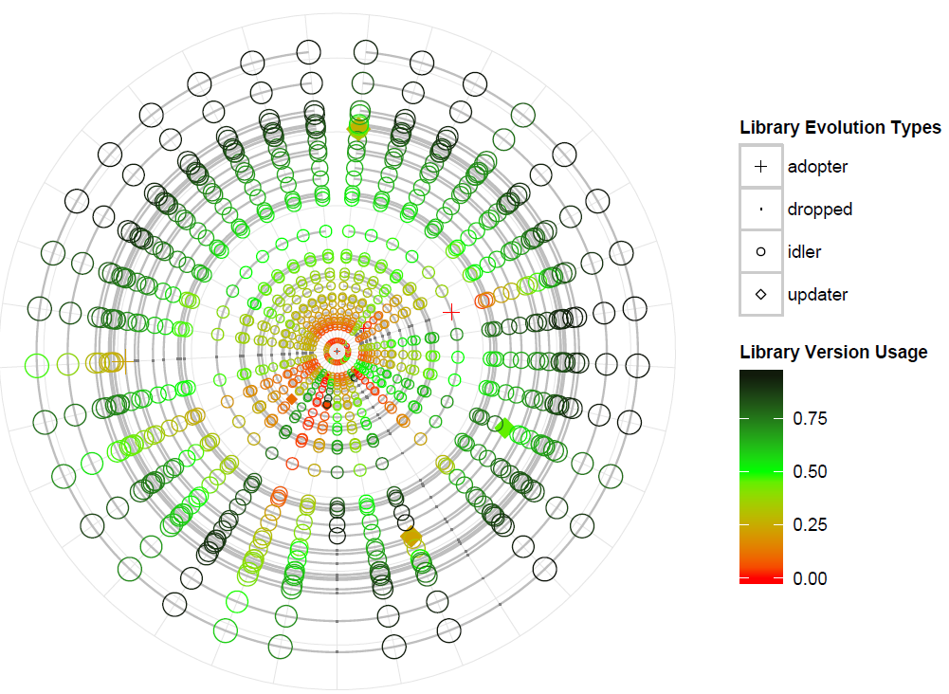

System-centric Dependency Plot (SDP)
Usage is a count of other systems that have also adopted the same library version
Layout/Metaphor Design : Tree Rings
Shape Design: Adopter types
Color/Lines: Version rings
Usage at that point in time
Usage at the current version
$$\frac{{usage}_{vt}}{{usage}_{ct}}$$
Library Version Usage=

Slide 7
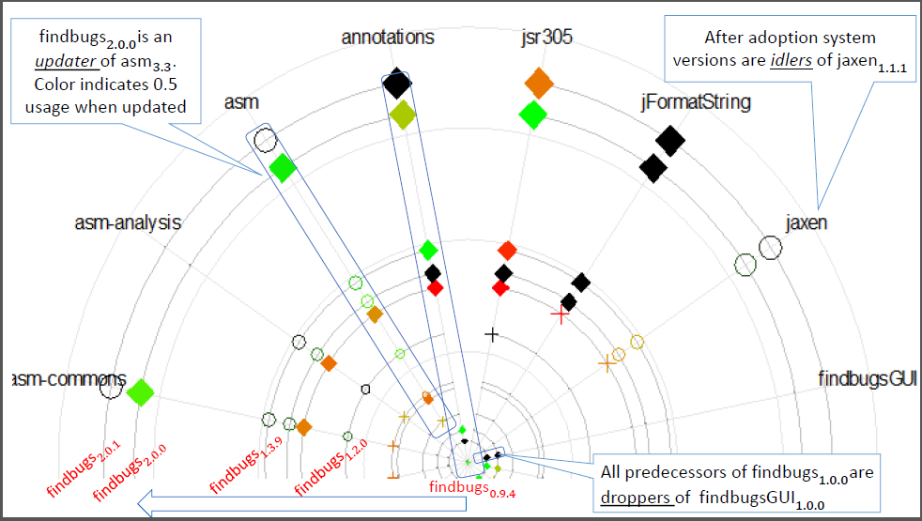
System-centric Dependency Plot (SDP)
Layout/Metaphor Design : Tree Rings
Shape Design: Adopter types
Color/Lines: Version rings

Slide 8
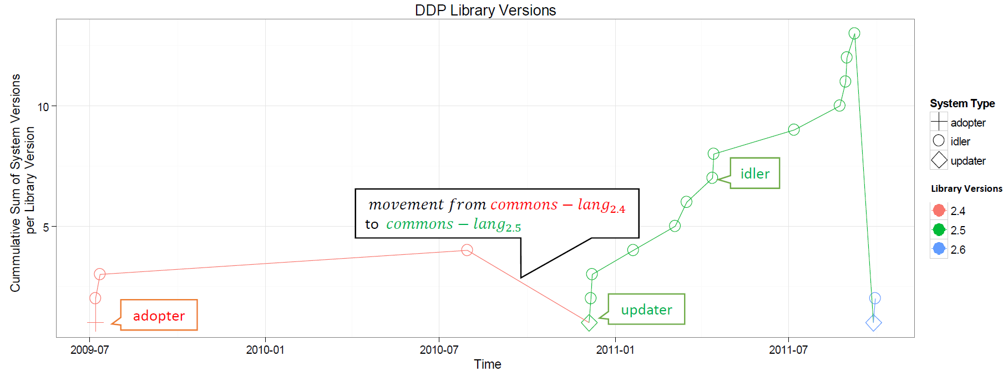
Library-centric Dependency Plot (LDP)
Layout/Metaphor Design: Time-series plot /Growth Curve
Shape Design: Adopter types
Color/Lines: Library Version

Slide 9

Cognitive Walkthrough
Rusty the new systems maintainer
Through real-world examples
Four scenarios
Rusty is a new maintainer to a software project. Rusty notices that some of the system's library dependencies are outdated.
Simply upgrading to the latest versions of all dependencies seems natural, however, Rusty does not know where to start.
How to help Rusty?
We extracted dependency information of systems and libraries
within the Maven Repository (2005-11 to 2013-11)

Slide 10
Scenario Types
To explore intuitive insights from these visualizations
System Centric (SDP)
S1. Regularity of updates
S2. Structural dependency changes
Library Centric (LDP)
S3. Attractiveness of different library versions
S4. Identify opportunities to updating

Slide 11
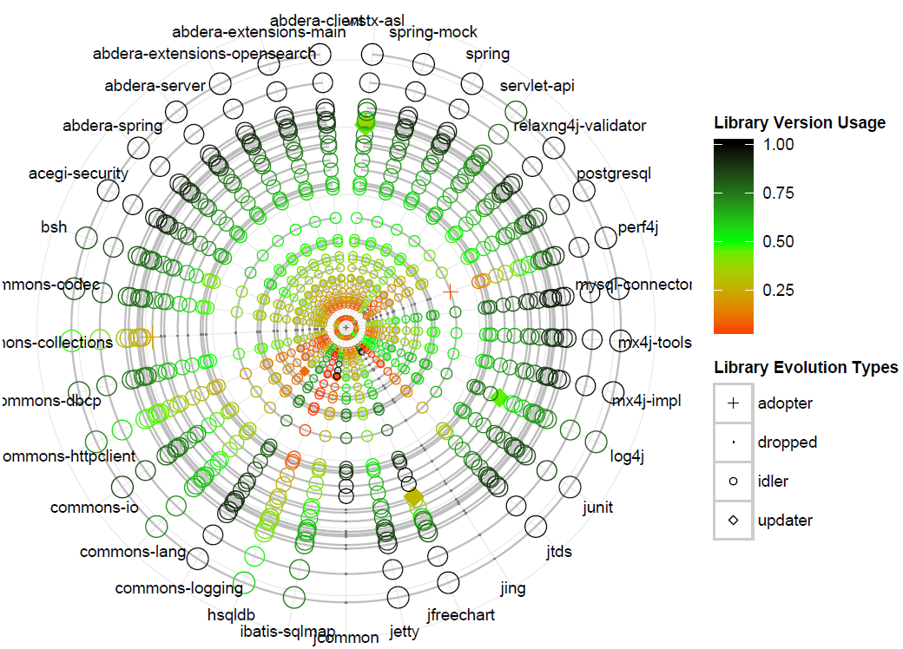
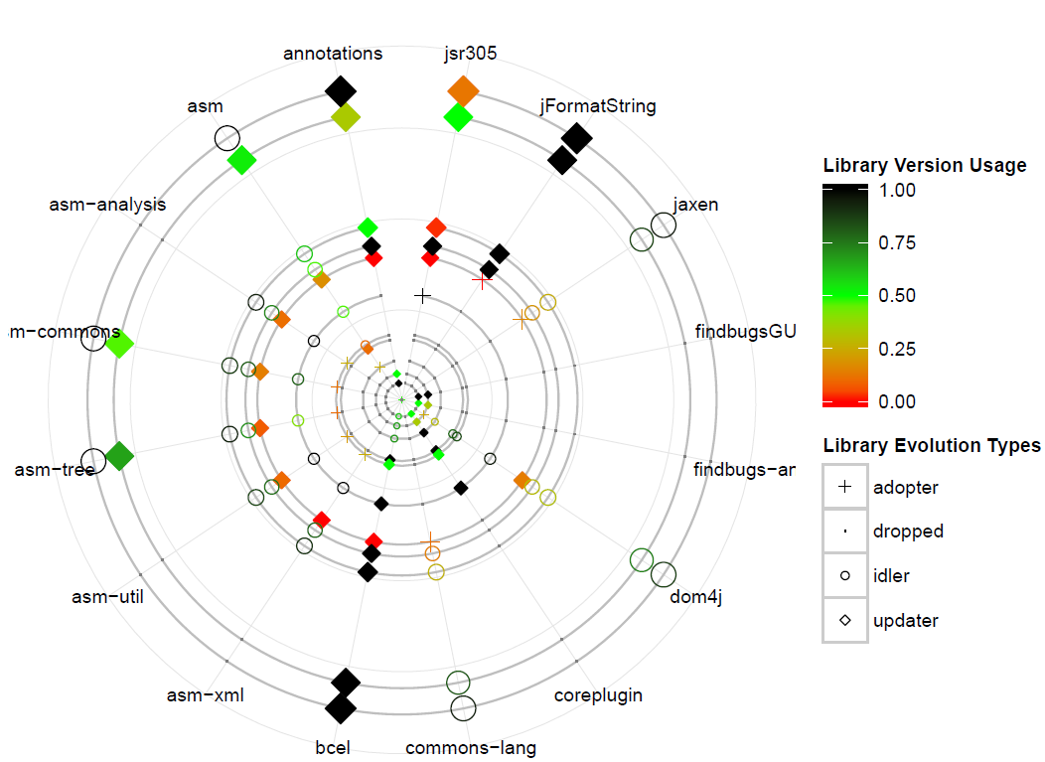
Scenario 1: Regularity of dependency changes
OpenCMS System
Findbugs System
Frequency of release times and risk of updating

Slide 12
Scenario 1: Regularity of dependency changes

Slide 13
Scenario 2: Structural dependency changes
Based on history consider:
what are more risker library types and associated libraries.

Slide 14
Scenario 3 & 4
asm
dom-4j
commons-lang

Slide 15
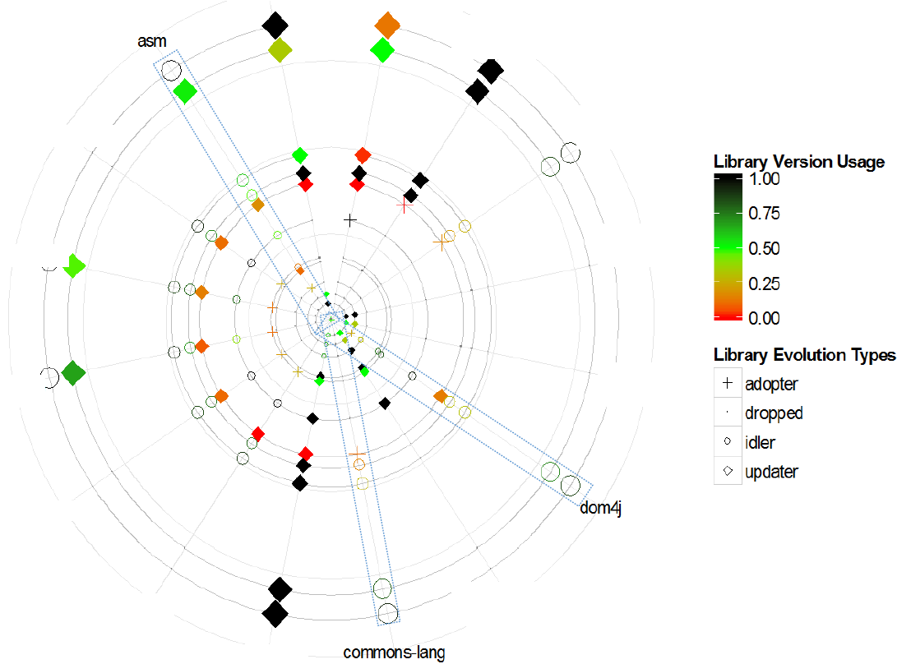
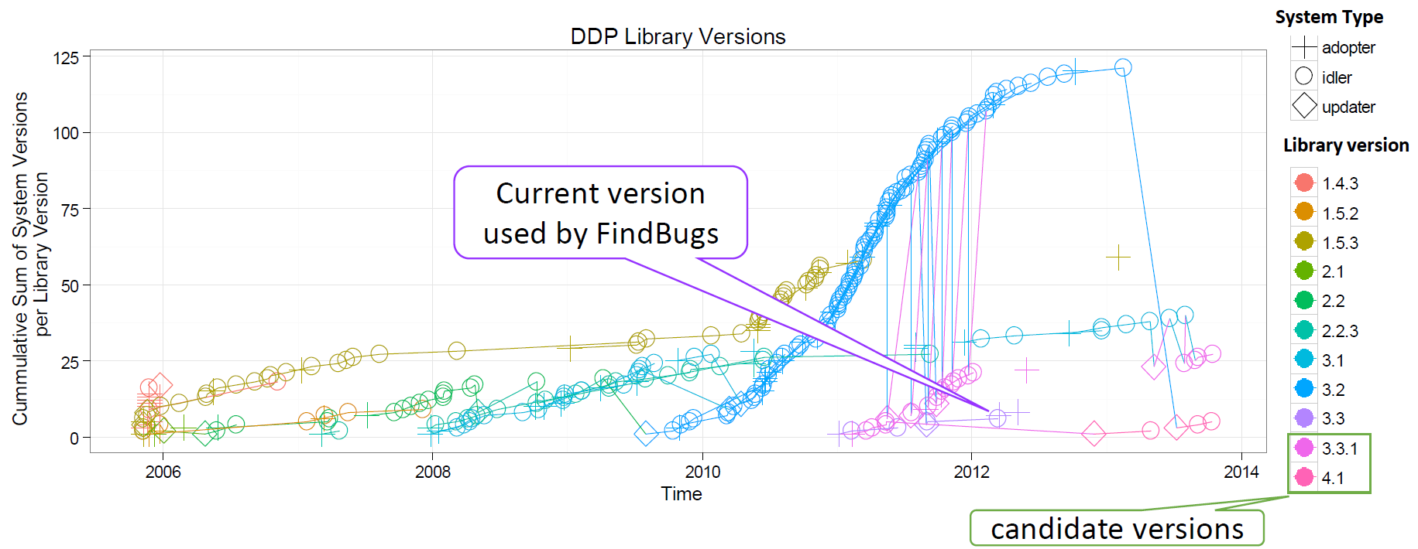
Scenario 3: Attractiveness of different library versions
asm

Slide 16
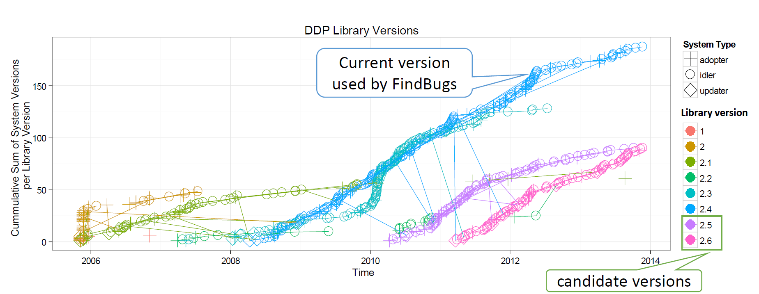
Scenario 3: Attractiveness of different library versions
commons-lang

Slide 17
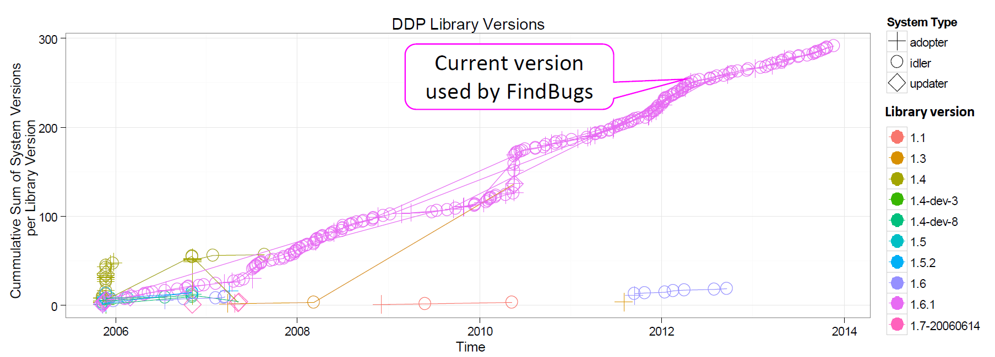
Scenario 3: Attractiveness of different library versions
dom4-j

Slide 18
Scenario 4: Opportunities to update
asm
Candidate versions are 3.3.1 and 4.1

Slide 19
Scenario 4: Opportunities to update
commons-lang
candidate versions are 2.5 and 2.6

Slide 20
Scenario 4: Opportunities to update
dom4-j
Dominant version is evident

Slide 21
Discussion Points
Generality – Granularity of our data, understanding the dataset
Visual Scalability – Interactivity and reducing clutter of information
Practicality – Incremental size of evolution data
Ease of Use - Assessment by practitioners and researchers
Additional Scenarios – Peeking on other systems, multiple libraries

Slide 22
Summary and Future Work
Towards the effective reuse of software libraries.
System and Library Centric Views.
4 case scenarios with real world examples.
Regularity, Structural Dependency changes,
Attractive and Update Opportunities based on Usage.
Current State: Feedback and Implementation
Investigating co-existing matrix libraries
Any questions/comments and feedback ……
http://sel.ist.osaka-u.ac.jp/SARF/index.html.en

