Slide 1
What Kinds of Refactorings are Co-occurred? An Analysis of Eclipse Usage Datasets
Tsubasa Saika¹, Eunjong Choi¹, Norihiro Yoshida²,
Akira Goto¹, Shusuke Haruna¹, Katsuro Inoue¹
¹Osaka University, Japan
²Nagoya University, Japan
Notes:
(Thank you for the introduction. )
(Hello, I’m Tsubasa Saika. I’m a graduate student at Osaka University.)
Now, I would like to talk about our research entitled “What Kinds of Refactorings are Co-occurred? An Analysis of Eclipse Usage Datasets”.

Slide 2

Refactoring
Changing internal structure of software without altering the external behavior [1]
Improving the maintainability of a software system
Same external behavior
Refactoring
Complicated
Source code
Sophisticated
Source code
Easy to be maintained
Developer
[1] M. Fowler，“Refactoring:Improving the Design of Existing Code.” Addison Wesley，1999.
Notes:
At first, I will explain about the background of the research, refactoring. Refactoring is a process of changing the internal structure of software without altering the external behavior. It is a promising way to improve the maintainability of a software system. By performing Refactoring, a developer can modify complicated source code into sophisticated source code which is easy to be maintained.

Slide 3



Refactoring Support Tools
Manually performed refactoring is not only time-consuming but also error-prone. [2]
Several IDEs support many kinds of refactoring patterns.
  Eclipse, IntelliJ IDEA, NetBeans, etc.
Don’t do by hand
Use support tools
[2] G. Bavota et al. “When does a refactoring induce bugs? an empirical study.” in Proc. of SCAM，2012
Notes:
However, manually performed refactoring is not only time-consuming but also error-prone. To alleviate this problem, several modern IDEs, such as Eclipse, support many refactoring patterns that rename, move, or split program elements such as methods, classes, and packages.

Slide 4
Related Work
To improve refactoring support tools, Murphy-Hill et al. investigated Eclipse usage datasets.
They found that developers often repeat same kinds of refactoring. [3]
However, it has not been examined what different kinds of refactoring are frequently co-occurred in their datasets.
[3] E. Murphy-Hill et al. “How we refactor, and how we know it,” IEEE Trans. Softw. Eng., 2012
Notes:
To improve refactoring support tools, Murphy-Hill et al. investigated Eclipse usage datasets and found that developers often repeat same kinds of refactoring. However, it has not been examined what different kinds of refactoring are frequently co-occurred in their datasets.

Slide 5

Example of Co-occurred Refactoring
E.g.) Move and Rename
  A developer moves a class to another package and then renames its name consecutively.
  A developer needs to repeatedly select the class then invoke refactoring feature and configure its setting
Step1
Moves the class to another package
Package1
Package2
Move
Rename
ClassA.java
ClassA.java
ClassB.java
Step2
Renames the class name
5
Notes:
ここまで1:40
I will explain an example of co-occurred refactorings. This figure depicts a consecutive executions of Move and Rename refactorings. In this figure, a developer moves a class named classA from package1 to package2 and then change its name to classB. Currently to perform these refactorings, a developer needs to repeatedly select the targets, then invoke refactoring feature and configure its setting.

Slide 6
Research Motivation
Existing refactoring support tools do not support consecutively co-occurred refactoring.
Supporting co-occurred refactoring should improve software development efficiency.
To develop the tool, the most frequently co-occurred refactoring should be clarified.
Notes:
Existing refactoring support tools don’t support consecutively co-occurred refactoring. To alleviate this problem, a tool which supports consecutively co-occurred refactorings is required. Supporting co-occurred refactoring should improve software development efficiency. In order to develop the tool, the most frequently co-occurred refactoring should be clarified.

Slide 7
Overview of Research
Investigated the refactoring tool usages
  Step1. Identifying frequency of co-occurred
  refactorings in the software development history
  Step2. Analyzing details of frequently co-occurred
  refactorings
Devised suggestions for improving refactoring support tools based on the investigation results
Notes:
Next, I will give an overview of this research. The investigation is comprised of two steps. In the first step, we identified frequency of co-occurred refactoring in software development history. In the second step, we manually analyzed details of frequently co-occurred refactoring. Then, we devised suggestions for improving refactoring support tools to support frequently co-occurred refactoring based on the investigation results.

Slide 8
Analyzed Datasets
Usage data of Eclipse which includes usage logs of the refactoring features
  Users: usage record of Eclipse users [4]
  Mylyn: usage record of Mylyn plug-in developers
Dataset name | # developrs | Period | # performed refactoring | # types of refactoring
Users | 41 | Jul. 2005～ Sep. 2005 | 3494 | 22
Mylyn | 8 | Feb. 2006～Aug. 2009 | 4637 | 19
[4] G.C. Murphy et al. “How Are Java Software Developers Using the Eclipse IDE?” IEEE Software, 2006.
Notes:
In the investigation, we analyzed usage data of Eclipse which includes usage logs of refactoring features. It is rare that a dataset includes refactoring usages. Moreover, these datasets are the actual development histories. The table below is the summary of the datasets. The first dataset is called Users which contains usage logs of 41 Eclipse-users. Developers in this dataset work at different organizations with various backgrounds. It contains total 3494 refactoring instances that are comprised of 22 types of refactoring. The second dataset is called Mylyn which contains usage logs of 8 developers of Mylyn project. Mylyn plugin is a task management plugin for Eclipse. It contains total 4637 refactoring instances that are comprised of 19 types of refactoring.

Slide 9
Step1: Identifying Frequently Co-occurred Refactorings
Identified co-occurred refactoring combinations
  regarded refactorings successively occurred within 90 seconds as co-occurred refactorings
Investigated the number of instances for each combinations of co-occurred refactorings
Within 90s
Over 90s
Developer
Move
Rename
Rename
Co-occurred Refactorings
Notes:
ここまで4:50
Now, I will explain the details of investigation and its findings in Step1. In this step, we identified consecutively co-occurred refactoring combinations based on the time stamps of refactoring instances. We regarded refactorings successively occurred within 90 seconds as co-occurred refactorings. This figure represents an instance of work flow of a developer. In this figure, the refactorings enclosed in this green circle are occurred within 90 seconds. So, they are determined as co-occurred refactoring by our definition. On the other hand, this refactoring which is carried out after longer than 90 seconds is not regarded as co-occurred refactoring in this study. Then, we investigated the number of instances for each combinations of co-occurred refactorings found in the datasets.

Slide 10
Frequently Co-occurred Refactoring
Users
rank | refactoring 1 | refactoring 2 | # performed
1 | Extract Method | Rename | 52
2 | Extract Local Variable | Rename | 33
3 | Extract Local Variable | Extract Method | 29
4 | Extract Local Variable | Inline | 28
5 | Move | Rename | 27
Mylyn
rank | refactoring 1 | refactoring 2 | # performed
1 | Move | Rename | 115
2 | Move static Member | Rename | 21
3 | Extract Constant | Rename | 14
4 | Extract Interface | Move | 14
5 | Move | Move static Member | 12
Different combinations between Rename, Move, and Extract are the most frequent.
Notes:
These tables show the top 5 combinations of frequently co-occurred refactorings. The upper table shows the result of Users dataset. The lower table shows the result of Mylyn dataset. These two columns, Refactoring 1 and 2, show the patterns of refactoring but they do not indicate the order of execution. These two tables show similar combinations of co-occurred refactorings. That is, most combinations of co-occurred refactorings contain at least one of Rename, Move, and Extract refactorings which are highlighted in yellow. Also, these refactoring patterns are known as the most frequently occurred refactoring patterns.

Slide 11

Step2: Details of Co-occurred Refactoring (1/2)
Investigated details of frequently co-occurred refactorings to devise tool supports
  Only Mylyn dataset contains information about program elements altered by refactoring instances.
Classified the targets of each refactoring into three types
  “Same”, “Related”, “Others”
Notes:
ここまで7:10
Next, I‘m going to explain the investigation and its findings in Step2. In this step, we investigated details of frequently co-occurred refactorings to devise tool supports. However, this investigation was carried out only for Mylyn dataset because Users dataset doesn’t contain information about program elements altered by refactoring instances. We manually analyzed the details of the 10 most frequently co-occurred refactorings. And then we checked targets of each refactoring and classified them into three types: Same, Related and Others.

Slide 12
Step2: Details of Co-occurred Refactoring (2/2)
Same: each refactoring alters the same program element
Related: targets have similar names or belong to the same package / class
1. Rename Field
int number;
int id;
Similar Names
int getNumber(){
return number;
}
2. Rename Method
int getId(){
return id;
}
Notes:
If each refactoring alters the same program element, we classified them as Same. Meanwhile, targets are determined as related program elements if they have similar names or belong to the same package or class. In the rest cases, we could not identify the relationship between targets and classified them as “Others”. This figure illustrates an example of refactoring instance of Rename and Rename pair. Since, these refactorings renames different kinds of program element, they are considered as different kinds of refactoring and this pair is classified as related. First, a developer renames a field named number. Then, he or she renames a method named getNumber that is similar to the name of the field.

Slide 13
Result of Detailed Investigation
refactoring 1 | refactoring 2 | # performed | # Investigated | # same | # related
Move | Rename Type | 58 | 10 | 4 | 1
Rename Field | Rename Method | 48 | 10 | 0 | 5
Rename Type | Rename Method | 32 | 10 | 0 | 4
Move | Rename Package | 29 | 10 | 1 | 7
Rename Type | Rename Field | 26 | 10 | 0 | 3
Move Static Member | Rename Field | 15 | 10 | 6 | 0
Extract Interface | Move | 14 | 10 | 7 | 1
Rename Local Variable | Rename Field | 12 | 10 | 0 | 6
refactoring 1 | refactoring 2 | # performed | # Investigated | # same | # related
Move | Rename Type | 58 | 10 | 4 | 1
Rename Field | Rename Method | 48 | 10 | 0 | 5
Rename Type | Rename Method | 32 | 10 | 0 | 4
Move | Rename Package | 29 | 10 | 1 | 7
Rename Type | Rename Field | 26 | 10 | 0 | 3
Move Static Member | Rename Field | 15 | 10 | 6 | 0
Extract Interface | Move | 14 | 10 | 7 | 1
Rename Local Variable | Rename Field | 12 | 10 | 0 | 6
refactoring 1 | refactoring 2 | # performed | # Investigated | # same | # related
Move | Rename Type | 58 | 10 | 4 | 1
Rename Field | Rename Method | 48 | 10 | 0 | 5
Rename Type | Rename Method | 32 | 10 | 0 | 4
Move | Rename Package | 29 | 10 | 1 | 7
Rename Type | Rename Field | 26 | 10 | 0 | 3
Move Static Member | Rename Field | 15 | 10 | 6 | 0
Extract Interface | Move | 14 | 10 | 7 | 1
Rename Local Variable | Rename Field | 12 | 10 | 0 | 6
Notes:
This table shows the result of investigation on details of frequently co-occurred refactorings. Rename refactorings are classified according to their applied elements. The numbers of performed refactoring, investigated refactoring, same targets, and related targets are shown. For example, Move and Rename Type refactoring pairs are co-occurred fifty eight times in Mylyn dataset and we manually investigated ten instances. 4 instances are classified as Same and 1 instance is classified as Related. Overall, more than half of all investigated refactoring-pairs are same or related. I will explain focus on (Move, Rename) pairs highlighted in red and (Rename,Rename) pairs highlighted in blue which are the most frequently co-occurred refactoring patterns and devise tool support for them.

Slide 14
Details of (Move, Rename)
When targets are classified as “Same”
  Rename the program element that was previously moved
mylyn.tasks.ui
mylyn.internal.tasks.ui.properties
Package
Moves the class to other Package
ProjectPreferencesLinkProvider.java
ProjectPreferencesLinkProvider.java
ProjectPropertiesLinkProvider.java
Class
Renames the class name
Notes:
ここまで10:35
In the case where targets of Move and Rename refactorings were the same program element, Rename was occurred to change the names of program element that were previously moved. This figure depicts an example of Move and Rename refactorings pair recorded in the Git repository of Mylyn project. A class named ProjectpreferencesLinkProvider was moved from a ppackage named mylyn.task.ui into another package named mylyn.internal.tasks.ui.properties and its class name was changed to ProjectPropertiesLinkProvider including a word , “properties” which came from the name of its new package.

Slide 15
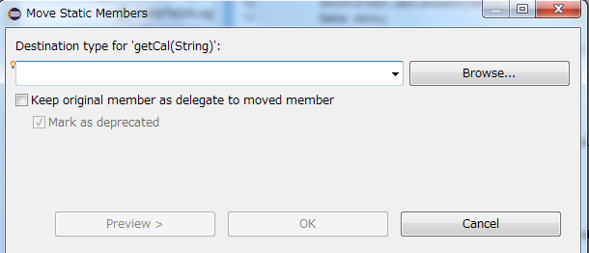
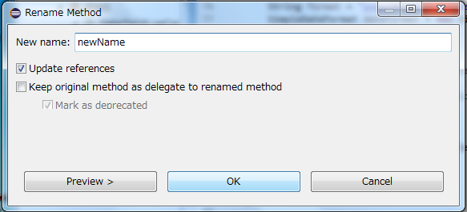
Suggestions for Supporting (Move, Rename)
Providing feature that simultaneously supports Move and Rename
  Appending a text field for new name to the dialog of Move refactoring
Dialog of Move Refactoring
Dialog of Rename Refactoring
Notes:
Currently, Eclipse does not provide interaction between Move and Rename refactorings. Therefore, developers need to perform Move and Rename refactoring separately and configuration dialog appear twice even though developers often do not configure refactoring tools. For supporting this combinations of refactorings, we suggest to develop a new menu which simultaneously performs Move and Rename refactorings in Eclipse. If the name of the program element can be changed in the dialog of Move refactoring, it is unnecessary to perform Rename refactoring separately.

Slide 16
Details of (Rename, Rename)
Rename refactorings are often performed together.
  regardless of types of targeted program elements
  altering “Related” program elements (similarly named)
e.g.) Rename Field and Rename Local Variable
TaskElementLabelProvider.java
Field
Rename
compositeImages
wideImages
Same Name
TaskElementLabelProvider(…){
…
compositeImages
…
}
Same Name
Local Variabe
Rename
wideImages
Notes:
ここまで12:35
About refactoring pair of Rename and Rename, it turned out that Rename refactorings are often performed together regardless of types of targeted program elements. In addition, those program elements tend to have similar names and some relationship. This figure shows an instance where Rename Field and Rename Local Variable refactorings were used together. This instance is also recorded in the Git repository of Mylyn project. In this figure, a field variable named compositeImages is renamed to wideImages using Rename Field refactoring. Moreover, a local variable also named compositeImages is similarly renamed to wideImages using Rename Local Variable refactoring.

Slide 17
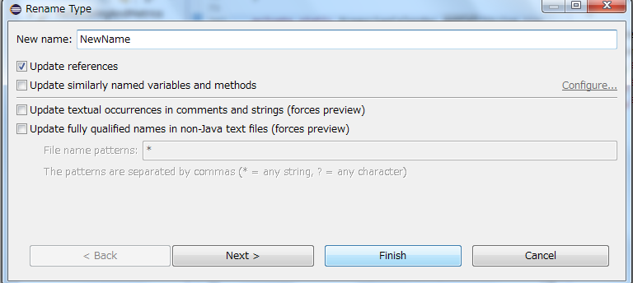
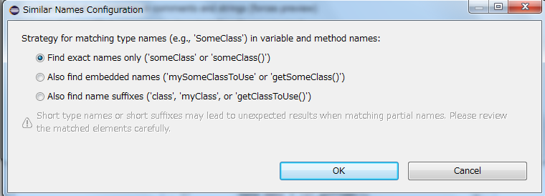
Suggestions for Supporting (Rename, Rename)
Developing a refactoring feature for renaming several program elements regardless of their types
  Currently only the Rename refactoring intended for class can update similarly named elements automatically.
  There is no such support for Rename refactoring intended for other types of program elements
Notes:
For supporting these refactorings, we suggest to develop a refactoring feature for renaming several program elements at once regardless of their types. In the current specification of refactorings of Eclipse, only the Rename refactoring intended for class can update similarly named elements automatically. However, there is no such support for Rename refactoring intended for other types of program elements such as fields or methods. Therefore, it is necessary to support them in the same way.

Slide 18
Conclusion & Future Work
Conclusions
  This study investigated consecutively co-occurred refactoring combinations.
  We devised suggestion for the improvement of the refactoring feature of Eclipse.
Future Works
  Collecting additional datasets to achieve generality
  Developing and examining a refactoring support tool according to our investigation results
Notes:
ここまで14:20
In conclusion, this study investigated consecutively co-occurred refactoring combinations. Moreover, based on the results of manual analysis, we devised suggestion for the improvement of the refactoring feature of Eclipse. As future work, we will collect additional datasets to achieve generality of the findings. Also, the actual tool that supports frequently co-occurred refactoring should be developed and examined according to our investigation results.
Thank you very much for your attention.

