Slide 1
Extraction of Conditional Statements for Understanding Business Rules
Tomomi Hatano¹ Takashi Ishio¹
Joji Okada² Yuji Sakata² Katsuro Inoue¹
¹ Osaka University
² NTT DATA Corporation

Slide 2
Maintenance of a business system
Developers must understand computational business rules [1]
The rules define how the output of a feature is computed from inputs.
The rules are implemented in the source code.
void action(int early) {
int fee;
if (early == 1) {
fee = 3000;
} else {
fee = 4500;
}
setFee(fee);
}
Rule for fee: The registration fee is 3,000 yen if an application is early received and 4,500 yen otherwise.
[1] K. Wiegers and J. Beatty, Software Requirements,
3rd ed. Microsoft press, 2013.

Slide 3

Understanding Computational Business Rules
A tedious and error-prone activity because
Documentation is generally unavailable.
A system has many features.
A feature may compute multiple outputs.
void action(int early) {
int fee;
if (early == 1) {
fee = 3000;
} else {
fee = 4500;
}
setFee(fee);
}
Rule for fee
?

Slide 4
Example: An imaginary facility
A feature computes a usage fee and a time limit for a facility.
A constraint
Children may not become premium members
fee [$]
time limit [hour]
values | conditions
5 | children
10 | students
15 | adults
values | conditions
3 | premium members
2 | regular members

Slide 5
Example: Implementation
1
2
3
4
5
6
7
8
9
10
11
12
13
14
15
void action(int status,
boolean member) {
if (hasError()) { return; }
int fee = 15;
if (status==CHILD) {
if (member) { return; }
fee = 5;
} else if (status==STUDENT) {
fee = 10;
}
setFee(fee);
setHour(2);
if (member) {
setHour(3);
}
}
Line 2
Checks the database access
Lines 3 ─ 10
Computes the fee
Line 5 checks violation
Lines 11 ─ 14
Computes the time limit

Slide 6
Example: Extracting Rules
1
2
3
4
5
6
7
8
9
10
11
12
13
14
15
void action(int status,
boolean member) {
if (hasError()) { return; }
int fee = 15;
if (status==CHILD) {
if (member) { return; }
fee = 5;
} else if (status==STUDENT) {
fee = 10;
}
setFee(fee);
setHour(2);
if (member) {
setHour(3);
}
}
fee [$]
values | conditions
5 | children
10 | students
15 | adults
?

Slide 7
Example: Extracting Relevant Statements
1
2
3
4
5
6
7
8
9
10
11
12
13
14
15
void action(int status,
boolean member) {
if (hasError()) { return; }
int fee = 15;
if (status==CHILD) {
if (member) { return; }
fee = 5;
} else if (status==STUDENT) {
fee = 10;
}
setFee(fee);
setHour(2);
if (member) {
setHour(3);
}
}
fee [$]
values | conditions
5 | status==CHILD
10 | status==STUDENT
15 | !(status==CHILD) && !(status==STUDENT)
Relevant statements are conditional statements
that represent “conditions” of computational business rules.

Slide 8
Example: Extracting Relevant Statements
1
2
3
4
5
6
7
8
9
10
11
12
13
14
15
void action(int status,
boolean member) {
if (hasError()) { return; }
int fee = 15;
if (status==CHILD) {
if (member) { return; }
fee = 5;
} else if (status==STUDENT) {
fee = 10;
}
setFee(fee);
setHour(2);
if (member) {
setHour(3);
}
}
Which conditional statements
are relevant to the fee?
Lines 4 and 7 are relevant.
The value of the fee is affected by their results.
Lines 2 and 5 are irrelevant.
If their conditions are not hold, the fee is not outputted.

Slide 9
Program slicing appears to be a promising technique but…
1
2
3
4
5
6
7
8
9
10
11
12
13
14
15
void action(int status,
boolean member) {
if (hasError()) { return; }
int fee = 15;
if (status==CHILD) {
if (member) { return; }
fee = 5;
} else if (status==STUDENT) {
fee = 10;
}
setFee(fee);
setHour(2);
if (member) {
setHour(3);
}
}
A program slice for setFee
Lines 1 ─ 10
The slice includes irrelevant statements [2]
Lines 2 and 5
[2] V. Cosentino, J. Cabot, P. Albert, P. Bauquel, and J. Perronnet,
“Extracting business rules from COBOL: A model-based framework,”
in Proc. WCRE, 2013, pp. 409–416.

Slide 10
Why Program Slicing Includes Irrelevant Statements?
Because program slicing extracts two types of conditional statements without distinction
a statement which decides whether the computation is executed ⇒ irrelevant
a statement which affects the output value
⇒ relevant
We focus on a control-flow graph
to exclude irrelevant statements.

Slide 11
Dependence in Program Slicing
Entry
2
1
2
3
4
5
6
7
8
9
10
11
12
13
14
15
void action(int status,
boolean member) {
if (hasError()) { return; }
int fee = 15;
if (status==CHILD) {
if (member) { return; }
fee = 5;
} else if (status==STUDENT) {
fee = 10;
}
setFee(fee);
setHour(2);
if (member) {
setHour(3);
}
}
3
3
4
4
7
5
7
5
8
6
8
6
10
setFee
10
11
11
12
12
13
13
return

Slide 12
Dependence in Program Slicing
Entry
2
1
2
3
4
5
6
7
8
9
10
11
12
13
14
15
void action(int status,
boolean member) {
if (hasError()) { return; }
int fee = 15;
if (status==CHILD) {
if (member) { return; }
fee = 5;
} else if (status==STUDENT) {
fee = 10;
}
setFee(fee);
setHour(2);
if (member) {
setHour(3);
}
}
3
4
5
7
6
8
10
setFee
11
12
13
return

Slide 13
Our Key Idea
Extract a partial control-flow graph, every path of which must output the value.
Extract relevant statements from the graph in a similar way to program slicing.

Slide 14
Extraction of Partial CFG
Entry
2
1
2
3
4
5
6
7
8
9
10
11
12
13
14
15
void action(int status,
boolean member) {
if (hasError()) { return; }
int fee = 15;
if (status==CHILD) {
if (member) { return; }
fee = 5;
} else if (status==STUDENT) {
fee = 10;
}
setFee(fee);
setHour(2);
if (member) {
setHour(3);
}
}
3
4
5
7
6
8
10
setFee
11
Every path must output the fee
12
13
return

Slide 15
Extraction of Relevant Statements
Entry
2
1
2
3
4
5
6
7
8
9
10
11
12
13
14
15
void action(int status,
boolean member) {
if (hasError()) { return; }
int fee = 15;
if (status==CHILD) {
if (member) { return; }
fee = 5;
} else if (status==STUDENT) {
fee = 10;
}
setFee(fee);
setHour(2);
if (member) {
setHour(3);
}
}
3
define fee
4
5
7
define fee
6
8
define fee
10
use fee
Control
Lines 2 and 5 Null
Line 4 Lines 5, 6, and 7
Line 7 Line 8
Lines 3, 6, and 8 Line 10
Lines 4 and 7 are extracted

Slide 16
Evaluation
Q1. Does our technique help developers aa_accurately identify relevant statements?
Q2. Does our technique affect the time aa_needed to identify relevant statements?
Q3. Is our technique accurate?

Slide 17
Controlled Experiment
8 developers in NTT DATA Corporation
Each developer analyzed two Java methods
one method with our technique
the other method without our technique
Process of the analysis
The developers classify each conditional statement as either relevant or irrelevant
They create a table of the computational business rules using the classification results

Slide 18
Analysis with Our Technique
1
2
3
4
5
6
7
void action(int status,
boolean member) {
if (hasError()) { return; } // IRRELEVANT
int fee = 15;
if (status==CHILD) { // RELEVANT
if (member) { return; } // IRRELEVANT
fee = 5;
}
…
}
Spreadsheet
Source Code
# | Line | Condition | Result | Your Answer
1 | 2 | hasError() | IRRELEVANT
2 | 4 | status==CHILD | RELEVANT
3 | 5 | member | IRRELEVANT
4 | 7 | status==STUDENT | RELEVANT
5 | 12 | member | IRRELEVANT

Slide 19
Analysis without Our Technique
1
2
3
4
5
6
7
void action(int status,
boolean member) {
if (hasError()) { return; }
int fee = 15;
if (status==CHILD) {
if (member) { return; }
fee = 5;
}
…
}
Spreadsheet
Source Code
# | Line | Condition | Result | Your Answer
1 | 2 | hasError()
2 | 4 | status==CHILD
3 | 5 | member
4 | 7 | status==STUDENT
5 | 12 | member

Slide 20
Decision of the Correct Answer
The 8 developers and the third author discussed the correct answer of classification
They used the table of computational business rules to review the classification results.

Slide 21
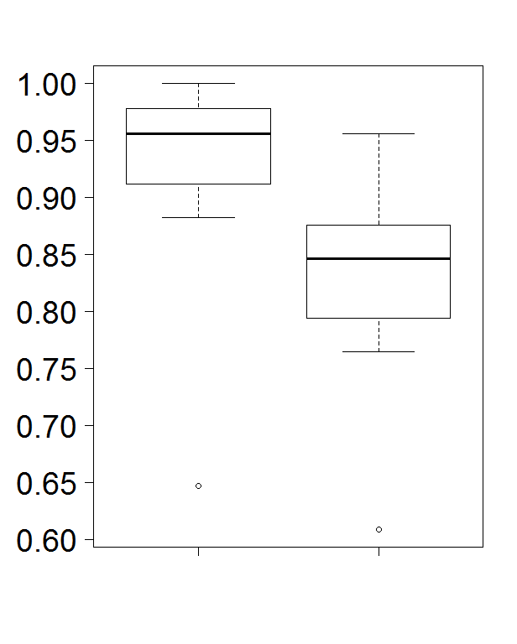

Result: Q1. Does our technique help developers accurately identify relevant statements?
Yes
$\frac{\# correctly classified statements}{\# all conditional statements}$
Statistically significant
A Wilcoxon rank sum test
Developers without our technique missed relevant statements
Accuracy
Yes
No
Support

Slide 22
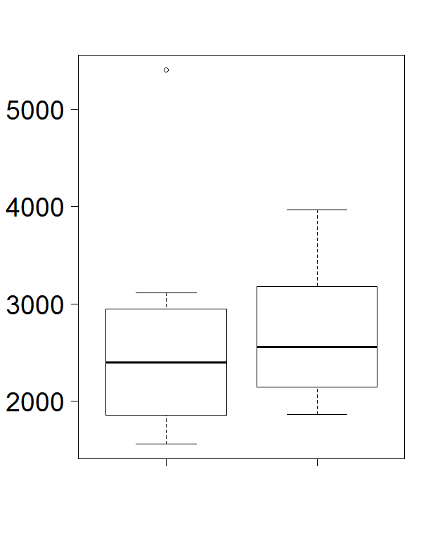
Result: Q2. Does our technique affect the time needed to identify relevant statements?
No
Not statistically significant
Developers must read the entire method to verify conditions represented in statements
Time[s]
Our technique improves the
accuracy of identification of
relevant statements
without affecting the time.
Yes
No
Support

Slide 23
Result: Q3. Is our technique accurate?
Yes but…
Our technique included 8 irrelevant statements.
Precision was 0.64 (14 / 22)
The statements would be excluded by a more precise analysis for library methods.
Our technique missed 3 relevant statements.
Recall was 0.82 (14 / 17)
The next slide

Slide 24
Example: Missed Relevant Statements
void foo(int mode) {
if (mode==ON) {
setX(1);
} else if (mode==OFF) {
setX(0);
}
}
Condition | Our technique | Developers
mode==ON | Relevant | Relevant
mode==OFF | Irrelevant | Relevant
Entry
Entry
mode==ON
setX(1)
combined
conditions
mode==ON
mode==OFF
Missed
mode==OFF
setX(0)
setX(1)
setX(0)
Our technique
Developers

Slide 25
Conclusion
We proposed a program dependence analysis technique to understand computational business rules.
Our technique improved the accuracy of identification of relevant statements.
We plan to apply our technique to re-engineering processes in practical projects.

