Slide 1


Trust of a Library: A Study of the Latency to Adopt the Latest Maven Release
Raula Gaikovina Kula, Daniel German, Takashi Ishio, Katsuro Inoue
Osaka University, Japan
SANER2015-ERA Track

Slide 2










Software Library Reuse
Developer
Next System Release
Adopt 3rd party libraries
from
Previous System Version
Why adopt libraries?
extended features
inherited quality
time/effort cost efficient
avoid reinvent wheel

Slide 3
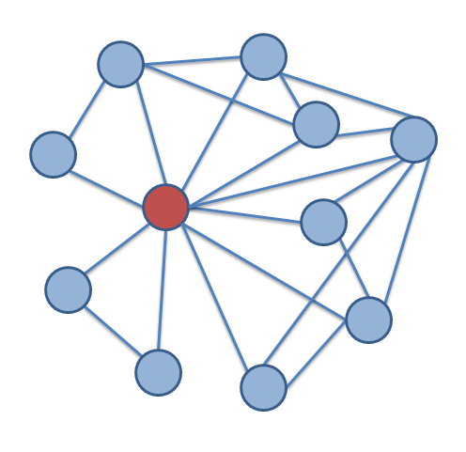
Software Systems
System
library
As the system evolves, more libraries are added.
As the system evolves, dependencies can become complex

Slide 4







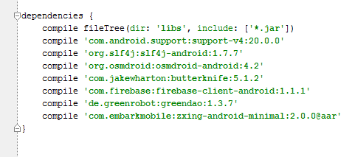

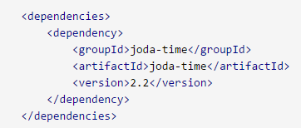
Dependency Management Tools to the rescue…
Build tools such as Maven and Gradle allow for management of library dependencies

Slide 5
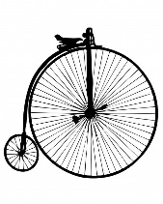



If, When and What to update??
As the system evolves, dependencies can become complex
At the same time…
As libraries evolve, Library Updates to fix bugs and new features

Slide 6



System Maintainers are wary beings…
But any changes may disrupt dependencies: aka breaking changes
System Maintainer needs to decide `if’, `when’ and `what to update?’
Dependency
Hell
Our previous work + related works suggests breaking changes and systems still using older versions

Slide 7
Notion of Trust as a metric …
Trusted Adoption: When the latest adoption is adopted
Latent Adoption: When previous releases are adopted
Assist with the `if’, `when’ and `what to update’ questions…

Slide 8
Four types of trust
‘Do exactly what it says’ –
Functional and non-functional specification
Major: Minor: Patch (SemVer)
API Documentation
‘Play with others’ –
Volatile to current system environment
Incompatibilities with other library transitive and non-transitive dependencies (Example: asm backward compatibility)

Slide 9
Four types of trust
3. ‘Prior Engagements’ –
Loyalty to a release version based on previous experiences.
Wary of other new libraries and rather stick to familiar libraries
4. ‘Tried and tested’ –
Common belief that the latest release may contain untested bugs.
Prefer to adopt release versions 1 or 2 releases behind the latest.

Slide 10

Guiding Research Questions for this study
How much ‘latent adoption’ exists?
What is the current trend of maintainers trust?

Slide 11
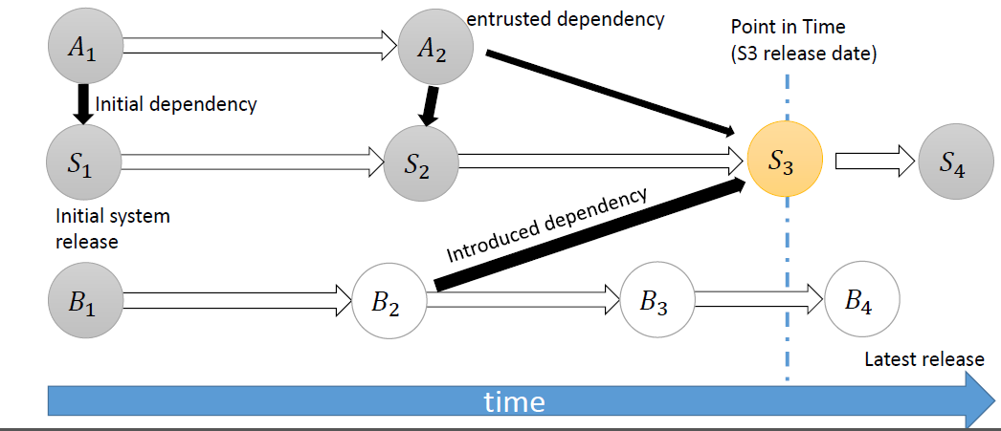
All about Systems and Libraries

Slide 12
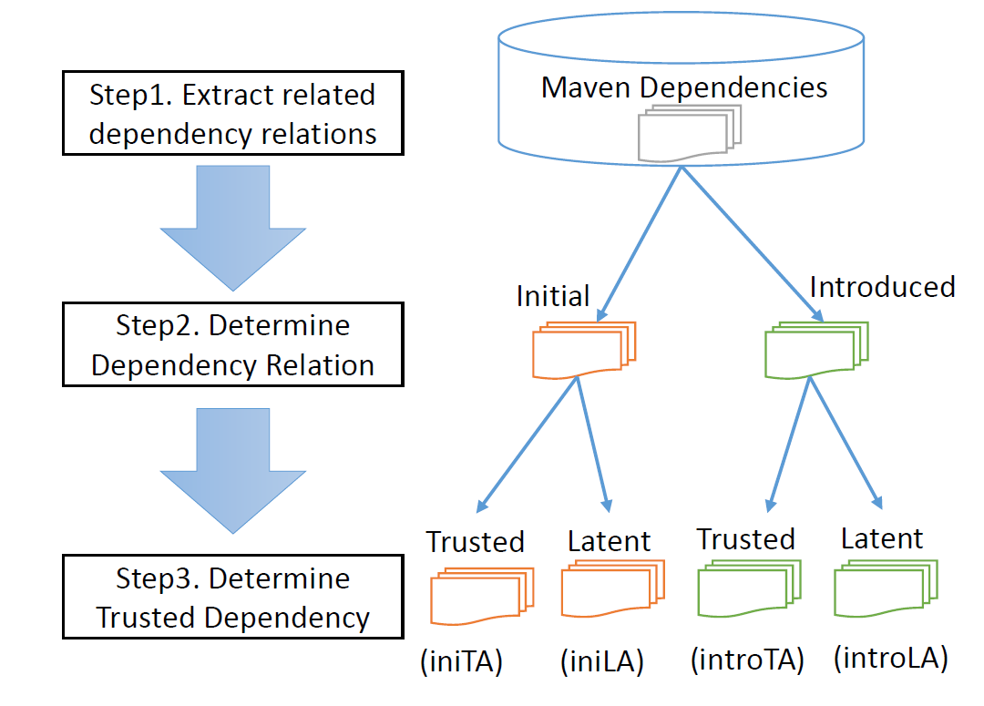
Research Approach

Slide 13


Empirical Study
pom.xml
 | Maven Dataset
Time Period | 2005-11-03 ~ 2013-11-24
# of Dependency Relations | 188,951
# of Systems | 6,374
# of libraries | 5,146

Slide 14
Results
Trusted Dependency Classifications
 | # of libraries | # of dependencies (%)
iniTA | 4,192 | 20, 372 (56.63%)
iniLA | 848 | 13, 791 (40.37%)
introTA | 3,064 | 29,303 (81.16%)
introLA | 823 | 6,543 (18.24%)

Slide 15
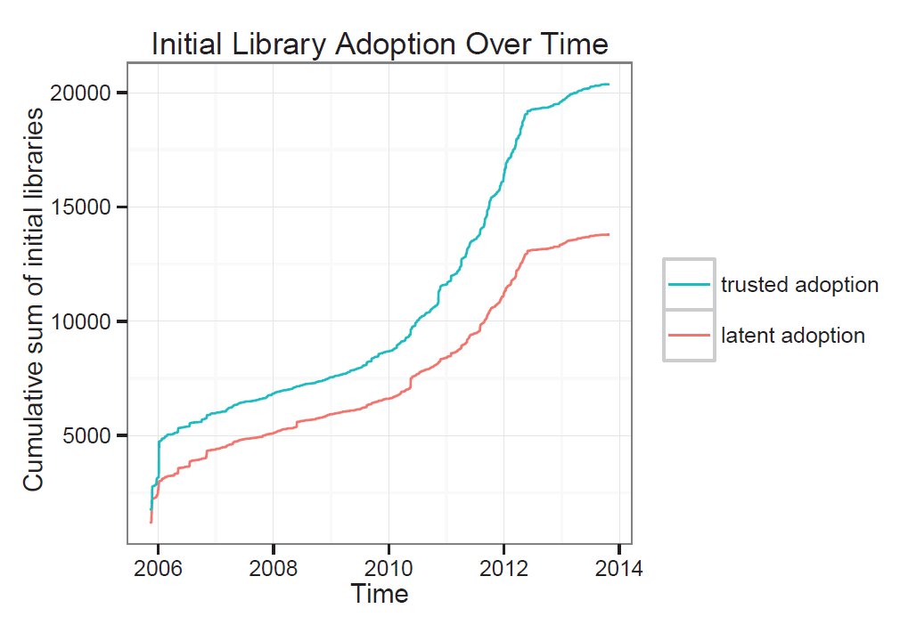
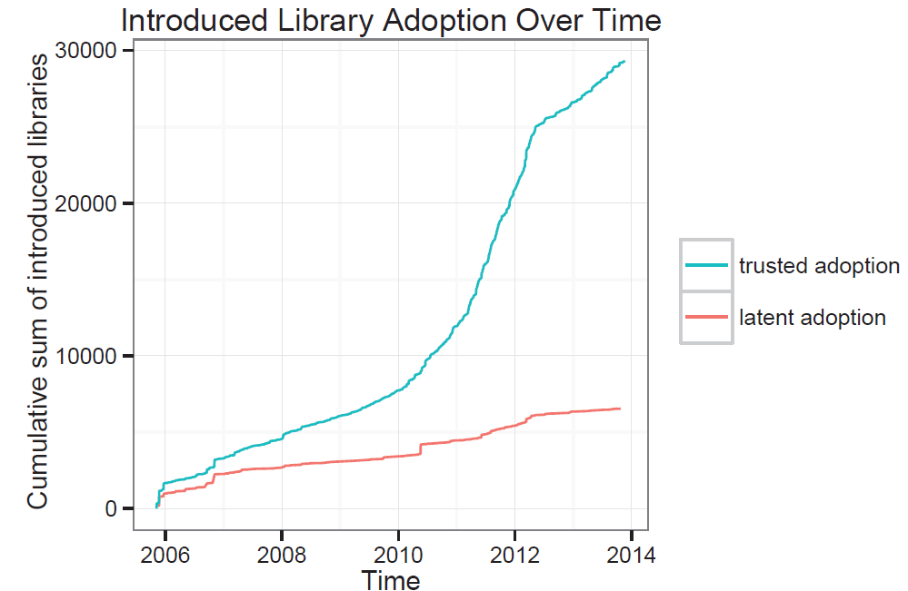
Adoption Trends over time

Slide 16
Back to RQs
How much ‘latent adoption’ exists?
It is common, almost 40% at initial conception as compared to introduced.
What is the current trend of maintainers trust?
Over time, maintainers are more inclined to adopt the latest release (trusted dependency adoptions).

Slide 17
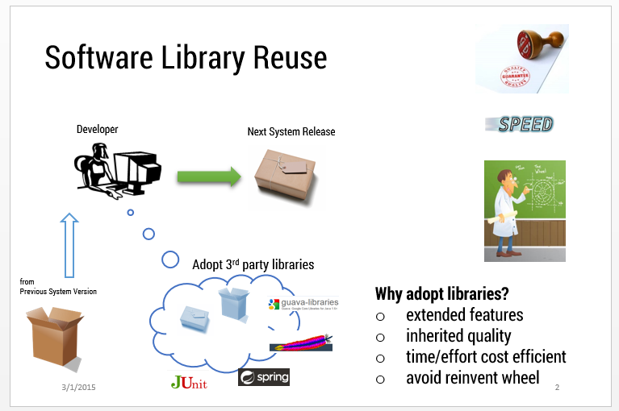
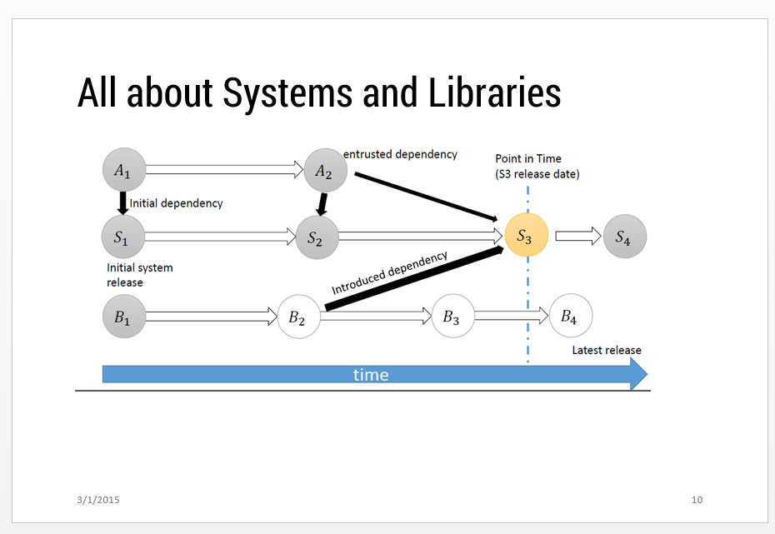
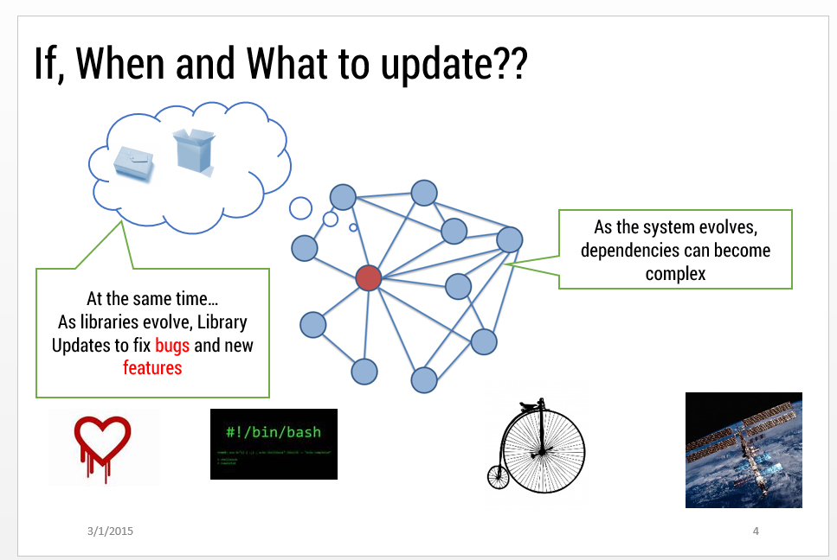
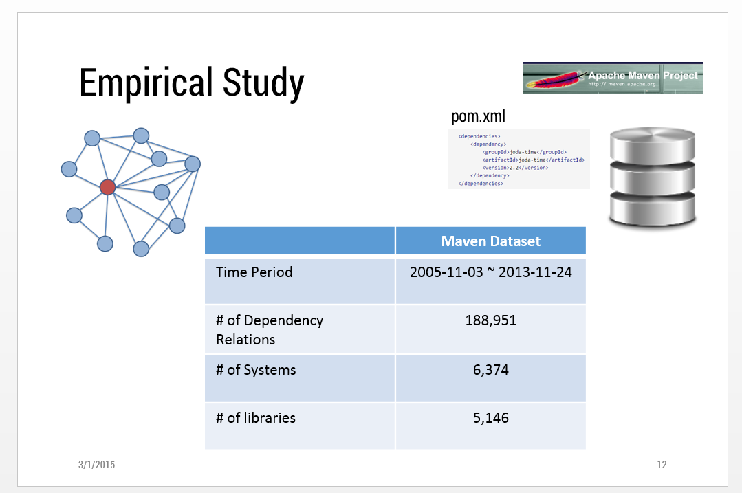
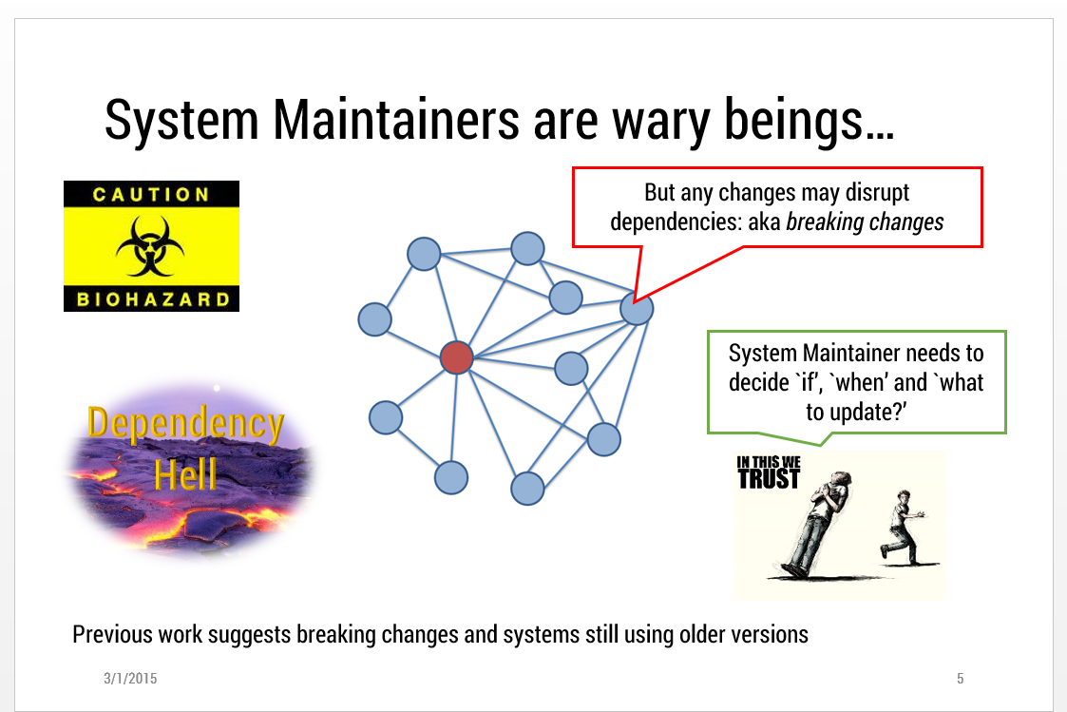
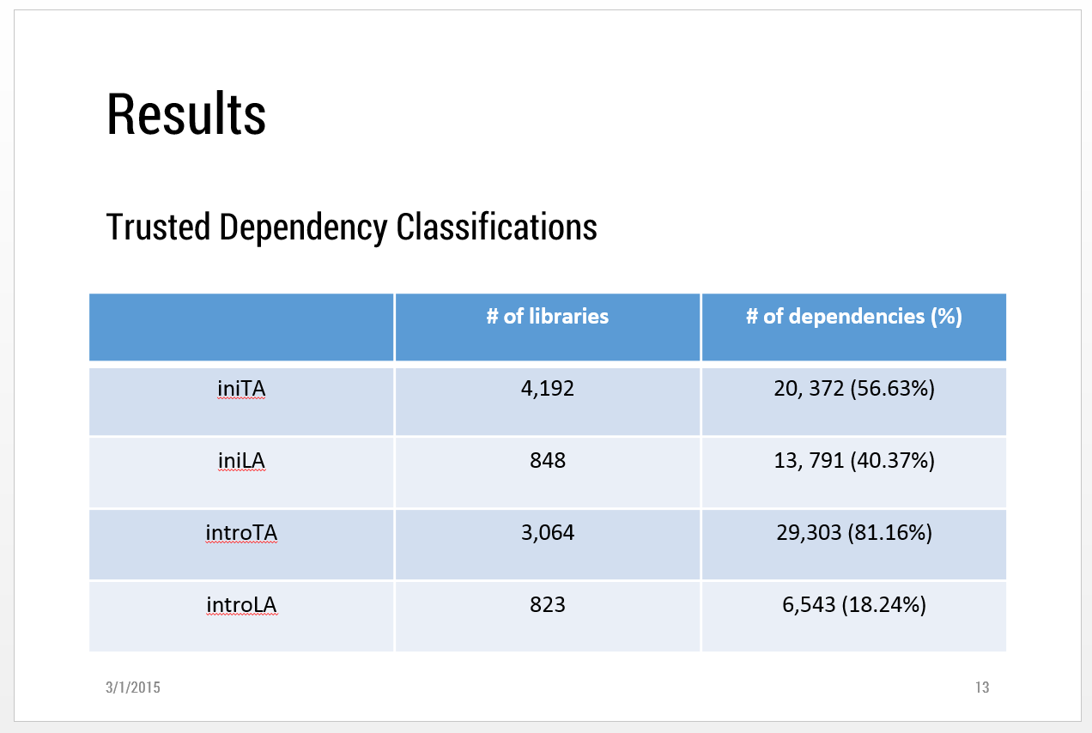
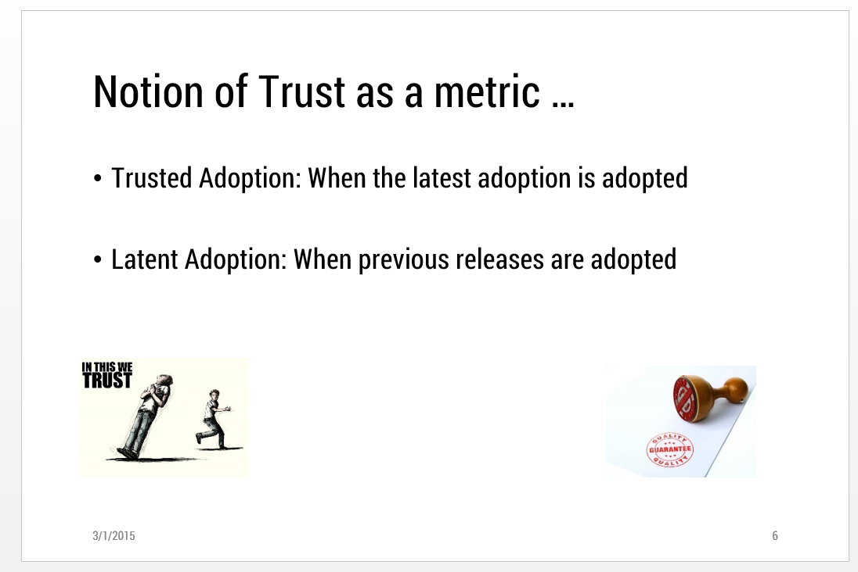
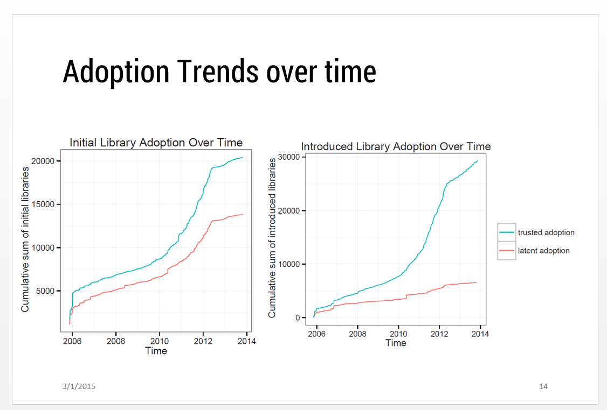
End Thoughts

