Slide 1
Evolution Analysis for Accessibility Excessiveness in Java
SANER2015
Kazuo Kobori, NTT DATA Corporation
Makoto Matsushita, Osaka University
Katsuro Inoue, Osaka University

Slide 2
Introduction
Access Modifier in Java controls the access of other classes to class/field/method.
Proper use of access modifiers and controlling visibility are essential to well-encapsulated Java programming [1].
A discrepancy between the declared accessibility and actual usage of a field or method is called Accessibility Excessiveness (AE) here
AE can be a cause of program faults due to unintended use of the fields or methods.
Access Modifier | Same Class | Package | Subclass | Any Class
Public | OK | OK | OK | OK
Protected | OK | OK | OK | -
Default | OK | OK | - | -
Private | OK | - | - | -
[1] K. Arnold, J. Gosling and D. Holmes, “The Java Programming Language 4th Edition”, Prentice Hall, 2005

Slide 3
Example of Research Motivation
We would like to get the length of String type variable “str”
<Proper access procedure>
public class X {
private String str = null;
private void setString( ) { // (1)
str = "hello";
}
int getLength() { // (2)
return str.length();
}
public int getCorrectLength() {
this.setString();
return this.getLength();
}
}
(1) Substitute some string for variable “str” by calling method “setString()”.
(2) Get the length of variable “str” by calling method “getLength()”
This procedure is implemented in public method “getCorrectLength()” to be called by external classes.
private
public
If the access modifier of method “getLength()” is not private but public
Then, external class can execute (2)
before execution of (1)
NullPointerException is happen.

Slide 4
Existence of AE would be a bad smell of program
Immature Design and Programming Issues:
Maintenance Issues:
Security Vulnerability Issues:
This problem shows the immaturity and carelessness of the designer and developer.
This is main target issue in our research.
Intentionally set AE for future use or for the purpose of being called from other programs.
This is also mentioned in our tool implementation.
It’s so difficult to judge an AE was made carelessly or intentionally.
Developer’s manual judgments support is necessary for our tool.
An attacker may access an AE field and/or method.
This is a future work.
It needs strict investigation including consideration of using reflection.
Method call using reflection would be detected by dynamic analysis approach.
However, dynamic analysis is not easy for developers because it needs enough execution traces.

Slide 5
Contributions of this paper
Support developer to find AE from their programs.
Support developer to find the appropriate timing of AE analysis.
We propose an AE classification model for the fields/methods of Java program. Based on this model, we also define AE metrics, which would be an indicator of bad smell of the target program.
We present empirical results of AE analyses for various OSS systems, including transition patterns and evolution pattern of AE metrics.

Slide 6
AE classification model
The vertical column shows the declaration of an access modifier for a field or method in the source code.
The horizontal row shows its actual usage from other objects.
Each element in AE classification is an Accessibility Excessive identifier (AE id) which identifies each AE case.
 | Public | Protected | Default | Private | NoAccess
Public | pub-pub | pub-pro | pub-def | pub-pri | pub-na
Protected | x | pro-pro | pro-def | pro-pri | pro-na
Default | x | x | def-def | def-pri | def-na
Private | x | x | x | pri-pri | pri-na

Slide 7
AE classification model
Categorize the classification into 3 groups
(1) AE
Declaration scope is broader than actual usage scope.
(3) NA
Those fields/methods are declared but they are never used.
 | Public | Protected | Default | Private | NoAccess
Public | pub-pub | pub-pro | pub-def | pub-pri | pub-na
Protected | x | pro-pro | pro-def | pro-pri | pro-na
Default | x | x | def-def | def-pri | def-na
Private | x | x | x | pri-pri | pri-na
(2) Proper
There is no discrepancy between the declaration and actual usage.

Slide 8
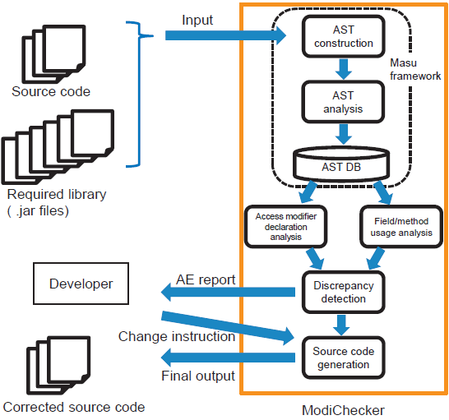
AE analysis tool “ModiChecker”
ModiChecker reports all AE list and metrics.
Developer selects AE to be fixed.
ModiChecker fixes code automatically.
MASU - http://sourceforge.net/projects/masu/

Slide 9
Research Questions
We would like to step forward to analyze the evolution of source code.
When AEs are created, changed and fixed?
RQ1:
Are the AE fields and methods are fixed in the next version?
What is the AE state transition in the versions?

Slide 10
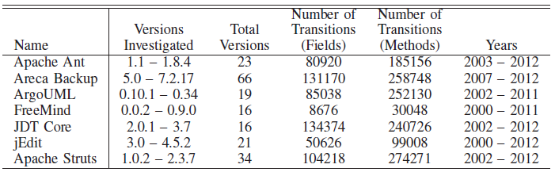
Target OSS projects
7 OSS projects were investigated in our research.
They have long development histories with sufficient version numbers.

Slide 11
RQ1: What is the AE state transition in the versions?
Transition Diagram of Access Modifiers between two versions
4 status
18 transition pattern
a,p
j
No
Existence
Proper
g
m
k
d
b
n
l
o
c
f
No
Access
AE
e,q
i,r
h

Slide 12
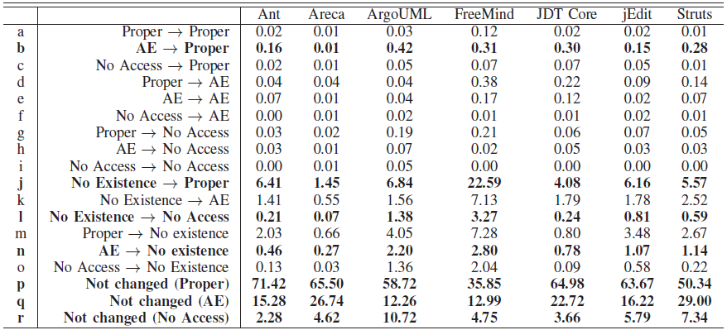
State Transition Ratio of Fields
Transitions modifying AE are less than 1%.
Transitions of “Not changed” are 53-97%.
From “No Existence”, “Proper” is the largest transition destination.

Slide 13
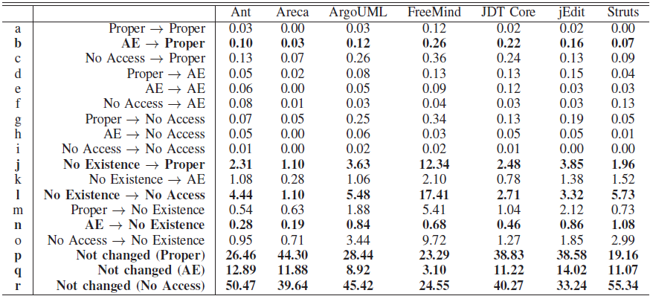
State Transition Ratio of Methods
Transitions modifying AE are less than 1%.
Transitions of “Not changed” are 51-96%.
From “No Existence”, “No Access” is the largest transition destination.

Slide 14
Answer to RQ1
RQ1:
Are the AE fields/methods are fixed in the next version?
What is the AE state transition in the versions?
Answer to RQ1:
Changing AE for the fields/methods are generally infrequent.
Once AE is created, it’s fairly stable in the software evolution
When is the best timing for developers to check AEs?
RQ2:
Do the AE metric values change over OSS evolution?
If so, what is the evolution pattern?

Slide 15
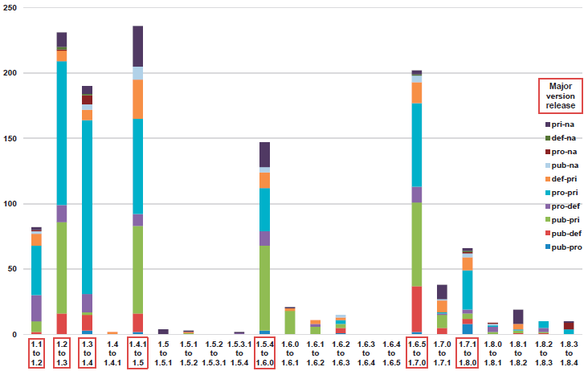
Change of # of AE Fields in Two Consecutive Versions of Ant
Top 7 large AE field changings are occurred at the major version releases.
Top 2 significant large AE field changing are “pro-pri” and “pub-pri”.
Examined 22 versions of Ant from version 1.1 to 1.8.4, including 7 major version releases and 15 minor version releases.

Slide 16
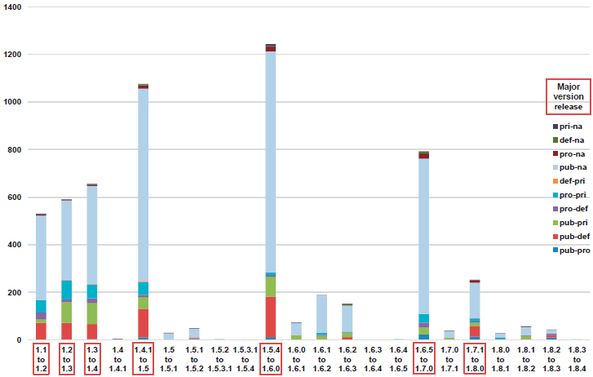
Change of # of AE Methods in Two Consecutive Versions of Ant
Top 7 large AE method changings are occurred at the major version releases.
Top 1 significant large AE method changing is “pub-na”.
AE method changing means that the absolute value of the difference of the number of AE methods in two versions.

Slide 17
Answer to RQ2
RQ2:
Do the AE metric values change over OSS evolution?
If so, what is the evolution pattern?
Answer to RQ2:
The numbers of some AE ids for fields and methods are largely changed at the major version releases, compared to the minor version releases.
To confirm this, we have also conducted Mann-Whitney U test for each AE id with 5% significance level.

Slide 18
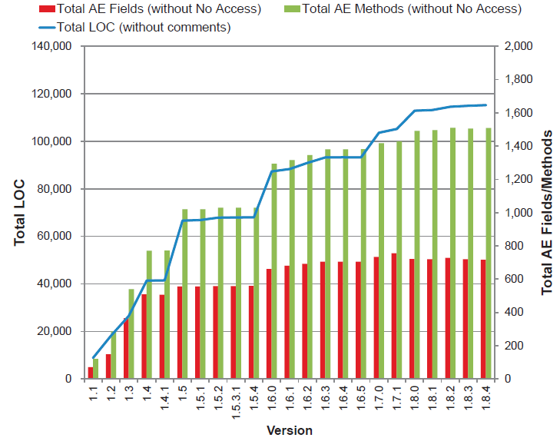
Discussion: Correlation coefficient between AE and LOC
There is a strong correlation between the total LOC and AE fields/methods.
On the other hand, the correlation coefficient between the source code changes and the AE fields/methods changes is not so high.
Pearson's correlation coefficient
 | LOC vs # of AE Fields | LOC vs # of AE Methods
Total Amount | 0.93 | 0.98
Change Amount | 0.85 | 0.69
Change amount means that the absolute value of the difference of the number of AE fields in two versions.

Slide 19
Conclusion
For supporting developer to find AE from their programs.
For Supporting developer to find the appropriate timing of AE analysis.
AE analysis tool “ModiChecker” implementing AE classification model supports developer to find AE from their programs.
ModiChecker also supports them to fix the AE automatically.
Once AE is created, it’s fairly stable in the software evolution.
We understood that it would be better for developers that they would like to check AEs before releasing new major version to find out potential bugs effectively.

Slide 21
Discussion
Summary
Open Question
How can we judge whether AE was made carelessly or intentionally.
-> Ask to developer.
We defined Accessibility Excessiveness (AE) and found Once AE is created, it’s fairly stable. So we suggested releasing new major version is good timing to analyze AE.

Slide 22
Example of Research Motivation
Class X
Public method A
Public method B
Current
program
OK
Initialization
Main job
Invoke
Future
modification
Other objects
Directly invoke B
Notes:
Add explaination of Access modifier

Slide 23
Special cases
Interface and Abstract Method
They are detected and reported as No Access
Overriding Method
They are detected and reported as AE between the access modifier of the overridden method and its actual usage.
In dynamic binding cases, if a class accesses a method of a superclass, ModiChecker will consider that class also accesses the method of all subclasses of the superclass.

