Slide 1
What Do Practitioners Ask about Code Clone? A Preliminary Investigation of Stack Overflow
Eunjong Choi¹, Raula Gaikovina Kula²,
Norihiro Yoshida², Katsuro Inoue¹
¹Graduate School of Information Science and Technology,
Osaka University, Japan
²Graduate School of Information Science, Nagoya University, Japan

Slide 2
Motivation of This Study
Very little is known about practitioner’s needs on the detection and analysis of code clones.
practitioners
researcher

Slide 3
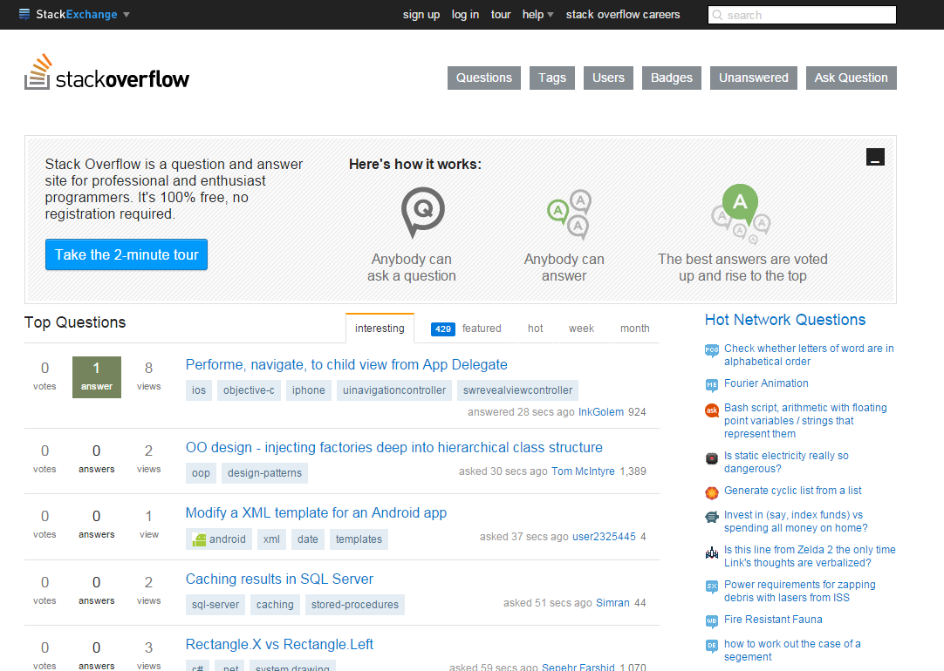
Stack Overflow (SO)

Slide 4
The Data That We Analyzed
from July 31, 2008
to July 31, 2012

Slide 5
The Data That We Analyzed
from July 31, 2008
to July 31, 2012
Choose keywords related code clones

Slide 6
The Data That We Analyzed
'code clone'
'code cloning'
'code redundancy'
'code duplicate'
'code duplication'
'duplicate code'
'duplicated code'
from July 31, 2008
to July 31, 2012
Choose keywords related code clones
Select questions based on the chosen keywords

Slide 7
The Data That We Analyzed
'code clone'
'code cloning'
'code redundancy'
'code duplicate'
'code duplication'
'duplicate code'
'duplicated code'
from July 31, 2008
to July 31, 2012
Choose keywords related code clones
Select questions based on the chosen keywords
1,654 questions
Manually validate

Slide 8
The Data That We Analyzed
'code clone'
'code cloning'
'code redundancy'
'code duplicate'
'code duplication'
'duplicate code'
'duplicated code'
from July 31, 2008
to July 31, 2012
Choose keywords related code clones
Select questions based on the chosen keywords
1,654 questions
925 questions
Manually validate

Slide 9
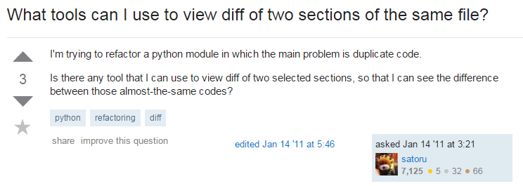
The Data That We Analyzed
'code clone'
'code cloning'
'code redundancy'
'code duplicate'
'code duplication'
'duplicate code'
'duplicated code'
from July 31, 2008
to July 31, 2012:
Choose keywords related code clones
Select questions based on the chosen keywords
925 questions
Manually validate

Slide 10
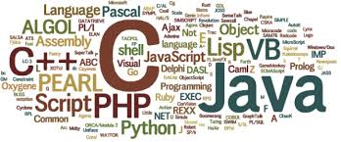
Research Question 1
RQ1: What Kinds of Programming Languages/Techniques were Appeared in Questions on Clones?

Slide 11
Methodology

Slide 12
Methodology
Tags related to programming language ?
Tags related to development techniques?

Slide 13
Methodology

Slide 14
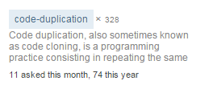
Methodology
Tags related to programming language ?
Tags related to development techniques?

Slide 15
Finding (1/2)
Tags related to programming language

Slide 16
Finding (2/2)
Tags related to development techniques

Slide 17
Finding (2/2)
The most frequently appeared tags in the questions
are about object-oriented programming languages and web programming languages.
Moreover, tags about clone management also frequently appear
Tags related to development techniques

Slide 18
Research Question 2
RQ2: Were Questions on Clones Asked by Trusted Practitioners?
Novice?
Expert?
Practitioners that are interested in handling code clones

Slide 19
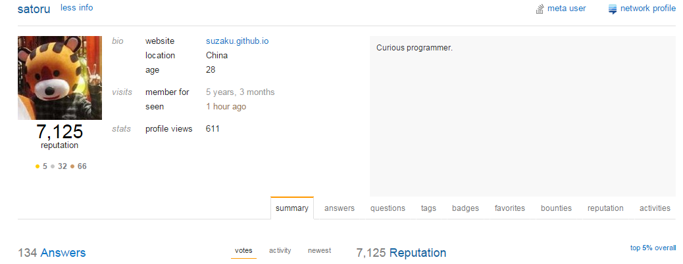
Methodology

Slide 20
Finding
The average reputations of practitioners who asked and answered questions on clones, and other questions

Slide 21
Finding
Practitioners who asked about clones
are trusted by the others in SO.
The average reputations of practitioners who asked and answered questions on clones, and other questions

Slide 22
Discussion

Slide 23
Discussion

Slide 24
Discussion

Slide 25
Discussion

Slide 26
Summary

