Slide 1
A Multi-Objective Refactoring Approach to Introduce Design Patterns and Fix Anti-patterns
Ali Ouni¹, Marouane Kessentini², Houari Sahraoui³, Mel Ó Cinnéide⁴, Kalyanmoy Deb⁵, Katsuro Inoue¹
¹Osaka University, Japan; ²University of Michigan, USA
³University of Montréal, Canada; ⁴University College Dublin, Ireland
⁵Michigan State University, USA

Slide 2
Outline
Context and research problem
Approach
Validation
Conclusion and future work

Slide 3
Context
Software, like people, get old
increase in complexity and degrade in effectiveness
Some changes may degrade the design and QoS of software systems
Maintain a high level of quality during the life cycle of a software system
The original developers are not around anymore
Refactoring
“The process of improving a code after it has been written by changing its internal structure without changing the external behavior” (Fowler et al., ‘99)

Slide 4
Refactoring
Modern IDEs: Eclipse, NetBeans
Examples: Move method, move attribute, extract class, etc.
Advantages
Improve software quality, maintainability, readability
Provide better software extensibility
Increase the speed at which programmers can write and maintain their code
but…
Manual refactoring is an error-prone and time-consuming task
What are the suitable refactorings to apply?

Slide 5
Existing work: Refactoring
Quality-based approaches
Optimize a set of quality metrics/attributes. (Seng et al., ‘06, Harman et al., ‘07, O’Keeffe et al., ‘08)
Code smells-based approaches
Fix code-smells in existing code. (Bavota et al., ‘10, Ouni et al., ‘12, Fokaefs, et al., ‘12, Ouni et al., ’13)
Design patterns-based approaches
Find code transformations/refactorings to introduce design patterns (Ó Cinnéide et al., ’00, Jensen et al., ‘10, Ajouli et al., ‘13)

Slide 6
Problem statement
Limitations
Most of existing works are goal-specific approaches
Fixing anti-patterns may affect some quality metrics.
Improve quality metrics does mean that anti-patterns are fixed
Applying a design pattern where it is not needed may increase the complexity of the system
The semantic coherence of the refactored program is not considered
Conflicting considerations
Existing refactoring techniques are underused (Murphy-Hill et al., ’11)
Goal-oriented approaches
Fit specific needs of developers

Slide 7
Approach
Original Source Code
MORE
A
B
Source Code Parser and Analyser
(SOOT)
Anti-patterns Detector
C
Design Patterns Detector
Search Process
(NSGA-II)
G
D
Software Quality Evaluator
F
E
List of coherence constraints
List of possible refactorings
R₁ R₂ R₃ … R_{n}
Suggested Refactoring Solution

Slide 8
SBSE formulation
Search technique
Non-dominated Sorting Genetic Algorithm (NSGA-II) (Deb et al., 2002)
Solution representation
Vector representation: sequence of refactoring operations
Considered refactoring operations:
Move method, Move field, Pull up field, Pull up method, Push down field, Push down method, Inline class, Extract method, Extract class, Move class, Extract superclass, Extract subclass, and Extract interface
Introduce method factory, introduce visitor, introduce singleton
Move method
Extract class
Move field
Inline class
Move method
Pull Up method
Push down field

Slide 9



SBSE formulation
Change operators
Crossover : single, random, cut-point crossover
Mutation: randomly select one or more refactorings and replace them by other refactorings
Objective functions
Anti-patterns objective function
Design patterns objective function
Quality improvement
$$ACR=\frac{number of corrected antipatterns}{initial number of antipatterns}$$
$$NP=DPA−DPB$$
$$QG=\sum_{i=1}^{n}{\left.w_{i}∗(q_{i}^{′}−q_{i}\right)}$$

Slide 10
Evaluation
Three research questions
RQ1: To what extent can the proposed approach improve the quality of software systems?
RQ2: How does the propose approach perform compared to existing search-based refactoring approaches?
RQ3: Is the proposed approach useful for software engineers?

Slide 11
Experimental setting
Studied systems
Antipatterns
God Class, Feature Envy, Data Class, and Spaghetti Code
Design patterns
Abstract Method Factory, Visitor, and Singleton
Quality attributes
QMOOD: reusability, flexibility, understandability, effectiveness, functionality, and extendibility
Systems | Release | # classes | KLOC | # anti-patterns | # design patterns
Xerces-J | v2.7.0 | 991 | 240 | 81 | 36
GanttProject | v1.10.2 | 245 | 41 | 49 | 15
AntApache | v1.8.2 | 1191 | 255 | 92 | 38
JHotDraw | v 6.1 | 585 | 21 | 24 | 18

Slide 12


Analysis method
Quantitative evaluation
ACR: Ratio of fixed anti-patterns
NP : number of introduced design patterns
QG: Quality gain
Qualitative evaluation
Comparison to state-of-the-art research:
Seng et al., ‘06, Jenson et al., ‘10, Kessentini et al., ‘11
$$RM=\frac{\# meaningful refactorings}{\# evaluated refactorings}$$
$$PU=\frac{\# useful design patterns}{\# introduced design patterns}$$

Slide 13
Quantitative evaluation
Systems | Approaches | ACR | NP | QG
Xerces-J | MORE | 89% | 12 | 0.47
 | Seng et al. | 23% | 0 | 0.54
 | Jensen et al. | 14% | 31 | 0.41
 | Kessentini et al. | 88% | 0 | 0.32
GanttProject | MORE | 88% | 7 | 0.34
 | Seng et al. | 24% | 1 | 0.33
 | Jensen et al. | 33% | 14 | 0.35
 | Kessentini et al. | 84% | 0 | 0.21
AntApache | MORE | 86% | 4 | 0.5
 | Seng et al. | 7% | 0 | 0.52
 | Jensen et al. | 12% | 28 | 0.51
 | Kessentini et al. | 87% | 0 | 0.39
JHotDraw | MORE | 83% | 4 | 0.17
 | Seng et al. | 38% | 0 | 0.19
 | Jensen et al. | 25% | 9 | 0.14
 | Kessentini et al. | 88% | 0 | 0.1
Average (all systems) | MORE | 86% | 7 | 0.37
 | Seng et al. | 23% | 0.25 | 0.39
 | Jensen et al. | 21% | 20.5 | 0.35
 | Kessentini et al. | 86% | 0 | 0.25

Slide 14
Quality gain

Slide 15
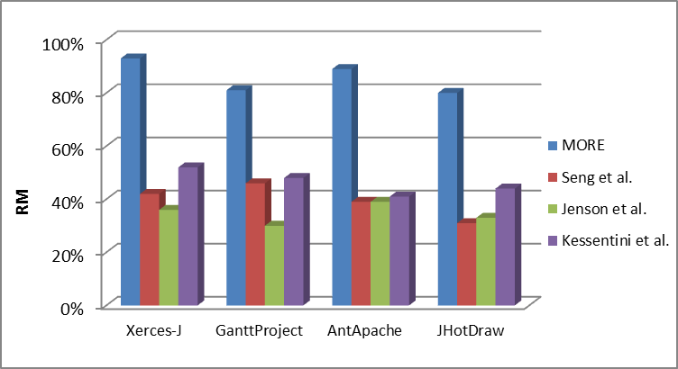
Qualitative evaluation
Refactoring meaningfulness (RM)
Systems | MORE | Jensen et al.
Xerces-J | 83% (10 | 12) | 35% (11 | 31)
GanttProject | 86% (6 | 7) | 36% (5 | 14)
AntApache | 100% (4 | 4) | 14% (4 | 28)
JHotDraw | 100% (4 | 4) | 22% (2 | 9)
Design patterns usefulness (PU)

Slide 16
Scalability

Slide 17
Conclusion & Future Work
We proposed an SBSE to recommend refactoring.
Three objectives to optimize
Fix antipatterns
Introduce design patterns
Improve quality attributes
Empirical evaluation on 4 open-source java systems
Future Works
Include other types of anti-patterns and design patterns
Test with other software systems
Interactive refactoring: put the developer in the loop

Slide 18
Thank you for your attention
Questions? Discussions? Sugggestions?

