Slide 1
A Method to Detect License Inconsistencies for Large-Scale Open Source Projects
Yuhao Wu¹, Yuki Manabe², Tetsuya Kanda¹, Daniel M. German³, Katsuro Inoue¹
¹Osaka University, Japan
²Kumamoto University, Japan
³University of Victoria, Canada

Slide 2
Open Source Software License
A legal instrument governing the use or redistribution of software, usually put in the header of a source file
GPLv3+
Generally not allowed to be modified, removed or changed without copyright owner’s permission
MIT
This program is free software: you can redistribute it and/or modify
it under the terms of the GNU General Public License as published by
the Free Software Foundation, either version 3 of the License, or
(at your option) any later version.
…
…
The above copyright notice and this permission notice shall be included in all copies or substantial portions of the Software.

Slide 3
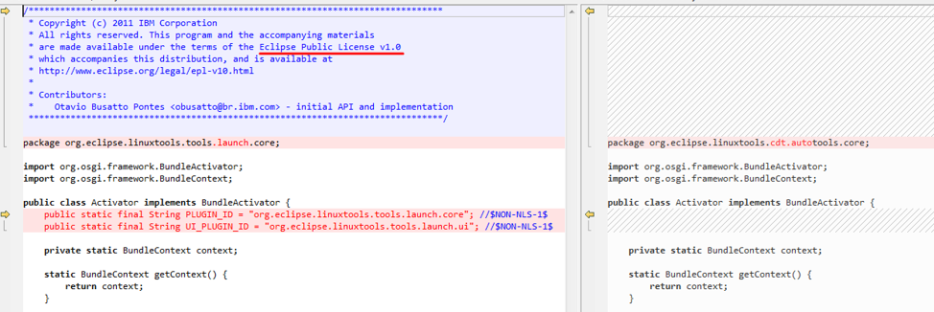
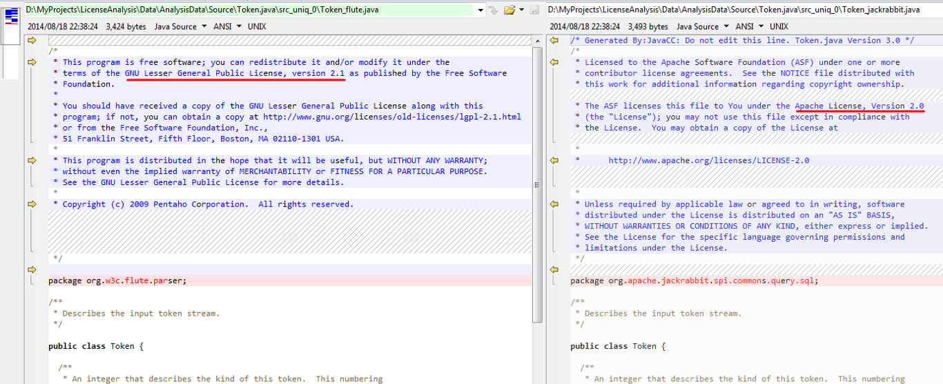
Motivation
Files with same contents under different licenses
License A <==> License B
License C <==> No license
Definition of License Inconsistency
Two source files that evolved from the same provenance contain different licenses
EPLv1.0
None
LGPLv2.1
Apachev2.0
License inconsistency indicates potential license violation problems

Slide 4
Problem
No research has been done to address these questions:
RQ1: How many types of license inconsistency are there?
RQ2: Do they exist in large open source products?
RQ3: What is the proportion of each type of license inconsistency?
RQ4: What caused these license inconsistencies? Are they legal?

Slide 5
Approach Overview
Distribution
Project1
…
Project2
Project3
j Select files that have the same file name
a.cpp
b.java
…
k Group semantically identical files using CCFinder^{[1]}
a.cpp_0
a.cpp_1
…
l Detect the license of each file in each group using Ninka^{[2]}
File name | #Licenses | None | Unknown
a.cpp_0 | 2 | 5 | 0
a.cpp_1 | 2 | 2 | 0
…
m Calculate metrics for the groups that contain license inconsistencies
[1] T. Kamiya, S. Kusumoto, and K. Inoue, “CCFinder: A multilinguistic token-based code clone detection system for large scale source code,” IEEE Transactions on Software Engineering, vol. 28, no. 7, pp. 654–670, 2002.
[2] D. M. German, Y. Manabe, and K. Inoue, “A sentence-matching method for automatic license identification of source code files,” in Proceedings of the 25th International Conference on Automated Software Engineering (ASE2010), 2010, pp. 437–446.

Slide 6
Empirical Study
Goal
To reveal the characteristics of license inconsistency in a large open source software
Target:
Debian 7.5
Categorization
LAR: License Addition or Removal
LUD: License Upgrade or Downgrade
LC: License Change
Characteristics | Number
Projects | 17,160
Total files | 6,136,637
.c files | 472,861
.cpp files | 224,267
.java files | 365,213
Inconsistency type | Number | Perc.
LC | 5,272 | 98.4%
LUD | 2,350 | 43.9%
LAR | 1,500 | 28.0%

Slide 7
Answers to RQ1-3
RQ1: How many types of license inconsistency are there in the target distribution?
3 types: LAR, LUD and LC
RQ2: Do they exist in large open source projects?
Yes, they exist in Debian 7.5
RQ3: What is the proportion of each type of license inconsistency?
LAR (28.0%), LUD (43.9%) and LC (98.4%)

Slide 8
Manual Analysis
To determine the reason and safety of each license inconsistency (RQ4):
Find the repository of each related project
Check the license evolution of the files
Find out when and why the license is modified
Determine whether the license modification is legally safe or not

Slide 9
Example of license change
TagLibraryInfo.java
Apachev1.1
tomcat6
Tools to maintain the licenses
Discussed with Apache people and changed to combined licenses
Validating the license by file basis is complicated and expensive
Apachev2
tomcat 5.5.x
CDDL
Multiple: CDDL, GPLv2
or Apachev2
glassfish
Debian7.5

Slide 10
Example of license inconsistencies
Other safe examples
Original file is multi-licensed, which means the developer can choose either license from them and remove the others.
Original file is under a permissive license, developers added another compatible license to it.
A suspicious example
Developers reused a file licensed under BSD3, but they changed the license to GPLv2 and also modified the copyright owner, which is not allowed in the original license.

Slide 11
Answer to RQ4
RQ4: What caused these license inconsistencies? Are there potentially illegal license modifications?
i) Original author modified/upgraded the license;
ii) The file was originally multi-licensed and reusers chose either one;
iii) Reuser added one or more compatible licenses;
iv) Reuser replaced the original license, and changed the copyright owner.
Among them, the last type of license modification is unsafe.

Slide 12
Conclusion
An efficient method is proposed to detect license inconsistencies in open source projects
An exploratory study is done to investigate the license violation problems
Challenges of license maintenance are revealed
Future work
Apply this method to more projects to detect more patterns
Develop a (semi-)automatic method to identify whether the license changes are legal or not.

