Slide 1
Scalable Clone Detection on Low-Level Codebases
Davide Pizzolotto
Advisors: Katsuro Inoue, Yoshiki Higo

Slide 2
Table of Contents
Introduction
Clone Detection in IR
Transforming Source Code
Function Detection in Binary Code
Compiler Detection
Conclusion
Part 1: Improving Source Clone detection
Part 2: Scalable Binary Clone detection
Notes:
List of publication

Slide 3
Table of Contents
Introduction
Clone Detection in IR [1]
Transforming Source Code [2]
Function Detection in Binary Code [3]
Compiler Detection [4] [5]
Conclusion
[1] Code Clone Detection in Rust Intermediate Representation. Davide Pizzolotto and Makoto Matsushita and Katsuro Inoue. In IPSJ/SIGSE, 2022-SE-211(26), 1-7 (2022-07-21), 2188-8825.
[2] Blanker: A Refactor-Oriented Cloned Source Code Normalizer. Davide Pizzolotto and Katsuro Inoue. In Proceedings of the 14th IEEE International Workshop on Software Clones, IWSC 2020, London, ON, Canada, February 18, 2020
[3] BinCC: Scalable Function Similarity Detection in Multiple Cross- Architectural Binaries. Davide Pizzolotto and Katsuro Inoue. IEEE Access, 2022, Volume 10, Pages 124491-124506.
[4] Identifying Compiler and Optimization Options from Binary Code using Deep Learning Approaches. Davide Pizzolotto and Katsuro Inoue. In Proceedings of the 36th IEEE International Conference on Software Maintenance and Evolution, ICSME 2020, Adelaide, Australia, September 28 - October 2, 2020.
[5] Identifying Compiler and Optimization Level in Binary Code From Multiple Architectures. Davide Pizzolotto and Katsuro Inoue. IEEE Access, 2021, Volume 9, Pages 163461-163475.
Notes:
List of publication

Slide 4
Introduction
Copying and reusing portions of code has become a common practice
Copying code often generates Code Clones
Clones create maintainability problems: fixing a bug in a clone snippet requires fixing the same bug in all clones

Slide 5
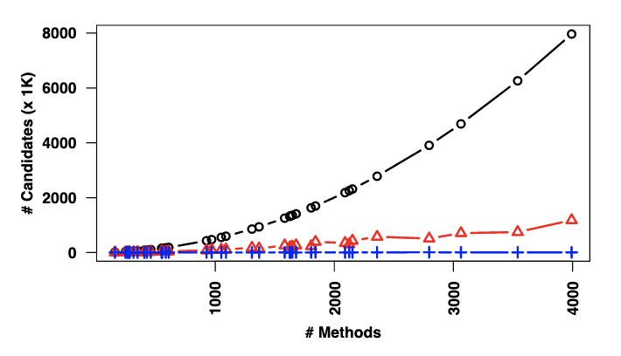
Introduction
In recent years, several tools to detect code clones have been developed
Several techniques have been developed to reduce the amount of comparisons done.
Comparison reduction in the SourcererCC tool [1]
[1] Sajnani, Hitesh, et al. "Sourcerercc: Scaling code clone detection to big-code." Proceedings of the 38th International Conference on Software Engineering. 2016.

Slide 6
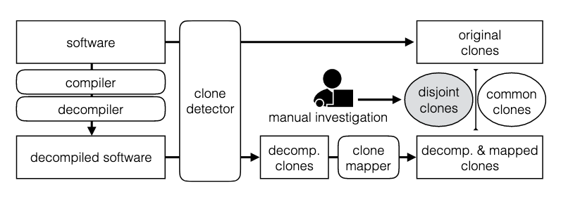
Introduction
Moreover, also the quality of code clones have improved
Ragkhitwetsagul et al. experimented with compilation-decompilation to normalize code and reduce differences between clones [1]
Setup of Ragkhitwetsagul et al. to detect clones using a compiler
[1] Ragkhitwetsagul, Chaiyong, and Jens Krinke. "Using compilation/decompilation to enhance clone detection." 2017 IEEE 11th International Workshop on Software Clones (IWSC). IEEE, 2017.
Notes:
Paper cit

Slide 7
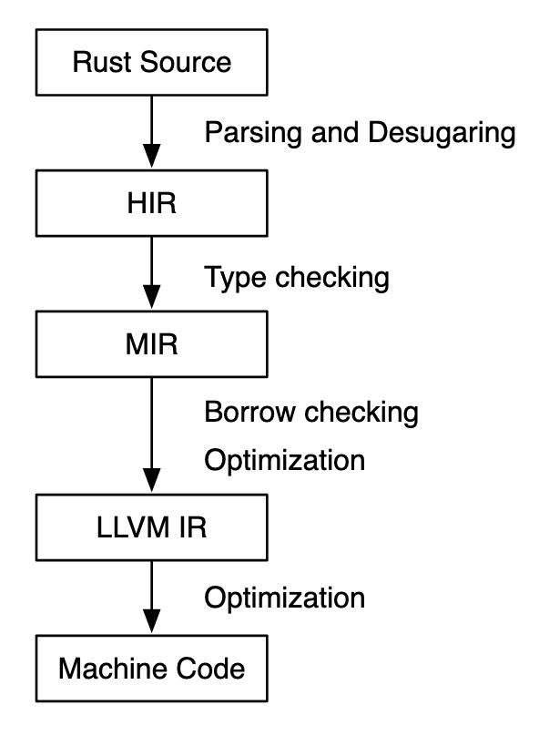
Introduction
We tried to remove the decompilation step of previous works, and applied code cloning on the compiler intermediate code
We also manually implemented compiler transformations
Results were good, but too much effort is required to map the transformed code to the original one
Check for clones here
Notes:
Why we use this approach

Slide 8
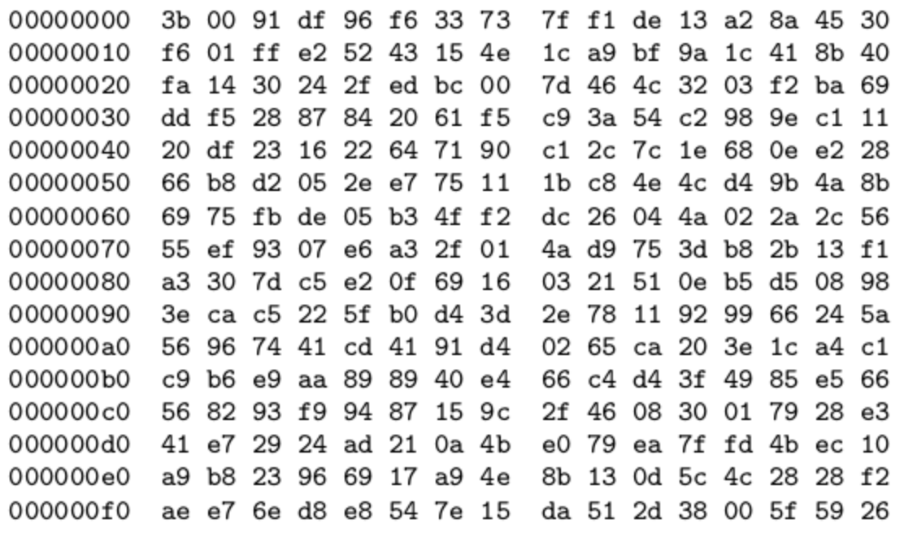
We have to go deeper!
Going closer to machine level complicates everything: no more variables, comments, optimized code everywhere…
Source clone detectors fails
Binary clone detectors are limited to pairwise comparison and slow

Slide 9
We have to go deeper!
quotearg in /bin/ls
quotearg in /bin/mv

Slide 10
We have to go deeper!
quotearg in /bin/ls
quotearg in /bin/mv

Slide 11
Goals
A fast clone detection in binary code
Comparing multiple files at once
Ability to scale up to hundred of megabytes
Cross-architecture compatibility

Slide 12
Table of Contents
Introduction
Clone Detection in IR
Transforming Source Code
Function Detection in Binary Code
Compiler Detection
Conclusion
Part 1: Improving Source Clone detection
Part 2: Scalable Binary Clone detection

Slide 13
Binary clone detection – Main Problem
Our idea is to compare the program flow, called Control Flow Graph (CFG) and find similar ones.
CFGs encode the program’s logic and can be extracted from the binary code.
However, comparing CFGs requires exponential time!
The worst case require 2¹⁰⁰⁰⁰ comparisons.
The average case require 2⁴⁰ comparisons.
Notes:
Motivating why CFG

Slide 14
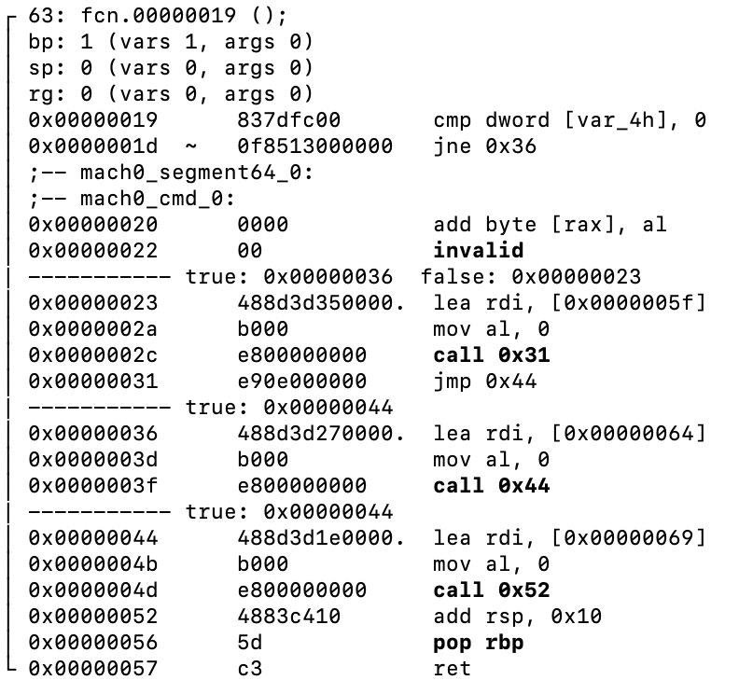
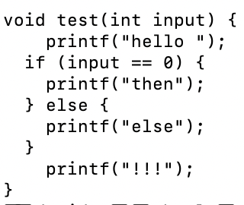
Binary clone detection – Our solution
Our solution is to convert the program flow into high level structures, and compare with hashing

Slide 15
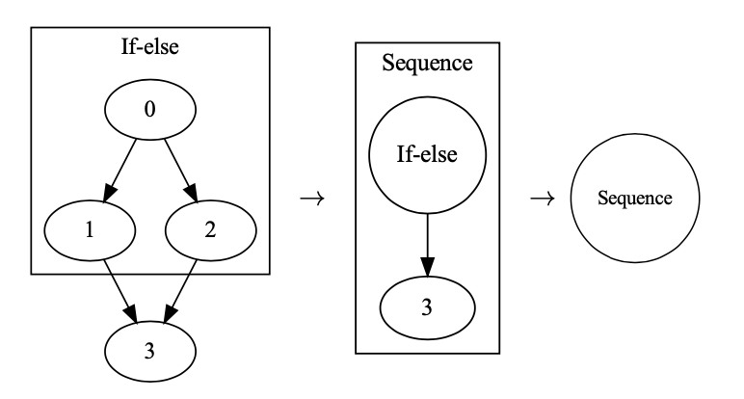
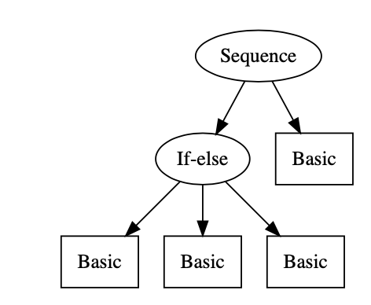
Binary clone detection – Our solution
Our solution is to convert the program flow into high level structures, and compare with hashing

Slide 16
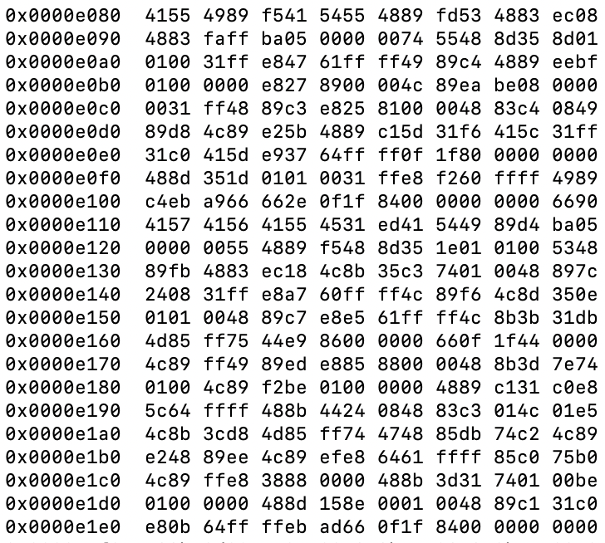
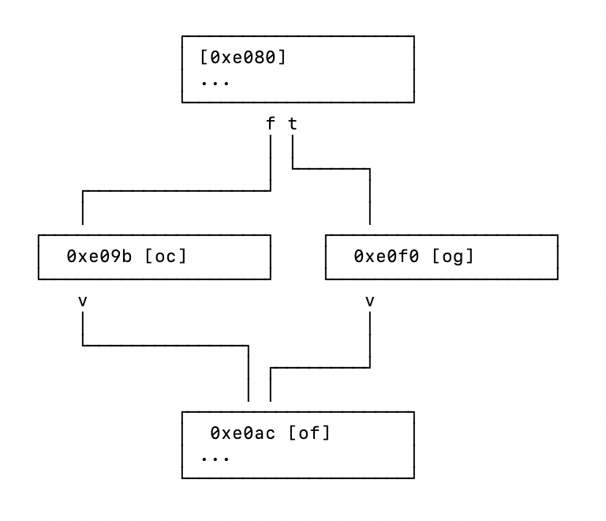
Disasm and CFG
We use existing tools to disassemble and build the Control Flow Graph (CFG)

Slide 17
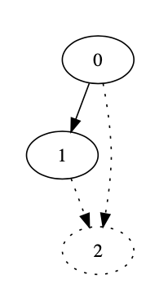
Reconstruction
We check for 11 different high-level patterns defining a CFG, finding them with a set of rules
If-else rules:
Sequence rules:
While rules:
If-then rules:
node has two children, 1 and 2
child 1 has one parent and one child
child 2 is the son of 0 and child 1

Slide 18
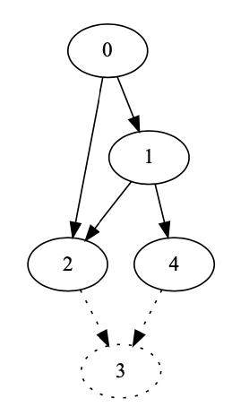
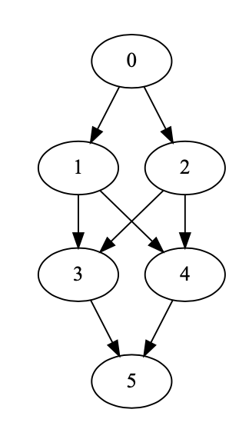
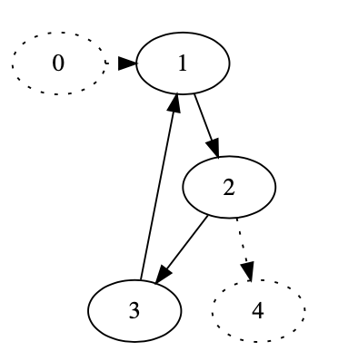
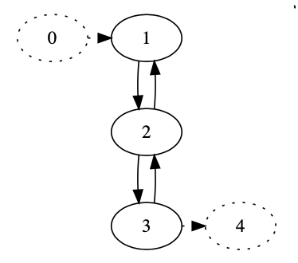
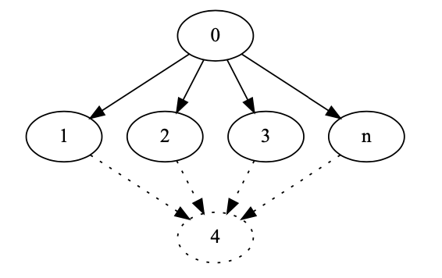
Reconstruction
We check for 11 different high-level patterns defining a CFG, finding them with a set of rules

Slide 19
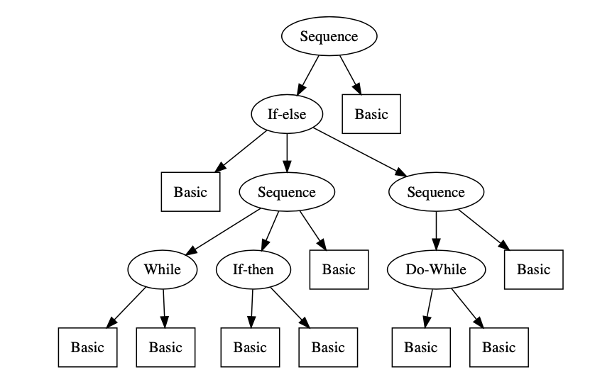
Comparison
Finally, we compare using hashing, and check for semantic consistency using cosine similarity.

Slide 20
Comparison
Finally, we compare using hashing, and check for semantic consistency using cosine similarity.

Slide 21
Overview
Step 1
Step 2
Step 3
Step 4
Step 5

Slide 22
Research Questions
RQ1: Can we convert every CFG to a tree?
RQ2: How accurate is our clone detection?
RQ3: Can we detect library usage in a real-world application?
RQ4: How performant is our tool varying the input size?
Notes:
Explain reasons for investigating

Slide 23
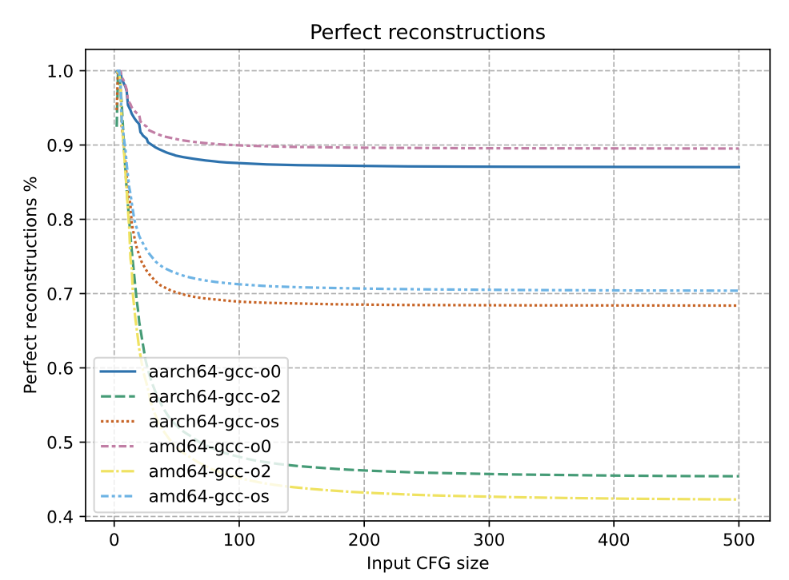
RQ1
RQ1: Can we convert every CFG to a tree?
No. In highly optimized code our approach can convert only 50% of the functions
Notes:
Explain legends

Slide 24
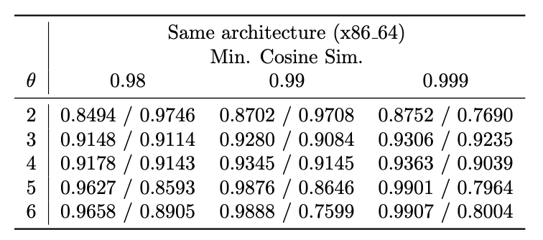
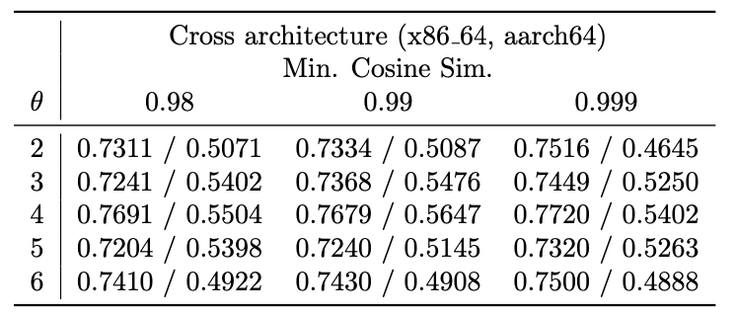
RQ2
How accurate is our clone detection?
Using structural analysis and semantic analysis
Notes:
Explain dataset

Slide 25
RQ2
How accurate is our clone detection?
Using semantic analysis only

Slide 26
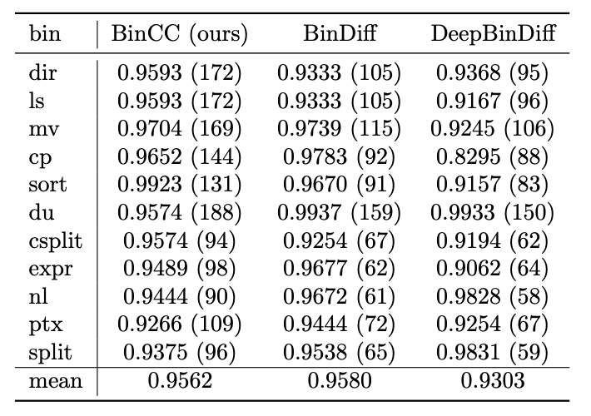
RQ2
Precision comparison with BinDiff and DeepBinDiff

Slide 27
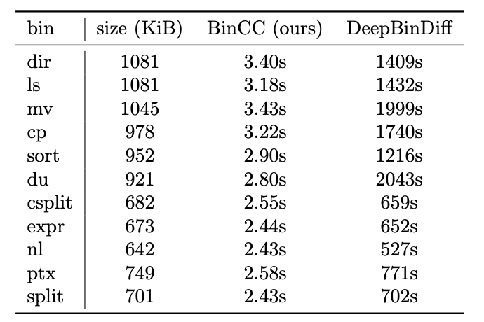
RQ2
Speed comparison with DeepBinDiff

Slide 28
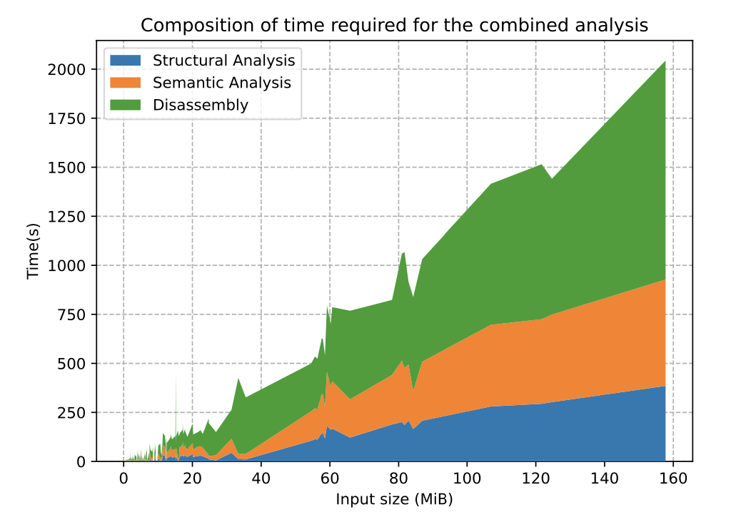
RQ4
How performant is our tool varying the input size?
Notes:
Explain how to read graph

Slide 29
Limitations
Our approach is faster and more scalable than the competition, while obtaining the same accuracy
However, like the rest of the binary clone detectors, it is limited by different compilers and optimization flags in the analyzed files

Slide 30
Table of Contents
Introduction
Clone Detection in IR
Transforming Source Code
Function Detection in Binary Code
Compiler Detection
Conclusion
Part 1: Improving Source Clone detection
Part 2: Scalable Binary Clone detection

Slide 31
Compiler detection
Checking just the PE/ELF header is not always sufficient
String dump of section '.comment':
[ 0] Linker: LLD 10.0.0
[ 13] GCC: (GNU) 9.2.0
[ 25] clang version 10.0.0

Slide 32
Compiler detection - Overview
Deep Learning based approach
Trained on 76k different binary files and more than 24M functions
Real-time performance, several microseconds for each batch
Detecting O0/O1/O2/O3/Os optimization levels

Slide 33
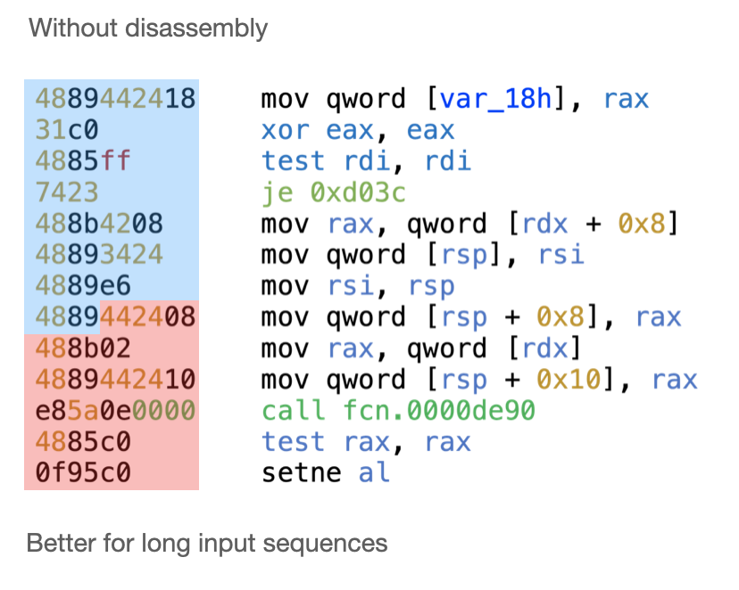
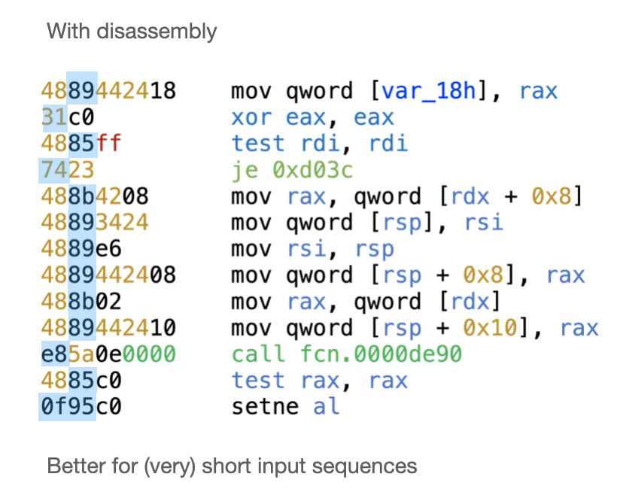
Input Type

Slide 34
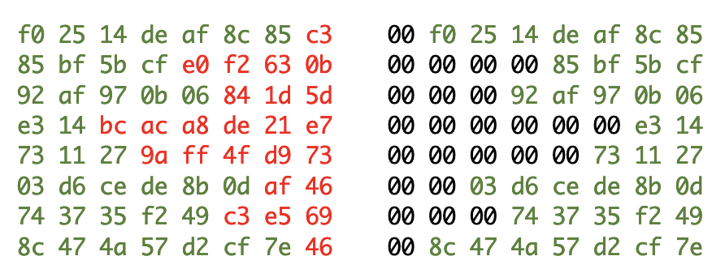
Adding variation
We also padded and shifted the input to teach the network how to work with small sequences

Slide 35
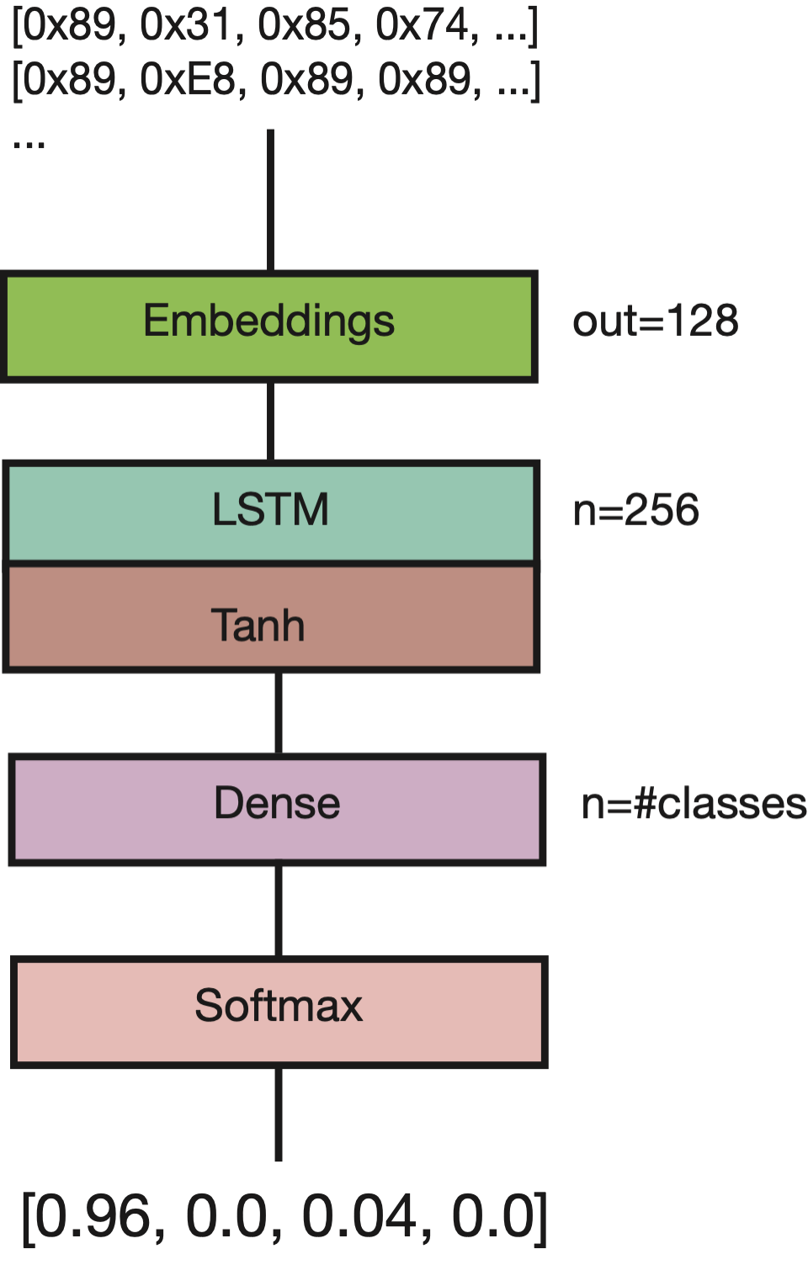
LSTM network
Slow training (hours)
Slow inference (hundredth of milliseconds)
High accuracy for very small inputs (less than 50 bytes)

Slide 36
CNN network
Fast training (minutes)
Fast inference (several microseconds)
Lower accuracy for very small inputs, comparable to RNNs for medium sized inputs

Slide 37
Research Questions
RQ1: Is is better to use a LSTM or a CNN?
RQ2: What is the minimum number of bytes for accurate predictions?
RQ3: Using a disassembler increases accuracy?
RQ4: Using padding increases accuracy?
RQ5: What are the most common optimizations?

Slide 38
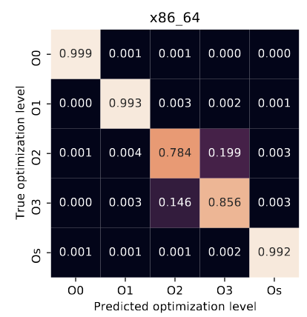
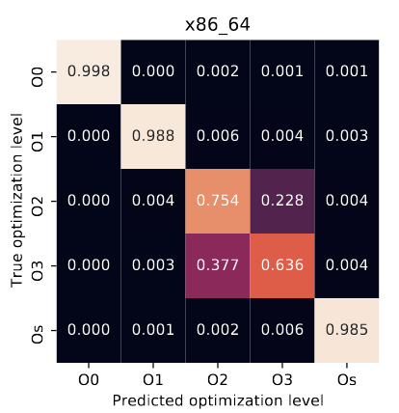
RQ1
RQ1: Is is better to use a LSTM or a CNN?
LSTM
CNN
Notes:
Explain how to read

Slide 39
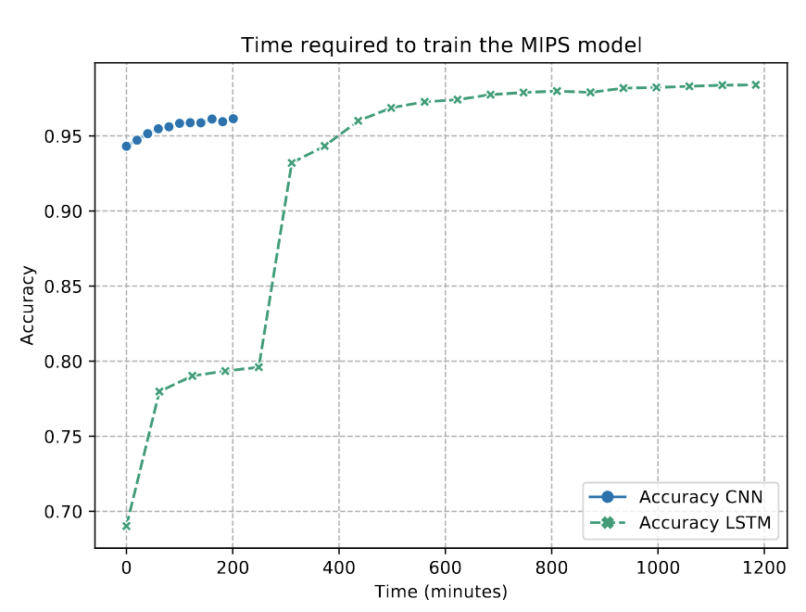
RQ1
RQ1: Is is better to use a LSTM or a CNN?

Slide 40
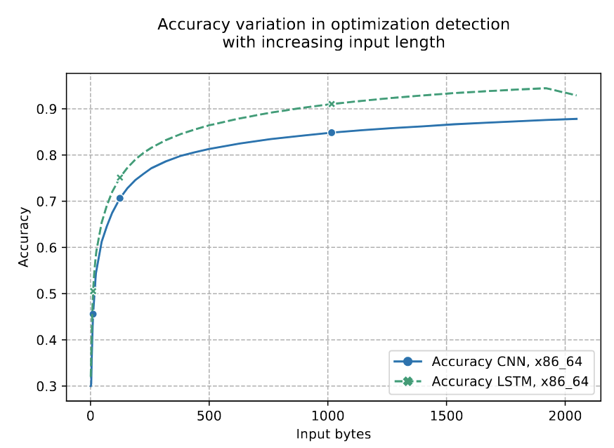
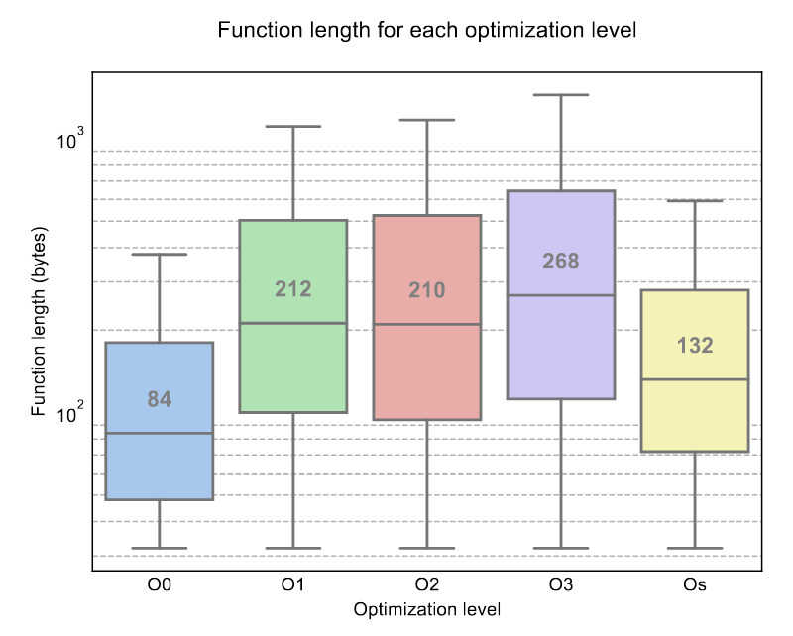
RQ2

Slide 41
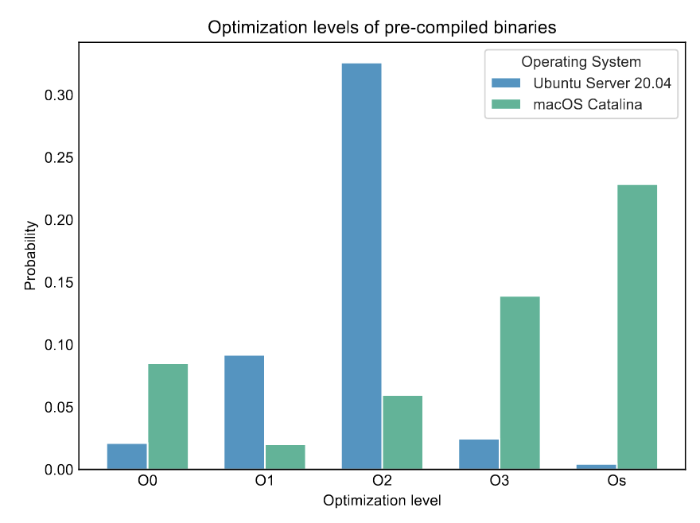
RQ5
RQ5: What are the most common optimization levels?

Slide 42
Table of Contents
Introduction
Clone Detection in IR
Transforming Source Code
Function Detection in Binary Code
Compiler Detection
Conclusion
Part 1: Improving Source Clone detection
Part 2: Scalable Binary Clone detection

Slide 43
Conclusion
We presented a new approach at detecting clones in binary code
This approach is fast and scalable, works in cross architecture and can reach the same accuracy as state-of-the-art
Although this approach suffers when comparing differently optimized binaries, we developed an optimization detector

