Slide 1




HOME
ABOUT
INTRO
PART I
PART II
FINAL
Page
01
Analyzing Code Compatibility, Equivalence, and Similarity
to Support Software Maintenance and Evolution
Presented By :
Shiyu Yang
Advisor: Prof. Yoshiki Higo

Slide 2
HOME
ABOUT
INTRO
PART I
PART II
FINAL
Page
02
Structure of the Dissertation
Introduction
Empirical Analysis of Code Compatibility on Stack Overflow [1]
Tool Support for Python Version Compatibility Detection [2]
Detecting Functionally Equivalent or Similar Code for Software Evolution [3]
Integrated Discussion and Implications
Conclusion and Future Work
Major Publications
Shiyu Yang, Tetsuya Kanda, Daniel M. German, and Yoshiki Higo, "Unveiling Python Version Compatibility Challenges in Code Snippets on Stack Overflow," IEICE Transactions on Information and Systems, vol. E107-D, no. 8, pp. 1007–1015, Aug. 2024, doi: 10.1587/transinf.2023EDP7238.
Shiyu Yang, Tetsuya Kanda, Davide Pizzolotto, Daniel M. German, and Yoshiki Higo, "PyVerDetector: A Chrome Extension Detecting the Python Version of Stack Overflow Code Snippets," in Proceedings of the 31st IEEE/ACM International Conference on Program Comprehension (ICPC 2023), Melbourne, Australia, 2023, pp. 25-29, doi: 10.1109/ICPC58990.2023.00013.
Shiyu Yang, Yusheng Guo, Akihiro Tabata, and Yoshiki Higo, "Constructing a Dataset of Functionally Equivalent Python Methods Using Test Generation Techniques," IEICE Transactions on Information and Systems, 2026 (to appear).

Slide 3
HOME
ABOUT
INTRO
PART I
PART II
FINAL
Page
03
Revisions to the Structure of the Dissertation
Comment
Chapter 1 presents the dissertation in three parts based on RQ1, RQ2, and RQ3. To keep the structure consistent, the rest of the dissertation should follow the same format. Dividing the remaining content into two parts causes inconsistency, so the three related chapters should be organized in a balanced and parallel way.
Response
Following this comment, the original division into Part 1 (Study 1 and Study 2) and Part 2 (Study 3) was removed, and Study 1, Study 2, and Study 3 are now presented as parallel parts.

Slide 4
HOME
ABOUT
INTRO
PART I
PART II
FINAL
Page
04
Table of Contents
Introduction
Python Version Compatibility on Stack Overflow
PyVerDetector for Python Version Inference on Stack Overflow
Functional Equivalence Dataset of Python Methods
Conclusion

Slide 5


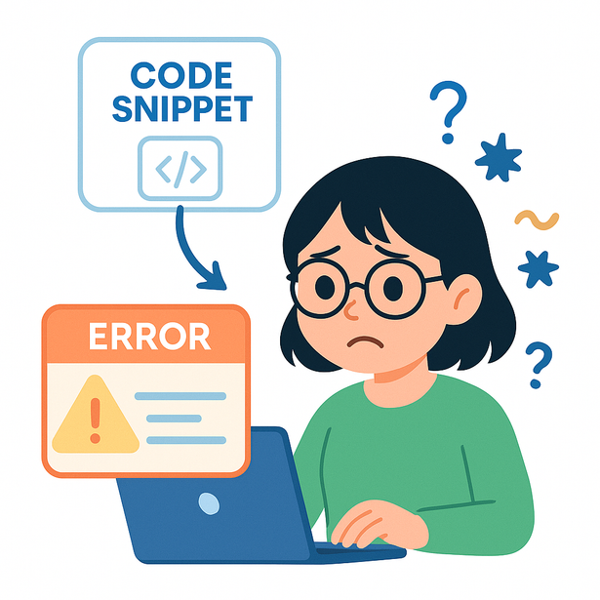
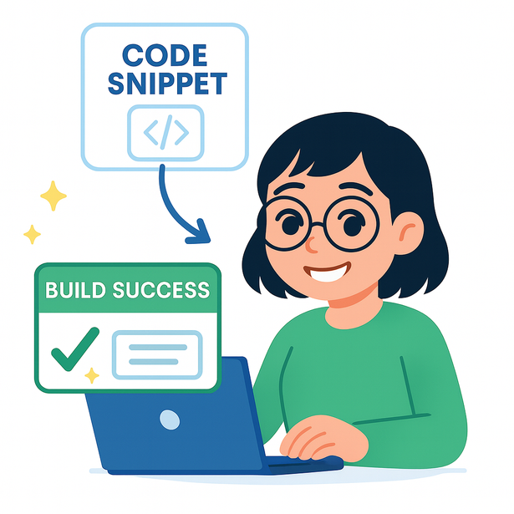
HOME
ABOUT
INTRO
PART I
PART II
FINAL
Page
05
A day of copy & paste

Slide 6
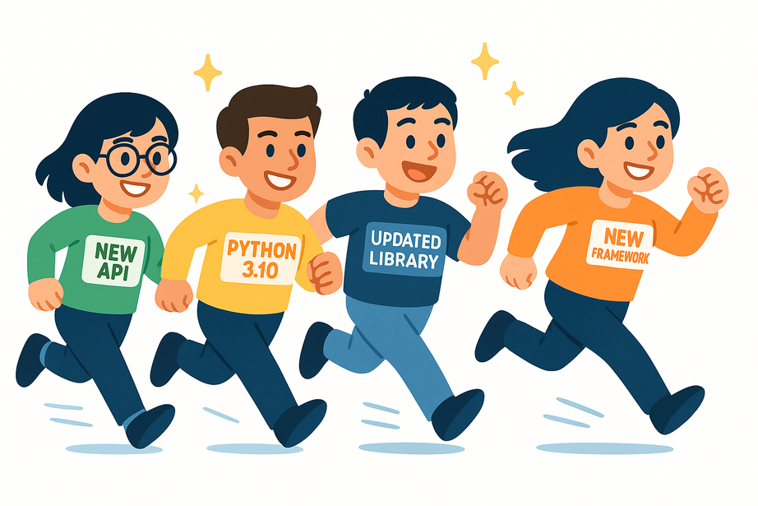
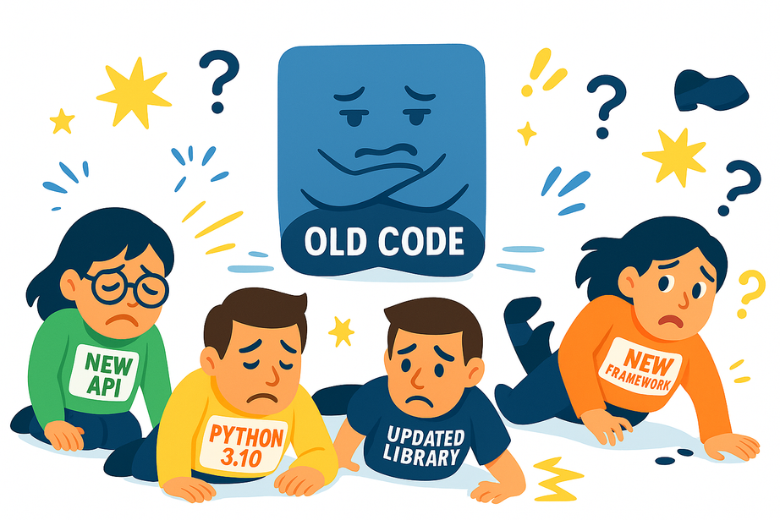

HOME
ABOUT
INTRO
PART I
PART II
FINAL
Page
06
Static Code vs. Evolving Software
Software keeps changing
But reused code is static

Slide 7

HOME
ABOUT
INTRO
PART I
PART II
FINAL
Page
07
Three Lenses for Understanding Code Reuse in Evolving Software
Compatibility
Does this code run in my environment?
Equivalence
Do two implementations behave the same?
Similarity
How structurally close are two pieces of code?

Slide 8

HOME
ABOUT
INTRO
PART I
PART II
FINAL
Page
08
Connecting the three lenses to Python code reuse
RQ1 — Compatibility prevalence
How common are version compatibility issues in reused code snippets on platforms like Stack Overflow, and how do they affect safe code reuse?
(Study 1: Empirical analysis)
RQ2 — Compatibility detection
How can automated tools detect and visualize version compatibility issues in online code snippets,
and how can such tools help developers safely reuse code?
(Study 2: PyVerDetector)
RQ3 — Equivalence & similarity
How can we identify and analyze functionally equivalent and non-equivalent Python methods?
(Study 3: PyFuncEquivDataset)

Slide 9
HOME
ABOUT
INTRO
PART I
PART II
FINAL
Page
09
Revisions to Chapter 1 (Introduction) (1/6)
Comment
The term sustainable software evolution is used in the introduction, but its definition was unclear and required explicit definition.
Response
In response to this comment, an explicit definition of sustainable software evolution has been added at the end of Section 1.1 (Background and Significance of Software Maintenance).
The definition explains that sustainable software evolution refers to a state in which software can accommodate continual ecosystem changes without compromising acceptable functional correctness or maintainability, and that this concept is operationalized through joint analyses of compatibility, functional equivalence, and structural similarity.

Slide 10
HOME
ABOUT
INTRO
PART I
PART II
FINAL
Page
10
Revisions to Chapter 1 (Introduction) (2/6)
Comment
More well-known backward-incompatible examples beyond Python 2 to Python 3 were suggested.
Response
Following this comment, more backward-incompatible examples from other languages (e.g., Swift, PHP, and Ruby) were added.

Slide 11
HOME
ABOUT
INTRO
PART I
PART II
FINAL
Page
11
Revisions to Chapter 1 (Introduction) (3/6)
Comment
Clarification was requested on how compatibility is defined and evaluated in the dissertation, particularly whether successful interpreter parsing alone is sufficient to judge compatibility when runtime behavior may differ.
Clarification was requested on which level of functional equivalence the proposed approach addresses, and on the scope of inputs considered, given that formal definitions usually rely on specifications.
Response
In response to this comment, the subsections Software Compatibility and Functional Equivalence in Section 1.3 (Key Concepts: Compatibility, Equivalence, and Similarity) were rewritten, and their definitions were refined in accordance with major publications.

Slide 12
HOME
ABOUT
INTRO
PART I
PART II
FINAL
Page
12
Revisions to Chapter 1 (Introduction) (3/6)
Response
Compatibility: Evaluated at the syntax level—whether the code can be successfully parsed or compiled by a given Python version. Behavioral differences are out of scope.
Functional Equivalence: Assessed via observational equivalence using a finite test suite. Two implementations are considered equivalent if they produce the same outputs or exceptions on the generated inputs.

Slide 13
HOME
ABOUT
INTRO
PART I
PART II
FINAL
Page
13
Revisions to Chapter 1 (Introduction) (4/6)
Comment
D-RQ2 seems to mix two aspects: tool functionality and tool usefulness, and the distinction between them requires clarification.
Response
D-RQ2 was clarified in Sections 1.4 and 1.5 by decomposing it into two sub-questions on detection/visualization feasibility and on usefulness in reuse settings.

Slide 14
HOME
ABOUT
INTRO
PART I
PART II
FINAL
Page
14
Revisions to Chapter 1 (Introduction) (5/6)
Comment
Although Chapter 1 introduces RQ1–RQ3, Chapter 2 presents RQ1–RQ3 with different meanings. If these are detailed questions derived from the original RQs, clearer numbering (e.g., RQ1.1, RQ1.2) is required to distinguish them from the dissertation-level research questions.
Response
In response to this comment, a clear naming convention for research questions was introduced to avoid confusion between dissertation-level and study-level questions.
D-RQ1–D-RQ3 are used to denote the three dissertation-level research questions defined in Chapter 1.
S1-RQ1–S1-RQ3 denote the study-specific sub-questions used only in Study 1 to operationalize D-RQ1 for measurement and analysis.
Study 2 and Study 3 address D-RQ2 and D-RQ3 directly and therefore do not define additional study-specific research questions.

Slide 15
HOME
ABOUT
INTRO
PART I
PART II
FINAL
Page
15
Revisions to Chapter 1 (Introduction) (6/6)
Comment
The paragraph on page 2 emphasizes the importance of preventive and perfective maintenance for long-term sustainability. However, the proposed approach appears to have little connection to preventive and perfective maintenance, raising concerns about how this passage relates to the actual focus of the dissertation and whether it contradicts its subject.
Response
In response to this comment, the discussion was revised to clarify the relationship between maintenance categories and the scope of the dissertation.
The revised text explains that the four maintenance categories are complementary and context-dependent, and explicitly positions this dissertation as focusing on ecosystem-driven adaptive maintenance.
The revision clarifies that the contributions target version-related risks arising from code reuse under evolving ecosystems, and explains how compatibility, functional equivalence, and structural similarity analyses support this focus.

Slide 16
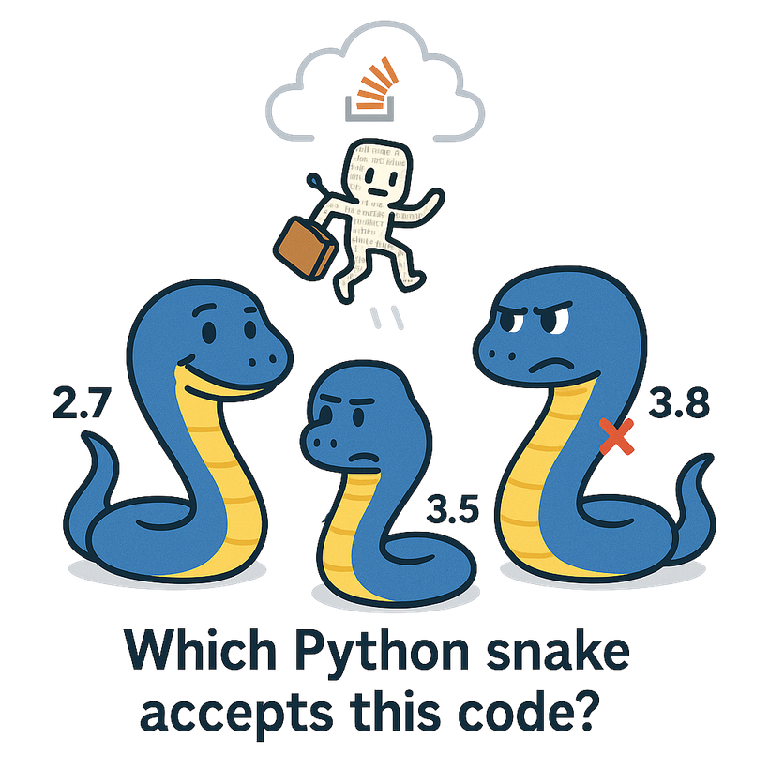


HOME
ABOUT
INTRO
PART I
PART II
FINAL
Page
16
Study 1:
Compatibility prevalence
Focus on Python code snippets from StackOverflow

Slide 17
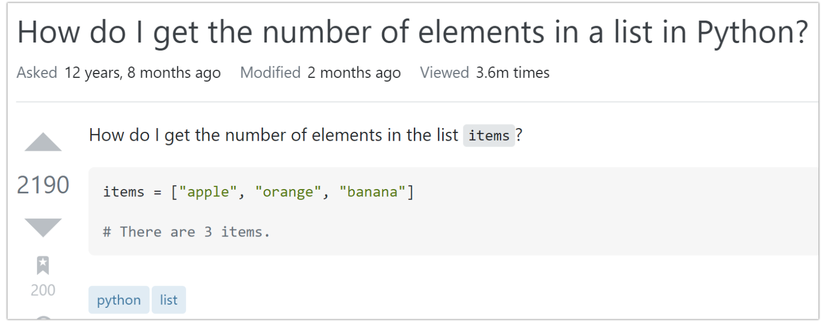
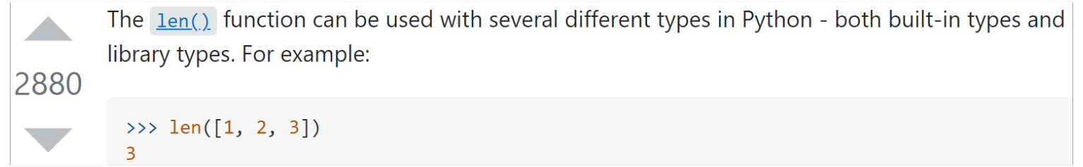
HOME
ABOUT
INTRO
PART I
PART II
FINAL
Page
17
Stack Overflow (SO)
Even with ChatGPT, StackOverflow remains a key code source
Question
Code Snippets
Tags
Answer
Code Snippets

Slide 18



HOME
ABOUT
INTRO
PART I
PART II
FINAL
Page
18
Why Python?
User Project
Python 2.x
Programming languages evolve with shifting requirements while generally keeping backward compatibility
Reuse
Python 3 breaks
backward compatibility with Python 2
User Project
Python 3.x
Reuse
This break introduces
significant issues for developers
With Python 2 features

Slide 19
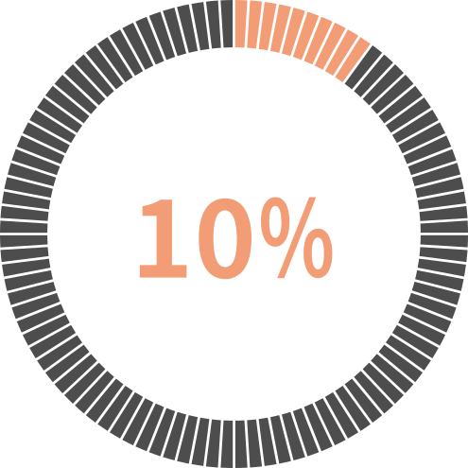
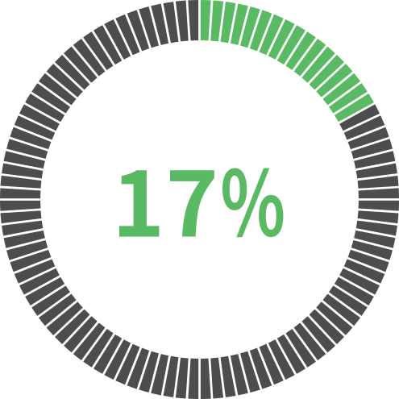
HOME
ABOUT
INTRO
PART I
PART II
FINAL
Page
19
Empirical Study
Investigating how common are SO Python code snippets with version compatibility issues
A tool needs to be provided for users to detect the Python version of the Python code snippets on Stack Overflow!!!
Results
About 10% of snippets have version compatibility issues in the top answers to questions
Only about 17% of snippets interpretable only by Python 2 or only by Python 3 are tagged with the Python version
with compatibility issues
with version tag

Slide 20
HOME
ABOUT
INTRO
PART I
PART II
FINAL
Page
20
Revisions to Chapter 2 (Study 1) (1/2)
Comment
The research questions introduced in Chapter 1 are not referenced again in later chapters, giving the impression that they are left unanswered.
Response
The opening of the Study 1 chapter was revised to explicitly state that it addresses D-RQ1, clarifying the study’s role within the overall research questions.

Slide 21
HOME
ABOUT
INTRO
PART I
PART II
FINAL
Page
21
Revisions to Chapter 2 (Study 1) (2/2)
Comment
The research questions appear abruptly (Section 2.4).
The treatment of construct validity is unclear; in particular, the use of interpreter parsing success as a compatibility criterion needs further justification (Section 1.3).
Response
In response to this comment, Section 2.4 was revised to add clearer contextualization before introducing the research questions, explicitly linking them to the data collection and analysis procedure and organizing the results around S1-RQ1 to S1-RQ3.
In addition, Section 2.5 was extended to clarify construct validity by explaining that version compatibility is operationalized as syntax-level interpretability, justifying this choice and explicitly discussing its limitations.

Slide 22
HOME
ABOUT
INTRO
PART I
PART II
FINAL
Page
22
Study 2:
Compatibility detection
Focus on Python code snippets from StackOverflow

Slide 23
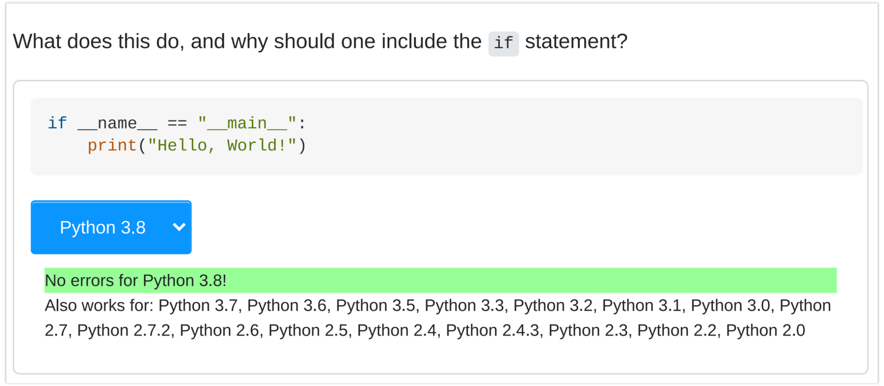
HOME
ABOUT
INTRO
PART I
PART II
FINAL
Page
23
PyVerDetector
A Chrome extension that helps SO users address the version compatibility issue of Python code snippets
SO page
Message Areas

Slide 24
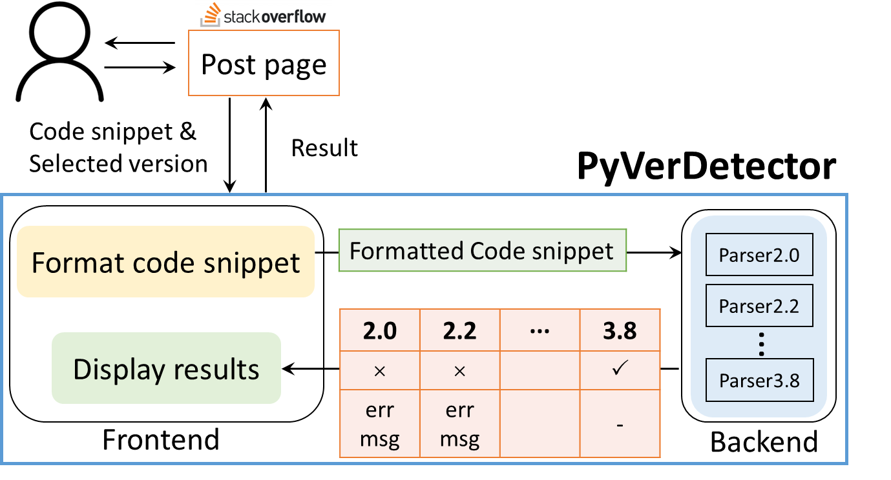

HOME
ABOUT
INTRO
PART I
PART II
FINAL
Page
24
PyVerDetector
Frontend
Fetching the code snippet from SO
Displaying the results

Slide 25
HOME
ABOUT
INTRO
PART I
PART II
FINAL
Page
25
PyVerDetector
Backend
Statically analyzing the given code snippet across multiple Python versions

Slide 26
HOME
ABOUT
INTRO
PART I
PART II
FINAL
Page
26
PyVerDetector

Slide 27
HOME
ABOUT
INTRO
PART I
PART II
FINAL
Page
27
Usage Scenarios
1. Displaying the latest version as default
2. Accurate display of results for selected versions
27

Slide 28
HOME
ABOUT
INTRO
PART I
PART II
FINAL
Page
28
Revisions to Chapter 3 (Study 2) (1/3)
Comment
The research questions introduced in Chapter 1 are not referenced again in later chapters, giving the impression that they are left unanswered.
Response
The opening of the Study 2 chapter was revised to explicitly state that it addresses D-RQ2, clarifying the study’s role within the overall research questions.

Slide 29
HOME
ABOUT
INTRO
PART I
PART II
FINAL
Page
29
Revisions to Chapter 3 (Study 2) (2/3)
Comment
Some parts of Chapter 3 appear similar to the content already discussed in Chapter 2, raising questions about how Chapter 3 differs in its contribution. Although results are summarized in terms of research questions, they initially seem to correspond to Chapter 2, despite differing numerical values. In addition, the conclusion of Chapter 3 is relatively brief, and clarification is requested on the key contributions of Chapter 3 within the overall dissertation.
Response
In response to this comment, redundant empirical evaluation content in Chapter 3 (Study 2) that overlapped with Chapter 2 was removed, and the chapter was revised to focus explicitly on tool-related research questions.
In addition, the conclusion of Chapter 3 was expanded to summarize its main contributions and clarify its role within the overall dissertation.

Slide 30
HOME
ABOUT
INTRO
PART I
PART II
FINAL
Page
30
Revisions to Chapter 3 (Study 2) (3/3)
Comment
Chapter 3 lacks a related work section, whereas Chapters 2 and 4 include independent sections for related work. These chapters should be organized to follow a consistent, parallel structure.
Response
In response to this comment, Section 3.5 (Related Work) was added to Chapter 3 to align its structure with Chapters 2 and 4.

Slide 31
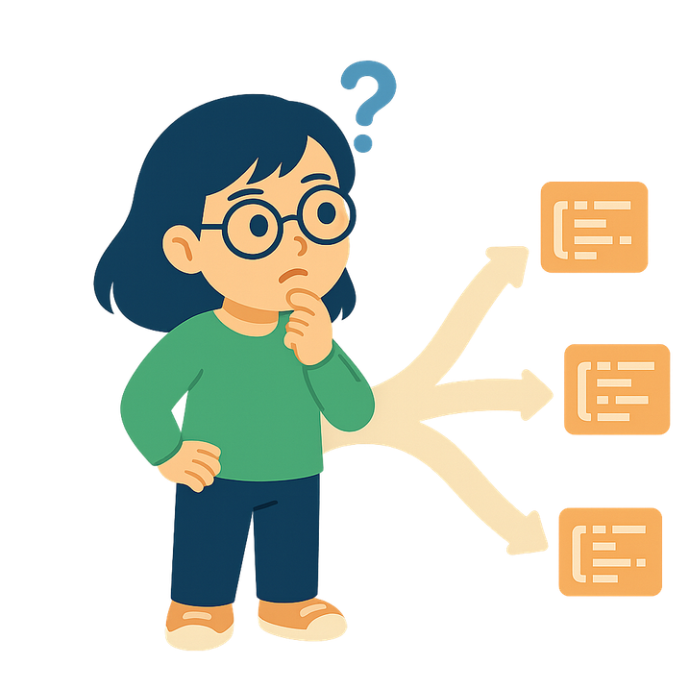
HOME
ABOUT
INTRO
PART I
PART II
FINAL
Page
31
When Running Is Not Enough
From “Does it run?” to “Are these implementations the same?”
Study 1&2: Compatibility — Does the snippet run?
Investigated Python version compatibility issues in online code
Developed PyVerDetector for real-time compatibility detection
But running is only the beginning…
Developers may encounter multiple snippets solving the same task
So the next question becomes:
Do these implementations behave the same?
Are structurally different snippets functionally equivalent?

Slide 32

HOME
ABOUT
INTRO
PART I
PART II
FINAL
Page
32
Study 3:
PyFuncEquivDataset
Functional Equivalence Dataset of Python Methods

Slide 33

HOME
ABOUT
INTRO
PART I
PART II
FINAL
Page
33
Different Implementations, Same Functionality
def sum1d(s: int, e: int) -> int:
c = 0
for i in range(s, e):
c += i
return c
Functionally Equivalent
Developers may implement the same functionality using different algorithms or structures
def while_count(s: int, e: int) -> int:
i = s
c = 0
while i < e:
c += i
i += 1
return c
Significance and Research Direction
The foundation supporting code refactoring, semantic clone detection and LLM understanding
Extract functionally equivalent method pairs using automated testing and build a dataset of such methods

Slide 34

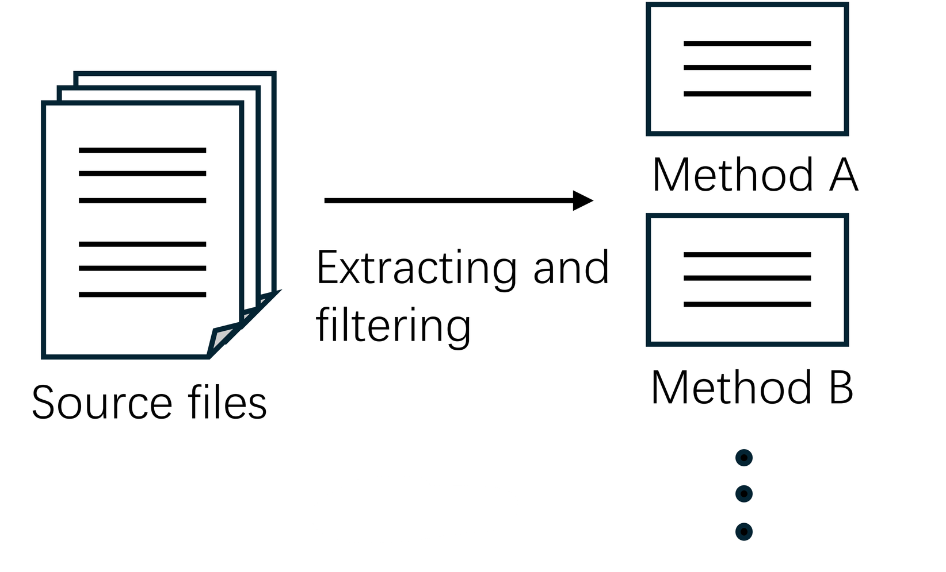
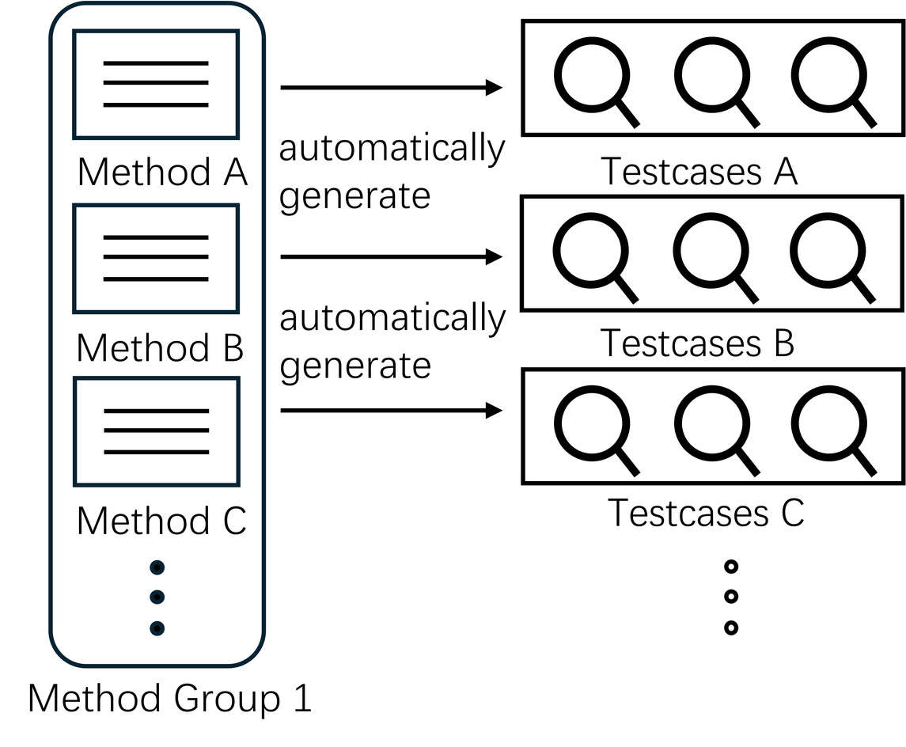
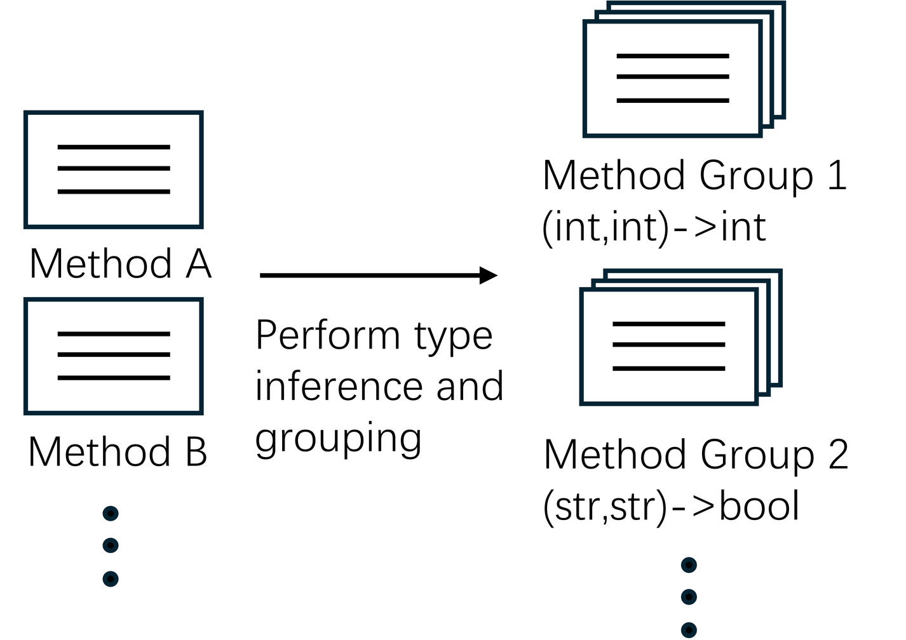
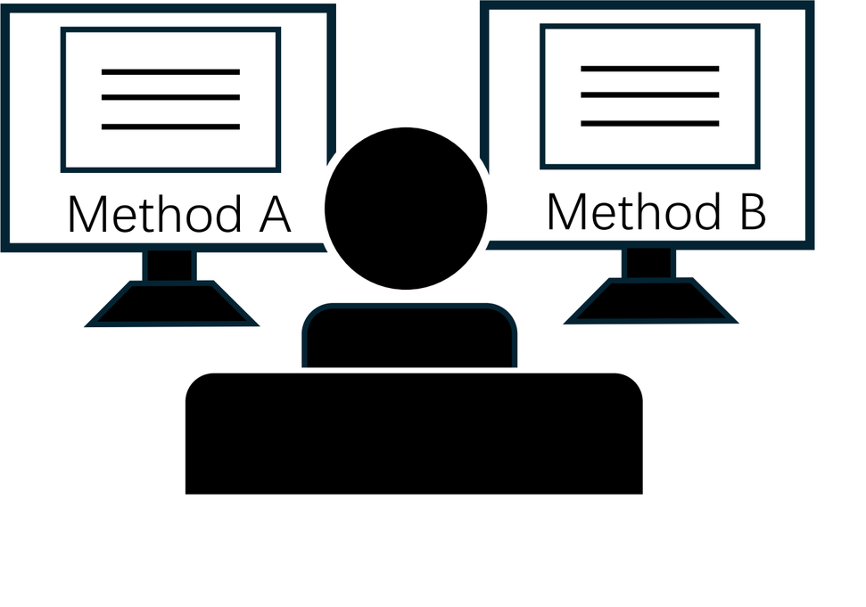
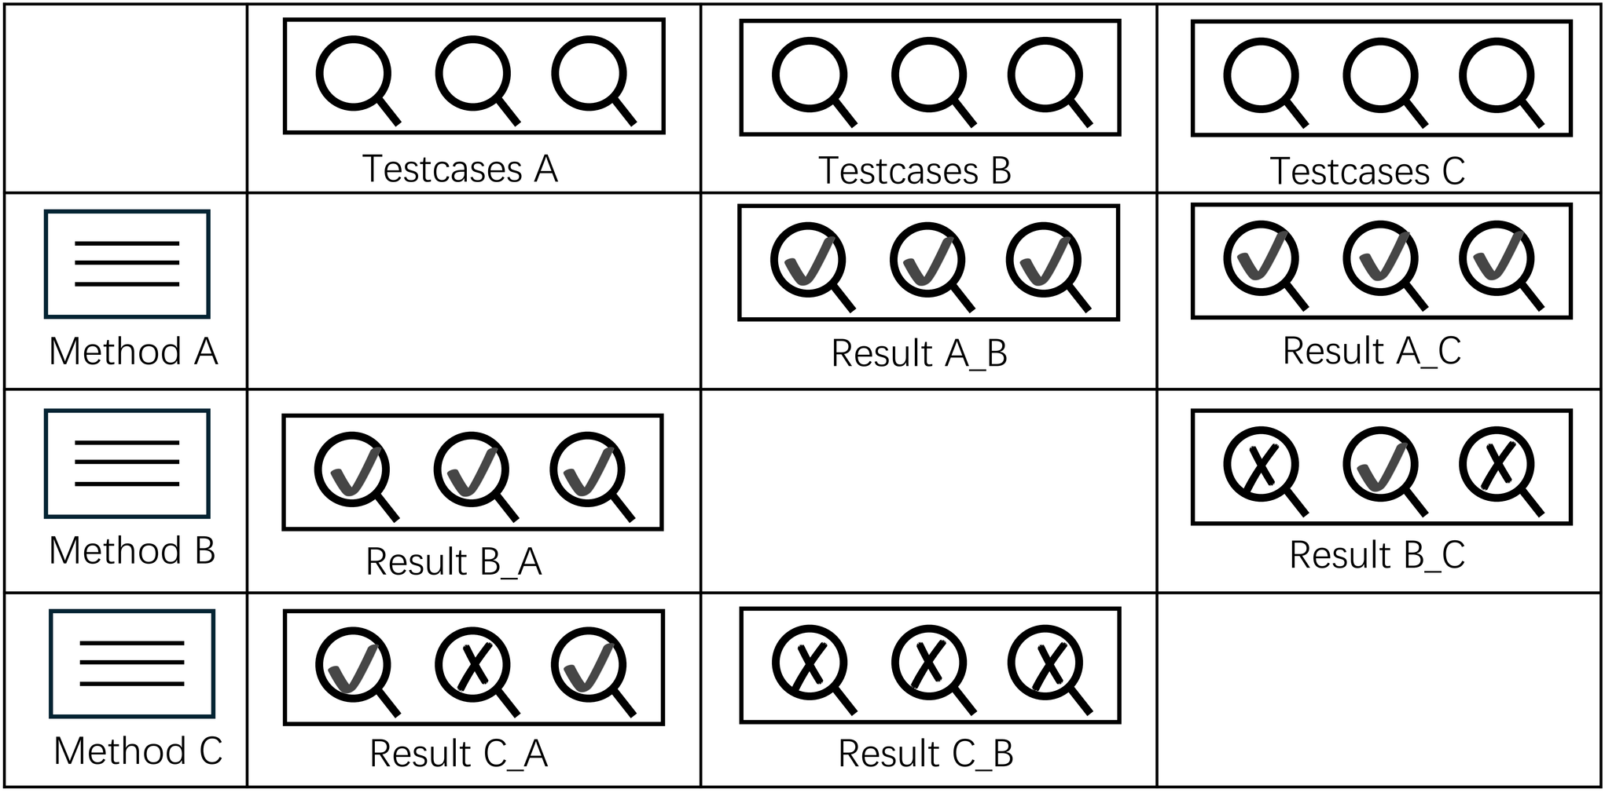




HOME
ABOUT
INTRO
PART I
PART II
FINAL
Page
34
Dataset Construction
Method Extraction and Initial Filtering
Identification of
Candidate
FE Method Pairs
Type Inference and Grouping
Test Case Generation
Manual Validation

Slide 35


HOME
ABOUT
INTRO
PART I
PART II
FINAL
Page
35
Dataset & GPT-4 Evaluation
Causes of Misclassification
Dataset
Over 70% of false positives were due to semantic similarity bias
Boundary-condition differences and mismatched input/error handling were also major causes
Most misclassifications occurred in string processing and numeric computation tasks
68 functionally equivalent pairs
683 non-equivalent pairs
GPT-4o Evaluation Results
Accuracy: ~85%
Recall: ~94%
Precision: Low (~37%), due to false positives
Directions for Improvement
Strengthen prompt design to better capture edge cases
Incorporate training examples where code is semantically similar but functionally different

Slide 36
HOME
ABOUT
INTRO
PART I
PART II
FINAL
Page
36
Revisions to Chapter 4 (Study 3) (1/4)
Comment
The research questions introduced in Chapter 1 are not referenced again in later chapters, giving the impression that they are left unanswered.
Response
The opening of the Study 3 chapter was revised to explicitly state that it addresses D-RQ3, clarifying the study’s role within the overall research questions.

Slide 37
HOME
ABOUT
INTRO
PART I
PART II
FINAL
Page
37
Revisions to Chapter 4 (Study 3) (2/4)
Comment
Objective of Performance and LLM Evaluation
Chapter 4 includes both performance evaluation and LLM evaluation on the constructed functional equivalence dataset. Clarification was requested on why these evaluations are necessary and how they relate to the concept of functional equivalence.
Response
Performance and LLM evaluations were added to show the practical implications of functional equivalence and to demonstrate how the constructed dataset can be used in downstream analyses (Section 4.1).

Slide 38
HOME
ABOUT
INTRO
PART I
PART II
FINAL
Page
38
Revisions to Chapter 4 (Study 3) (3/4)
Comment
Dataset Size and Value
The dataset contains only 68 functional equivalence pairs, which may appear small at first glance. Clarification was requested on how this dataset should be interpreted and why it is valuable despite its size.
Response
In response to this comment, Section 4.4 was revised to clarify that the dataset is intended as a high-confidence, curated ground-truth benchmark rather than a large corpus. Although the number of equivalent pairs is modest, strict verification and manual validation ensure label reliability, and the inclusion of a large set of validated non-equivalent pairs provides additional value for robust evaluation.

Slide 39
HOME
ABOUT
INTRO
PART I
PART II
FINAL
Page
39
Revisions to Chapter 4 (Study 3) (4/4)
Comment
The related work section of Chapter 4 misses studies that are more directly relevant, such as EqBench, a dataset of equivalent and non-equivalent program pairs. Additional related work should be considered.
Response
Relevant equivalence benchmarks (EqBench, EquiBench, and S4Eq) were added to Chapter 4, with explicit discussion of how PyFuncEquivDataset complements existing datasets (Sections 4.7.3–4.7.5).

Slide 40
HOME
ABOUT
INTRO
PART I
PART II
FINAL
Page
40
Revisions to Chapter 6
Comment
The research questions introduced in Chapter 1 are not referenced again in later chapters, giving the impression that they are left unanswered.
Response
In response to this comment, Chapter 6 now includes additional text that explicitly answers the three dissertation-level research questions introduced in Chapter 1.
In particular, explicit answers to D-RQ1–D-RQ3 were added to Section 6.1 (Conclusion) to clearly link the findings back to the main research questions.

Slide 41

HOME
ABOUT
INTRO
PART I
PART II
FINAL
Page
41
Conclusion
Studied Python version compatibility issues
Developed a version-detection tool
Identified functionally equivalent method pairs to support safer understanding and reuse
Future work
Cross-language analysis of compatibility and functional equivalence
Building larger, more automated FE benchmarks
Integrating FE insights into refactoring, repair, and developer tools

Slide 42
HOME
ABOUT
INTRO
PART I
PART II
FINAL
Page
42
Thank You!
Presented By :
Shiyu yang
Advisor: Prof. Yoshiki Higo

