Slide 1
A merge conflict resolution method using source code metrics and development history data (ソースコードメトリクスと開発履歴データを用いたマージコンフリクトの解決手法)
Master Thesis
Inoue Laboratory
Bian Mohan

Slide 2
Background
Version Control System(VCS) make it possible for parallel developing in a large number of people
There are also problems when using VCS, merge conflict is one of them

Slide 3
Merge Conflict
10 - int a;
10 + int a, b;
11 + a = 1;
12 + b = 2;
Merge Conflict
Ancestor
Commit P
Commit P1
10 int a;
++<<<<<
+ int a, b;
+ a = 1;
+ b = 2;
++======
+ int a = 1;
+ int b = 2;
++>>>>>
10 - int a;
10 + int a = 1;
11 + int b = 2;
Commit P2
To resolve merge conflicts, it takes time and effort[1]
[1] Bakhtiar Khan Kasi and Anita Sarma. Cassandra: Proactive Conict Minimization through Optimized Task Scheduling. In Proceedings of ICSE 2013, San Francisco, CA, USA , pp. 732-741.

Slide 4
Solution of Merge Conflict
For commit pairs where merge conflicts occur, it is often resolved by adopting one and deleting the other(98%) [2]
Shiraki[3] used machine learning to build a judging model
By proposing to the developer how to resolve each commit,
Attempt to help resolve merge conflicts
++<<<<<
+ int a, b;
+ a = 1;
+ b = 2;
++======
+ int a = 1;
+ int b = 2;
++>>>>>
adopt
+ int a, b;
+ a = 1;
+ b = 2;
delete
An Example of merge conflict resolution
[2] 湯月亮平(2015), 開発履歴を用いたメソッドコンフリクト分析, 修士論文, 奈良先端科学技術大学院大学
[3] 白木秀弥(2020), 開発履歴を用いたメソッドコンフリクトの分析, 修士論文, 大阪大学

Slide 5
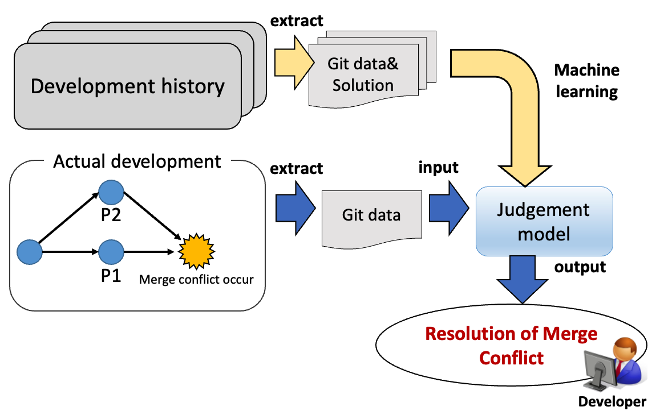
Previous Research[3]：Experimental Approach
[3] 白木秀弥(2020),発履歴のメタ情報を用いたマージコンフリクトの消支援手法, 修士論文, 大阪大学

Slide 6
Parameters used to build the model（previous research）
The following information is extracted from P1, P2 and the differences between P1, P2, and used as model parameters
line_num | (P1) | number of lines where merge conflicts occur
 | (P2)
 | (Diff)
time | (P1) | commit creation date and time
 | (P2)
 | (Diff)
distance | (P1) | Distance between commit and its Evolutionary Commit
 | (P2)
 | (Diff)
author_ratio | (P1) | ratio of commit made by creator to total commit number
 | (P2)
 | (Diff)

Slide 7
Definition of Merge Conflict Resolution
++<<<<<
+ int a, b;
+ a = 1;
+ b = 2;
++======
+ int a = 1;
+ int b = 2;
++>>>>>
adopt
+ int a, b;
+ a = 1;
+ b = 2;
delete
Output: (adopt, delete)

Slide 8
Model Expansion (in my research)
Research goal
Investigate the influence of source code metrics to the judging model
To help resolve merge conflicts not only for Java but also for other language
Improve prediction accuracy by improving features in previous research

Slide 9
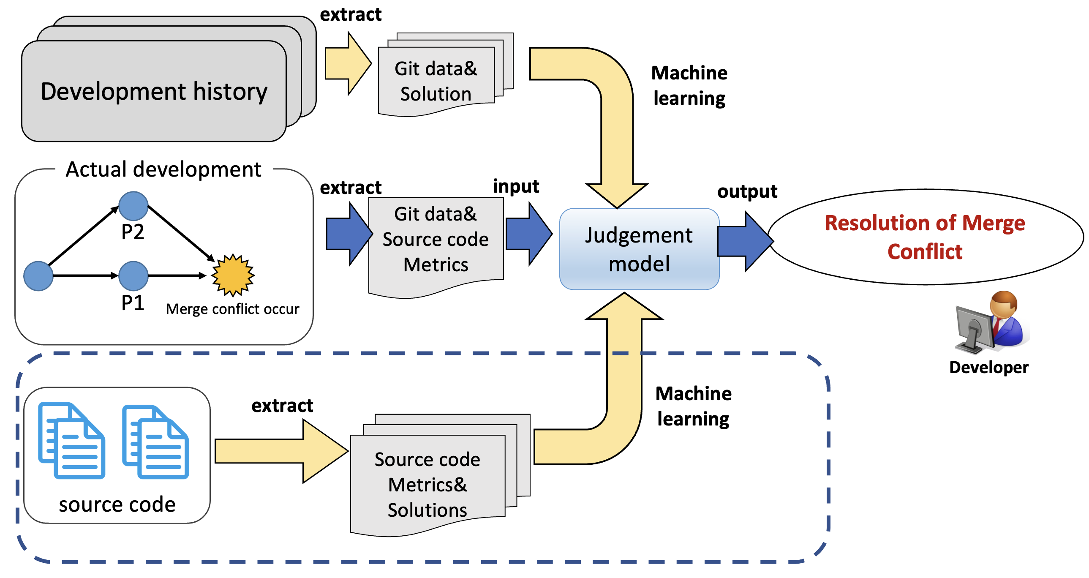
New judgment model by adding code metrics
Model Expansion

Slide 10
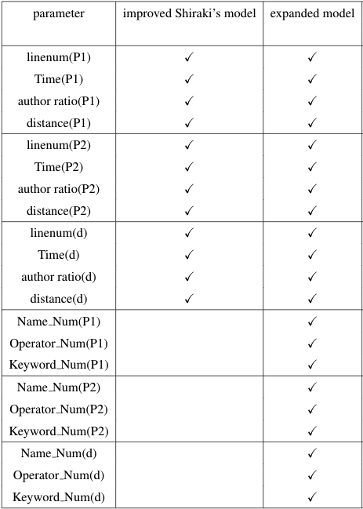
Parameter in the experiment
Java : 34 kinds of operators
50 kinds of keywords
Python: 39 kinds of operators
35 kinds of keywords
Name: number of variables and functions
Operators: + - * / = ! …
Keywords: if, else, continue…
Newly added
Code metrics

Slide 11
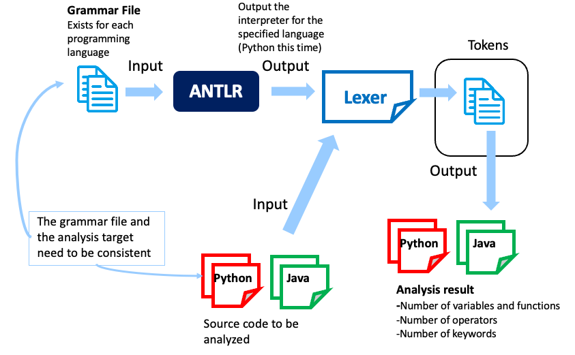
The method of extracting code metrics

Slide 12
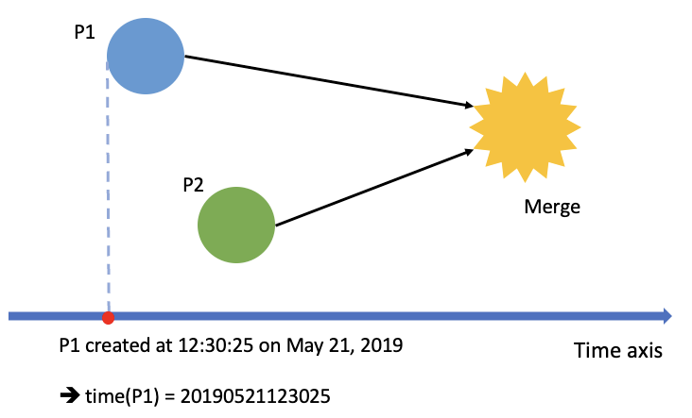
Parameter Improvement
Time parameter in previous research

Slide 13
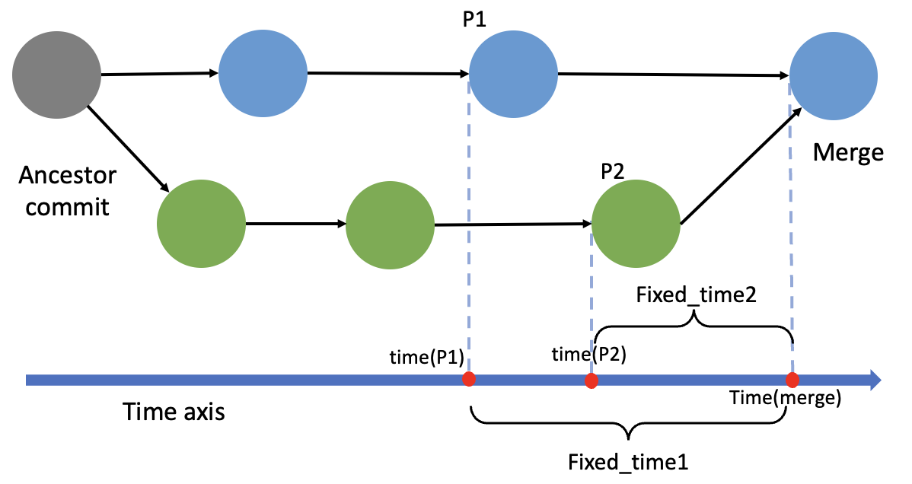
Parameter Improvement
The new time feature Fixed_time1, Fixed_time2 used in this research

Slide 14
Parameter Improvement
After parameter improvement of Shiraki’s model, the accuracy of the model increased
From 66.41% to 74.99% in case of Java project

Slide 15
Evaluation
Evaluate the model expansion from the following viewpoints
RQ1: How will the results change if both developing history data and language specific source code metrics are used?
RQ2: How is the developing history data that contributes to the judgment different between Java and Python language projects?

Slide 16
Projects used in the experiment
20 Java projects from the OSS projects published by the Apache Software Foundation.
15 Python projects from the same place
Projects with no conflicts and projects with extremely few conflicts (less than 10) are excluded, and 8 projects remained.

Slide 17
RQ1: How will the results change if both developing history data and language specific source code metrics are used?
Accuracy of each model
Java
Python

Slide 18
RQ1: How will the results change if both developing history data and language specific source code metrics are used?
Feature importance
Blue: P1(mainstream parameter)
Red: P2(branch parameter)
Green: P1 - P2(difference)
Grey: Source code metrics

Slide 19
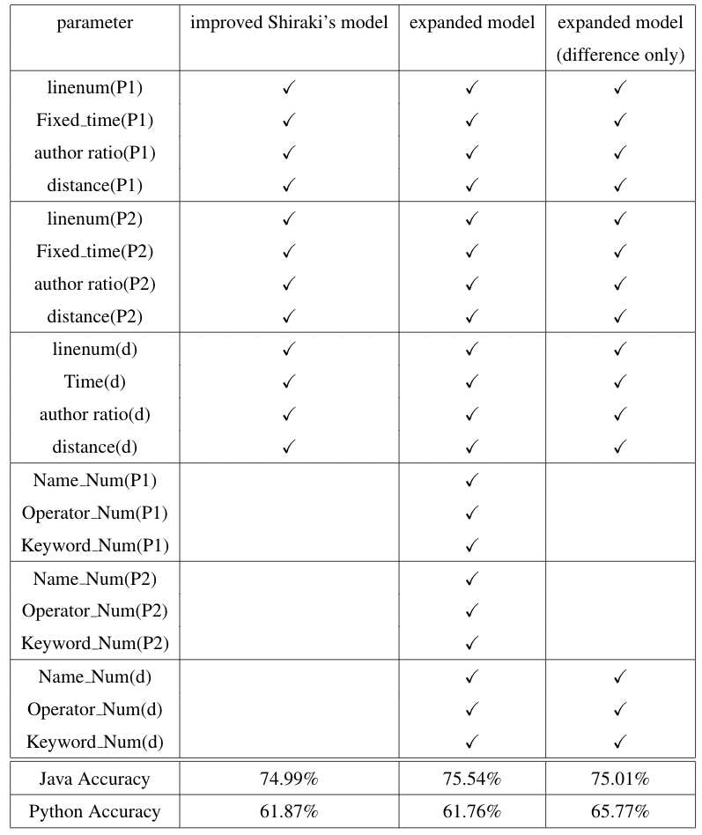
RQ1: How will the results change if both developing history data and language specific source code metrics are used?
By adding 9 source code metrics into the model, the accuracy didn’t change much in both Java and Python project.
With only the difference of metrics from each commit, it increased about 4% in Python.

Slide 20
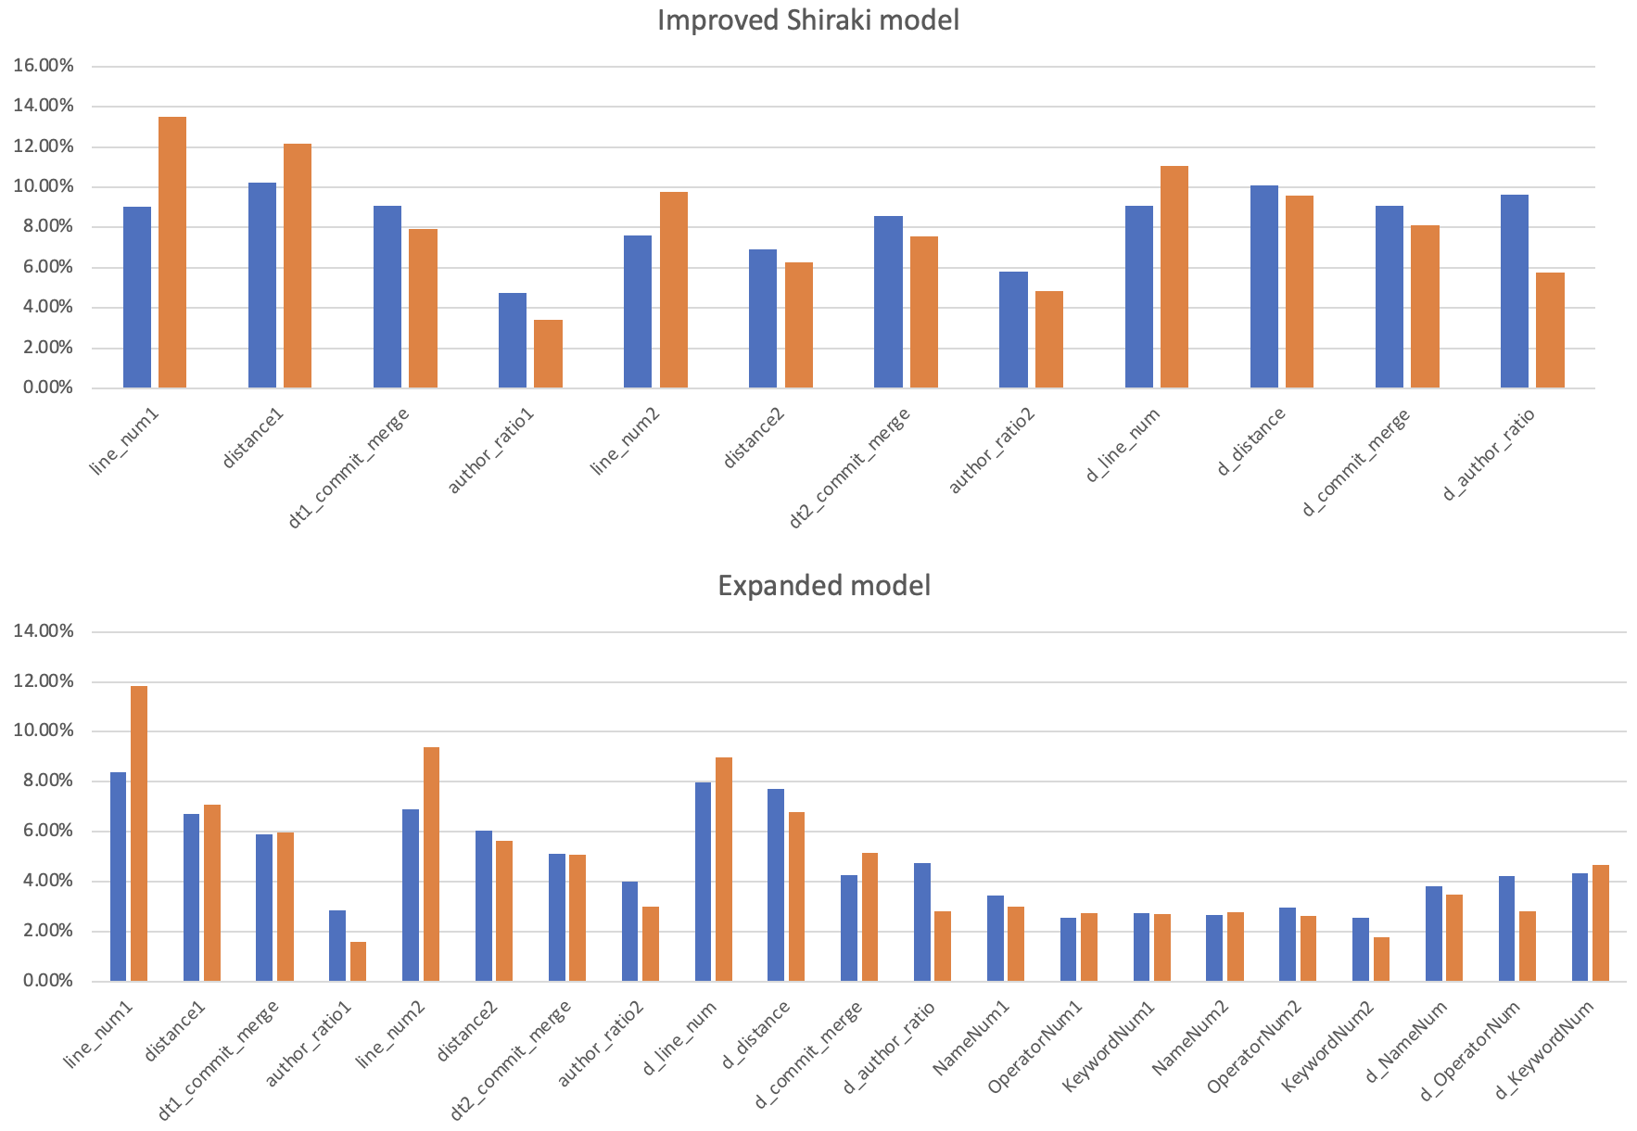
RQ2: How is the developing history data that contributes to the judgment different between Java and Python language projects?
Java project features that are of high importance tend to have high importance in Python as well.
The same result came up even when building the model without the source code metrics.
Java project
Python project

Slide 21
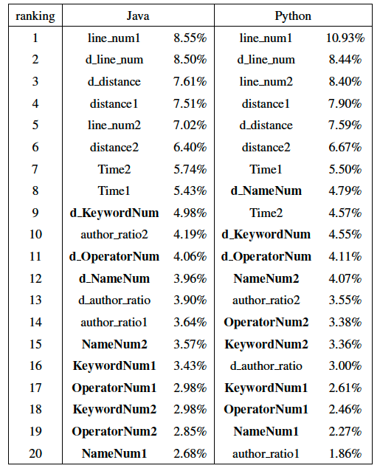
Feature importance ranking
Line num, distance, Time, and the differences in the source code metrics have high importance

Slide 22
Conclusion
We traces back to the file contents during the development phase, extracts the source code metrics, and added them to Shiraki’s model
For building the model, the importance of source code metrics is not high, but the difference of the metrics from each commit has a relative high importance
The features with high importance of the Java project tend to be of high importance also in Python.

