Slide 1
Code Clone Detection in Rust Intermediate Representation
Pizzolotto, D.
Matsushita, M.
Inoue, K.
松下誠
井上克郎
大阪大学
大阪大学
南山大学

Slide 2
Code clones detection
State of the art
Code clone detection has been an actively researched topic and a large number of tools have been developed
However, almost every tool focus on Java language, or C language.
Lower-than-source level has been tried in a limited way only for Java code and LLVM IR, and most efforts are shifted in detecting type 4 clones rather than improving existing detectors.

Slide 3
Problem definition
Is it possible to detect additional clones due to normalization, by checking lower stages of the compilation pipeline?
Instead of targeting Java or C we try a modern language with an higher number of compiler restrictions
Instead of analyzing clones at source level, we try analyzing at Intermediate Representation, in particular after desugaring and normalization
We then compare differences between the original source code clones and the Intermediate Representation clones.

Slide 4
Background
rust-lang
Language developed by the Mozilla Foundation
Designed around safety
Compiler guarantees the absence of data races, guarantees type safety and guarantees the absence of invalid references
Requires additional syntax from the programmer,
that may introduce additional clones

Slide 5
Background
Lifetimes
// This struct has one lifetime
// parameter, 'src
struct Config<'src> {
hostname: &'src str,
username: &'src str,
}
The compiler needs to know when it is safe to drop a reference to memory
In this case the lifetime ‘src is used by the programmer to tell the compiler that the struct Config can not live longer than hostname and username

Slide 6
Background
Mutability
let mut a = Point { x: 5, y: 6 };
a.x = 10;
let b = Point { x: 5, y: 6 };
b.x = 10; // Error: cannot assign to immutable field `b.x`.
To avoid data races, Rust allows a single mutable reference or multiple immutable references to the same variable
The compiler is highly conservative and may force the programmer to use mutexes or runtime checks.

Slide 7
Background
Compilation structure
In order to enforce the compiler constraints, several transformations are done to Rust source code during compilation
These transformations relax some constraints and may reveal additional code clones that were missed at source level due to strict compiler rules

Slide 8
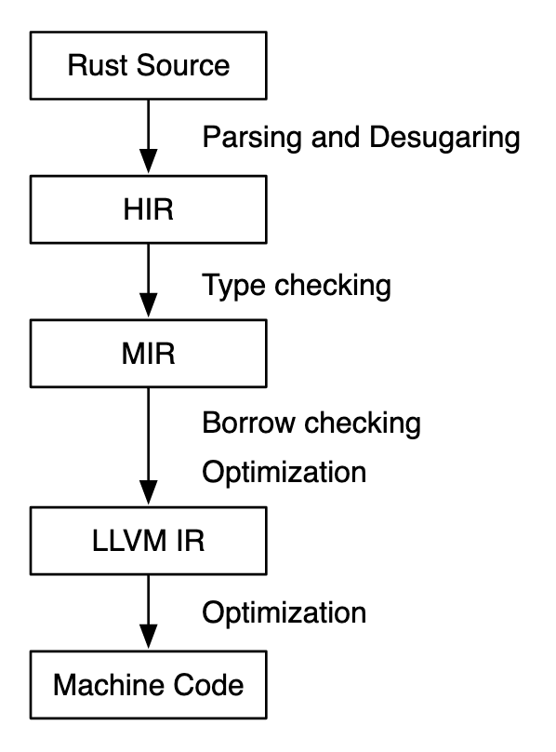
Background
Compilation structure
In our work we focus mainly on HIR

Slide 9
Background
Compilation structure
In our work we focus mainly on HIR
HIR involves the following normalizations:
parenthesis are removed
if let syntax is normalized into match syntax
for and while normalized into loop syntax
additional contraints are relaxed

Slide 10
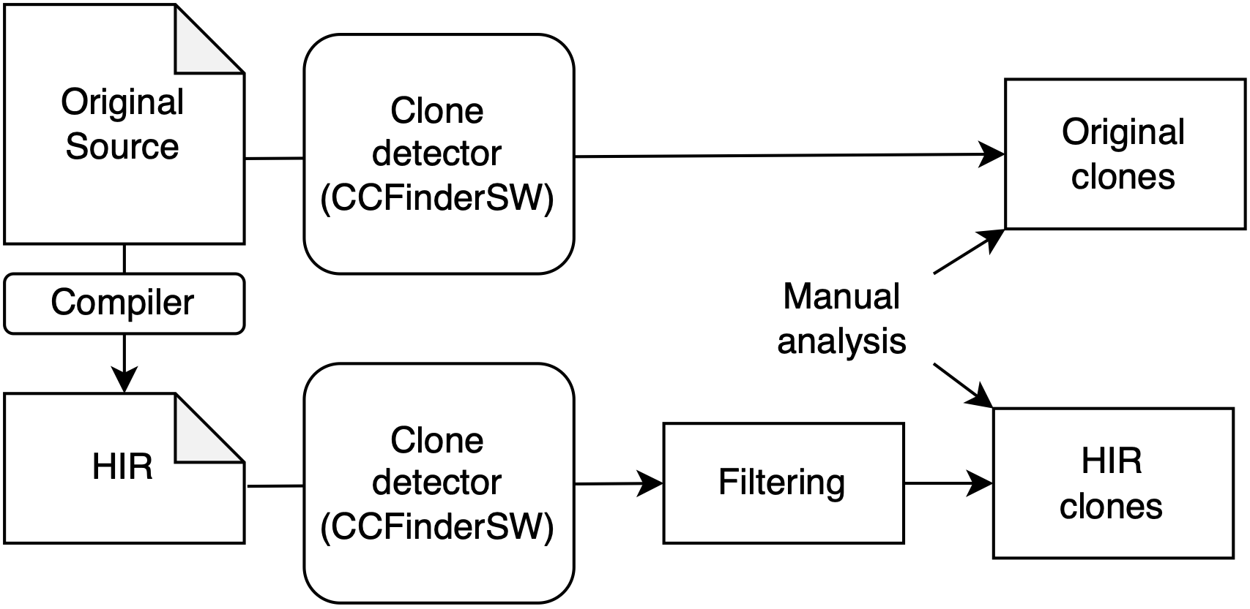
Approach
Overview

Slide 11
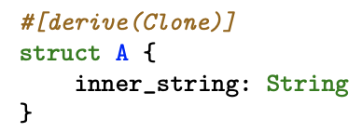
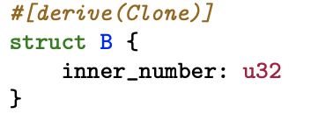
Approach
Macros

Slide 12
Approach
Macros
Invoke macro
at compile time

Slide 13
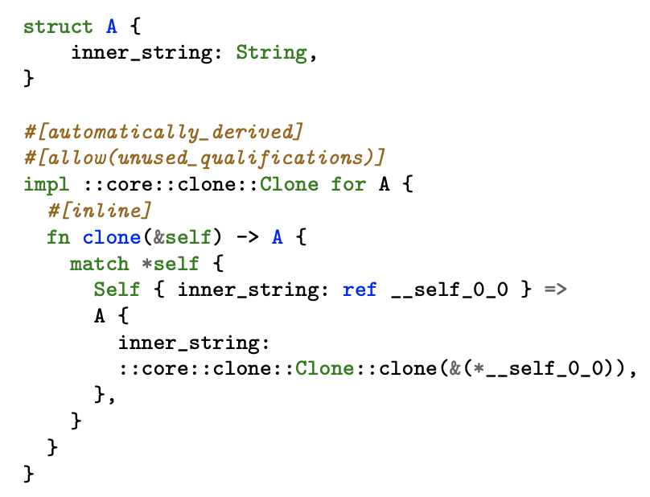
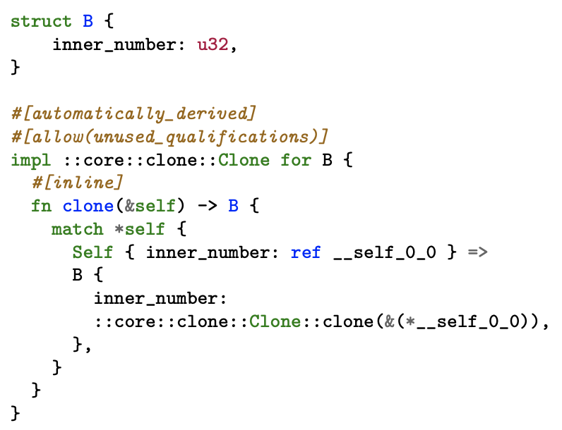
Approach
Macros

Slide 14
Approach
Macros
Generated by macros, we need to filter these methods before
running the clone detector

Slide 15
Evaluation
Research Questions
RQ1, type: What type of clones can be usually found in a Rust project? Can the clones be easily refactored?
RQ2, agreement: How different are the clones between original code and HIR? What type of clones are detected only by one method?
RQ3, accuracy: How accurate is the clones detection in both original code and HIR? How many false posi- tives are generated by the code?

Slide 16
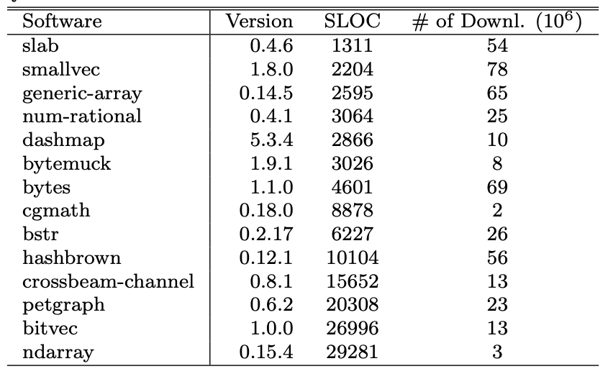
Evaluation
Case Studies

Slide 17
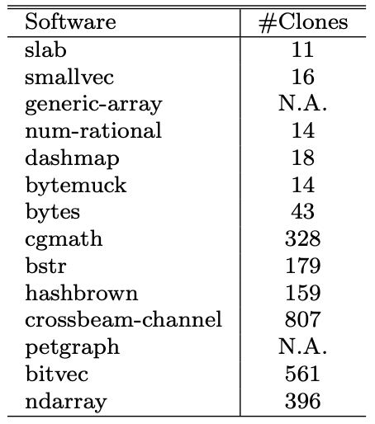
Evaluation
RQ1: Type
3033 clones in 15 rust projects:
manual implementation of the method len or print for a specific class, copy pasted everywhere.
different number of parameters for the same function. Instead of calling a more generic function, the body is copy pasted.
A lof of functions marked as #[test] and #[bench]. Rust allows mixing test and benchmark code.

Slide 18
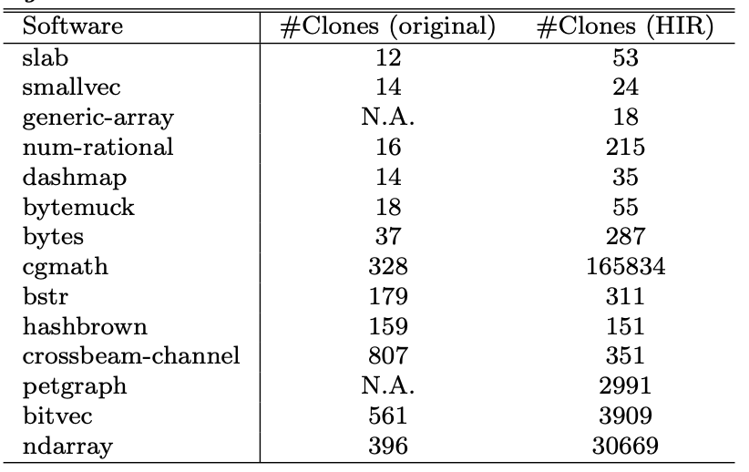
Evaluation
RQ2: Agreement
Number of clones is essentially increased sometimes by a factor of 1000.
Most of these clones were due to custom build scripts or procedural macros that we failed to filter.

Slide 19
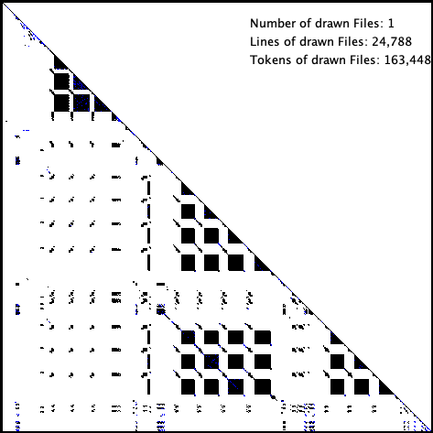
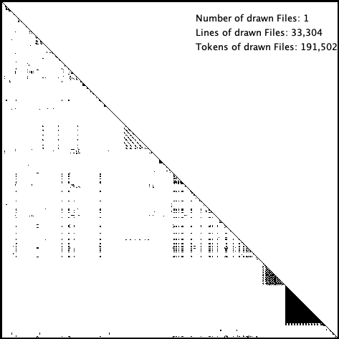
Evaluation
RQ2: cgmath and ndarray
Clone map shows clustered clones for both cgmath and ndarray.
These are mainly due to procedural macros that we did not filter.
In particular, in cgmath they represent the matematical operations for each class (Vector2, Vector3, Vector4…)

Slide 20
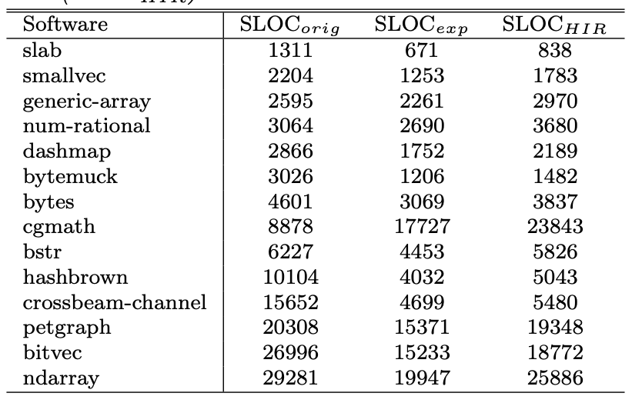
Evaluation
RQ2: agreement
In all instances, the amount of line of codes in the HIR version is lower than the original.
Compiler removes useless methods and boilerplate code including #[test] and #[bench] functions
These clones, reported in the original code are thus not found in the HIR clones

Slide 21
Evaluation
RQ3: accuracy
We analyzed all clones in original source code and some randomly selected HIR code and could not determine any false positives
However, most of the clones detected are not refactorable.

Slide 22
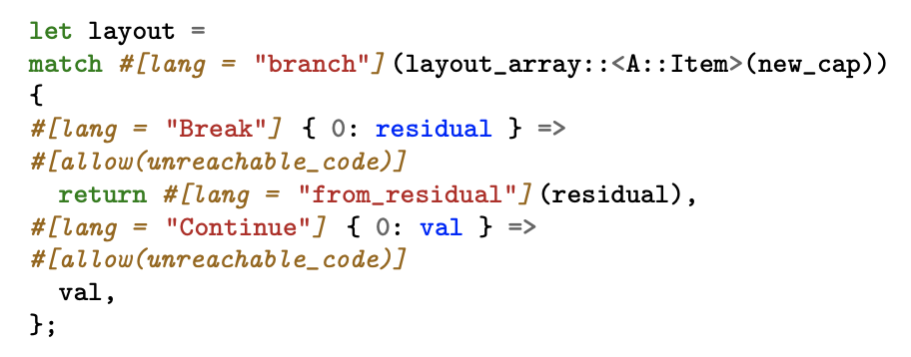
Evaluation
RQ3: accuracy
Reported as clone in the HIR, due to the increased number of tokens

Slide 23
Conclusion
We analyzed the clones of 15 different Rust projects both in source code and High-level Intermediate Representation
Most clones at source level are due to implementation of common methods such as “len” for multiple classes.
In HIR code, most useless clones such as tests or benchmarks are removed, but a lot of clones may be added due to procedural macros.
Although some new clones can be found, correctly filtering the macros requires high effort

