Slide 1
SBOM Challenges for Developers:
From Analysis of Stack Overflow Questions
Wataru Otoda† Tetsuya Kanda††
Yuki Manabe††† Katsuro Inoue†††† Yoshiki Higo†
† Osaka University †† Notre Dame Seishin University
††† The University of Fukuchiyama †††† Nanzan University
Notes:
Thank you for the introduction. I, Wataru Otoda, will talk about our research on this topic.

Slide 2




Background: Software Supply Chain Risks
Current software development takes advantage of many external libraries
  Reduced dev costs, short dev cycles, and more robust & sophisticated software
  96% codebases contain open-source code [1]
However, it entails risks
  Cyber Security (Supply Chain Attack)
    Cyberattacks on the U.S. govs and private sectors via SolarWinds Orion software (2020)
  Copyright Infringement (License Violation)
[1] Synopsys，2023 OPEN SOURCE SECURITY AND RISK ANALYSIS REPORT
Notes:
Let’s start the talk with the research background. Current software development takes advantage of many external libraries, which reduces development costs, shorten development cycles, and leads to more robust & sophisticated software. In fact, 96% codebases are known to contain open-source code.
However, it entails risks, namely, cybersecurity risks such as supply chain attack, and copyright infringement risks such as license violation. Security and copyright concerns exist in the software supply chain can persist in production software. The cyberattacks on the U.S. government and private sectors through supply chain attack on SolarWinds Orion software in 2020 underscores its significance.

Slide 3

Software Bill of Materials (SBOM)
Formal and machine-readable record of software components [2]
  Components: Libraries, etc.
Quick response to supply chain risks
  Executive Order on Improving the Nation’s Cybersecurity
    US Exec. Order, 2021
  Cyber Resilience Act
    EU legislation proposal
    Expected to be effective on 2024
Developer
Component Name
Dependencies
Version
Other Identifiers
(CPE, SWID tag, PURL, etc.)
Timestamp
SBOM Creator
[2] The United States Department of Commerce, “The Minimum Elements For a Software Bill of Materials (SBOM)”
Notes:
To better manage these risks, the use of Software Bill of Materials (SBOM) is encouraged.
SBOM is a formal and machine-readable record of software components, such as software libraries. It typically contains information about component developer, component name, dependency relationships, component version, other component identifiers such as CPE, SBOM creation date, and SBOM creator. It facilitates a quick response to supply chain risks and government bodies are looking closely to SBOM, that the U.S. issued the Executive Order on Improving the Nation’s Cybersecurity in 2021 and the EU is preparing to enact a cyber resilience act in 2024, both requesting software vendors to provide SBOMs.

Slide 4

SBOM Advantages
Easy acquisition of software component information
→ Detect & mitigate vulnerability/licensing issues before they get problematic
Package A
Version: 1.5.1
!
Software
System
SBOM
Package B
License: GPLv3
Notes:
Here is a hypothetical situation that demonstrates the importance of SBOMs.
Let’s think about a black-box software system and its user. This software in fact has a security vulnerability and license violation, but the user can’t tell since it’s a black box. Here, the user is under risks of getting a cyberattack or getting sued of copyright infringement. However, with an SBOM, the user can easily acquire the software component information, which enables us to detect & mitigate vulnerability/licensing issues before they get problematic.

Slide 5


Primary SBOM Formats
Linux Foundation ISO/IEC Standard
Compliance and Transparency
OWASP Standard
Security and Supply Chain Analysis
Notes:
There is two primary ways to script an SBOM, the formats.
SPDX is an ISO/IEC standard format which is maintained by Linux Foundation and focused on compliance managements and transparency. On the other hand, CycloneDX is a format developed by a worldwide cybersecurity organization OWASP which is good at cybersecurity management and supply chain analysis.
From these facts we can conceive that there are urgent risks SBOMs can help handle, governments are enforcing the SBOM use, and we have precise SBOM standards.

Slide 6
SBOM Issue
SBOM adoption is still inadequate
Readiless Survey (Linux Foundation, 2022) [3]
Studied the SBOM readiness of 412 organizations in various types and sizes from various aspects
Questionnaire (Xia et al., 2023) [4]
Questioned online SBOM practitioners and
presented their views and future goals
Interview (Stalnaker et al., 2024) [5]
Issues that stakeholders faced when creating and consuming SBOMs and ways to handle them
Adoption Study (Nocera et al., 2023) [6]
Quantitively analyzed OSS projects hosted on GitHub
No study revealed concrete challenges that ordinal devs faced
[3] S. Hendrick and J. Zemlin, “The State of Software Bill of Materials (SBOM) and Cybersecurity Readiness”
[4] B. Xia et al., “An Empirical Study on Software Bill of Materials: Where We Stand and the Road Ahead”
[5] T. Stalnaker et al., “BOMs Away! Inside the Minds of Stakeholders: A Comprehensive Study of Bills of Materials for Software Systems”
[6] S. Nocera et al., “Software Bill of Materials Adoption: A Mining Study from GitHub”
Notes:
However, SBOM adoption is still inadequate.
Many studies have been conducted to reveal the reason and solution. Linux Foundation studied the SBOM readiness of 412 organizations in various types and sizes from various aspects in 2022, Xia et al. questioned online SBOM practitioners and presented their views and future goals in 2023, Stalnaker et al. studied issues that stakeholders faced when creating and consuming SBOMs and ways to handle them, and Nocera et al. quantitively analyzed OSS projects hosted on GitHub.
However, no study has been conducted to reveal concrete challenges that ordinal developers, who don’t belong to an organization, faced.

Slide 7
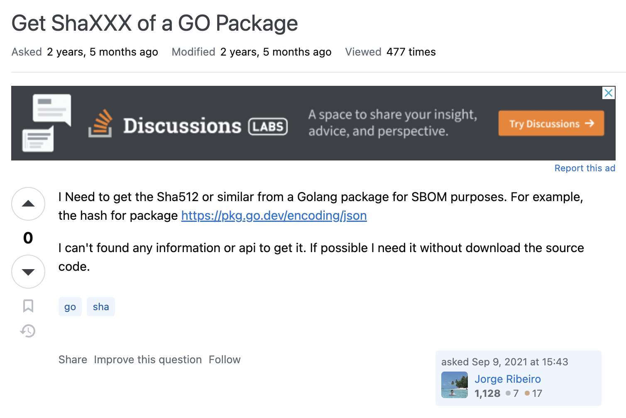
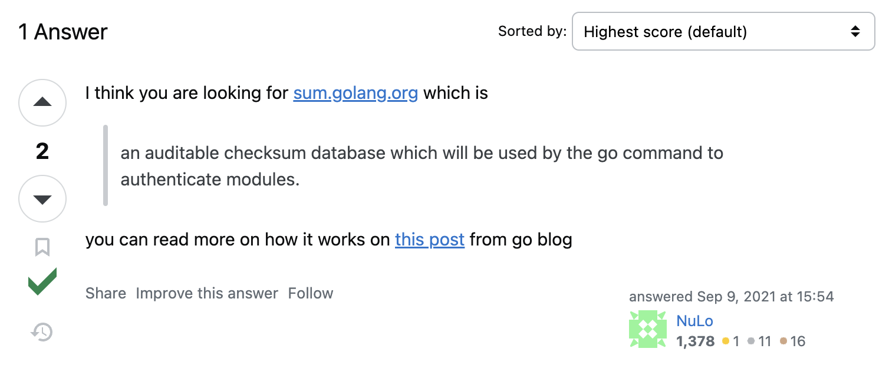
Stack Overflow
Developer Q&A website where many ordinal developers ask questions
#Users > 23 million
#Posts > 60 million
#New questions per day > 2,400
Title
Question
Answer
Body
Tags
Timestamp
Accepted Sign
https://stackoverflow.com/questions/69121175
Notes:
This brought us to look at Stack Overflow, a primary developer Q&A website where many ordinal developers ask questions. It has more than 23 million users, 60 million posts, and 2,400 new questions daily. A stack overflow question is composed of a question and multiple answers, as shown here. A question consists of a title, body, tags, and timestamp. And an answer consists of body and an accepted sign, which is given by the question asker to an answer that most contributed to resolve the question, but no answer get it if the question doesn't get resolved.

Slide 8
Analysis of Stack Overflow Questions
Our expectation：
  Developers facing challenges in utilizing SBOM are likely to seek solutions on Stack Overflow by asking questions
Stack Overflow analysis should reveal SBOM challenges that ordinal developers faced
Notes:
Considering the popularity and characteristics of Stack Overflow, developers facing challenges in utilizing SBOM are likely to seek solutions on Stack Overflow by asking questions. Therefore, Stack Overflow analysis should reveal SBOM challenges that ordinal developers faced, which led to this analysis.

Slide 9


Analyses
Analysis 1: Answered and Resolved Rate of SBOM Questions
Can Stack Overflow resolve SBOM challenges?
Analysis 2: Trends in the Number of SBOM Questions
Are there any effects on the SBOM question count from the U.S. Exec. Order requesting SBOM use and ISO/IEC standardization of SPDX?
Analysis 3: Challenges Faced by SBOM Users
What are the concrete challenges that ordinal developers faced?
Notes:
Here’s the analyses we conducted. First, we analyzed the Answered and Resolved Rate of SBOM Questions, which answers the question “Can Stack Overflow resolve SBOM challenges?” Second, we analyzed the Trends in the Number of SBOM Questions, which answers the question “Are there any effects on the SBOM question count from the U.S. Exec. Order requesting SBOM use and ISO/IEC standardization of SPDX?” Third, we analyzed the Challenges Faced by SBOM Users, which answers the question “What are the concrete challenges that ordinal developers faced?”

Slide 10
Question Extraction – Overview
Keywords: SBOM, CycloneDX, SPDX
  Case-insensitive
  Appears in title or body (whole-word)
Tags are useless
  SBOM tags are not widely used
Keyword Extraction
SBOM Questions
(with noise)
Noise Elimination (by hand)
SBOM Questions
Notes:
For our analysis, we extracted questions in this way. First, we selected search keywords that are SBOM, and two primary formats CycloneDX and SPDX. Then, we extracted questions that case-insensitively contained at least one of these keywords in the title or body. We didn’t use tags because SBOM tags weren’t widely used at the time of our analysis.

Slide 11
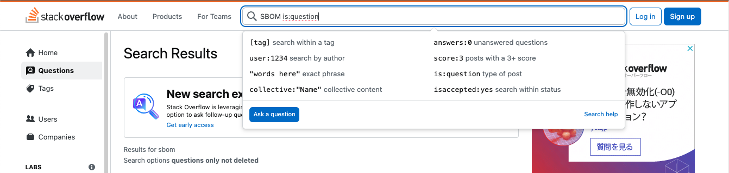
Question Extraction – SBOM, CycloneDX
Used the search bar on the Stack Overflow website
  is:question allows us to extract only questions
Excluded noise by hand
Extracted only questions before Sep. 2023 to keep the condition same to SPDX
Notes:
Let’s go in details. For keyword SBOM and CycloneDX, we used the search bar on the Stack Overflow website and excluded noise by hand. However, we extracted only questions before Sep. 2023 to keep the condition same to the keyword SPDX as we address next.

Slide 12
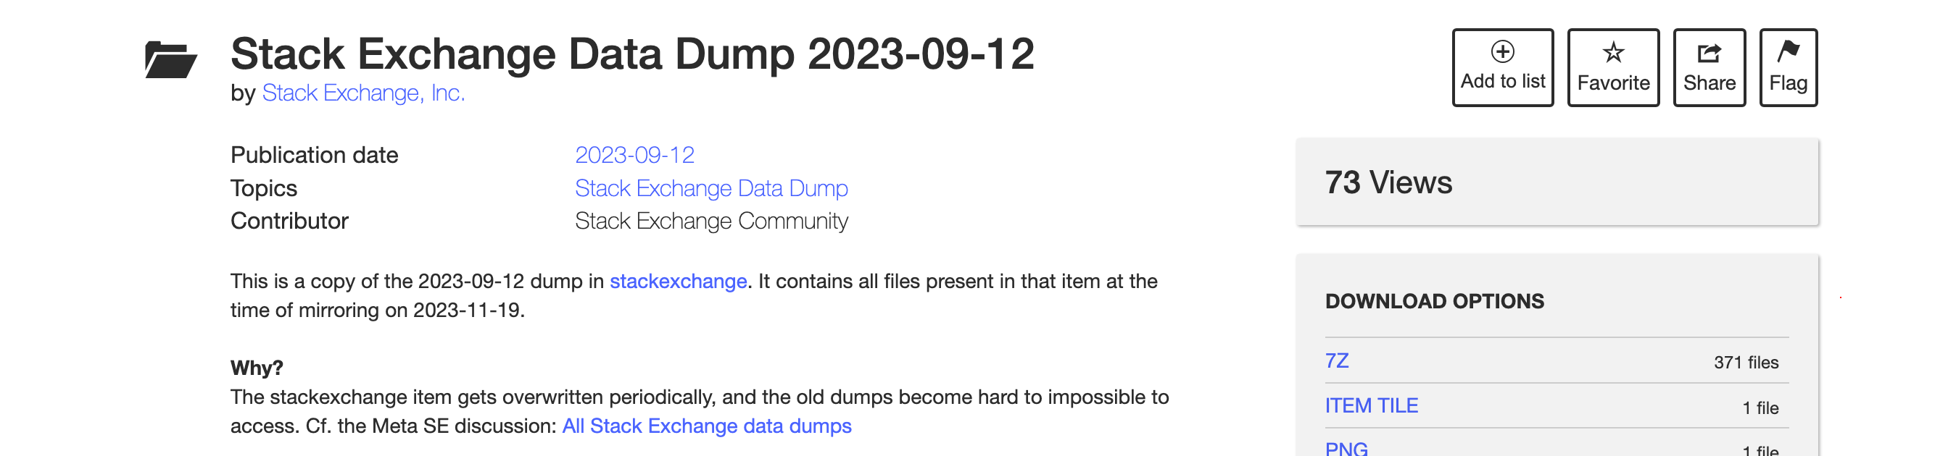
Question Extraction – SPDX
Search result exceeded the upper limit of 500 imposed by Stack Overflow
However, they were mostly noise in some certain patterns
Filter out noise from Stack Exchange Data Dump 2023-09-12
  Automatically remove questions with a noise pattern string
  Manually exclude remaining noise
Notes:
And for SPDX, we went for another way because the search result exceeded the upper limit of 500 questions imposed by Stack Overflow and most of them were noise in some certain patterns.
To efficiently conduct our research, we used the Stack Exchange Data Dump 2023-09-12 and automatically filtered out questions from it that contain at least one of the “noise pattern strings” we will define later, then excluded remaining noise by hand.

Slide 13
Question Extraction – Noise Pattern Strings
Frequent text in noise verified to not appear in an SPDX SBOM
41 questions extracted
  SBOM: 27 out of 58
  CycloneDX: 28 out of 31
  SPDX: 6 out of 1432
Noise Pattern Strings | Count
SPDX-License-Identifier | 1229
License should be a valid SPDX license expression | 30
spdy | 51
spdx-correct spdx-expression-parse spdx-exceptions spdx-license-ids | 62
Notes:
Here are the noise pattern strings and their counts. The noise pattern strings were selected from frequent texts in noise and verified to not appear in an SPDX SBOM.
This one is a standardized notation used to declare licenses at the beginning of program code, which is specified as part of the SPDX standard, but the notation itself is not an SBOM.
This one is a warning output from the Yarn package manager for incorrect package license notation.
We excluded this one because some programs use a variable named spdx to represent the velocity on the 𝑥-axis, often accompanied by spdy, representing the velocity on the 𝑦-axis.
Finally, these ones appear in log outputs contained in questions regarding NPM errors where these packages are included in the project dependencies.
Through these steps, we extracted 41 questions out of these search results.

Slide 14
Analysis Methodology
Analysis 1: Answered and Resolved Rate of SBOM Questions
Examine the presence of answers and the resolution status of each question.
Questions with an accepted answer were considered resolved.
Analysis 2: Trends in the Number of SBOM Questions
Sum up the number of new questions posted each year.
Analysis 3: Challenges Faced by SBOM Users
Extract technical issues from each question, identifying FAQs and those seemingly unresolved based on the subjective judgment of the lead author.
Notes:
With these preparations, we conducted the analysis in this way.
For answered and resolved rate, we examined the presence of answers and the resolution status of each question. Questions with an accepted answer were considered resolved. For trends, we summed up the number of new questions posted each year. For Challenges Faced by SBOM Users, we extracted technical issues from each question, identifying Frequently Asked Questions and those seemingly unresolved.
Then let’s go on to the results.

Slide 15
Results – Analysis 1 (Answered and Resolved Rate)
Among SBOM questions
  Answered (Resolved) was 6
  Answered (Unresolved) was 19
  Unanswered was 15
  (2021 onwards for fair comparison)
It is challenging to find solutions for SBOM questions on Stack Overflow
  Shortage of software developers knowledgeable enough to answer SBOM questions
  SBOM tools being so immature that many SBOM issues are currently unsolvable
Answer Rate: Average
Resolve Rate: Low
Notes:
For Answered and Resolved Rate, Among SBOM questions, Answered and Resolved was 6, the red bar in this graph, Answered but Unresolved was 19, the blue bar, and Unanswered was 15, the grey bar. Please be noted that we counted only the questions posted in and after 2021, to facilitate a fair comparison by adjusting the scope to when SBOM questions are frequently asked.
Compared to the overall Stack Overflow questions showed in the above bar, answer rate is mostly the same comparing the grey bar, but the resolve rate is extremely low comparing the read bar.
From this result we can conclude that it is challenging to find solutions for SBOM questions on Stack Overflow, which may be attributed to a Shortage of software developers knowledgeable enough to answer SBOM questions and SBOM tools being so immature that many SBOM issues are currently unsolvable.

Slide 16
Results – Analysis 2 (Trends in the Number of Questions)
U.S. EO14028
ISO/IEC 5962:2021
Small over the four years
  Before 2019: 1 in 2012 and 0 for the rest
Steady increase from 2020 to 2023, with a notable acceleration from 2021
  Correlation with the U.S. exec. order and the ISO/IEC standardization of SPDX?
Notes:
For annual Trends in the Number of New Questions, here is the annual count of new questions, thus incremental graph from 2019 to September 2023. Before 2019, there were only 1 question in 2012 and 0 for the rest.
Although the number is small over the four years, we can observe a steady increase from 2020 to 2023, with a notable acceleration from 2021, which might correlate with the U.S. exec. order requesting the SBOM use and the ISO/IEC standardization of SPDX.
メモ： カジュアル調査で 2023 年は 25 件まで増え、2024 年は 3/7 現在 5 件。

Slide 17


Results – Analysis 3 (SBOM Challenges)
Insufficient Coverage of Use Cases by SBOM Tools (7)
Inability of SBOM Tools to Meet Requirements (4)
Immaturity of SBOM Tools or Unclear Usages (19)
Notes:
For SBOM Challenges, we identified these three challenges. Insufficient Coverage of Use Cases by SBOM Tools which received 7 posts, Inability of SBOM Tools to Meet Requirements which received 4 posts, and Immaturity of SBOM Tools or Unclear Usages which received 19 posts.
Let’s see the details for them.

Slide 18




Results – Analysis 3 – Challenge 1
Insufficient Coverage of Use Cases by SBOM Tools
 | Insufficient tool support for older project management systems “How do I generate a Cyclonedx bom for a Java project built with Ant?” ¹
 | Absence of tool support for Microsoft Windows “Is there any tool through which we can generate SBOM report (SPDX / CycloneDX) for Windows programs?” ²
¹ https://stackoverflow.com/questions/71605182 (March 2022)
² https://stackoverflow.com/questions/73648096 (September 2022)
Notes:
For the challenge “Insufficient Coverage of Use Cases by SBOM Tools”, we found two prominent examples.
First one highlights the Insufficient tool support for older project management systems, addressing the fact that there are No SBOM tool for Apache Ant Java projects While it’s there for Gradle.
Second one highlights the Absence of tool support for Microsoft Windows, addressing that they couldn’t generate an SBOM for applications installed on their Microsoft Windows system While it’s possible on Linux systems where we normally install packages through package managers.

Slide 19




Results – Analysis 3 – Challenge 2
Inability of SBOM Tools to Meet Requirements
 | Gap between SBOM tools’ ability and compliance requirements, or challenges in obtaining all the necessary information as specified in the guideline from the perspective of SBOM tool developers “NTIA minimum SBOM requirement tool” ¹ (NTIA released it in July 2021 following the U.S. Exec. Order)
 | Limitations of GitHub's SBOM functionality for software license compliance “How to include Open Source license in GitHub SBOM export?” ² (GitHub generates an SBOM from info available within the repo)
¹ https://stackoverflow.com/questions/76103711 (April 2022)
² https://stackoverflow.com/questions/76962834 (August 2023)
Notes:
For the challenge “Inability of SBOM Tools to Meet Requirements”, we found two prominent examples.
First one highlights a Gap between SBOM tools’ ability and compliance requirements, or challenges in obtaining all the necessary information as specified in the guideline from the perspective of SBOM tool developers, which addresses that they couldn’t generate an SBOM for Java, Python, etc. fulfilling the NTIA requirement. This requirement is released in July 2021 following the U.S. Exec. Order requesting the SBOM use.
Second one highlights Limitations of GitHub's SBOM functionality for software license compliance, which addresses the fact that there is No open source license information in GitHub’s SBOM export feature. This is the feature which is available to all GitHub repositories and GitHub automatically generates an SPDX SBOM from information available within the repository and make it downloadable through a button click.

Slide 20

Results – Analysis 3 – Challenge 3
Immaturity of SBOM Tools or Unclear Usages
Immature SBOM tools are making correct SBOM generation difficult
  defects
  insufficient features
  lack of comprehensive docs or accumulated knowledge among devs on basic usage
Questions on errors and unclear usages by SBOM tool users were prevalent
How to create a BOM file in a Flutter project¹
  Encountered an error on CycloneDX SBOM generation for a Flutter project
¹ https://stackoverflow.com/questions/76515339 (June 2023)
Notes:
For the challenge “Immaturity of SBOM Tools or Unclear Usages”, we found that Immature SBOM tools are making correct SBOM generation difficult, because of defects, insufficient features, and lack of comprehensive documentations or accumulated knowledge among developers on basic usage.
Questions on errors and unclear usages by SBOM tool users were prevalent, with this example addressing their struggle in CycloneDX SBOM generation for a Flutter project.

Slide 21
Results – Analysis 3 – Discussion
Ordinal developers seek:
Questions requiring fundamentally new approaches or systems were scarce
Most were revolving around usages, issues, and minor missing functionalities on existing tools
Accumulated Knowledge on Existing SBOM Tools
Refinement and Extension to Existing SBOM Tools
Notes:
From this analysis, we conclude that ordinal developers seek Accumulated Knowledge on Existing SBOM Tools and Refinement and Extension to Existing SBOM Tools. Questions requiring fundamentally new approaches or systems were scarce, and Most were revolving around usages, issues, and minor missing functionalities on existing tools.

Slide 22
Conclusion: SBOM Challenges for Developers on Stack Overflow
Analysis 1: Answered and Resolved Rate of SBOM Questions
Resolve rate is exceptionally low, indicating that Stack Overflow is still not a satisfactory venue to ask SBOM questions to obtain solutions.
Analysis 2: Trends in the Number of SBOM Questions
Notable increase from 2021, possibly due to the U.S. executive order mandating SBOM use and the standardization of SPDX by ISO/IEC.
Analysis 3: Challenges Faced by SBOM Users
“Insufficient Coverage of Use Cases by SBOM Tools”, “Inability of SBOM Tools to
Meet Requirements”, and “Immaturity of SBOM Tools or Unclear Usages”.
Future work: Keep tracking the latest trends in SBOM use
Notes:
And that’s all for my talk. Thank you for listening.

Slide 23
Appendix

Slide 24
NTIA-defined Minimum Elements for an SBOM [2]
Data Field | Description
Supplier Name | The name of an entity that creates, defines, and identifies components.
Component Name | Designation assigned to a unit of software defined by the original supplier.
Version of the Component | Identifier used by the supplier to specify a change in software from a previously identified version.
Other Unique Identifiers | Other identifiers that are used to identify a component, or serve as a look-up key for relevant databases (e.g., CPE, SWID tag, PURL).
Dependency Relationship | Characterizing the relationship that an upstream component X is included in software Y.
Author of SBOM Data | The name of the entity that creates the SBOM data for this component.
Timestamp | Record of the date and time of the SBOM data assembly.
[2] The United States Department of Commerce, “The Minimum Elements For a Software Bill of Materials (SBOM)”

Slide 25
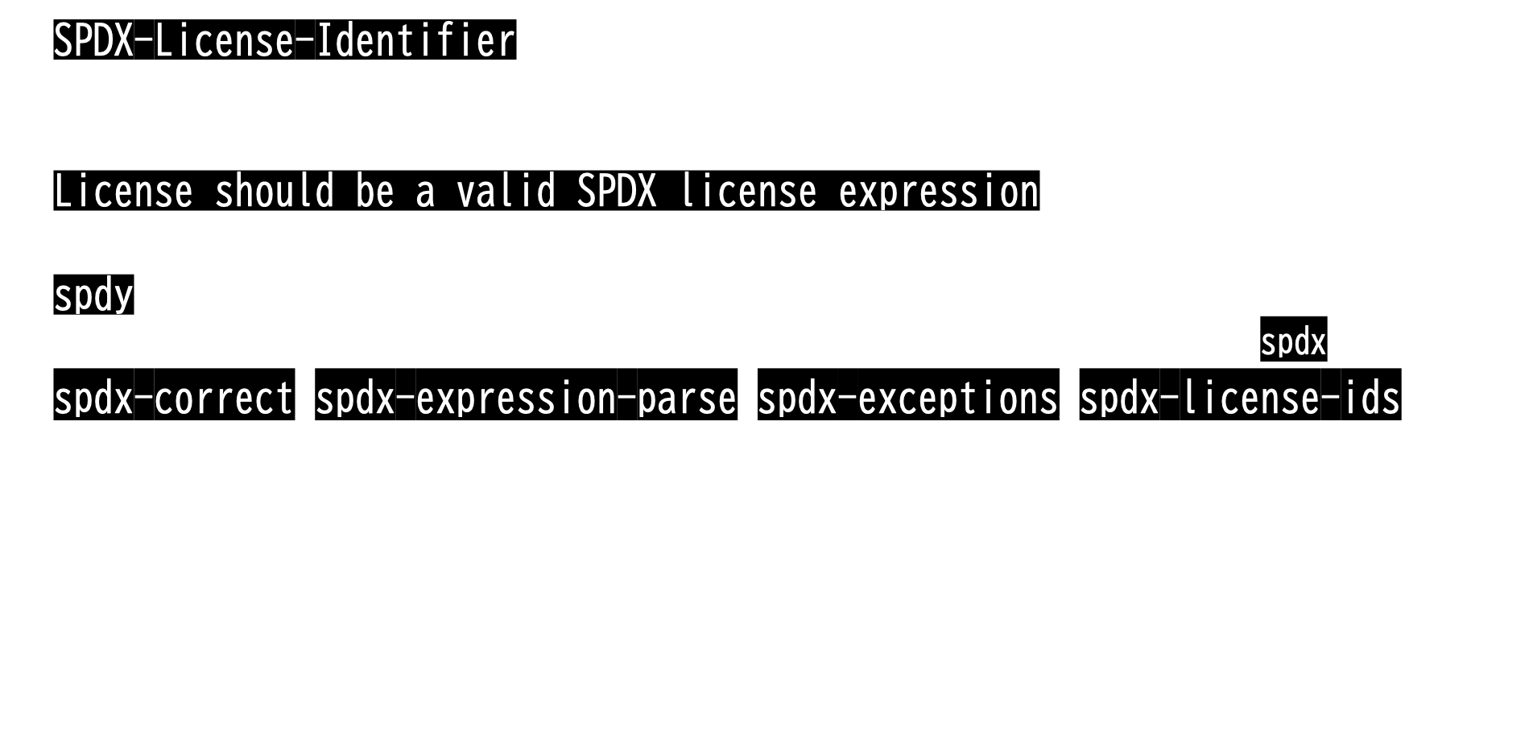
Question Extraction – Details on Noise Pattern Strings
SPDX-License-Identifier
  Notation for declaring licenses at the beginning of program code
  Part of the SPDX standard but not an SBOM
License should be a valid SPDX license expression
  Warning output from the Yarn package manager
spdy
  Variable name represents "speed $y$" often accompanied by the variable name spdx (speed $x$)
spdx-correct, spdx-expression-parse, spdx-exceptions, spdx-license-ids
  NPM package names as they appear in the log outputs for NPM errors

Slide 26
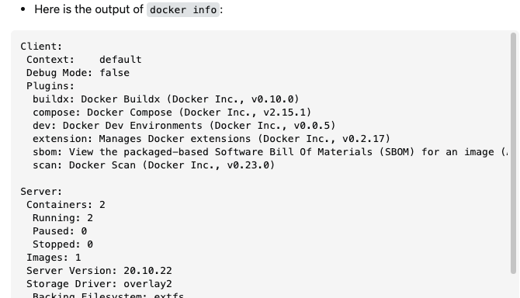
Question Extraction – Noise Example (SBOM)
Docker question with a docker info result to show the environment
→ Matches the search condition by including “SBOM” message
https://stackoverflow.com/questions/75465933

Slide 27
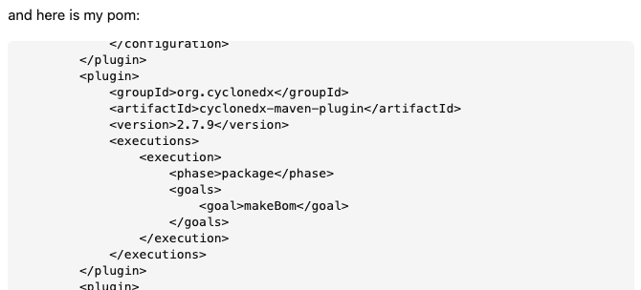
Question Extraction – Noise Example (CycloneDX)
General coding question with a project configuration file attached
→ Matches the search condition because of a dependent CycloneDX SBOM tool
https://stackoverflow.com/questions/76645336

Slide 28
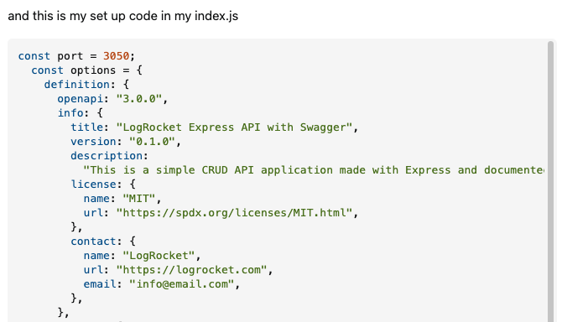
Question Extraction – Noise Example (SPDX)
General coding question with a program code attached
→ Matches the search condition because of a license info (SPDX License List URL)
https://stackoverflow.com/questions/75939666

Slide 29
Example of an SPDX SBOM
{
"SPDXID": "SPDXRef-DOCUMENT",
"spdxVersion": "SPDX-2.3",
"creationInfo": {
"created": "2024-02-26T15:42:46Z",
"creators": ["Tool: GitHub.com-Dependency-Graph"]
},
"name": "com.github.watamario15/formsclient",
"dataLicense": "CC0-1.0",
"documentDescribes": ["SPDXRef-com.github.watamario15-formsclient"],
“documentNamespace”: "https://github.com/watamario15/formsclient/dependency_graph/sbom-dc5516f2edc68207",
"packages": [
{
"SPDXID": "SPDXRef-com.github.watamario15-formsclient",
"name": "com.github.watamario15/formsclient",
"versionInfo": "",
"downloadLocation": "git+https://github.com/watamario15/formsclient",
"licenseDeclared": "CC0-1.0",
"filesAnalyzed": false,
"supplier": "NOASSERTION",
"externalRefs": [
{
"referenceCategory": "PACKAGE-MANAGER",
"referenceType": "purl",
"referenceLocator": "pkg:github/watamario15/formsclient"
}
]
}
],(Omitted)
"relationships": [
{
"relationshipType": "DEPENDS_ON",
"spdxElementId": "SPDXRef-com.github.watamario15-formsclient",
"relatedSpdxElement": "SPDXRef-actions-actions-checkout-3"
},(Omitted)
]
}

Slide 30
SQL Query for Noise Elimination
create table posts_spdx
select * from Posts
where PostTypeId = 1 and
(Body regexp '[[:<:]]spdx[[:>:]]' or Title regexp '[[:<:]]spdx[[:>:]]');
select Id from posts_spdx
where not Body like '%SPDX-License-Identifier%' and
not Body like '%spdy%' and
not Body like '%License should be a valid SPDX license expression%' and
not Body like '%spdx-correct%' and
not Body like '%spdx-expression-parse%' and
not Body like '%spdx-exceptions%' and
not Body like '%spdx-license-ids%'
order by Id desc;

Slide 31
Threats for Validity
Noise Elimination
We automatically filtered out SPDX questions
→ Might excluded some SBOM questions which were actually not noise
They were likely noise as we investigated multiple such posts
→ The threat to validity caused by this exclusion is considered small
Analyzed Question Count
The number of questions extracted as meeting the criteria was only 42
→ Might affect the accuracy of the analysis results
We observed no active usage of General Q&A sites like Quora apart from
Stack Overflow by developers or managers involved in SBOM adoption

Slide 32
Timeframe Adjustment for Analysis 1 (Answered/Resolved Rate)
Most SBOM questions are posted within 3 years from now
  Might be just that we analyzed too early for them to get answers
Limited the timeframe to 2021-01-01 - 2023-09-03 for both overall and SBOM Qs
  Both the raw and timeframe-adjusted result shows the similar tendency

Slide 33


Future Works
There should be more hidden struggles and questions
We should keep tracking the latest trends in SBOM use
Continue investigating Stack Overflow,
which is showing an increasing trend in the number of SBOM questions
Conduct analyses on websites other than Q&A sites,
such as Reddit and Issues in the SBOM-related projects on GitHub

