Slide 1
Improving Accuracy of LLM-based Code Clone Detection Using Functionally Equivalent Methods
Ryutaro Inoue† Yoshiki Higo†
†Osaka University
Notes:
I’m very pleased to have this opportunity to speak to you today.
I’m Ryutaro Inoue and I’m belonging to Osaka University from Japan.

Slide 2
Research Overview
Improving LLMs’ code clone detection ability using Dataset for Clone Detection
First, I will talk about:
Code Clone (Clone)
Clone Classification
Dataset for Clone Detection
Large Language models (LLMs)
Notes:
In this research, we aim to improve LLMs’ code clone detection ability through Fine-tuning.
First, I’ll talk about .
Code Clone, Clone Classification, Dataset for Clone Detection, and Large Language models, in short, LLMs.

Slide 3

Code Clone (Clone)
A code snippet identical or similar to another_{[1]}
Problem
Clones make system maintenance difficult_{[2]} Bugs propagate through clone_{[2]}
It needs to be detected and refactored if necessary
Many clone detection tools have been developed
[1] I. Baxter, A. Yahin, L. Moura, M. Sant’Anna, and L. Bier, “Clone detection using abstract syntax trees,” in Proc. ICSM, 1998, pp. 368–377.
[2] M. Mondal, C. Roy, and K. Schneider, “A Fine-Grained Analysis on the Inconsistent Changes in Code Clones,” in 2020 IEEE ICSME, 2020, pp. 220–231.
Notes:
I’ll explain about code clone.
Code snippet that is identical or similar to another is called code clone or simply clone.
Programmers make clones by reusing code in another place(elsewhere) or by reimplementing.
Clones have some problems.
First, Clones make system maintenance more difficult.
Second, Bugs propagate through clones.
Please look at the figure.

Slide 4
Code Clone (Clone)
A code snippet identical or similar to another_{[1]}
Problem
Clones make system maintenance difficult_{[2]} Bugs propagate through clone_{[2]}
It needs to be detected and refactored if necessary
Many clone detection tools have been developed
Generate a clone
clone
[1] I. Baxter, A. Yahin, L. Moura, M. Sant’Anna, and L. Bier, “Clone detection using abstract syntax trees,” in Proc. ICSM, 1998, pp. 368–377.
[2] M. Mondal, C. Roy, and K. Schneider, “A Fine-Grained Analysis on the Inconsistent Changes in Code Clones,” in 2020 IEEE ICSME, 2020, pp. 220–231.
Notes:
This program code has some bugs and generates a clone by copying and pasting this code. Of course, the original code and coped and pasted one share the same bugs.

Slide 5
Code Clone (Clone)
A code snippet identical or similar to another_{[1]}
Problem
Clones make system maintenance difficult_{[2]} Bugs propagate through clone_{[2]}
It needs to be detected and refactored if necessary
Many clone detection tools have been developed
Generate a clone
clone
[1] I. Baxter, A. Yahin, L. Moura, M. Sant’Anna, and L. Bier, “Clone detection using abstract syntax trees,” in Proc. ICSM, 1998, pp. 368–377.
[2] M. Mondal, C. Roy, and K. Schneider, “A Fine-Grained Analysis on the Inconsistent Changes in Code Clones,” in 2020 IEEE ICSME, 2020, pp. 220–231.
Notes:
After generating the clone, if the programmer removes bugs only in the original code, the bugs remain in the program code created later.
Like this, clones make system maintenance more difficult, and bugs propagate when generating a clone.
Therefore, programmers need to detect and refactor clones if necessary.
So far, many clone detection tools have been developed.

Slide 6
Clone Classification
Clones are classified based on their syntactic similarity_{[3]}
Type-1(T1)
Identical code
except for layouts
newline comment
white space etc.
Type-2(T2)
Identical code except for identifiers, literals, types, or layout
Type-3(T3)
Similar code with differences at the statement level
Type-4(T4)
Different code structures performing the same computation
[3] C. Roy, J. Cordy, and R. Koschke, “Comparison and evaluation of code clone detection techniques and tools: A qualitative approach,” Science of Computer Programming, vol. 74, no. 7, pp. 470–495, 2009.
Notes:
Clones are classified based on their syntactic similarity from Type-1 to Type-4.
Type-1 clones are identical code except for layouts such as newline, comment, and white space.
Type-2 clones are identical code except for identifiers, literals, types, or layouts.
Type-3 clones are similar code with differences at the statement level. A statement has been added, removed, or modified, but other parts of the code remain unchanged.
Type-4 clones are different code structures performing the same computation.
The right-side classification is more difficult to detect because the right-side classification has a different code structures.

Slide 7
Dataset for Clone Detection
 | BigCloneBench_{[4]} | FEMPDataset_{[5]}
Abstract | A large benchmark dataset for evaluating clone detections | a dataset of functionally equivalent methods with different structure
Language | Java | Java
Data count | 7,868,560 | 2,194
Classification | T1～T4 | T4
Conducting functional tests | No | Yes
[4] J. Svajlenko and C. K. Roy, "Evaluating clone detection tools with BigCloneBench," 2015 IEEE ICSME, 2015, pp. 131-140
[5] Y. Higo, “Dataset of Functionally Equivalent Java Methods and Its Application to Evaluating Clone Detection Tools, ” IEICE Trans. Inf. & Syst., 02 2024.
Notes:
There are some datasets for evaluating clone detection accuracy. I’ll introduce two datasets.
The first is BigCloneBench.
It is a large benchmark dataset for evaluating clone detections. It is one of the well-known datasets for code clone detection.
The programming language of the data is Java, and the amount of data is about 7 millions.
This dataset consists of from Type-1 to Type-4 clones.
The second is FEMPDataset.
It is a dataset of functionally equivalent methods with different structures.
The programming language of the data is also Java, and the amount of data is about 2 thousands.
This dataset consists of only Type-4 clones.
Functional tests were conducted to ensure that the two methods in each method pair are functionally equivalent.
These two datasets are a collection of method pairs.

Slide 8


Large Language Models (LLMs)
Language models trained on large amounts of text data
Achieving significant results in the field of natural language processing
In recent years, many LLMs have been developed
<example of LLMs>
GPT-3.5
GPT-4
Llama2
CodeLlama
Notes:
In our research, we used Large Language Models.
LLMs are Language models trained on large amounts of text data.
LLMs achieve significant results in the field of natural language processing.
In recent years, many LLMs have been developed.
For example, GPT-3.5 and GPT-4 developed by OpenAI and Llama2 and CodeLlama developed by Meta.

Slide 9
Clone Detection: Non-LLM Tools vs. LLMs_{[11]}
non-LLM Tools
NiCad・Oreo
Difficult to detect T3, T4
LLMs
GPT-3.5-turbo・GPT-4-turbo
Detect T3 and T4 clones more accurately than non-LLM tools
Struggle with T4 detection
Llama2-Chat-7B
Recognizes nearly all method pairs as clone pairs
(evaluation using BigCloneBench Dataset)
Recall
Precision
[11] S. Dou et al. Towards Understanding the Capability of Large Language Models on Code Clone Detection: A Survey. 2023
Notes:
Here, I’ll introduce previous research that compares the clone detection accuracy of Conventional non-LLM tools and LLMs.

Slide 10
Clone Detection: Non-LLM Tools vs. LLMs
non-LLM Tools
NiCad・Oreo
Difficult to detect T3, T4
LLMs
GPT-3.5-turbo・GPT-4-turbo
Detect T3 and T4 clones more accurately than non-LLM tools
Struggle with T4 detection
Llama2-Chat-7B
Recognizes nearly all method pairs as clone pairs
(evaluation using BigCloneBench Dataset)
Recall
Precision
[11] S. Dou et al. Towards Understanding the Capability of Large Language Models on Code Clone Detection: A Survey. 2023
Notes:
Please look at the graph.
Regarding non-LLM tools, type-3 and type-4 recall are low. This means that they couldn’t identify Type-3 and Type-4 clones as clones.
Therefore, with non-LLM tools such as NiCad and Oreo, it is difficult to detect Type-3 and Type-4 clones.

Slide 11
Clone Detection: Non-LLM Tools vs. LLMs
non-LLM Tools
NiCad・Oreo
Difficult to detect T3, T4
LLMs
GPT-3.5-turbo・GPT-4-turbo
Detect T3 and T4 clones more accurately than non-LLM tools
Struggle with T4 detection
Llama2-Chat-7B
Recognizes nearly all method pairs as clone pairs
(evaluation using BigCloneBench Dataset)
Recall
Precision
[11] S. Dou et al. Towards Understanding the Capability of Large Language Models on Code Clone Detection: A Survey. 2023
Notes:
In contrast, GPT-3.5-turbo and GPT-4-turbo could detect Type-3 and type-4 clones more accurately than non-LLM tools. However, they still struggle with Type-4 clone detection.

Slide 12
Clone Detection: Non-LLM Tools vs. LLMs
non-LLM Tools
NiCad・Oreo
Difficult to detect T3, T4
LLMs
GPT-3.5-turbo・GPT-4-turbo
Detect T3 and T4 clones more accurately than non-LLM tools
Struggle with T4 detection
Llama2-Chat-7B
Recognizes nearly all method pairs as clone pairs
(evaluation using BigCloneBench Dataset)
Recall
Precision
[11] S. Dou et al. Towards Understanding the Capability of Large Language Models on Code Clone Detection: A Survey. 2023
Notes:
And then Unfortunately, Llama2-Chat-7B recognizes nearly all method pairs as clone pairs.
Therefore, you can see that Recall is high because it detects nearly all clone method pairs as clones and Precision is low because it detects nearly all non-clone method pairs as clones.

Slide 13
Goal・Methodology
Goal
Improving LLMs’ ability to detect code clones with fine-tuning
Methodology
Fine-tuning LLMs using data of functionally equivalent method pairs
LLMs used in the experiment
GPT-3.5-turbo
Llama2-Chat-7B
CodeLlama-7B-Instruct
Dataset used in fine-tuning
FEMPDataset
Notes:
From these previous research results, we thought we could improve LLM’s ability to detect code clones through fine-tuning with Dataset for clone detection.
LLMs used in the experiment are GPT-3.5-turbo, Llama2-Chat-7B, and codeLlama-7B-Instruct.
We used FEMPDataset for fine-tuning.
FEMPdataset is a dataset of functionally equivalent methods with different structures.

Slide 14


Experimental Procedure
STEP1：FT the LLMs
STEP2：Executing the LLMs
STEP3：Evaluation
FT
No
Yes
LLM
FT’d LLM
input
LLM
output
response
Compare
collect
FEMPDataset (Test data)
No
FEMPDataset (Train/Validation data)
Yes
Test data
FT’d LLM
FT’s response
※FT is fine-tuning
※FT’d is fine-tuned
Notes:
This is the experimental Procedure.
The experiment can be divided into 3 steps.

Slide 15
STEP1：Fine-tuning the LLMs
STEP1：FT the LLMs
STEP2：Executing the LLMs
STEP3：Evaluation
FT
No
Yes
LLM
FT’d LLM
input
LLM
output
response
Compare
collect
FEMPDataset (Test data)
No
FEMPDataset (Train/Validation data)
Yes
Test data
FT’d LLM
FT’s response
※FT is fine-tuning
※FT’d is fine-tuned
Notes:
The first step is fine-tuning the LLMs.
We divided FEMPDataset into train, validation, and test data in advance.
And, use Train and validation Data for fine-tuning.

Slide 16
STEP2：Executing the LLMs
STEP1：FT the LLMs
STEP2：Executing the LLMs
STEP3：Evaluation
FT
No
Yes
LLM
FT’d LLM
input
LLM
output
response
Compare
collect
FEMPDataset (Test data)
No
FEMPDataset (Train/Validation data)
Yes
Test data
FT’d LLM
FT’s response
※FT is fine-tuning
※FT’d is fine-tuned
Notes:
The second step is Executing the LLMs.
We input the test data to LLM and fine-tuned LLM, and then get the response from each model.

Slide 17
STEP3：Evaluation
STEP1：FT the LLMs
STEP2：Executing the LLMs
STEP3：Evaluation
FT
No
Yes
LLM
FT’d LLM
input
LLM
output
response
Compare
collect
FEMPDataset (Test data)
No
FEMPDataset (Train/Validation data)
Yes
Test data
FT’d LLM
FT’s response
※FT is fine-tuning
※FT’d is fine-tuned
Notes:
Finally, the third step is evaluation.
We compare the results of LLM and fine-tuned LLM.

Slide 18
Fine-tuning method
GPT-3.5
Use OpenAI’s API
Llama2・CodeLlama
Use two technique
Lora (Low Rank Adapter)_{[12]}
Reduce the number of parameters to be fine-tuned and minimize VRAM consumption
ZeRO (Zero Redundancy Optimizer)_{[13]}
Minimize VRAM required per GPU
[12] E. Hu et al., “LoRA: Low-Rank Adaptation of Large Language Models,” in ICLR 2022, 2022.
[13] S. Rajbhandari, J. Rasley, O. Ruwase, and Y. He, “ZeRO: Memory optimizations Toward Training Trillion Parameter Models,” in SC20, 2020, pp. 1–16.
Notes:
In this slide, I would explain the fine-tuning method.
For fine-tuning GPT-3.5, we used OpenAI’s API.
For fine-tuning Llama2 and CodeLlama, we used two techniques: Lora and ZeRO to minimize VRAM consumption.

Slide 19
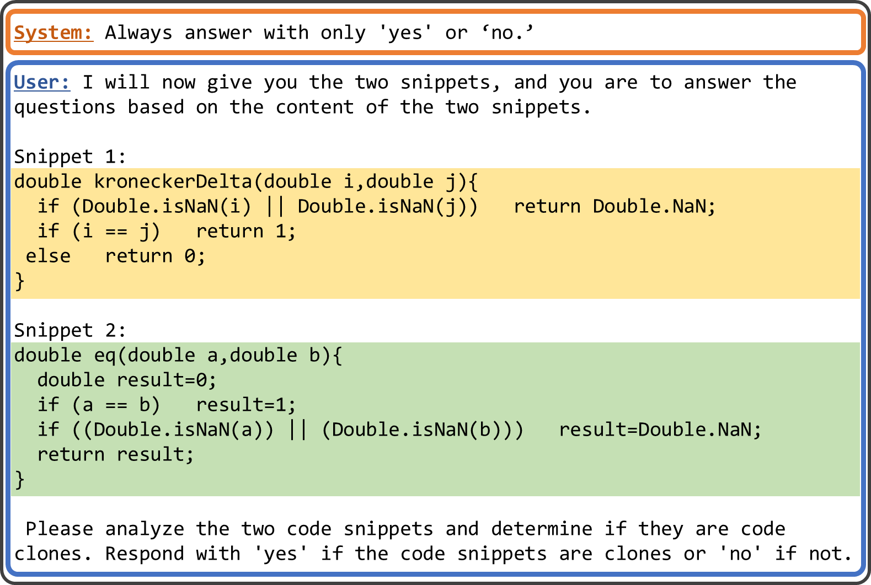
Prompt
System
Instruct the LLM to make the answer Yes or No.
User
Instruct the LLM to determine if the given code is a clone
Notes:
I’ll show the prompt in the experiment.
The prompt consists of two roles: system and user.
In the system role, instruct the LLM to make the answer Yes or No.
In the User role, instruct the LLM to determine if the given code is a clone.

Slide 20
Prompt
This part tells the LLM to input two code snippets
Notes:
I’ll explain the details of the User role.
First, the Prompt tells the LLM to input two code snippets with the following statements.

Slide 21
Prompt
Input the two snippets
Notes:
Second, input the two snippets. These snippets are specific code for which we want to determine if it is a clone or not.

Slide 22
Prompt
Ask if the two snippets are clones or not
Notes:
Finally, ask if the two snippets are clones or not.

Slide 23

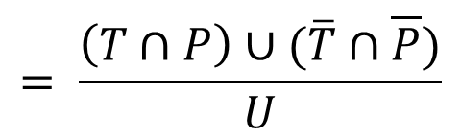

Evaluation Indexes
Recall
How much the tool correctly identifies actual code clones as clones
Precision
How much the identified code clones are truly clones
Accuracy
How much the tool correctly identifies both clones and non-clones
$$=\frac{T ∩ P}{T}$$
U
Universal
P
Predicted
$$= \frac{T ∩ P}{P}$$
T
True
$$= \frac{\left(T∩P\right)∪(\overline{T}∩\overline{P})}{U}$$
Notes:
We evaluated the results using evaluation indexes: recall precision and accuracy.
Recall means how much the tool correctly identifies actual code clones as clones.
Precision means how much the identified code clones are truly clones,
Accuracy means how much the tool correctly identifies both clones and non-clones.
There is a trade-off between recall and precision.

Slide 24
Evaluation of GPT (1/2)
original
11
96
12
10
fine-tuned
Identifying clones as clones
original
37
31
5
17
fine-tuned
Improved at identifying non-clones correctly
Improved overall clone detection performance
Identifying non-clones as non-clones
Notes:
This slide shows you the evaluation of GPT.
The graph on the left shows the results of the three evaluation indexes.
Precision and Accuracy improved after fine-tuning. This means the fine-tuned model could correctly identify non-clones, and overall performance is better than before fine-tuning.
The figure on the right shows the results of the distribution of method pairs that are detected correctly.
We can see that fine-tuned GPT-3.5-turbo can identify non-clones more correctly.

Slide 25
Evaluation of GPT (2/2)
original
11
96
12
10
fine-tuned
Identifying clones as clones
original
37
31
5
17
fine-tuned
Improved at identifying non-clones correctly
Improved overall clone detection performance
Identifying non-clones as non-clones
Notes:
In addition, fine-tuned GPT-3.5-turbo performs better than GPT-4-turbo.

Slide 26
Evaluation of Llama2
original
28
101
0
fine-tuned
Identifying clones as clones
original
0
38
52
fine-tuned
Improved at identifying non-clones correctly
Improved overall clone detection performance
Identifying non-clones as non-clones
Notes:
This slide shows you the evaluation of Llama2.
Like GPT, Precision and Accuracy improved after fine-tuning. This means the fine-tuned model could correctly identify non-clones, and overall performance is better than before fine-tuning.
We can see that fine-tuned models can identify non-clones correctly. 38 new non-clones were more correctly identified by fine-tuned LLM.

Slide 27
Evaluation of CodeLlama
original
8
58
36
27
fine-tuned
Identifying clones as clones
original
6
17
57
10
fine-tuned
Improved at identifying clones and non-clones correctly
Improved overall clone detection performance
Identifying non-clones as non-clones
Notes:
This slide shows you the evaluation of CodeLlama.
All indexes: Recall, Precision, and Accuracy improved after fine-tuning. This means the fine-tuned model could correctly identify clones and non-clones, and overall clone detection performance is better than before fine-tuning.

Slide 28
Discussion
Fine-tuning effectively improves clone detection accuracy
All tested models showed an improvement in accuracy
Pre-training data type and amount affect detection accuracy
Before fine-tuning, CodeLlama has higher detection accuracy than Llama2
Accuracy improvement for CodeLlama is greater than Llama2 through fine-tuning
Notes:
From the results of the experiment,
Fine-tuning effectively improves clone detection accuracy.
All tested models showed an improvement in accuracy.
Also, Pre-training data type and amount affect detection accuracy.
In fact, CodeLlama is a fine-tuned modle of Llama2 with data about the program.
Therefore, Before fine-tuning, CodeLlama has higher detection accuracy than Llama2.
And, Accuracy improvement for CodeLlama is greater than Llama2 through fine-tuning.

Slide 29
Summary
Conclusion
We aimed to improve the accuracy of T4 clone detection by fine-tuning the LLMs
Performance on FEMPDataset improved
Specifically, the accuracy of CodeLlama-7B-Instruct increased by 0.18
Feature works
Running experiments for other models
Performance evaluation using other benchmarks
Enhancing performance using prompt engineering
Notes:
I’d like to conclude my presentation.
In conclusion, We aimed to improve the accuracy of Type-4 clone detection by fine-tuning the LLMs, and performance on FEMPDataset improved.
Specifically, the accuracy of CodeLlama increased by 0.18.
There are three feature works.
The First is running experiments for other models. In our research, we use only three models.
The second is performance evaluation using other benchmarks. We used FEMPDataset for evaluation.
The third is Enhancing performance using prompt engineering. We can improve performance by using techniques such as Chain-of-thought and few-shot learning.
That’s all. Thank you very much.

Slide 30
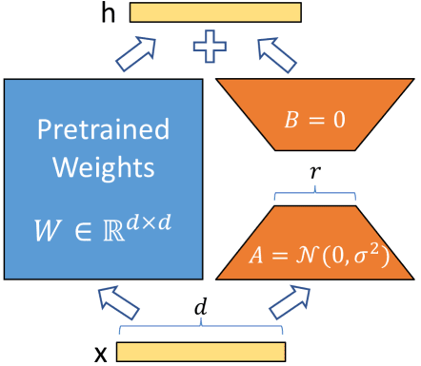
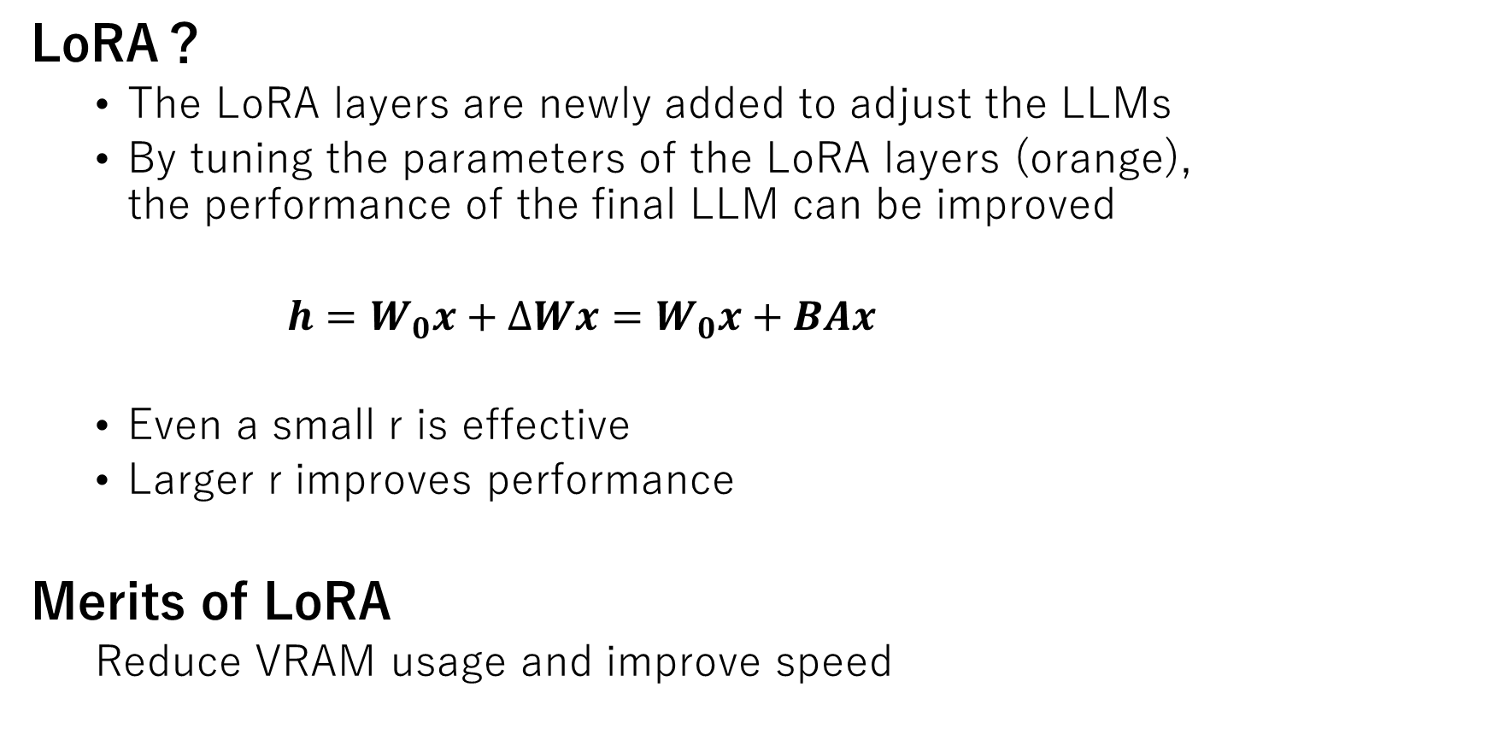
Appendix：LoRA
LoRA？
The LoRA layers are newly added to adjust the LLMs
By tuning the parameters of the LoRA layers (orange), the performance of the final LLM can be improved
$h=W_{0}x+∆Wx=W_{0}x+BAx$
Even a small r is effective
Larger r improves performance
Merits of LoRA
Reduce VRAM usage and improve speed

Slide 31
Appendix：Difference of Datasets
A dataset of extracted similar method pairs
The method pairs are considered code clones if they contain the same functionality, even if they are not fully functionally equivalent as entire methods
There are some differences between FEMPDataset and BigCloneBench
FEMPDataset
A collection of method pairs that produce the same results across the entire method, fully functionally equivalent method pairs
BigCloneBench
A dataset of extracted similar method pairs
The method pairs are considered code clones if they contain the same functionality, even if they are not fully functionally equivalent as entire methods
Notes:
データセットの性質が異なる
三行を二行にする
最後いらない，口頭でいい

