Slide 1




Challenges in Adopting LLaMA:
An Empirical Study of Discussions on Stack Overflow
QuASoQ 2024: 12th International Workshop on Quantitative Approaches to Software Quality

Slide 2

Hello there
Authors:
  Ramita Deeprom
  Shiyu Yang
  Yoshiki Higo
  Morakot Choetkiertikul
  Chaiyong Ragkhitwetsagul
1
2
2
1
Undergraduate Student,
Software Engineering Track,
ICT Faculty
1
1 Mahidol University, Thailand
2 Osaka University, Japan
2

Slide 3
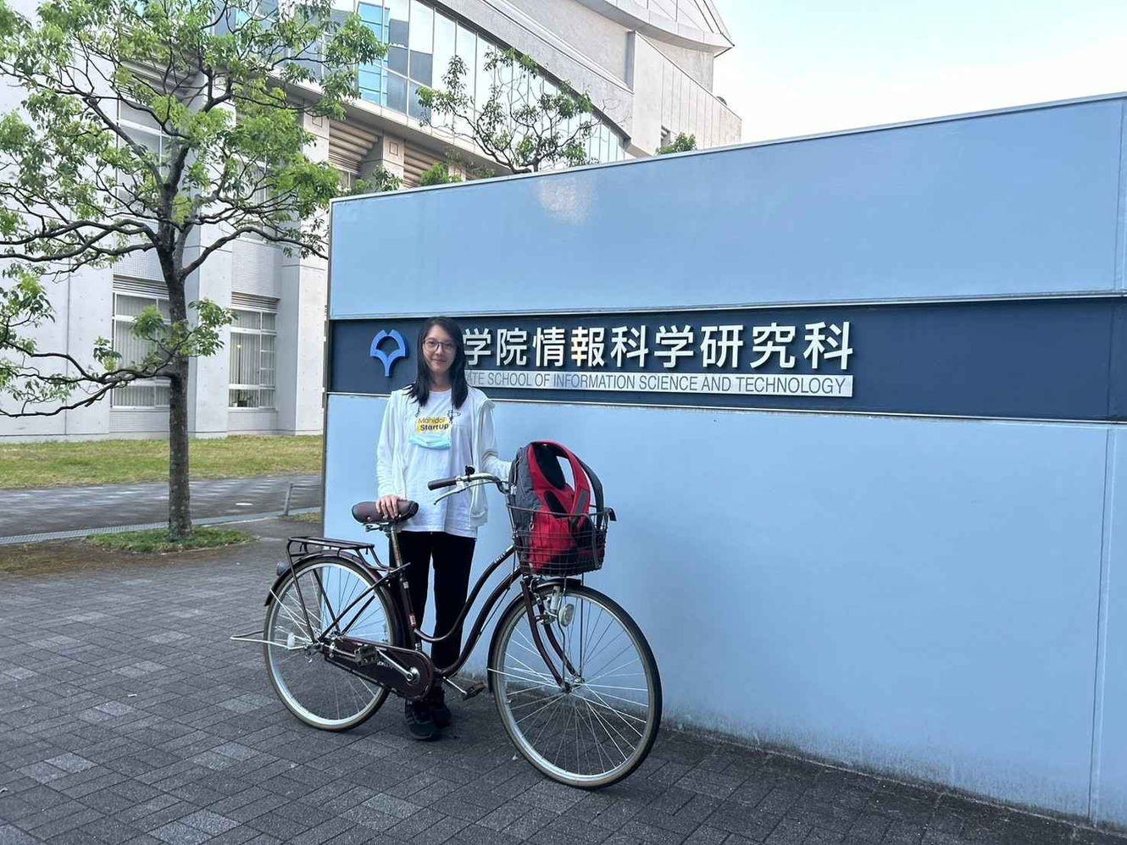
3

Slide 4
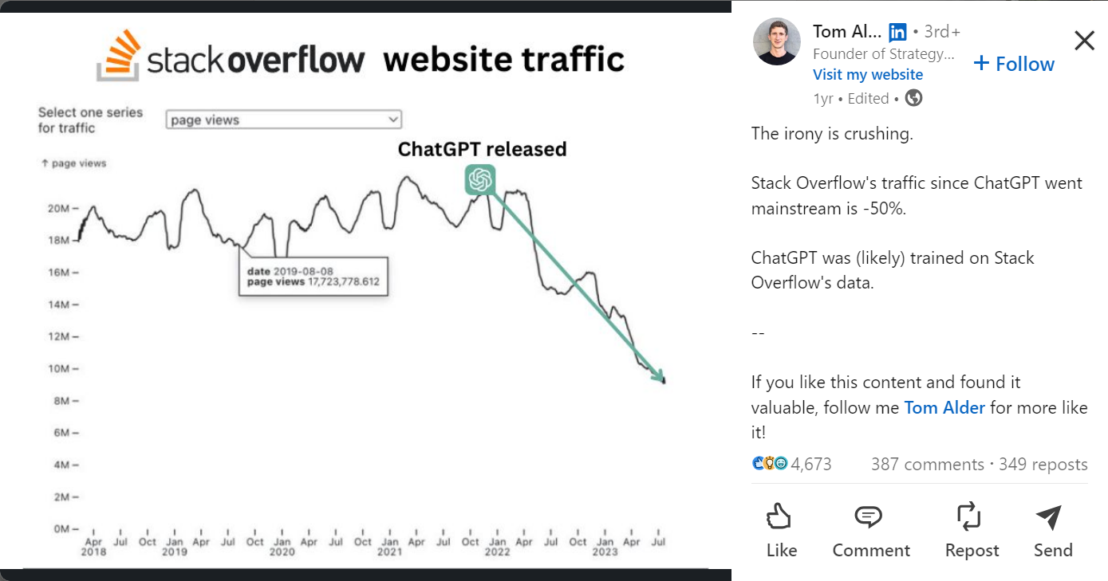
https://www.linkedin.com/posts/tom-alder_the-irony-is-crushing-stack-overflows-activity-7099208596369903616-EQH6/
4

Slide 5
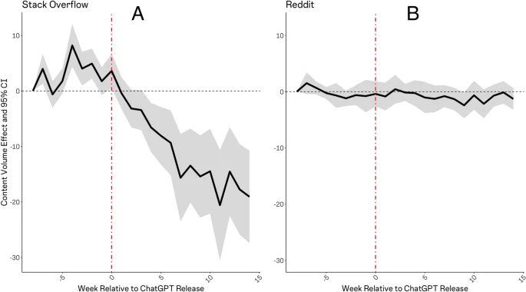
[1]
5
[1] Burtch, G., Lee, D. & Chen, Z. The consequences of generative AI for online knowledge communities. Sci Rep 14, 10413 (2024). https://doi.org/10.1038/s41598-024-61221-0

Slide 6
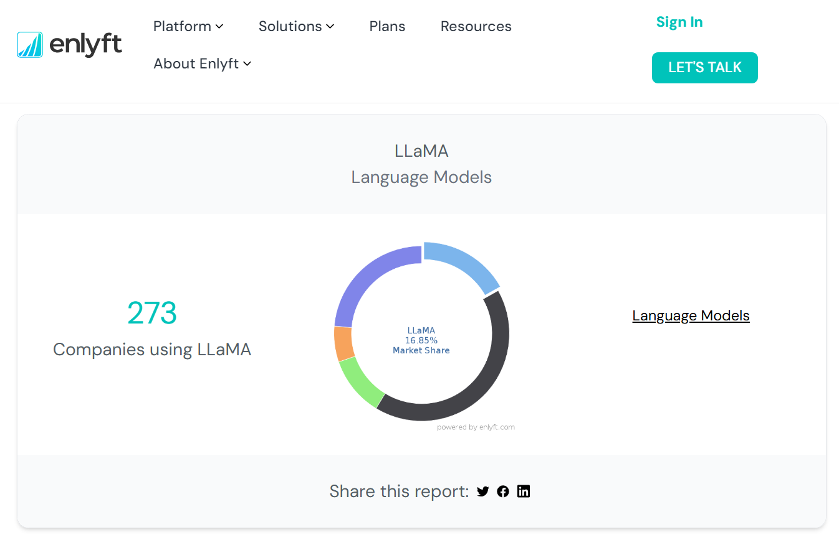
6
https://enlyft.com/tech/products/llama

Slide 7
Trends in Large Language Models
  LLMs have transformed developer workflows.
  LLaMA stands out for its fine-tuning and customization capabilities.
Literature Review
Stack Overflow (SO)
  Prior studies showed LLMs like GPT-4 struggle with specific frameworks, leading developers back to SO.
7

Slide 8

MOTIVATION
Rapid adoption of generative AI models like LLaMA and their integration challenges.
To analyze discussions on SO to uncover challenges and themes in LLaMA adoption.
8

Slide 9
RESEARCH QUESTIONS
1
What are the main topics discussed about LLaMA on Stack Overflow?
2
What related topics and technologies emerge in discussions about LLaMA?
9

Slide 10
METHODOLOGY OVERVIEW
Data Collection
Data Analysis
  Sources: Posts on SO (473 posts analyzed).
  Methods: Keyword and tag searches for "LLaMA".
  Categorized posts into six themes: Model Configuration, Error Handling, Installation, Integration, Performance, Deployment.
  Co-occurrence analysis for related topics and technologies.
10

Slide 11
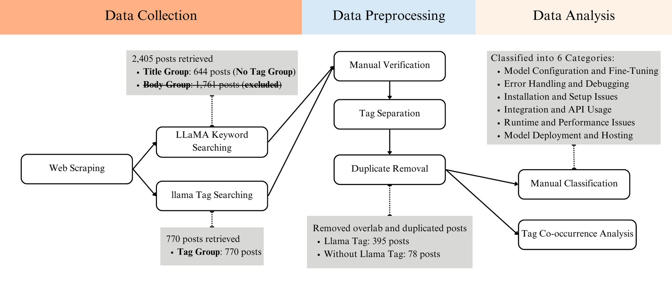
METHODOLOGY
Web Scraping (July 22, 2024)
11

Slide 12
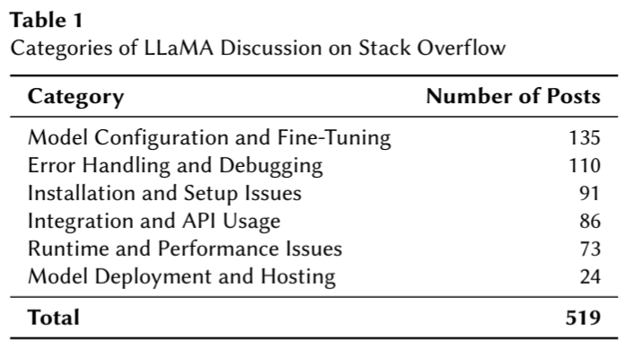
KEY FINDINGS #1
What are the common topics discussed regarding LLaMA?
12

Slide 13
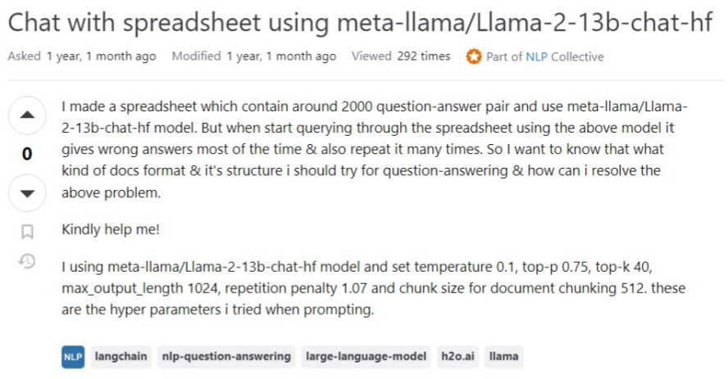
COMMON CHALLENGES
Model Configuration and Fine-Tuning
13

Slide 14
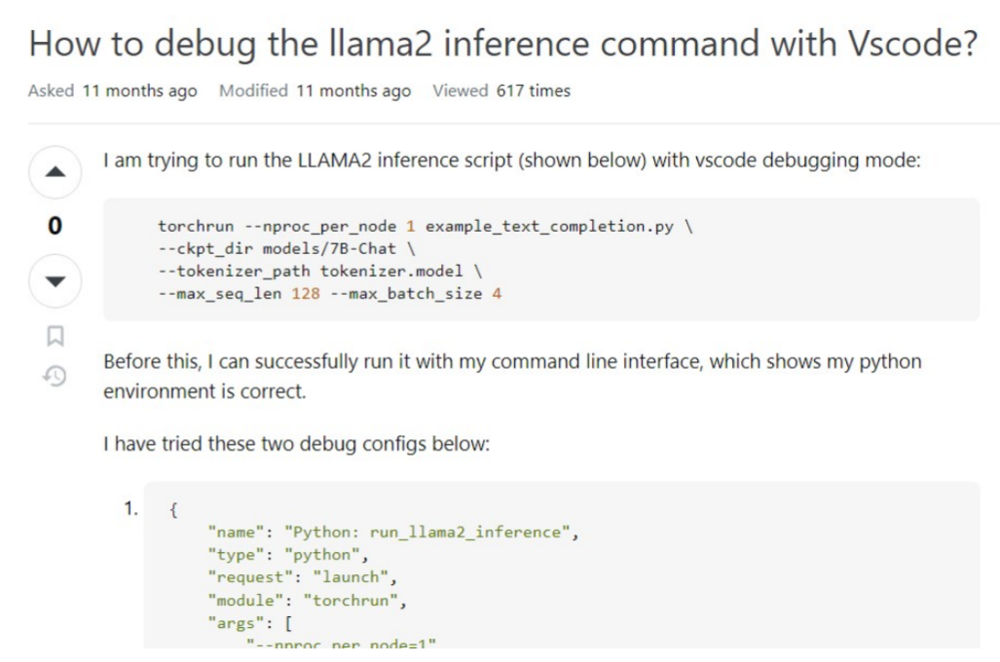
COMMON CHALLENGES
Error Handling and Debugging
14

Slide 15
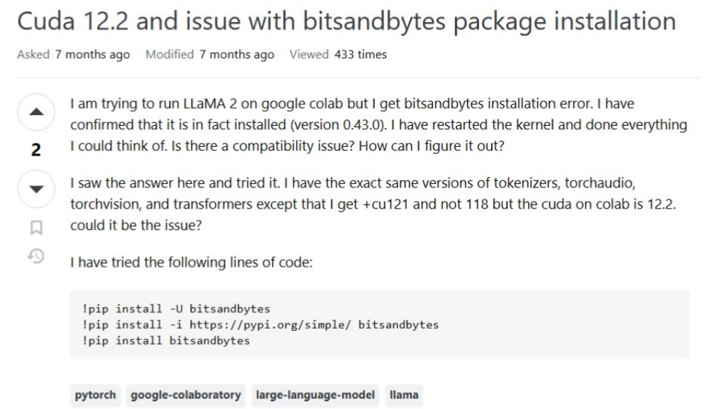
COMMON CHALLENGES
Installation
and Setup Issues
15

Slide 16
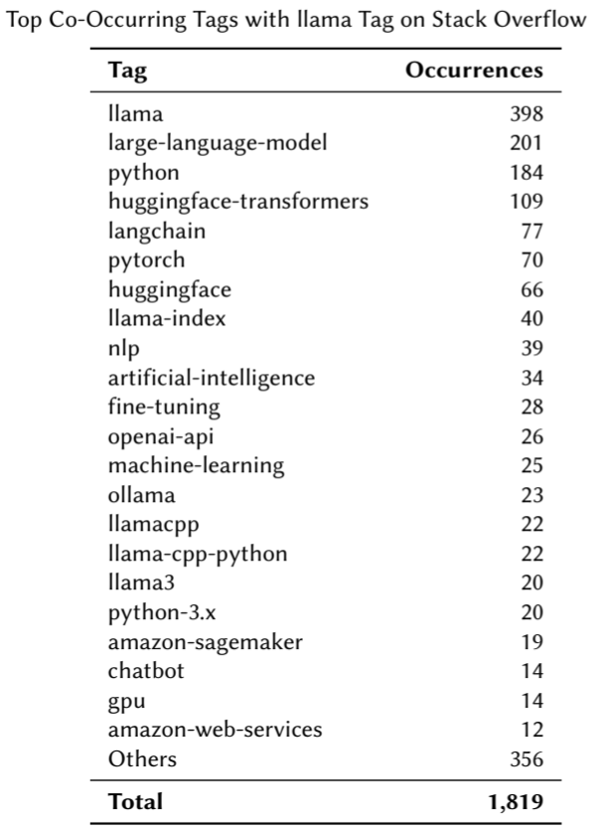
KEY FINDINGS #2
What related topics and technologies are associated with LLaMA?
16

Slide 17
KEY FINDINGS #2
What related topics and technologies are associated with LLaMA?
  Related Topics:
    Most common tags are Python, Hugging Face Transformers, LangChain.
    Focus on fine-tuning, vector databases, RetrievalQA, and computational resources.
  Technological Ecosystem:
    Interoperability with frameworks like PyTorch and Hugging Face.
    Popular tasks are Fine-tuning for domain-specific use, integrating APIs​.
17

Slide 18
IMPLICATIONS
  For Developers:
    Enhance community-driven support for troubleshooting and resource sharing.
  For Meta:
    Improve documentation, tooling, and interoperability with popular ML frameworks.
    Develop user-friendly fine-tuning APIs​
18

Slide 19
FUTURE WORK
  Compare LLaMA with other models (e.g., ChatGPT, Gemini) for broader insights.
  Explore sentiment analysis and advanced user studies to capture nuanced developer feedback
19

Slide 20
CONCLUSION
  LLaMA is gaining popularity but poses challenges in configuration, debugging, and integration.
  Addressing these challenges will drive smoother adoption and innovation in the AI ecosystem.
20

Slide 21

THANK YOU
Challenges in Adopting LLaMA:
An Empirical Study of Discussions on Stack Overflow

Slide 22
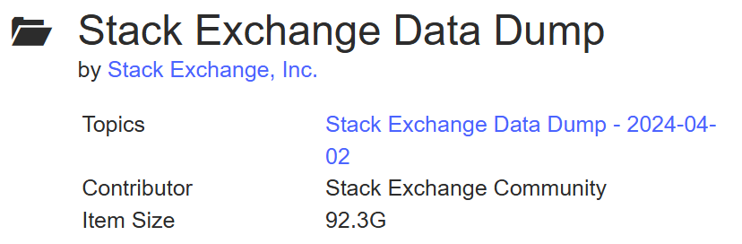
DATA COLLECTION
Stackxchange 2024
  Posts.xml
  Tags.xml
https://archive.org/details/stackexchange

Slide 23
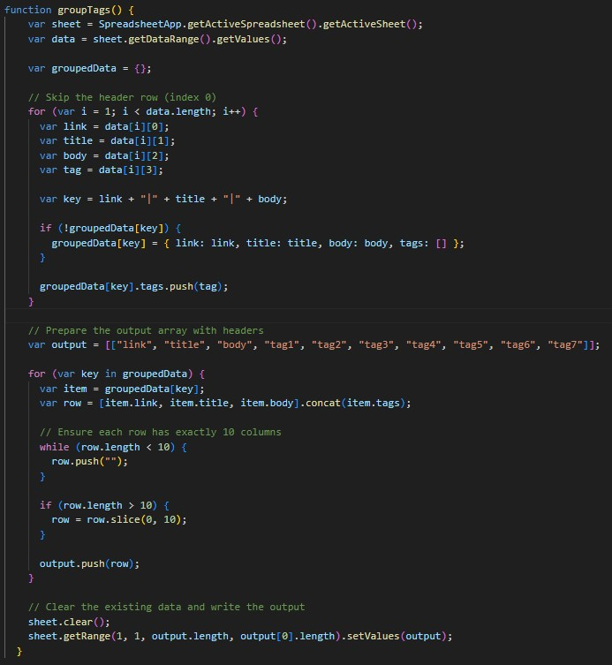
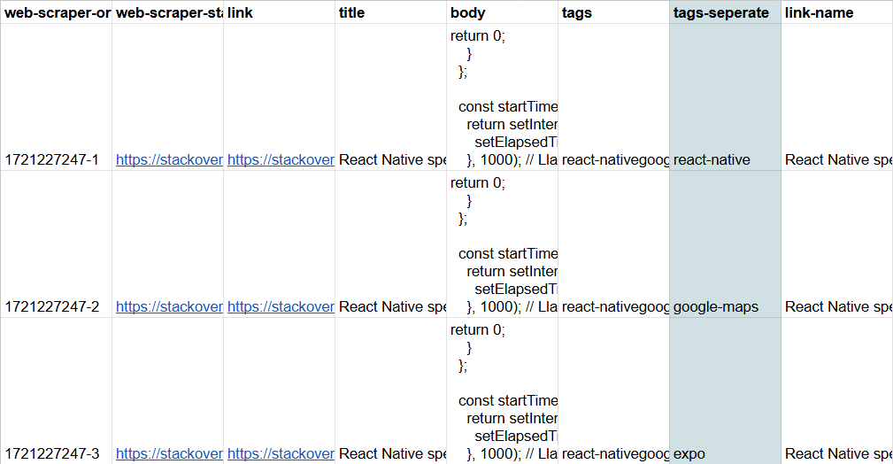
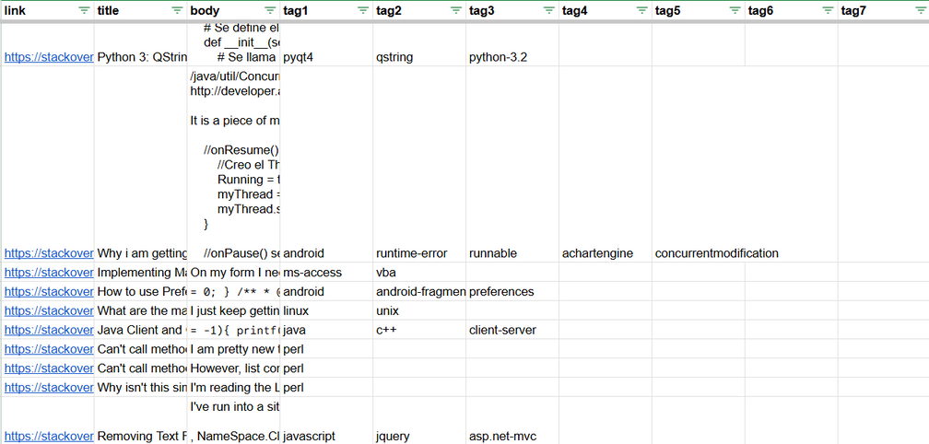
Tag Seperation

Slide 24
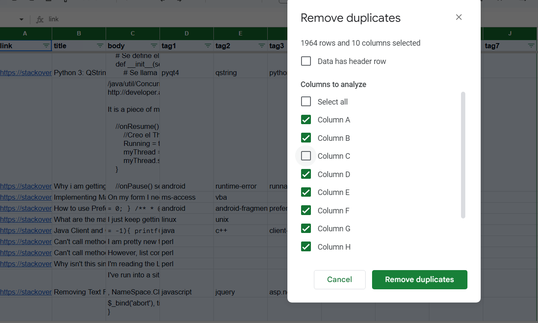
Duplicate Removal
Checked the duplication of:
  link
  title
  tag1
  tag2
  tag3
  tag4
  tag5
  tag6
  tag7

Slide 25
KEY FINDINGS #1
What are the common topics discussed regarding LLaMA?
  Model Configuration and Fine-Tuning
    Adjusting hyperparameters, loading pre-trained models, and optimizing models for specific tasks.
  Error Handling and Debugging
    Resolving runtime errors, compatibility issues, and debugging code.
  Installation and Setup Issues
    Problems with installation, configuring environments, or setting up dependencies.
12

Slide 26
KEY FINDINGS #1
What are the common topics discussed regarding LLaMA?
  Integration and API Usage
    Connecting LLaMA with other systems or APIs.
  Runtime and Performance Issues
    Challenges in executing models, managing resources, or addressing latency.
  Model Deployment and Hosting
    Deploying LLaMA in production and managing hosting environments.
13

