Slide 1
Coverage Isn’t Enough: SBFL-Driven Insights into
Manually Created vs. Automatically Generated Tests
Sasara Shimizu, Yoshiki Higo
The University of Osaka, Japan
Notes:
Thank you for the introduction.
I’m very pleased to have this opportunity to speak to you today.
I’m Sasara Shimizu and I’m belonging to the University of Osaka from Japan.
We will talk about our study on the comparison of manually created tests and automatically generated tests from the perspective of fault localization.
Spectrum-Based Fault Localizationについて説明を入れることができる

Slide 2
Background
- Unit testing is essential for early bug detection
- Manually creating unit tests is time-consuming and challenging
- Automated test generation tools have been developed
- Few studies directly compare AG-Tests and MC-Tests
MC-Tests＝Manually Created Test
AG-Tests＝Automatically Generated Test
Notes:
As for the background, Unit testing is essential for early bug detection in software development
However, manual test creation is time-consuming for developers.
Therefore automated test generation tools have been developed, such as Evosuite, to reduce this burden.
In this presentation, tests created by developers are called MC-tests, and tests generated by automated tools are called AG-tests
Currently, few studies directly compare AG-Tests and MC-Tests

Slide 3
SBFL (Spectrum-Based Fault Localization)
- Technique to estimate defect locations in a given program
- Uses execution path information recorded during test execution
- Statements executed by failed tests are regarded as suspicious
Notes:
(To address this research gap), we focused on fault localization using a technique called SBFL. Let's first explain what SBFL is.
SBFL is a technique to estimate defect locations in a given program.
This uses execution path information recorded during test execution.
(The underlying idea is that statements executed by failed test cases are highly likely to contain bugs, whereas statements executed by successful test cases are less likely to be defective. )
(Consequently, )statements frequently executed by failed test cases are regarded as suspicious.

Slide 4
Research Purpose and Methodology
Purpose
Reveal the characteristics of MC-tests and AG-tests
Methodology
Compare them based on their code coverage and SBFL score
Notes:
This is our research purpose and methodology.
The goal is to clarify the characteristics , including the strengths and weaknesses, of MC-tests and AG-tests
By comparing them, we want to learn the best way to combine MC-tests and AG-tests, and when we should use one over the other.
To achieve this, we compare them based on their code coverage and the SBFL score.

Slide 5




Experimental Flow
Step1: Test Collection
Step2: Measurement
Step3: Comparison
167 bugs
Generates test
automatically
Code coverage
SBFL score
Product code
AG-tests
Measure Code coverage
and SBFL score
Compare
Uses
Test suite
MC-tests
Notes:
I will now explain the flow of our experiment.．
In step 1. we utilize 167 bug instances, which include product code and their test suites.
We apply EvoSuite to the product code to obtain the AG-tests.
The existing test suites included in the instances are used as the MC-tests.
In step 2 we measure the code coverage and SBFL score of both AG-tests and MC-Tests.
In step3 we compare the results obtained in Step 2.

Slide 6
SBFL score [13]
- A measure of program suitability for SBFL
- The value ranges from 0 to 1
- A higher value indicates that SBFL works well for a given program
[13] Sasaki, Y., Higo, Y., Matsumoto, S., Kusumoto, S.: Sbfl-suitability: A software characteristic for fault localization. In: 2020 IEEE International Conference on Software Maintenance and Evolution (ICSME). pp. 702–706 (2020)
Notes:
let me explain the SBFL Score.
The SBFL Score is a value that indicates how well SBFL can identify bug locations.
SBFL score ranges from 0 to 1, and a higher value indicates that SBFL works well for a given program.

Slide 7





How to measure SBFL score 1/3
Step1: Mutant Generation
Step1: Mutant Generation
  - Only a single change is introduced in each mutant
  - Generate as many mutants as possible
Program p
Mutant $m_{1}…\text{Mutant} m_{n}$
$${ rScore}^{T}(m_{1})・・・{ rScore}^{T}(m_{n})$$
Mutant Generator G
Test Suite T
$${SBFL Score}^{T,G}(m)$$
Notes:
Now, I will explain how to measure SBFL Score.
The SBFL Score is measured in three steps.
In Step 1, we generate mutants from the program P.
A mutant is a version of the original program where an artificial bug has been introduced.
These are generated using a Mutant Generator, and only a single change is introduced in each mutant.
We generate as many mutants as possible for a given program.

Slide 8


How to measure SBFL score 2/3
Step2: SBFL Execution
Step2: Executing SBFL on each mutant
  - Calculate suspiciousness values using the test suite
  - Rank the statements in descending order of their suspiciousness values
  - Normalize the resulting ranks to obtain the r-Score
Program p
Mutant $m_{1}…\text{Mutant} m_{n}$
$${ rScore}^{T}(m_{1})・・・{ rScore}^{T}(m_{n})$$
Mutant Generator G
Test Suite T
$${SBFL Score}^{T,G}(m)$$
Notes:
in Step 2, we execute SBFL on each mutant.
First, we use the test suite to run SBFL and calculate suspiciousness value for each statement.
Next, we rank the statements in descending order of suspiciousness values and then normalize the resulting rank.
This normalized value is called the r-Score.

Slide 9


Example of SBFL
$$S_{1}$$
$$S_{2}$$
$$S_{3}$$
$$S_{4}$$
$$S_{5}$$
$$S_{6}$$
$$S_{7}$$
String FizzBuzz(int number) {
if (number % 15 == 0) {
return "FizzBuzz";
} else if (number % 3 == 0) {
return "Fizz";
} else if (number % 4 == 0) {
return "Buzz";
}
return String.valueOf(number);
}
suspiciousness values
0.577
0.0
0.707
0.0
1.0
1.0
0.0
rank
4
7
3
7
2
2
7
r-Score
0.5
0.0
0.333
0.0
0.833
0.833
0.0
Step2: Executing SBFL on each mutant
  - Calculate suspiciousness values using the test suite
  - Rank the statements in descending order of their suspiciousness values
  - Normalize the resulting ranks to obtain the r-Score
Notes:
We will now demonstrate an example of SBFL.
In this example, we have sstatements s1 through s7 and the statement s5, contains a bug.
First, we execute SBFL and calculate suspiciousness values for each statement. In this example, statements s5 and s6 have the highest suspiciousness values,
Next, we rank the statements .
The rank is defined as the maximum number of statements that must be examined until the buggy statement is found.
Therefore, in this example, s5 and s6, which have the highest values, are ranked 2nd,
Then we linearly normalize the rank to a range between 0 and 1.
In this example, the normalized rank of statement s5, which is 0.833, becomes the rScore for this mutant.
A value closer to 1 indicates a more accurate locating bug.

Slide 10
How to measure SBFL score 3/3
Step3: SBFL score Computation
Step3: SBFL score Computation
  - Calculate the average of r-Scores from all the mutants.
Program p
Mutant $m_{1}…\text{Mutant} m_{n}$
$${ rScore}^{T}(m_{1})・・・{ rScore}^{T}(m_{n})$$
Mutant Generator G
Test Suite T
$${SBFL Score}^{T,G}(m)$$
Notes:
In Step 3, we calculate the SBFL Score.
We take the average of the r-Scores from all generated mutants.
The resulting value is the SBFL Score for program P.

Slide 11
Research Questions
RQ1:
Which tests achieve higher Code Coverage between
AG-tests and MC-tests?
RQ2:
Which tests achieve higher SBFL score between
AG-tests and MC-tests?
Answer: AG-Tests achieve higher Branch Coverage
Notes:
We set two research questions for this study.
Research Question 1 is: "Which tests achieve higher Code Coverage between AG-tests and MC-tests?"
While we omit the details in this presentation, the experimental results showed that AG-tests achieve higher Branch Coverage than MC-Tests.
Research Question 2 is: "Which tests achieve higher SBFL score between AG-tests and MC-tests?"
We will talk about the results of RQ2.

Slide 12
Experimental Setup
Target
  - 167 bug instances in Defects4J (v1.3.0)
  from Lang and Math projects
  - Compare MC-tests (developer-written) and AG-tests (EvoSuite v1.2.0)
Measurement & Metrics
  - Metrics Measured: Statement Coverage, Branch Coverage, and SBFL Score
  - Coverage Measurement: JaCoCo
  - SBFL Measurement: Gzoltar
Notes:
The subject of our experiment is Defects4J, a dataset that collects from Java projects.
Specifically, we targeted 167 bug instances included in its Lang and Math projects.
Each of these instances provides the product code and a set of manual test cases.
We then applied Evosuite to the product code to obtain AG-Tests
For the evaluation, our chosen metrics were Statement Coverage, Branch Coverage, and the SBFL Score.
We utilized Jacoco as the tool for measuring coverage, and GZoltar was employed for executing SBFL.

Slide 13
RQ2 Results: SBFL Score
- The median (red line)
- The mean (cross mark)
Both the median and the mean scores
are lower for AG-Tests
Notes:
The comparison of SBFL scores is shown in here. The red line indicates the median, and the cross mark shows the mean.
We can see that in terms of SBFL score, both the median and the mean scores are lower for AG-tests than for MC-tests.
(However, a large visual difference was not observed.)

Slide 14
RQ2 Results: SBFL Score
We find a statistically significant difference in SBFL scores
between MC-Tests and AG-Tests
Our experimental results show that:
 | Two-Sided Wilcoxon | One-sided Wilcoxon for MC-tests | One-sided Wilcoxon for AG-tests
p-valule | p=0.02 | p=0.01 | p=0.98
MC-Tests achieved higher SBFL scores than AG-Tests
Notes:
additonally, We conducted a Wilcoxon signed-rank test and we find a statistically significant difference in SBFL scores between MC-tests and AG-tests.
From the results of the one-sided Wilcoxon test, MC-tests significantly outperform AG-tests in terms of SBFL score.
Therefore our experimental results shows that MC-Tests achieved higher SBFL scores than AG-Tests.

Slide 15
Further Analysis of the SBFL Score
We focused on the r-Score
  - This value is obtained by applying SBFL on each individual mutant
  - It indicates how accurately the bug location was identified
Notes:
To conduct a further analysis based on the SBFL results, we focused on the rScore, which is used in calculating the SBFL Score.
The rScore is the value obtained by applying SBFL on each individual mutant during the SBFL Score calculation process.
It indicates how accurately the bug location in a specific mutant was identified.
The rScore ranges from 0 to 1, where a higher value indicates a more accurate locating bugs.

Slide 16
Further Analysis of the SBFL Score: Key Perspective
We focused on two key perspectives for analysis:
Mutation Operator
  The type of change introduced to the original source code
Nesting Depth
  The depth of code nesting where the bug (in the mutant) is located
No trend was observed across different mutation operators
Notes:
In this analysis, we focused on two perspectives.
the first is the Mutation Operator. Here, we looked at the relationship between the type of change introduced to the original source code during mutant generation and the r-Score.
The results showed no significant difference, and no trend was observed across different mutation operators.
The second is Nesting Depth. We focused on the relationship between the nesting depth of the code where the bug locates in the generated mutant and the r-Score.

Slide 17
Further Analysis of the SBFL Score: Nesting Depth
number of mutants
number of mutants
The median r-Score of AG-tests decreases as the depth increases
MC-Tests
AG-Tests
Notes:
This is the results of the analysis on the relationship between Nesting Depth and r-Score
Focusing on the median, which is shown by the red line, we can see that for MC-tests, the median of r-Score remains nearly constant regardless of the nesting depth.
In contrast, for AG-tests, the median of r-Score clearly decreases as the nesting depth increases.
From this analysis, we conclude that AG-tests become less effective at accurately locating bugs in more deeply nested code structures.

Slide 18
Discussion
- AG-tests excel in terms of branch coverage
- MC-tests excel in terms of SBFL score
- AG-tests' SBFL is ineffective for deeply nested structures
Hybrid Approach:
  - Use AG-tests to quickly achieve high code coverage
  - Use MC-tests to find bugs effectively in complex parts of the code
Notes:
The results indicate that AG-Tests are superior to MC-Tests in achieving branch coverage, but inferior in the SBFL score.
Specifically, we found that SBFL does not work well in code with deeply nested structures.
Based on these findings, we recommend a Hybrid Approach for better testing.
To make the most of both, We suggest using AG-tests for quickly achieving high coverage, and using MC-tests to find bugs effectively in complex parts of the code.

Slide 19
Summary
Conclusion
  We compare MC-tests and AG-tests on code coverage and SBFL score
  - AG-tests perform better than MC-Tests in branch coverage
  - But their utility for fault localization declines severely in complex code
  - An effective testing strategy should combine both tests
Future Work
  - Use other automated test generation tools
  - Explore intelligent test generation frameworks that statically analyze
  code structure and recommend an optimal mix of the two tests
Notes:
Here is conclusion.
For future work, we plan to use other automated test generation tools and explore intelligent test generation frameworks that statically analyze code structure and recommend an optimal test mix of AG-tests and MC-tests for the project.

Slide 20
Appendix

Slide 21
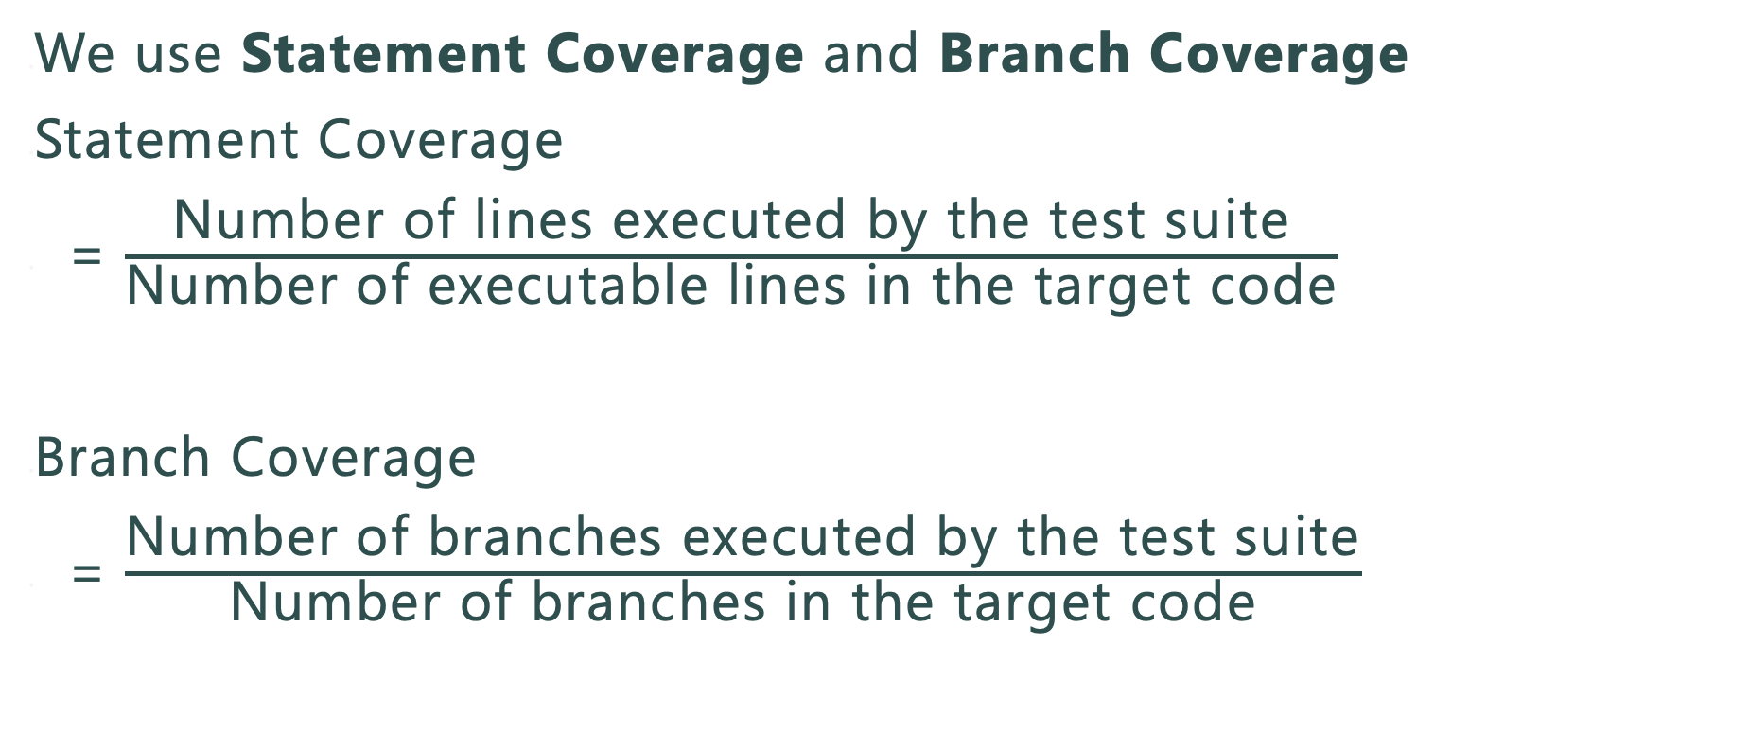
Code Coverage
We use Statement Coverage and Branch Coverage
Statement Coverage
= $\frac{\text{Number} \text{of} \text{lines} \text{executed} \text{by} \text{the} \text{test} \text{suite}}{\text{Number} \text{of} \text{executable} \text{lines} \text{in} \text{the} \text{target} \text{code}}$
Branch Coverage
= $\frac{\text{Number} \text{of} \text{branches} \text{executed} \text{by} \text{the} \text{test} \text{suite}}{\text{Number} \text{of} \text{branches} \text{in} \text{the} \text{target} \text{code}}$
Notes:
なくす，Appendixいき

Slide 22
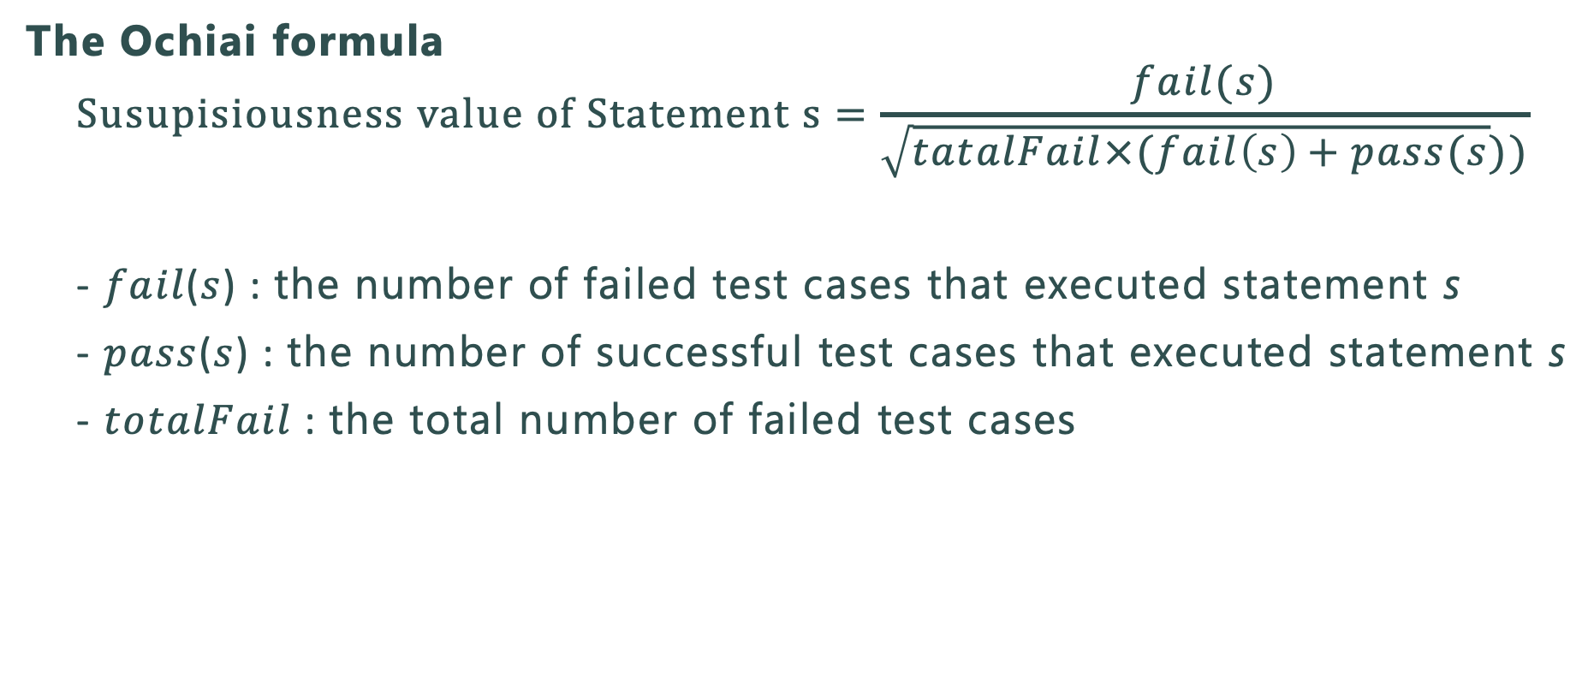
Ochiai
The Ochiai formula
  $$Susupisiousness value of Statement s=\frac{fail(s)}{\sqrt{tatalFail×(fail\left(s\right)+pass(s}))}$$
  - 𝑓𝑎𝑖𝑙(𝑠) : the number of failed test cases that executed statement s
  - 𝑝𝑎𝑠𝑠(𝑠) : the number of successful test cases that executed statement s
  - 𝑡𝑜𝑡𝑎𝑙𝐹𝑎𝑖𝑙 : the total number of failed test cases

Slide 23
Further Analysis of the SBFL Score: Nesting Depth
We calculated the effect size r for each nesting depth
  - It indicates the magnitude of the difference between AG/MC-Tests
  - Larger absolute values mean greater difference
  The difference in r-Score tends to increase with greater nesting depth
Nesting depth | １ | ２ | ３ | ４ | ５ | ６ | ７
effect size r | -0.095 | 0.12 | 0.21 | 0.28 | 0.55 | 0.67 | 0.65
AG-tests become less effective at accurately locating bugs
in more deeply nested code structures
Notes:
Additionally, we performed a Wilcoxon signed-rank test for each nesting depth and calculated the effect size r.
This effect size r indicates the magnitude of the difference between MC-tests and AG-tests.
Larger absolute values mean greater difference in r-score.
The table shows that for nesting depths 1 through 6, the effect size r increases as the nesting depth increases.
This shows that the gaps of r-scores between MC-tests and AG-tests become larger.
From these analysis, we conclude that AG-tests become less effective at accurately locating bugs in more deeply nested code structures.

Slide 24
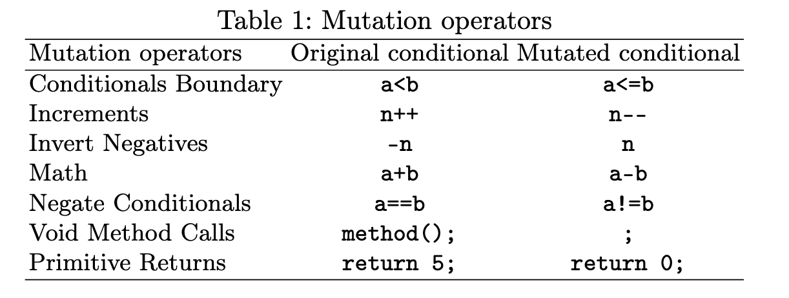
Example of Mutation Operator

Slide 25
Evosuite
- An automated tool for Java unit test generation
- Widely used in software research
- Uses exploratory approaches to find effective tests

