Slide 1



PyClone-Stream: An Automated and Self-growing Python Semantic Clone Dataset Nigar Alizada, Shiyu Yang, and Yoshiki Higo Software Engineering Laboratory, Department of Computer Science, Graduate School of Information Science and Technology, The University of Osaka, Osaka, Japan
nigar@ist.osaka-u.ac.jp

Slide 2
Roadmap
Background
Motivation
Research Gap
Core Idea
PyClone-Stream Structure
Methodology
Dataset Statistics
Comparison
Contributions
Future work

Slide 3
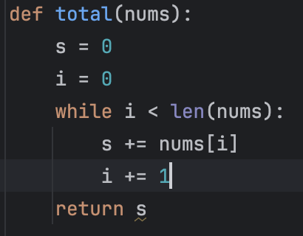
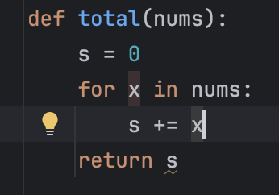
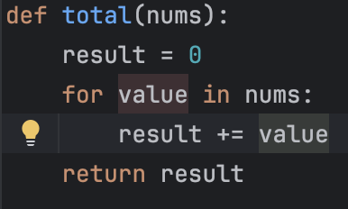
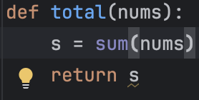
The Code Clones

Slide 4
Type-1: Two fragments are textually identical. Only whitespace or comments may differ.
The Code Clones
Pair 1

Slide 5
The Code Clones
Type-1: Two fragments are textually identical. Only whitespace or comments may differ.
Pair 1
Pair 2
Type-2: Same structure, but variables, function names, or types are renamed.

Slide 6
Type-3: Code is changed, reordered, or extended, but the overall logic remains similar.
The Code Clones
Type-1: Two fragments are textually identical. Only whitespace or comments may differ.
Pair 3
Pair 1
Pair 2
Type-2: Same structure, but variables, function names, or types are renamed.

Slide 7
The Code Clones
Type-3: Code is changed, reordered, or extended, but the overall logic remains similar.
Type-1: Two fragments are textually identical. Only whitespace or comments may differ.
Pair 3
Pair 1
Pair 2
Pair 4
Type-2: Same structure, but variables, function names, or types are renamed.
Type-4: Different algorithms or structures, but semantically equivalent behavior.

Slide 8
The Code Clones
Type-3: Code is changed, reordered, or extended, but the overall logic remains similar.
Type-1: Two fragments are textually identical. Only whitespace or comments may differ.
Pair 3
Pair 1
Pair 2
Pair 4
Type-2: Same structure, but variables, function names, or types are renamed.
Type-4: Different algorithms or structures, but semantically equivalent behavior.

Slide 9
The Real Clone Detection Problem
Machine Learning models need a huge dataset of these Type-4 code clone examples to learn from.
The existing datasets are not big enough.

Slide 10
Why Bother?
Software Development Life Cycle (SDLC)
Requirements
Implementation
Verification
Maintenance
Design

Slide 11
The Maintenance Crisis
Software Development Life Cycle (SDLC)
Requirements
Implementation
Verification
Maintenance
Design
The maintenance phase can consume the majority of a system’s total life-cycle cost.
Semantic clones become a major burden here.

Slide 12
Why Existing Datasets Fail?
Static: Most datasets (e.g., BigCloneBench*) are a snapshot in time. They don't reflect software evolution, newer versions of programming languages.
Python Scarcity: Python Type-4 data is limited; SemanticCloneBench* has only 1,000 samples.
Small-Scale & Artificially Curated: Datasets are often small and manually curated or synthetically created, which constrains coverage and reduces practical realism.
Limited Semantic Focus: Heavy bias towards syntactic (look-alike) clones, ignoring the harder-to-find semantic clones.
*https://ieeexplore.ieee.org/document/6976121
*https://ieeexplore.ieee.org/document/9047643

Slide 13



The PyClone-Stream Pipeline: Core Idea
Automated & Incremental
Self-growing
Reproducible

Slide 15



The PyClone-Stream Pipeline in Three steps

Slide 16

Phase 1: Data Retrieval
The PyClone-Stream Pipeline runs in two modes: daily&initial as background service
Automatically discovers new AtCoder contest submissions by web-scraping
Fetches recent accepted Python submissions
Collects metadata (problem ID, timestamp)
Stores raw code for downstream clone processing
Competitive programming platform: AtCoder
*https://info.atcoder.jp/logoguide

Slide 17
Phase 2: Data Refinement
Syntactic Clone Filtering
The PyClone-Stream Pipeline runs in two modes: daily&initial as background service
Normalize submissions
Filter using Nicad code clone detection tool
→ Keep only Type-4 pairs for the dataset
→ Threshold = 0.7
Output:
→ A filtered pool of Type-4 code clone candidates
Automatically discovers new AtCoder contest submissions by web-scraping
Fetches recent accepted Python submissions
Collects metadata (problem ID, timestamp)
Stores raw code for downstream clone processing
NiCad*
Competitive programming platform: AtCoder
*https://ieeexplore.ieee.org/document/5970189
*https://info.atcoder.jp/logoguide

Slide 18

Phase 3: Data Clustering
Turning Code Into Clone Clusters
Semantic Clone Grouping
Group surviving Type-4 clones by problem ID and create clone pairs
Form Type-4 clusters
Continuously add clusters to the live, growing dataset
Normalize submissions
Filter using Nicad code clone detection tool
→ Keep only Type-4 pairs for the dataset
Output:
→ A filtered pool of Type-4 code clones
NiCad*

Slide 19
Filtering Out Trivial Clones
The NiCad code clone detection tool is used to categorize submissions into clone types.
Submission 1 (S1)
Submission 2 (S2)
Submission 3 (S3)
Submission 4 (S4)

Slide 20
From All Pairs to Type-4 Pairs
Pair | Clone Type | Explanation | Survives NiCad Filtering?
(S1, S2) | Type-2 | Same structure; only variable names differ | ❌ No
(S1, S3) | Type-3 | Same logic but different control structure (for → while) | ❌ No
(S1, S4) |  | Loop vs built-in sum()
(S2, S3) | Type-3 | Structural differences but still closely derived | ❌ No
(S2, S4) |  | Loop vs built-in sum()
(S3, S4) |  | Index loop vs built-in sum()
Type-4
✅ Yes
Type-4
✅ Yes
Type-4
✅ Yes
Whatever survives this filtering pipeline becomes a semantic (Type-4) clone candidate record for our dataset.

Slide 21
Dataset Statistics
Current Snapshot based on initial back-fill:
20 contests
+120+ problems
+22K submissions
+0.1M Type-4 clone candidates
+2.4M syntactic pairs removed
Projected 1-Year Growth (Daily Scraping)
~150 new contests
~200K submissions
~1M Type-4 candidates

Slide 22
Example: Semantic Clone - Different implementations, identical output
# Sort-based
# Solution (a)
X = input()
c = X.count('0')
S = []
for i in X:
if i != '0':
S.append(i)
S.sort()
print(*( [S[0]] + ['0'] * c + S[1:] ), sep="")
# Counting-based
# Solution (b)
X = input()
count = [0 for _ in range(10)]
n_min = 9
for i in X:
count[int(i)] += 1
if int(i) > 0:
n_min = min(n_min, int(i))
ans = str(n_min)
count[n_min] -= 1
for i in range(10):
ans += str(i) * count[i]
print(ans)

Slide 23
Example: Filtered Type-2 - Lexically different (renamed variables), structurally identical logic.
# Solution (a)
X = input()
c = X.count('0')
S = []
for i in X:
if i != '0':
S.append(i)
S.sort()
print(*( [S[0]] + ['0'] * c + S[1:] ), sep="")
# Solution (c)
s = input()
zero = s.count("0")
ans = []
for x in s:
if x != "0":
ans.append(x)
ans.sort()
print(ans[0] + "0" * zero + "".join(ans[1:]))

Slide 24
Comparison with Existing Benchmarks
Aspect | PyClone-Stream | SemanticCloneBench | GPTCloneBench
Dataset Nature | Continuously growing (streaming) | Static benchmark | LLM-generated / labeled
Data Origin | Human-authored contest code | Stack Overflow snippets | Synthetic / model-generated
Primary Language | Python | C, C#, Java, Python | Multiple (model-dependent)
Scale | >20K submissions>0.1M Type-4 candidates | 4,000 pairs | Variable
Update Model | Daily incremental updates | One-time construction | On-demand generation

Slide 25
Contributions
PyClone-Stream provides:
Streaming dataset construction
Python-focused semantic diversity
Scalable automated pipeline
Reproducible infrastructure

Slide 26








Future Work
Extend to
other platforms
Cross-platform dataset expansion & ecosystem integration
Multilanguage Support
Generalized semantic cloning across programming languages
Train & Evaluate ML Models
Benchmarking deep models for semantic clone detection
Open-Source Clone Detection
Public semantic clone detection powered by contest-scale training

Slide 27
PyClone-Stream: An Automated and Self-growing Python Semantic Clone Dataset Nigar Alizada, Shiyu Yang, and Yoshiki Higo Software Engineering Laboratory, Department of Computer Science, Graduate School of Information Science and Technology, The University of Osaka, Osaka, Japan
nigar@ist.osaka-u.ac.jp

