Slide 1



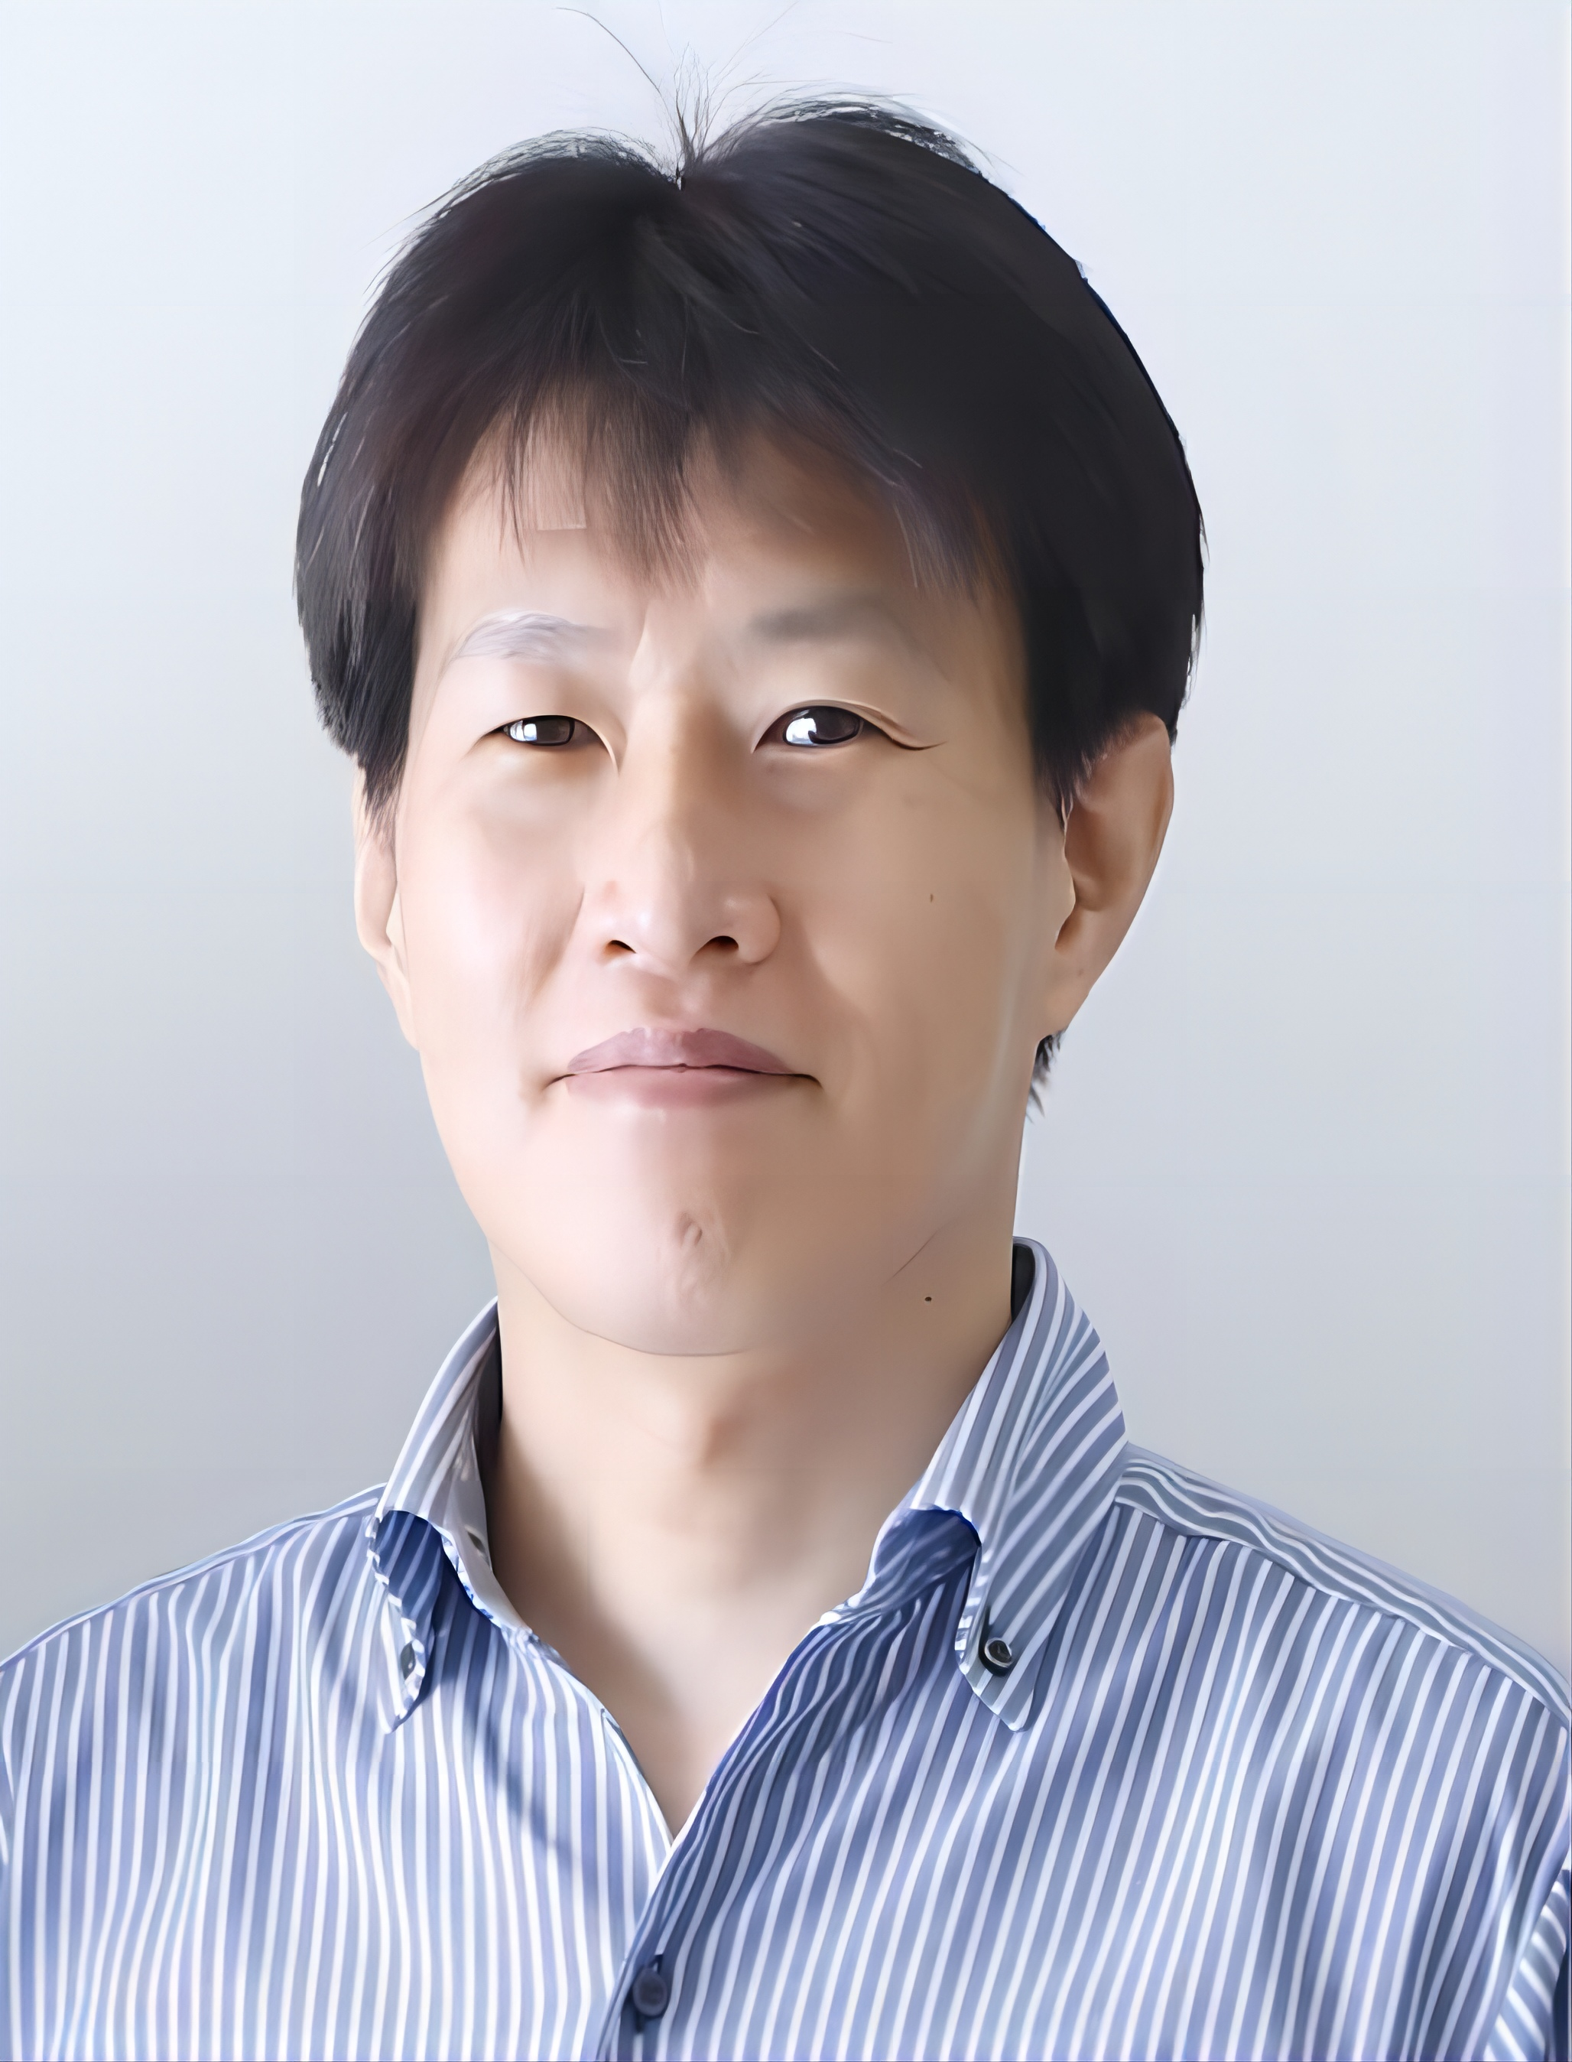

VISSOFT 2026 (NIER Track)
A Time-Based Visualization for
Agent-Based Codebase Interactions
Takuto Kawamoto (Ph.D., 1st year), Yoshiki Higo, Raula Gaikovina Kula
Graduate School of Information Science and Technology
The University of Osaka
Sept. 14th, 2026. Benevento, Italy
Notes:
Thank you for the introduction.
Hello, everyone. I’m Takuto Kawamoto from The University of Osaka.
Today, I will present our work, “A Time-Based Visualization for Agent-Based Codebase Interactions.”

Slide 2

Summary
1. Background (1 min.)
Skills, AGENT.md for specifying agent’s behavior
2. Motivation (1 min.)
3. Proposed Tool (2 min.)
4. Case Study (2 min.)
5. Future Works (1 min.)
Notes:
My talk has five parts.
background, motivation, our proposed tool, a case study, and future work.

Slide 3
1. Background
Various agents and skills are optimized for specific SE tasks,
but how to choose the best combination
for most effective (i.e., token cost, time, quality)​?
$
Adopt
?
?
Many kind of skills
Reject
Many kind of agents
Software Developer
Notes:
AI coding agents such as **Claude Code and Codex** provide many ways to customize their behavior, including different skills.
These agents and skills can be useful for different software engineering tasks, but it is not easy to know which combination is best. The best choice may depend on **token cost, execution time, and the quality of the result**.

Slide 4
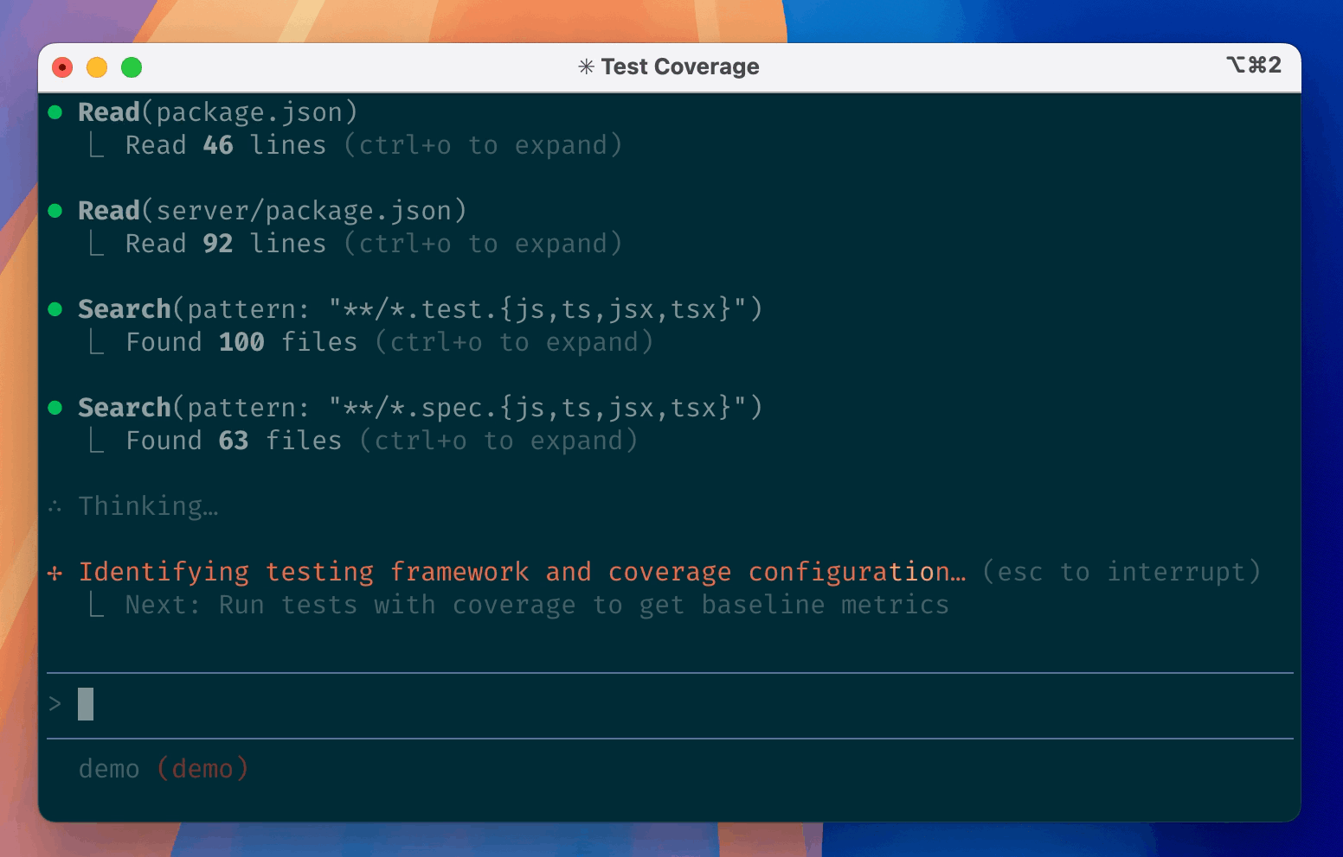
2. Motivation
Agentic logs can developers to evaluate the best combination, ​
but raw logs are hard to understand.​
What kind of log patterns are appearing?
▲
?
?
How much tokens were consumed?
▼
Software Developer
The image from https://github.com/anthropics/claude-code
Notes:
To help decide which combination to use, we can look at agentic logs.
These logs show what the agent actually did, including its actions and token usage.
An agent action is an operation performed through a tool.
However, there is still a problem. Raw logs are often long and hard to understand, making it difficult to grasp the overall process.
We aim to make agentic logs easier to understand through visualization.

Slide 5
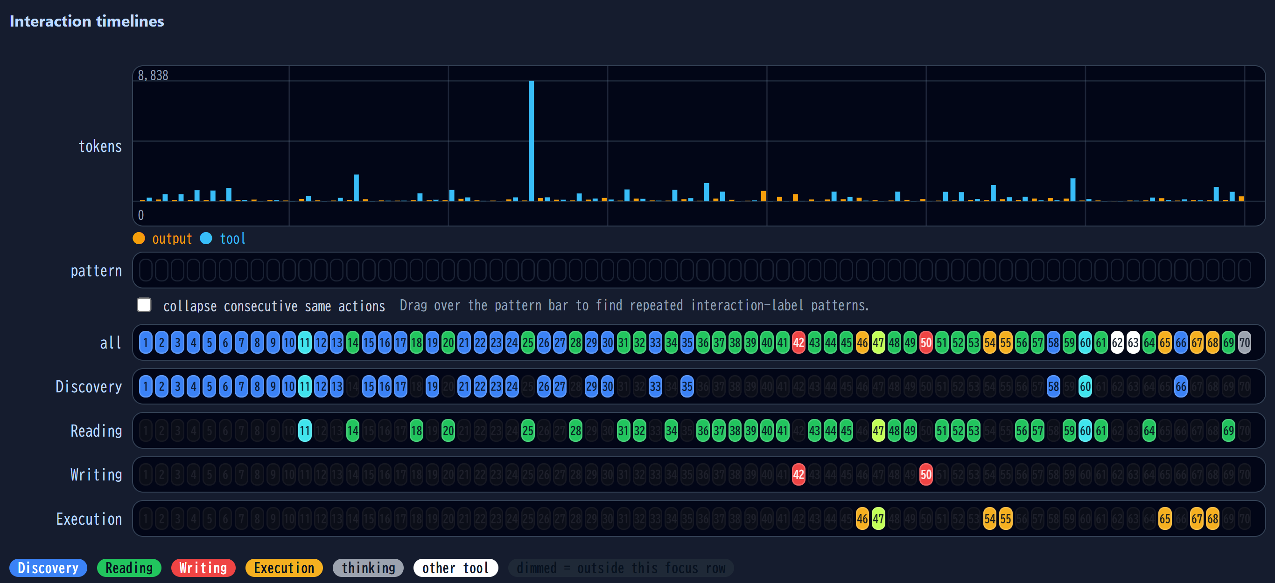
3. Proposed Tool: Agent ATO
Aims to visualize agentic logs over time:
actions, token usage.
Notes:
For this purpose, we developed **Agent ATO**.
It visualizes agentic logs over time, focusing on **agent actions and token usage**.

Slide 6
3. Proposed Tool: Agent ATO
Aims to visualize agentic logs over time:
actions, token usage.
1
2
3
1
2
3
Notes:
Each **square on the timeline** corresponds to one action in the raw log
shown on the right.
The numbers show how the actions in the raw log correspond to our visualization.
For example, number 1 on the right is a Read action, and number 1 on the left points to the corresponding vertical column in our tool. In the same way, numbers 2 and 3 correspond to these Search actions.

Slide 7
3-1. All Interactions Timeline
Colored by the kind of agent’s action:
discovery, reading, writing, execution.
Notes:
The first timeline shows all actions in order. They are colored by type: **discovery, reading, writing, and execution**.

Slide 8
3-2. Filtered Timeline
Filters interactions by agent’s action.
Notes:
The filtered timelines separate actions by these type.
This makes it easier to focus on a specific kind of action while keeping its place
in the overall sequence.

Slide 9
3-3. Tokens Usage Graph
Token usage indicates parts that should be
carefully checked.
Notes:
The token usage graph shows how many tokens each action consumed.
**The token usage for each action is shown directly above its square on the timeline.**

Slide 10
3-4-1. How to Use Actions Timeline?
Investigate why the file search began
after the task was completed.
Notes:
Let me show **some possible scenarios for using these visualizations**.
First, here is a scenario for the actions timeline. In this example, we can see file-discovery actions even after the main editing work is finished.
A developer can notice this unusual pattern and then investigate **why the agent started searching again**.

Slide 11
3-4-2. How to Use Tokens Usage Graph?
Investigate the actions that consume the most tokens.
Notes:
Another scenario is to use the token usage graph. Large spikes let us **quickly access the parts where many tokens were consumed**. We can then inspect the corresponding actions and investigate why they used so many tokens.

Slide 12
4. Case Study
I didn't include "to validate" because it felt superfluous. Is the intended information insufficient?
We manually inspected a small number of samples
to apply our visualization to real projects.
Target Bugs
2 Bugs on GitHub Issue (not toy project)
- immich-app/immich
- metabase/metabase
Executions
20 executions in total (10 executions per bugs)
Notes:
Next, I’ll show our case study. We applied Agent ATO to two real software projects, Immich and Metabase. For each bug, we ran the agent ten times and manually inspected the results.

Slide 13
4-1. Typical Bug Fixing Process
Step1: Localize a bug
Step2: Edit code
Step3: Verify modifications
Step1
Step2
Step3
Notes:
Before the observations, let me explain a typical bug-fixing process.
Bug fixing can be mainly divided into three steps,
First, the agent localizes the bug.
Second, it edits the code.
Finally, it verifies the modification, for example by running tests.
During Step 2, editing the code, we usually see many green, red, and yellow squares, while blue squares are rarely seen.
This pattern will be useful for understanding the next observation.

Slide 14
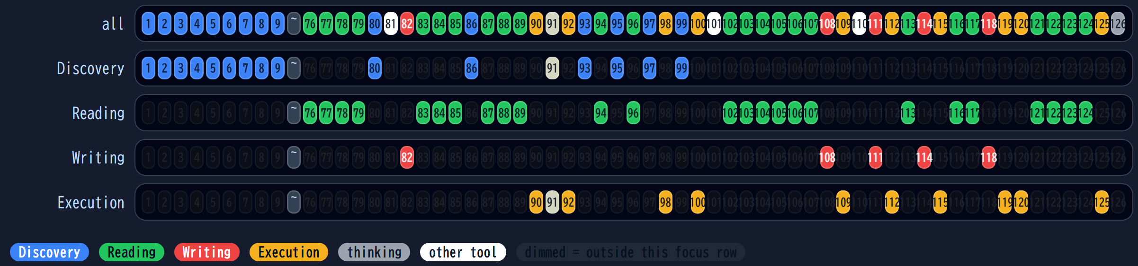
4-1. Exploring How To Validate
Agent ATO can show when the agent is taking many actions, and at what part of the bug fixing process.
Isn’t it taking too long for AI to
understand the validation approach (e.g. testing)?
First Edit
Second Edit
Step2
Notes:
Now, look at this editing step. Unlike the typical pattern, we see several blue discovery actions between the first and second edits. By inspecting them, we found that the agent was searching for how to validate its modification. This suggests that providing the validation method in advance may shorten the task.

Slide 15
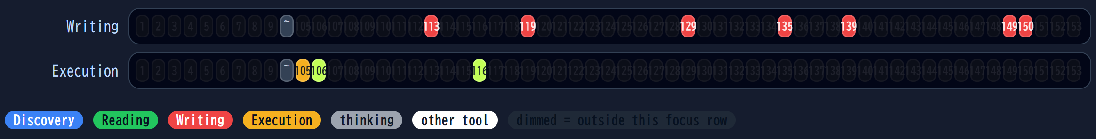
4-2. Thorough Testing
Understand the actual situation regarding the conduct of the validations.
Agent 2 does not validate
after editing!
Yellow action: validation action
1
2
Notes:
The second observation compares two executions of the same task. The first repeatedly validates after editing, while the second does not. If validation after every edit is required, the second execution may not satisfy that requirement. This difference is easy to see in the visualization.

Slide 16
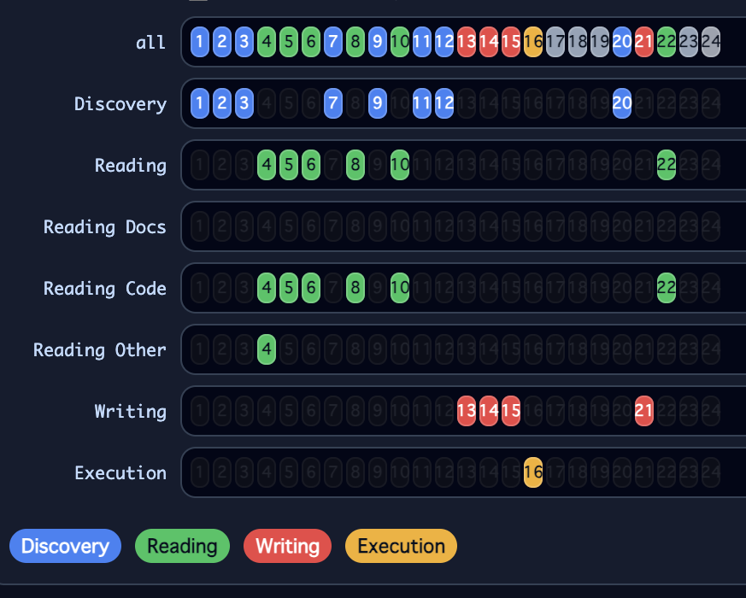
Future Works
・Additional filter timelines
・Proposal of quantitative metrics
Notes:
For future work, we plan to further improve Agent ATO.
First, we will add more detailed filter timelines, as shown here.
We also plan to propose quantitative metrics based on these visualized actions.
Beyond improving the tool itself, we will expand our empirical study and investigate software engineering tasks beyond bug fixing.

Slide 17
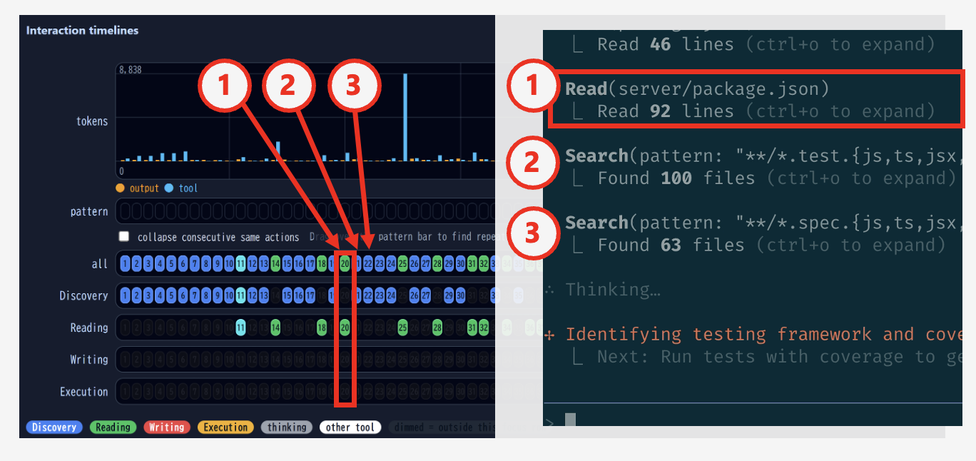

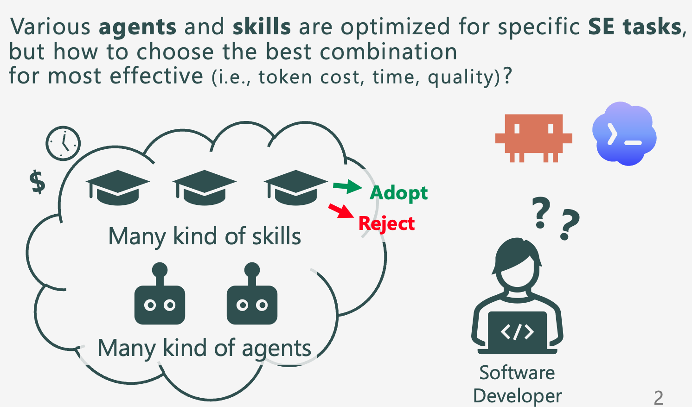
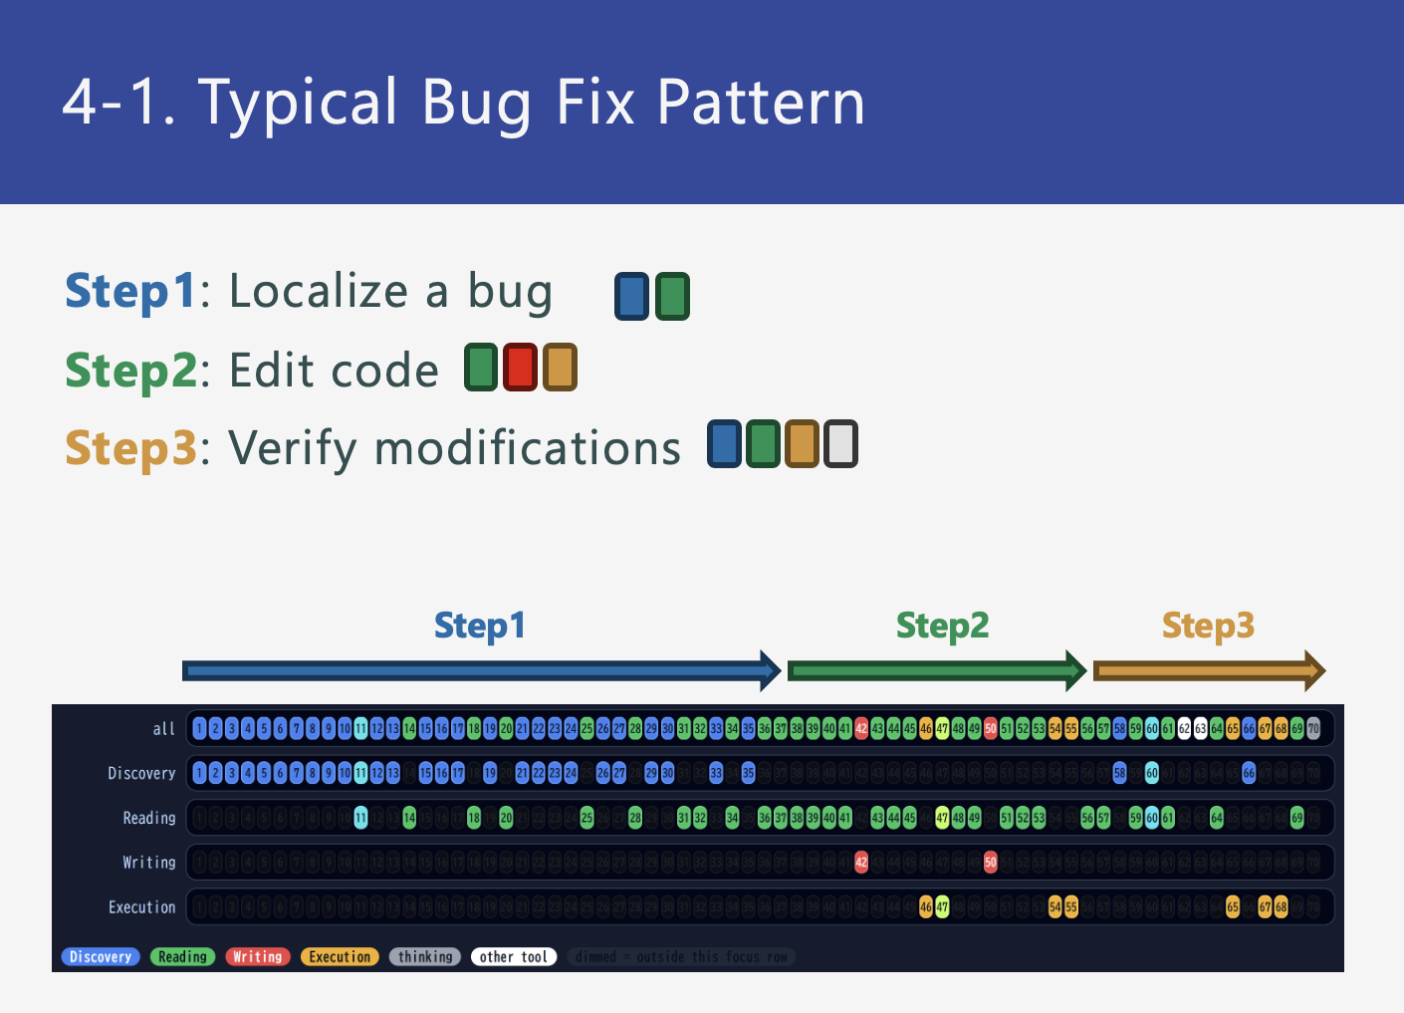
Summary
Notes:
That concludes my presentation. Thank you for your attention.

Slide 18
Appendix

Slide 19
AI Coding Agent
A system that autonomously executes SE tasks
specified by a user, with tools.
User
Specification
Command
Inference
LLM
Operation
by Tools
Computer
AI Coding Agent
Notes:
まず，背景としてAIコーディングエージェントについて説明します．
(よむ，このあと図をなぞっていく)
(このあと，登場人物と大まかな流れのまとめ)

Slide 20
Term Definition
Interaction
LLM inference and the associated tool calls.
Trajectory[1]
A chronological sequence of user instructions
and interactions.
Trajectory
Interaction
Interaction
Interaction
User
Command
LLM
Inference
Tool
Invocation
LLM
Inference
Tool
Invocation
LLM
Inference
Tool
Invocation
…
Time
[1] Y. Shunyu, et al. ReAct: Synergizing Reasoning and Acting in Language Models. ICLR2023.
Notes:
インタラクションとトラジェクトリという用語を導入します．
さきほどの反復的に繰り返す「LLMによる推論」と「ツールを用いたコンピュータの操作」の１組をインタラクションと呼びます．推論をして操作する，の順番です．
ですから，タスクを遂行するフローというのは，下の図の通り，ユーザの指示の後，１つ以上のインタラクションが続く，という構造になります．
これをトラジェクトリと呼びます．
トラジェクトリは時系列に沿ったユーザの指示と，インタラクションの列です．
トラジェクトリを理解することはエージェントの行動を理解することに等しく，エージェントの目的を理解するために重要です．
(目的の理解は，人間が考える目的と一致しているか？アラインするためにも重要．)

Slide 21
Observation of Trajectories
The trajectory is observed in the CUI standard output.
(Character User Interface)
The image from https://github.com/anthropics/claude-code
Notes:
普段，トラジェクトリはAIエージェントのCUIから確認できます．
CUIの出力には，ユーザの入力，LLMによる推論，ツールを使ったコンピュータの操作が時系列順に含まれています．これはトラジェクトリを観測するために使用できます．
ちょっと拡大してみてみます．左上に４つの丸があるのですが，(めくりながら)これを拡大すると

Slide 22
Observation of Trajectories
The trajectory is observed in the CUI standard output.
(Character User Interface)
The image from https://github.com/anthropics/claude-code
Notes:
Read,Read,Search,Searchとなっていて，これは4つのツール実行です．ただ，ここには，トラジェクトリの先頭にあるはずのユーザの指示が見つかりません．

Slide 23
Limitations of Trajectory Observation
・ Extensive log output
  Scrolling is required to view the content.
・Ambiguous agent behavior and objectives
  difficult to grasp the intended meaning.
▲
▼
The image from https://github.com/anthropics/claude-code
Notes:
なぜないかと言いますと，これは長大なトラジェクトリの一部だけを見ているためです．
実際のCUIはたとえばこのように，スクローラがすごく小さくなってしまうくらい，出力，即ちトラジェクトリが長大になってしまう場合があります．
この長いトラジェクトリを俯瞰するために，要所要所を(スクローラをつまんで行ったり来たりして)移動しながら見返すのは難しいです．
これが，エージェントがいつ，どんな目的でどんなコマンドを実行したか理解するのを難しくしています．
この問題をふまえ，本研究の目的に 〜をすえました

Slide 24
② Filtered Timeline
Filter interactions by condition
File Discovery Filter
File Read Filter
Notes:
基本的に，ということで一部，違った色のインタラクションが紛れ込んでいますが，これは複数のフィルタタイムラインに表示されるインタラクションです．
いま，この赤い部分を拡大しています．青いフィルタは「ファイル探索」インタラクション，緑のフィルタは「ファイル読み込み」インタラクションのみをそれぞれ表示するのですが，探索と読み込みの両方の側面を持つインタラクションもあります．
本研究では，そういった場合に，インタラクションの色をそれぞれの色を加法混色した色で表示しました．たとえば11番目のインタラクションは，これは青と緑なので，水色で表示されています．
<参考：両方の側面を持つインタラクションの例>
grep -R -n -C <数字> <対象文字列> <ディレクトリパス>
-R サブディレクトリも再帰的に探索
-n 行番号を表示
-C <数字> 前後5行も表示(-A, -Bも類似していて，これはそれぞれ後ろだけ，前だけ)

Slide 25
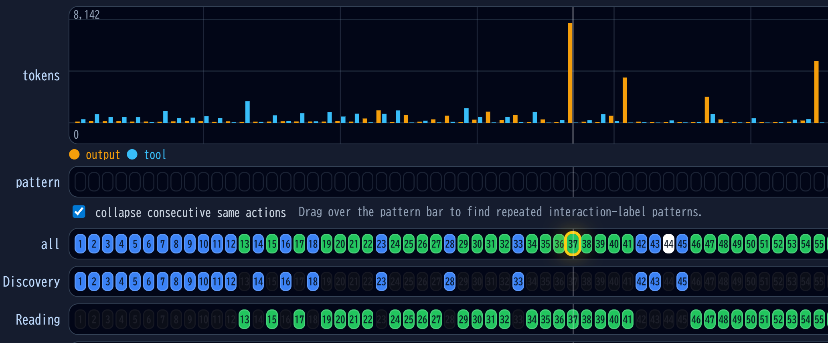
Finding3: Token Usage
The orange graph represents the number of tokens
in the LLM response.
A very large number of tokens are being output
in a single response.
Notes:
そうすると，このインタラクションに目が行くんじゃないかと思います．
このインタラクションですが，他と比べてLLM出力のために非常に多量のトークンを消費しています．

Slide 26
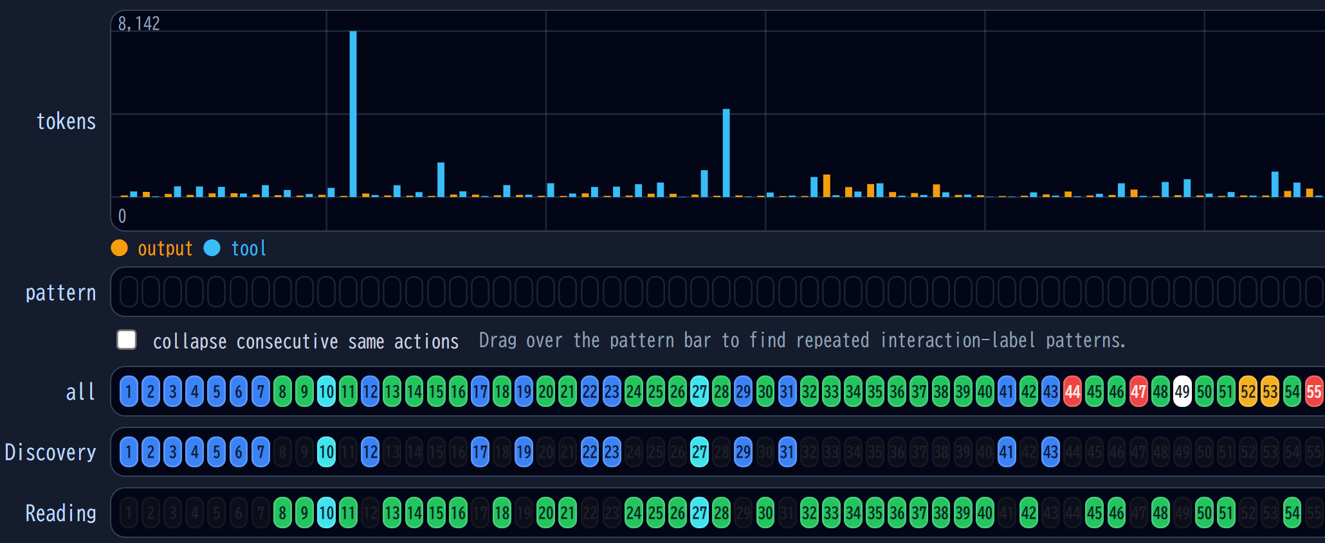
Finding3: Token Usage
The blue graph represents the number of tokens
in the tool output.
A large number of tokens were used
because a large file was read.
The higher the token count, the larger the file read.
Notes:
ここではこのインタラクションに目が行くのではないかと思います．こちらは先ほどと違って青いグラフになっています．青はツールの出力をLLMに渡すために使用するトークン量を表します．
トークン数が多いので，これは即ち読んだファイルのサイズが大きいということがわかります．
このツールを用いると，単にトークンの消費が激しい，というだけでなく，消費が激しい理由を明らかにでき，改善のために有用な情報を容易に得られます．
今ご紹介した観察をまとめます．
(これは言わなくても？)
こういったものを見つけると，例えば神クラスのような巨大なクラス，ドキュメントならいろいろな情報が詰め込まれた長すぎるドキュメントができてしまっていたりしないか？といったリファクタリングのきっかけが与えられます．

Slide 27
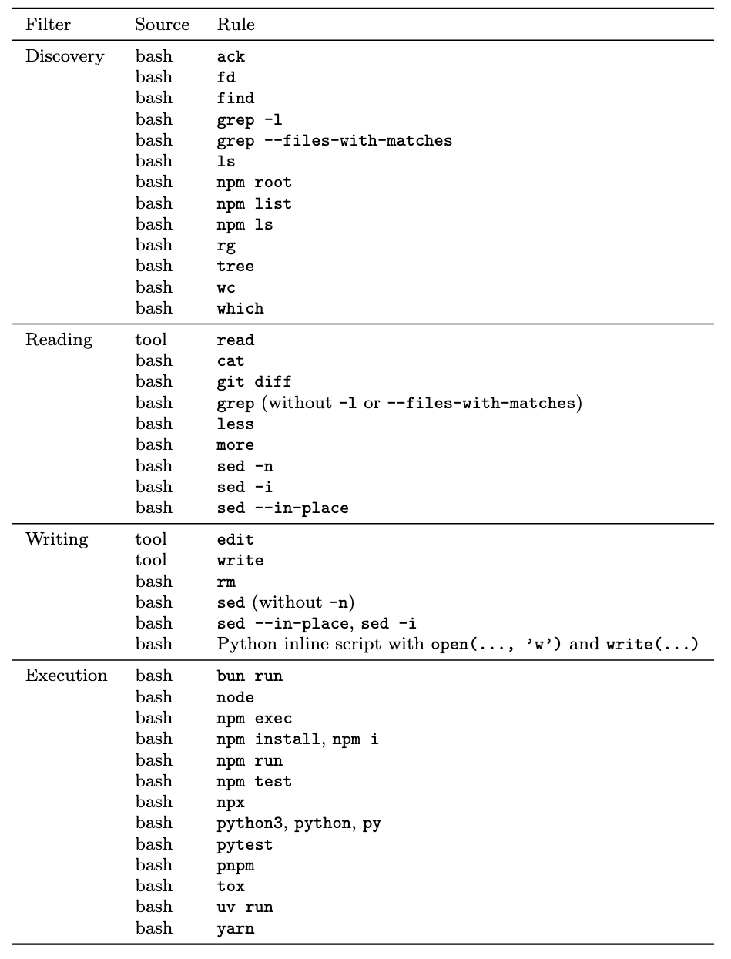
Appendix: Timeline Filter Condition

Slide 28
Appendix: Timeline Filter Condition

Slide 29
Appendix: Timeline Filter Condition

Slide 30
Appendix: Sample of Generated Long Text
(166 Characters)
Now let me think about the issue more carefully. The bug is
(2,003 Characters)
Wait, the user's description says
(2,241 Characters)
Wait, that's not how it works. Let me think again.
(12,796 Characters)
Wait, I just realized something crucial.
(6,159 Characters)
But wait, in the user's example,
(About 120,000 Characters)

