Slide 1
VerXCombo:
An interactive data visualization of popular library version combinations
Yuki Yano, Raula Gaikovina Kula, Takashi Ishio, Katsuro Inoue
Graduate School of Information Science and Technology,
Osaka University, Japan
Notes:
Hello everyone
My name is yuki yano.
I am a graduate master student at Osaka University, Japan.
I would like to talk about Our tool, called VerXCombo. It is visualization tool of popular library version combinations.

Slide 2

Software Library Reuse
Developers often use third-party libraries[1]
  Benefits:
    Needed features
    High quality
    Time and cost efficient
    Avoid reinventing the wheel
Adopt 3rd party libraries
[1] C. Ebert, “Open source software in industry,” in IEEE Software, 2008, pp. 52–53.
Notes:
In software development, the adoption of third-party libraries is now a commonplace.
Third-party libraries provide various features with high quality.
By using libraries, we can avoid reinventing the wheel.
Refference [1]..
According to [1] using 3rd party libraries is becoming very popular in software engineering both open source software and industry.
Benefit of using 3rd party llibrary is
Needed features are available
Trusting quality from library developers
You can save time and cost because you are not inplement yourself
Avoid reinvent wheel

Slide 3
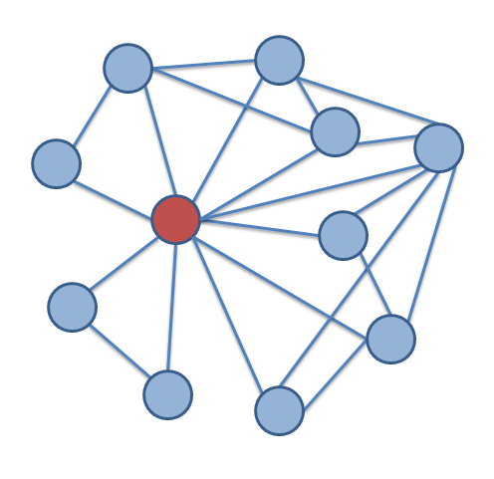
Complex library dependencies in large software systems
Large systems can have very complex library dependencies
System
Library
Notes:
A software system may depend on several libraries.
Each library also depends on other libraries.
Such transitive dependencies look like a tree structure, but the actual interaction among libraries can be represented as a complex graph.

Slide 4

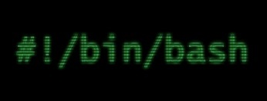
Library Update problem
Library update may cause software breakages because of incompatibility [2][3]
System Maintainer needs to decide “when” and “what version” to update?
[2] S. Raemaekers, A. van Deursen, and J. Visser, “Semantic versioning
versus breaking changes: A study of the maven repository,” in Proc. of SCAM, Sept 2014, pp. 215–224.
[3] R. G. Kula, D. M. German, T. Ishio, and K. Inoue, “Trusting a library: A study of the latency to adopt the latest maven release,” in 22nd IEEE Int. Conf. on Soft. Ana., Evo., and Reeng., SANER 2015, Montreal, Canada, March 2-6, 2015,
Notes:
The complexity causes a library update problem.
Third-party libraries are always updated to include new features and bug fixes.
But a new version of a library may be incompatible with system’s complex library dependencies.
Updating a library version breaks a software system if it is incompatible with another library used by the system.
Hence, a system maintainer needs to decide WHEN and WHAT version to update.
Without a library update, developers have risk of bugs like heart bleed and the shellshock bash bug.
if we don’t update, we have risk of bugs like heart bleed and the shellshock bash bug, but if we do update, we risk incompatibility issue.
Ref[2][3] concern of incompatibility when updating libraries.

Slide 5

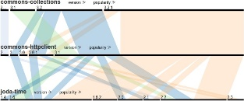




Propose solution: VerXCombo
VerXCombo visualizes popularity of library version combinations to determine best-fit
  Wisdom of the crowd: Popularity indicates Compatibility
VerXCombo
Notes:
To reduce the library update problem, we visualize which combinations of library versions are popular among existing systems available on the Internet.
we can not report actual incompatibility. but We assume popular use indicates a good combination of library versions.
Our tool named VerX-Combo is a web-application working on a browser and a server.
The server collects various programs available on GitHub and extracts library usage from their Maven configuration files.
When a user selects some libraries, then the tool visualizes which versions of the libraries are combined in existing systems using parallel sets.
Selecting a popular combination of latest library versions reduces the risk of incompatibility.

Slide 6
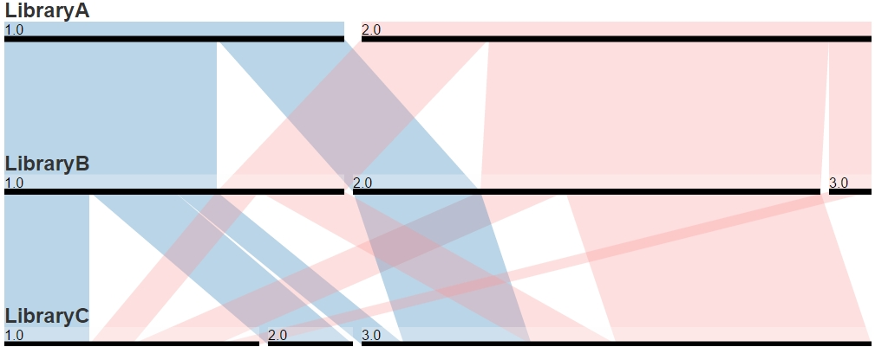
Features for User Interaction
Visualize library combinations as Parallel Sets[4]
Features
Mouse over highlighting a combination link.
Vertical Rearrangement
Horizontal Rearrangement
Sorting by Popular Usage
Sorting by Version
[4] F. Bendix, “Visual Analysis Tool for Categorical Data Parallel Sets”, no. 1, 2005.
Notes:
Our tool visualizes library combinations as Parallel Sets.
Now I will demonstrate how to read the Parallel sets visualization.
(デモページへ)
For example there are a system that uses 3 libraries A& B &C(point to ABC).
All these libraries are represented as a horizontal bar parallel to each other
Then, the bar is divided into each respective library versions.
The link between each library version represent the freaqency count of systems that uses both library versions.
The thickness represents popularity.
The color represent different combination sets in reference to Library A.
Our tool has several features for user interaction.
Mouse over can be use to highlight and select interested libraries,
For example, These lines correspond to the combination sets that include LibraryA version1.0.(point to LIbAver1)
Our tool can also do Vertical and Horizontal Rearrangement(rearrangement)
We can also sort by Popular Usage and Version(sort)

Slide 7


Demo Scenario
Introduce a new library.
Commons-
Collections
Ver. 3.2
Commons-
HttpClient
Ver. 3.1
Commons-
Collections
Ver. 3.2
Commons-
HttpClient
Ver. 3.1
Joda-Time
Ver. ?
$$S_{1}$$
$$S_{2}$$
Update
Notes:
We will now demonstrate how the tool can be used in a case scenario.
Suppose, System “S” has dependencies with the Apache Commons-Collections and COMMONS-HTTPCLIENT
In the next release of S, developer want to implement a new feature. the New feature involve adopting the Jodatime library. In this scenario user want to know what is the best jodatime version to use.
S wants new feature of calender, the developer want to use jodatime library which can implement calender feature.
Related library dependency is collections and httpclient. In this scenario user want to know what is the best-fit combination between the 3 libraries.

Slide 8
What information does the user want to know?
Q1: What set of the target library version combinations ‘best-fit’ the current system dependency environment?
Q2: What is the most popular combination set of libraries?
Q3: What combination satisfies the closest to the latest version combination?
Notes:
In my demo , we show how our tool is able to provide answers to the following 3 questions
What is the best fit combination of libraries. For this question we will use the current library versions in system S.
For Q2 we want to know the most popular versions used by the crowd
Finally for Q3 we want to know what is the most popular combination that is closest to the latest versions.

Slide 9

Q1: What set of the target library version combinations ‘fit-in’ the current system dependency environment?
Notes:
First, we will load the data. (enter and load there libs)
Next we will try to find the best fit. (3.1
So system S uses collections 3.2(point to 3.2) and http3.1(point to 3.1)
From our tool we can see that joda-time version 1.4;1.6;2.0;2.2

Slide 10
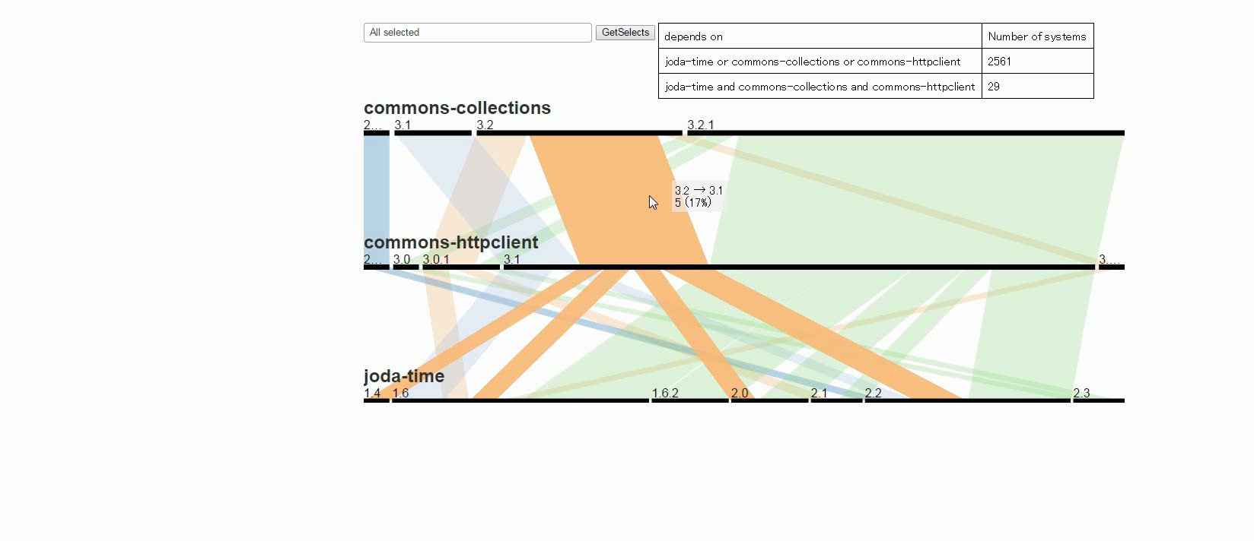
Q2: What is the most popular combination set of libraries?
Notes:
Next for Q2
We will use popularity sorting to find the most popular version(sort by popularity)
As you can see popular combination is commons-collection version 3.2.1 and commons-httpclient version 3.1 &joda-time version 1.6

Slide 11
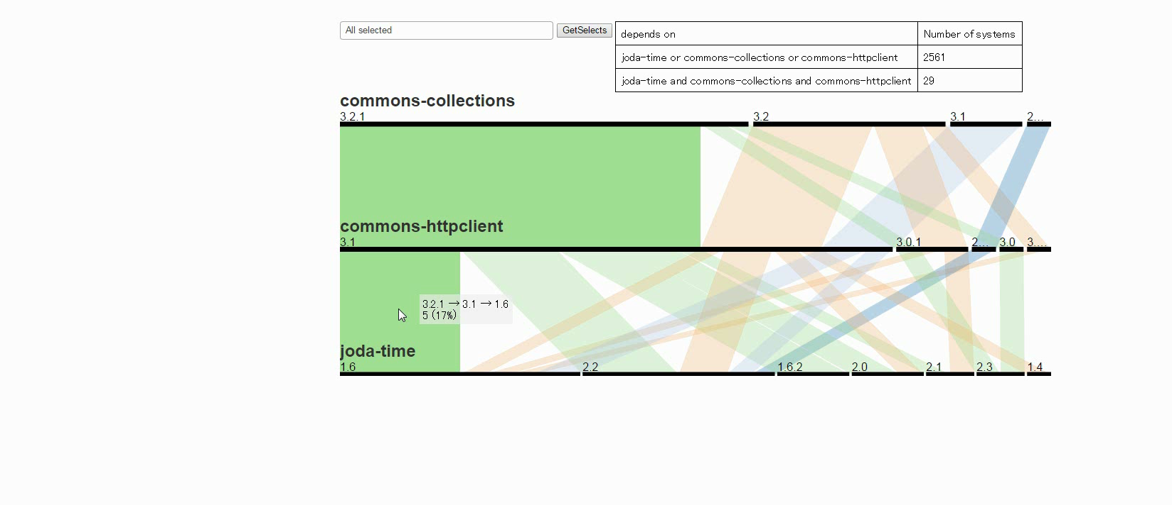
Q3: What combination satisfies the closest to the latest version combination?
Notes:
Finally for Q3,
We want to find the most popular which is closest to the latest versions of each library.
For this we will sort by version.(sort by version)
Also the thickness of lines provide indication of the recommended answer.
In this case recommended version is jodatime version 2.2.
note that our tool does not recommend the latest jodatime version 2.3.
Developer can decide to use jodatime version 2.3, but this is not a popular crowd choice.

Slide 12
Conclusion and Future Work
Our tool uses wisdom of crowd to determine best-fit library update for large systems
  Popularity
  Latest version
Future work
  Extend 3 combination to n combination
  Explore dependency within libraries(transitive dependency)
Notes:
Our tool uses wisdom of crowd to determine best-fit library update for large systems
In our future work,
We would like to extend 3 library combination to n combination,
and now, we had collected direct dependency data. But we would like to explore transitive depenedencies.
Thank you for your attention I invite you to visit our demo.

Slide 13
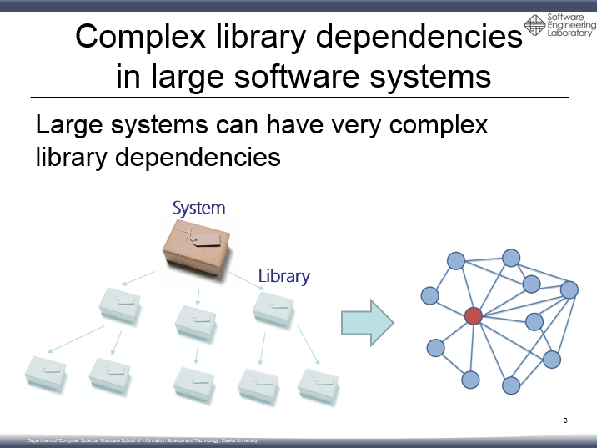
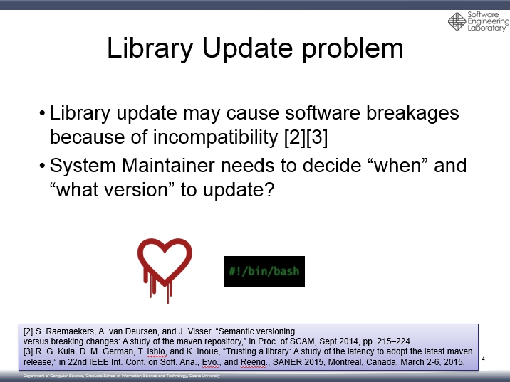
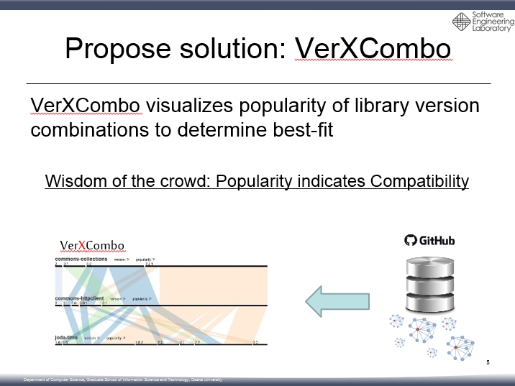
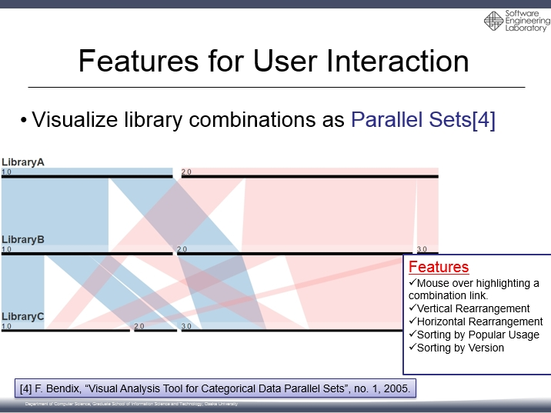
Thank you for your attention!

Slide 14
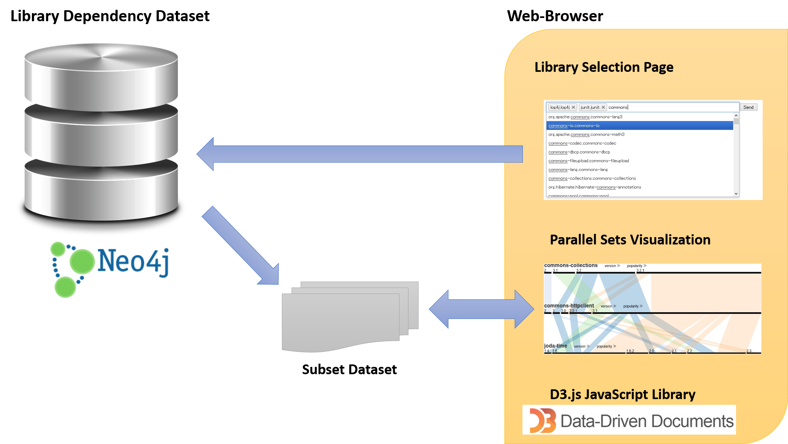
Tool Architecture
Notes:
The tool works on a web-browser interacting with the extracted dataset.
A user selects libraries on a browser.
Then the tool extracts a subset of library usage and visualizes the data using parallel sets.

Slide 15
Library combination as
Parallel Sets
We determine best-fit according to
  Popularity
  Latest release version
Notes:
We determine best fit combination according to the two criteria.
1.Popularity First, We assume popular use by similar system indicates a favorable library versions.
2.Latest … we also consider sorting by latest versions.
Using these two criteria we can find a best fit combination.

Slide 16
Software Evolution and Maintenance
Software is always changing
  Fix bugs
  New features
  Software maintenance
Library also require updates
  New versions library also change
Notes:
Software is always changing
So each time you have a new release that include bug fix or patches or new features or maintenance activities like refactoring
also libraries are evolving to fix bugs or….

Slide 17
Real world Scenario
Library | Description | System Environment Version | Latest Version
Commons-Collections | Java Utilities Library | 3.2 | 3.2.1
Commons-Httpclient | Client-side HTTP protocol library | 3.1 | 3.1
Joda-Time | Date, Time and Calender library | - | 2.3
Notes:
ケース設定

Slide 18
Dataset
Library dependency dataset
  Make a dataset by analyzing Projects in GitHub
Of projects | 4,210
Of Systems | 36,910
Of Libraries | 29,535
Of Libraries Versions | 151,647
Notes:
For our usage scenario we populate our tool using the github dataset.

Slide 19
Software Evolution
Release new versions
  New features
  Bug fix
System Maintainer needs to decide `if’, `when’ and `what to update?’
Notes:
ライブラリは，自身のプロジェクトとは別に開発が進められ，機能の改善やバグの修正などが行われる．これに伴って新しいバージョンがリリースされていく．
そのため，開発者にはライブラリのアップデートを行うかどうか，行う場合，どのライブラリのどのバージョンを利用するか，などの判断を行う必要がある．

