Slide 1
Detection of License Inconsistencies in Free and Open Source Projects
Yuhao Wu
Inoue Lab
2016/02/16

Slide 2
Open Source Software License
Gives developers permissions to reuse and redistribute the source code, which usually exists in the header comment of a source file
GPL-3.0+
Generally not allowed to be modified, removed or changed without copyright owner’s permission
MIT
This program is free software: you can redistribute it and/or modify
it under the terms of the GNU General Public License as published by
the Free Software Foundation, either version 3 of the License, or
(at your option) any later version.
[…]
[…]
The above copyright notice and this permission notice shall be included in all copies or substantial portions of the Software.

Slide 3
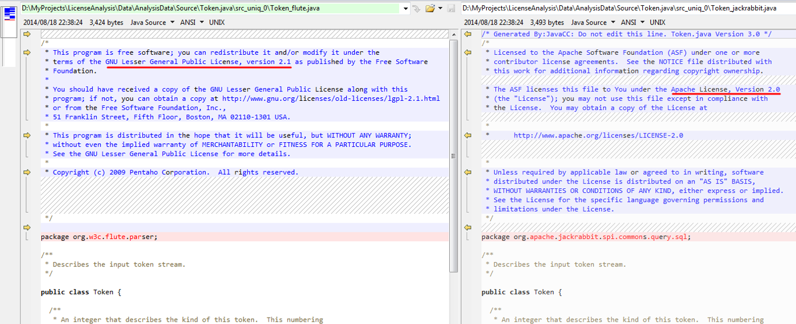
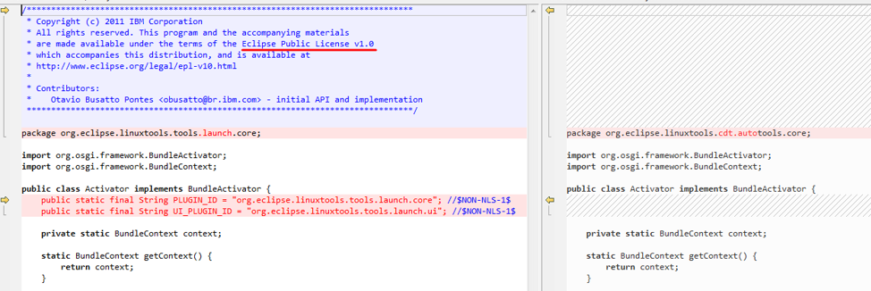
Motivation
Files with same code contents under different licenses
License A <==> License B
License C <==> No license
Definition of License Inconsistency
Two source files that evolved from the same provenance contain different licenses
EPL-1.0
None
LGPL-2.1
Apache-2.0
License inconsistency indicates potential license violation problems
“The LGPL is ineligible primarily due to the restrictions it places on larger works, violating the third license criterion. Therefore, LGPL-licensed works must not be included in Apache products.”
http://www.apache.org/legal/resolved.html#category-x

Slide 4
Problem
No research has been done to address these questions:
RQ1: How many types of license inconsistencies are there?
RQ2: Do they exist in open source projects?
RQ3: What is the proportion of each type of license inconsistency?
RQ4: What caused these license inconsistencies? Are they legal?

Slide 5
Method^{[1]} Overview
Collection of Projects
Project_1
…
Project_2
Project_3
j Group files by their normalized tokens using CCFinder^{[2]}
Group_1
Group_2
…
k Identify the license of each file in each group using Ninka^{[3]}
Group | #Licenses | #None | #Unknown
1 | 2 | 5 | 0
2 | 2 | 2 | 0
…
l Calculate metrics for the groups that contain license inconsistencies
[1] Yuhao Wu, Yuki Manabe, Tetsuya Kanda, Daniel M. German, Katsuro Inoue: "A Method to Detect License Inconsistencies in Large-Scale Open Source Projects", Proceedings of the 12th Working Conference on Mining Software Repositories (MSR 2015), pp.324-333, Flotrnce, Itary, May 2015.
[2] T. Kamiya, S. Kusumoto, and K. Inoue, “CCFinder: A multilinguistic token-based code clone detection system for large scale source code,” IEEE Transactions on Software Engineering, vol. 28, no. 7, pp. 654–670, 2002.
[3] D. M. German, Y. Manabe, and K. Inoue, “A sentence-matching method for automatic license identification of source code files,” in Proceedings of the 25th International Conference on Automated Software Engineering (ASE2010), 2010, pp. 437–446.

Slide 6
Empirical Study (1/3) - Setup
Goal
To reveal the characteristics of license inconsistencies in open source software projects
Target:
Debian 7.5 and a collection of
Java projects on GitHub
Categorization
LAR: License Addition or Removal
LUD: License Upgrade or Downgrade
LC: License Change
Type | Debian 7.5 | Java Projects
Projects | 17,160 | 10,514
Total files | 6,136,637 | 3,374,164
.c files | 472,861 | 15,627
.cpp files | 224,267 | 21,176
.java files | 365,213 | 3,337,361
Category | Debian 7.5 |  | Java Projects
LC | 5,272 | 98.4% | 12,653 | 90.9%
LUD | 2,350 | 43.9% | 1,316 | 9.5%
LAR | 1,500 | 28.0% | 6,179 | 44.4%

Slide 7
Empirical Study (2/3) - Manual Analysis
To determine the reason and safety of each case of license inconsistency (RQ4):
Find the repository of each related project
Check the license evolution of the files
Find out when and why the license was modified
Determine whether the license modification is legally safe or not

Slide 8
Empirical Study (3/3) - Result (example)
TagLibraryInfo.java
Apache-1.1
tomcat6
Tools that maintain the licenses made some mistakes accidentally;
Discussed with Apache people and agreed to change to a multi-license;
Validating the license by file basis is complicated and expensive.
Apache-2.0
tomcat 5.5.x
CDDL
Multiple: CDDL, GPL-2.0
or Apache-2.0
glassfish
Debian 7.5

Slide 9
Results (1/2) Answers to RQ1-3
RQ1: How many types of license inconsistency are there in the target collections of projects?
3 types: LAR, LUD and LC
RQ2: Do they exist in open source projects?
Yes, they exist in Debian 7.5 and Java projects on GitHub
RQ3: What is the proportion of each type of license inconsistency?
Debain 7.5
LAR (28.0%), LUD (43.9%) and LC (98.4%)
Java Projects
LAR (44.4%), LUD (9.5%) and LC (90.9%)

Slide 10
Results (2/2) Answers to RQ4
What caused these license inconsistencies?
i) Original author modified/upgraded the license;
ii) The file was originally multi-licensed and reusers chose either one;
iii) Reuser added one or more licenses to the source file;
iv) Reuser replaced the original license, and changed the copyright owner.
Among them, the last two types of license modification are legally unsafe.

Slide 11
Conclusion
An efficient method is proposed to detect license inconsistencies in open source projects
An empirical study is conducted to investigate the license violation problems
Future work
Apply this method to more projects to detect more patterns
Investigate the evolution of license inconsistencies

Slide 13
MSR’15

