Slide 1
SoL Mantra: Visualizing Library Update Complexity Through Orbital Layout and Coexistence Coefficient
Boris Todorov
Master’s Candidate
Software Engineering Laboratory, Osaka University

Slide 2



Problem Background Keeping Libraries up to Date
Am I using the latest version of a library?
Software Developer
Software System
Bug
If I update, what other libraries will be affected?
New Features
Tracking library evolution
Library repository
supports-color
babel-core
NPM
glob
bluebird
Dependencies / Libraries
char-spinner
mocha

Slide 3
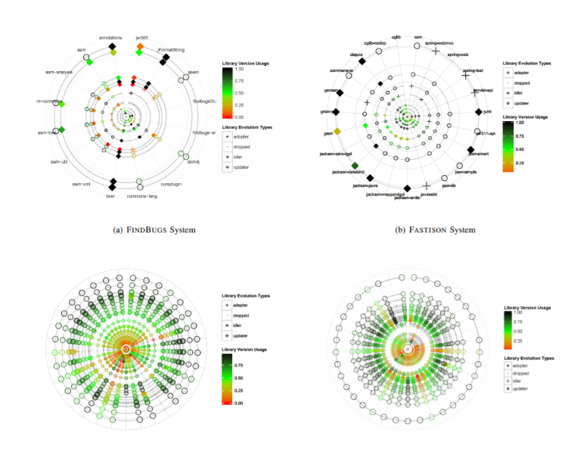
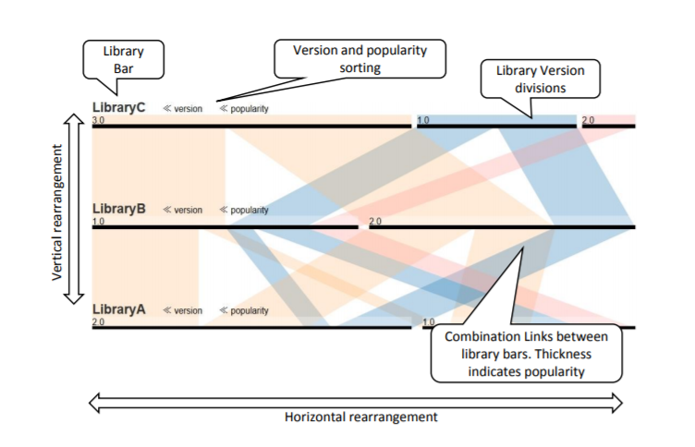
Previous Research
Kula et al:
Visualized circularly a software’s dependencies with added historical data;
Drawbacks: too much information and became overwhelming for inexperienced users
Yano et al:
Visualized popular library version combinations to assist software maintenance;
Drawbacks: was limited to 3 at a time

Slide 4
Basic Concepts
The Solar System Metaphor – we selected for our visualization the Orbital Layout powered by D3.Js as our main visualization technique, deriving that a software system is similar to the solar system.
Software – the program whose dependencies to other libraries are our concern for visualization;
Library – the programs used by the system or other libraries, forming library dependency directed graph;
Coexistence coefficient (cc) – a binary relation between two libraries (nodes) in an ecosystem, where those two libraries are used by at least one common library or common system.

Slide 5


Coexistence Coefficient (cc)
Library A – Q, D, J, F, E Library B – J, F, E, Z
F
J
E
Q
A
B
$$CCA(B)=\frac{|Users A ∩Users B|}{|Users A|}$$
D
Z
$$\frac{6884 ∩3165}{6884}=\frac{3158}{6884}≈0.4587=45.87\%$$
Low cc score – safe to update
High cc score – high complexity

Slide 6
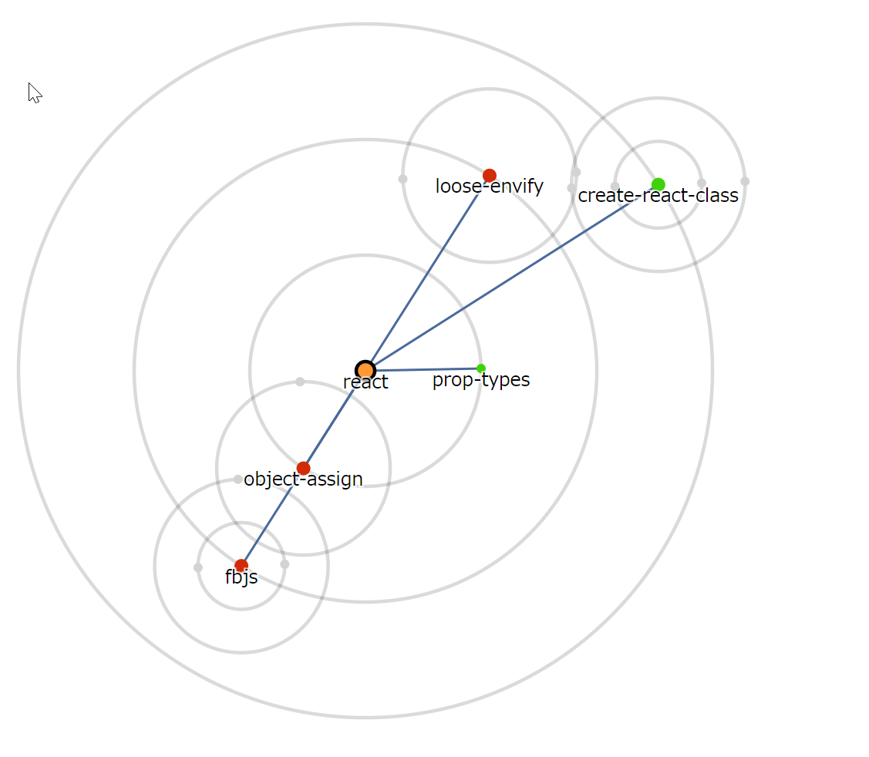
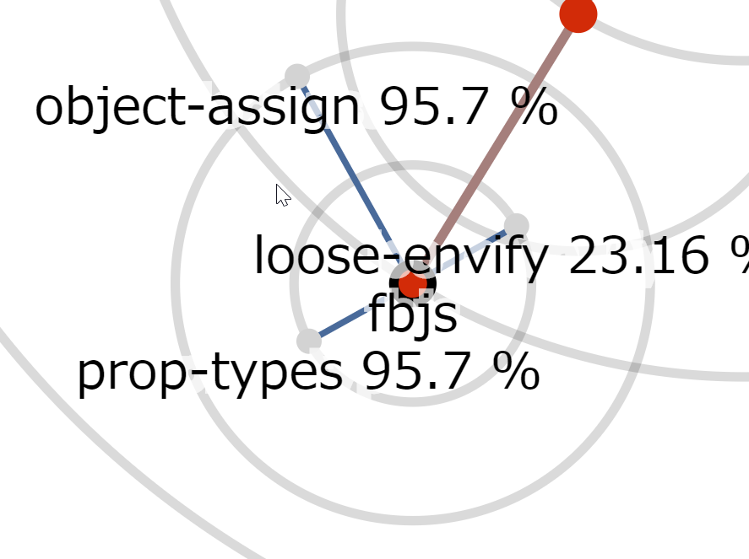
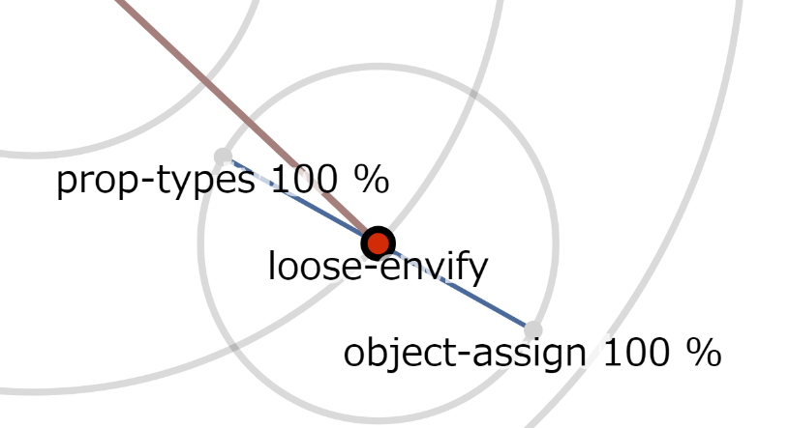
SoL Mantra Example Model
Library A
Library B
Notes:
Explanation A and B cc

Slide 7
SoL Mantra General Comprehension Survey
Conducted a survey using google forms with 19 participants in total.
Survey Goals – test tool comprehension amongst inexperienced audience and how well users understand the coexistence logic.
Survey RQ1 – Is the tool intuitive and easy to use?
Survey RQ2 – Do the users understand coexistence?

Slide 8
General Tool Comprehension Tasks Results
General comprehension tasks
3 simple questions regarding our visual cues:
What is the system represented – 100% answered correctly
How many libraries does the software system use – 94.7%
How many libraries are outdated (if any) – 94.7%

Slide 9
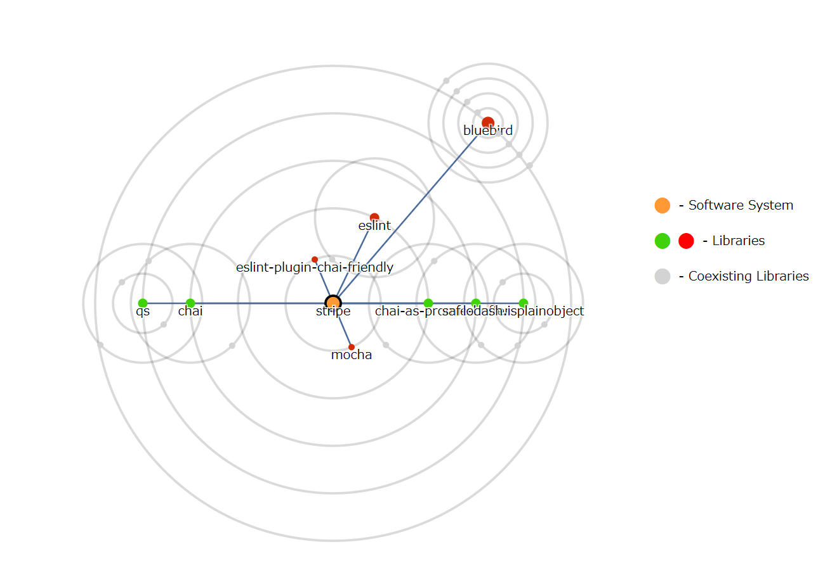
Survey SoL Mantra – “stripe”

Slide 10
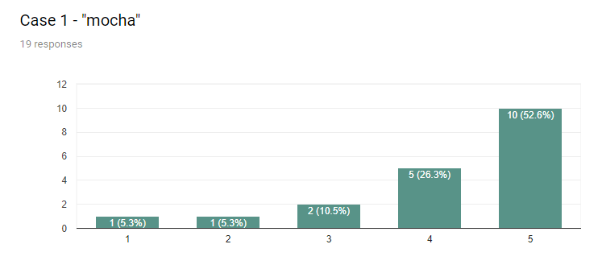
Coexistence Coefficient Comprehension Results – Case “mocha”
Further Investigate
Safe to update

Slide 11
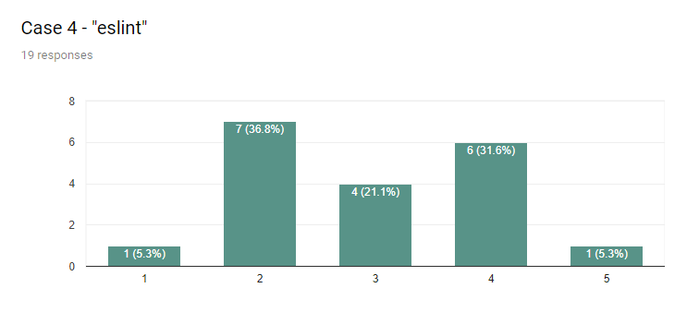
Coexistence Coefficient Comprehension Results – Case “eslint”
Further Investigate
Safe to update

Slide 12
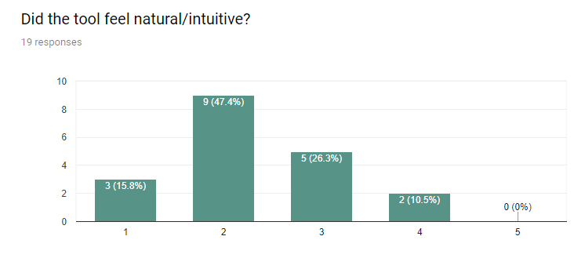
Post Task Survey Results – Is the tool intuitive or not?
Natural
Counter-intuitive

Slide 13
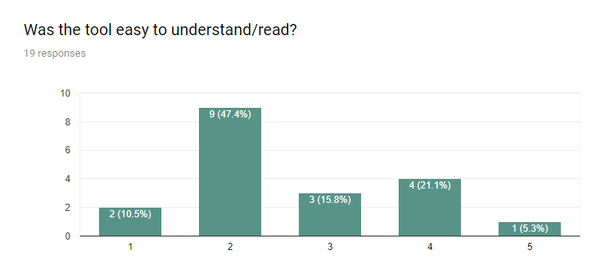
Post Task Survey Results – Was the tool easy to understand?
Difficult/
Confusing
Very easy

Slide 14
Threats to Validity
Collected data is based on established projects.
The tool was tested only on the NPM ecosystem packages.
The tested projects could have specific reasoning for the version used that we are unaware.
Survey participants count (19).
Survey users are mostly students that don’t have experience in the field.

Slide 15
Summary
We created the SoL Mantra tool to visualize library update complexity.
We tested empirically with results from 23 projects and presented these results at VISSOFT 2017 in Shanghai
We deployed an online survey to validate the usefulness and readability of our tool amongst inexperienced users.

