Slide 1
Detecting License Inconsistencies Based on Token Size in Open Source Software
Daniel Kim
Software Engineering Laboratory
Professor Katsuro Inoue

Slide 2
Background
Free open source software is an integral part of the software engineering ecosystem.
Various licenses emerged over the years.
Source code licenses can change over time depending on the author and developer’s actions.
These changes lead to license inconsistencies and in the case of legal incompatibility, license violations.

Slide 3
Previous Research
The first version of CCFX (Code Clone Finder X) was developed to find Type 1 and Type 2 code clones.
Ninka was developed to determine licenses found in source code.
Yuhao Wu, Katsurou Inoue, Yuki Manabe, Tetsuya Kanda, and Daniel M. German have published a paper detailing their analysis on Debian 7.5 and 10,514 Java projects using these tools.

Slide 4
Goals & Motivation
Validation of previous research.
To detect code clones based on varying thresholds to observe outcome of number and types of license inconsistencies.
Previous research used token size of 50, default for CCFX.

Slide 5
Tools Used
CCFX | Detect and report code clones
Ninka | Detect and classify licenses in source code
Python | Used as main scripting language
SQLite3 | Store and manage data output from CCFX and Ninka

Slide 6
Relevant Terminology
Code snippet | A portion of source code
Cloneset | A set of similar code snippets as determined by CCFX
Token Size | Number of essential elements that CCFX divides source code into
License Inconsistency | Difference in licenses found in two versions of the same source code

Slide 7
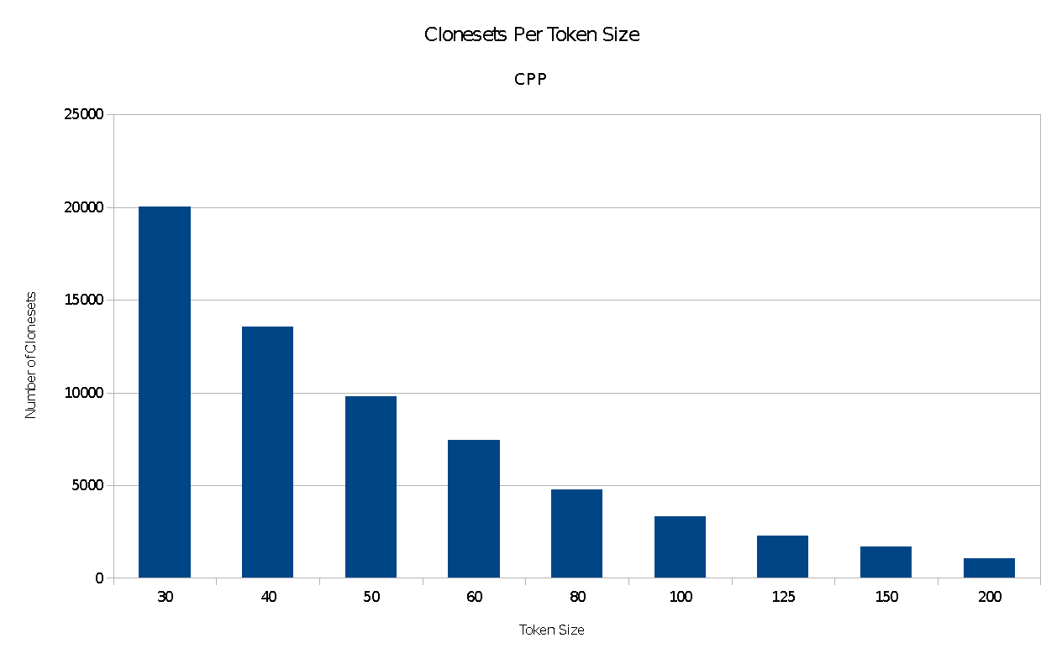
Results

Slide 8
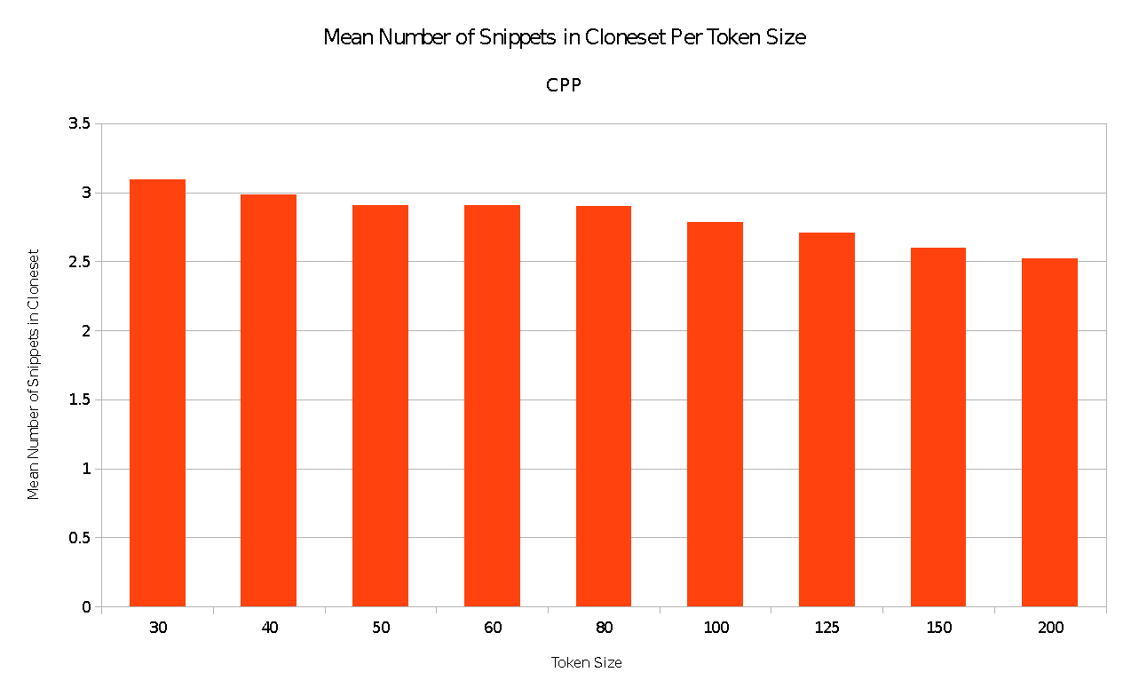
Results

Slide 9
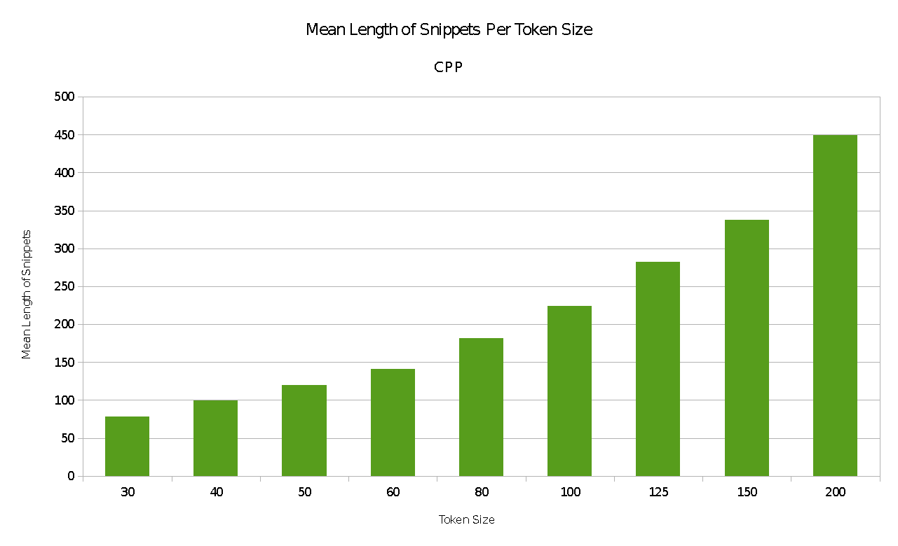
Results

Slide 10
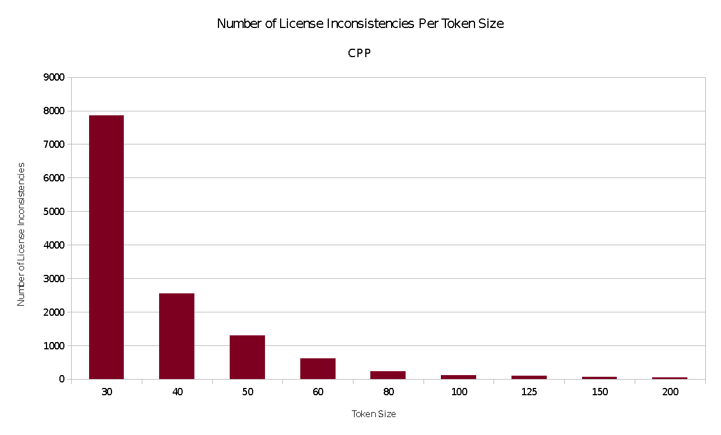
Results

Slide 11
Analysis & Conclusions
The mean number of code snippets per cloneset decreases only very slightly.
However, the number of license inconsistencies decreases heavily.
The number of clonesets also drops off heavily.
The mean length of snippets increases as expected.
Conclusion: Smaller token sizes of 30 to 50 may include many false positives of license inconsistencies.
Further reinforced by manual inspection of source code.

Slide 12
Types of License Inconsistencies
License Addition | The source file was without a license and one was added at a later time.
License Removal | The source file was under a license and was removed at a later time.
License Upgrade | The source file was under a certain version of a license and was upgraded to a newer version of the license.
License Downgrade | The source file was under a certain version of a license and was downgraded to an older version of the license.
License Change | The source file was under a certain license and has been changed to another license.

Slide 13
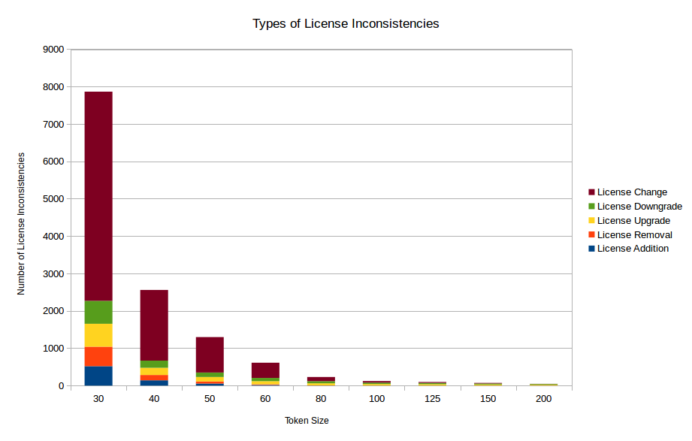
Results

Slide 14
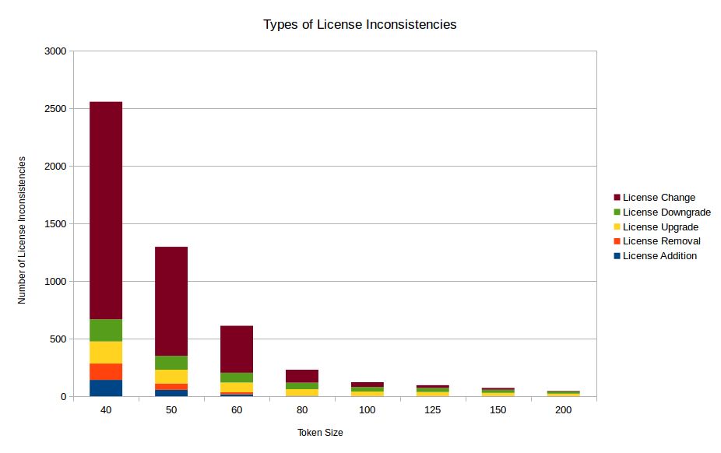
Results

Slide 15
Analysis & Conclusions
Based on the previous conclusions, we can safely exclude the column of token size 30.
The proportion of license changes decreases greatly as token size increases.
The number of license additions and license removals falls to nearly nothing as token size increases.
Conclusion: A large portion of false positives may include license additions, removals, and changes.

Slide 16
Further Research
Creating a systematic way to further detect license violations from license inconsistencies
Using CCFX and Ninka to analyze other large codebases such as ones written in Perl and other compatible languages
Further refining which token size is optimal for code clone detection for license inconsistencies
Running these analyses on several consecutive versions of Debian and Ubuntu to see how license violations evolve over time

