Slide 1
Assessing the Impact of Framework Changes Using Component Ranking
Reishi Yokomori
Nanzan University, Japan
Harvey Siy
University of Nebraska at Omaha, USA
Masami Noro
Nanzan University, Japan
Katsuro Inoue
Osaka University, Japan

Slide 2
Background
Most of today’s software applications are built on libraries or frameworks.
Not only the application, but also framework grow during the development.
Research question:
How do developers work through their evolution?
We would like to know how to assess the impact of framework changes.
In this study, we analyze the evolution of software based on use relationship between components.

Slide 3
Purpose of Study
We analyzed in an actual open source project;
To find characteristics for the evolution of use relation between framework components and application software.
To show that the analysis of use relation is a viable analysis methodology for studying software evolution.

Slide 4
Target Software
We will analyze the evolution of use relation between framework and application.
The target framework: JHotDraw
a Java-based GUI framework for technical and structured graphics.
The target application: JARP
a Java-based Petri net tool
It uses JHotDraw as a framework for editing a Petri net, drawing the result, and so on.
We will analyze use relation based on component graph and component rank.

Slide 5
Component Graph
It models use relations in software.
Nodes : component
Edges : use relation
incoming and outgoing edges for each component
A
component
(Class)
B
use relation
(Method call, variable, instance creation,
and field access)
C
D

Slide 6
Component Rank
is a ranking method for components.
How much component is used?
is based on use relation between components.
If the component is frequently used, its rank goes up.
Both direct and indirect use relation are taken into consideration.
is calculated from the component graph.
Value of each component is a steady-state distribution on a Markov chain.
Components are sorted by the value of each component.

Slide 7
Calculation Process of Component Rank
C₁
v₁
C₁
0.400
C₂
0.200
C₁
0.333
C₂
v₂
C₂
0.333
0.200
v₁×50%
C₁
C₂
0.167
C₁
0.333
v₁×50%
C₂
0.167
0.200
v₃×100%
0.167
v₂×100%
0.400
0.200
C₁
C₂
C₃
v₃
0.167
C₃
0.400
0.333
C₃
0.333
C₁
0.417
C₂
0.167
C₁
0.500
0.333
C₂
0.167
C₁
C₁
C₂
C₂
C₃
0.250
0.167
C₁
0.334
C₂
0.250
0.167
C₃
0.500
0.500
0.250
0.167
0.167
C₃
0.334
0.417
0.167
C₃
0.417
0.250
C₃
0.334
C₃
C₃
C₃
0.417

Slide 8
Metrics For Analysis
Edges from application component to framework component
Incoming edges to each framework component
Outgoing edges from each application component
Component rank

Slide 9
Results of Experiments
General Information
Major evolution periods in JARP development
The evolution of outgoing edges
The evolution of incoming edges
The transitions of component rank
The impact of framework upgrading
The impact of incoming edges from application classes

Slide 10
Results of Experiments
General Information
Major evolution periods in JARP development
The evolution of outgoing edges
The evolution of incoming edges
The transitions of component rank
The impact of framework upgrading
The impact of incoming edges from application classes

Slide 11
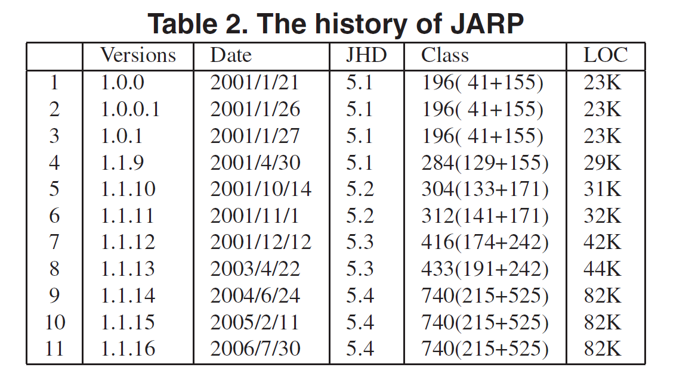
General Information
JARP has 11 versions.

Slide 12
The Evolution of Use Relation
Inside of JHotDraw
Inside of JARP
Use relation between framework and application
Gradually increase

Slide 13
Results of Experiments
General Information
Major evolution periods in JARP development
The evolution of outgoing edges
The evolution of incoming edges
The transitions of component rank
The impact of framework upgrading
The impact of incoming edges from application classes

Slide 14
Major Evolution Periods In JARP Development
We suggested a metrics to detect important updates in the development process.
In the previous experiment, change of component rank was useful to guess an impact of the update.
major-scale feature implementation
maintenance to core components
refactoring and restructuring of system
Large size of
Modification
A lot of changes in use relations
Component rank
is also changed.
R. Yokomori, M. Noro, and K. Inoue. “Evaluation of Source Code Updates in Software Development Based on Component Rank”. In Proceedings of 13th Asia Pacific Software
Engineering Conference, pages 327–334, Bangalore, India, 2006.

Slide 15
Major Evolution Periods In JARP Development
Class allocation
is changed drastically
JHotDraw is
Upgraded

Slide 16
Major Evolution Periods In JARP Development
We can confirm which update has an impact on the system by using the change of component rank.
We can also confirm which subsystem is affected by the update.
In ver. 1.1.9, functions of mainwindow are divided into subcomponents, and tools package is produced.
In ver. 1.1.12, functions of PetriNetImpl are divided into subcomponents, and edition and simulation packages are produced.
In ver. 1.1.10, 12, 14, JHotDraw is upgraded.

Slide 17
Results of Experiments
General Information
Major evolution periods in JARP development
The evolution of outgoing edges
The evolution of incoming edges
The transitions of component rank
The impact of framework upgrading
The impact of incoming edges from application classes

Slide 18
Evolution of Outgoing Edges
Max
Cumulative frequency
# of Outgoing edges to the framework classes

Slide 19
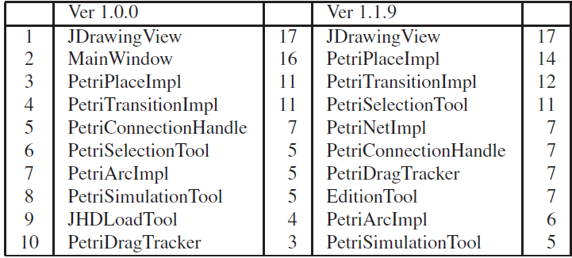
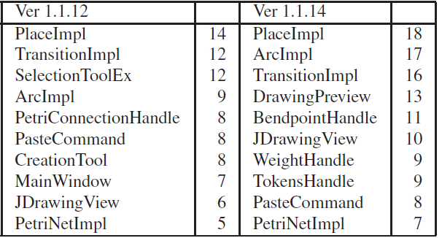
Evolution of Outgoing Edges
Disappeared!!
Drastically
decreased!!

Slide 20
Evolution of Outgoing Edges
In summary, the number of outgoing edges increases little by little.
The number of components which have outgoing edges increases.
However, the maximum number doesn’t change so much.
If a large component has a lot of outgoing edges, it becomes a target of refactoring.
Decomposed into several components which have a small number of outgoing edges.

Slide 21
Results of Experiments
General Information
Major evolution periods in JARP development
The evolution of outgoing edges
The evolution of incoming edges
The transitions of component rank
The impact of framework upgrading
The impact of incoming edges from application classes

Slide 22
Evolution of Incoming Edges
Max
Cumulative frequency
# of Incoming edges from the application classes

Slide 23
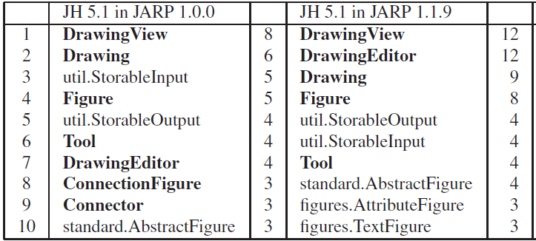
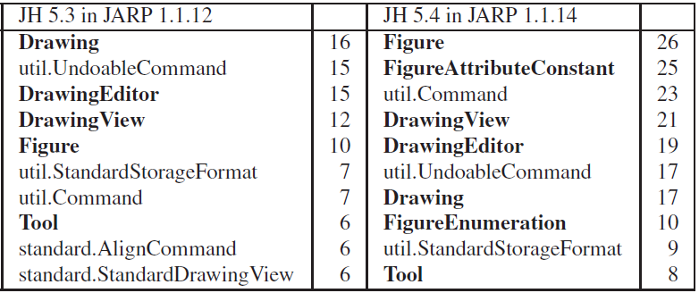
Evolution of Incoming Edges
Increasing!!
Increasing!!
Increasing!!
Increasing!!

Slide 24
Evolution of Incoming Edges
For almost all of the components, the number of incoming edges increases.
The maximum number also increases.
Existing interface is not changed.
The number of framework components which have incoming edges doesn’t increase so much.
Interface of framework is well-organized.

Slide 25
Results of Experiments
General Information
Major evolution periods in JARP development
The evolution of outgoing edges
The evolution of incoming edges
The transitions of component rank
The impact of framework upgrading
The impact of incoming edges from application classes

Slide 26
Transition of Component Rank - JARP(Application)

Slide 27
Transition of Component Rank - JARP(Application)
Component Rank depends on the implemented function.
Ver. 1.0.0 : About Petri-net
Ver. 1.1.9- : About Petri-net, Filter, Progress Callback, XMLBrowser
Based on the increase of rank, we can confirm
What functions are newly implemented?
What type of data is used for new function?

Slide 28
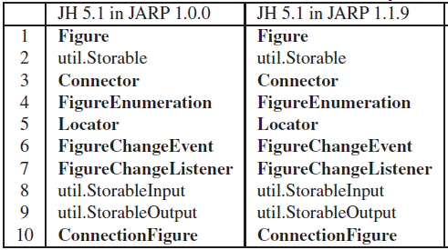
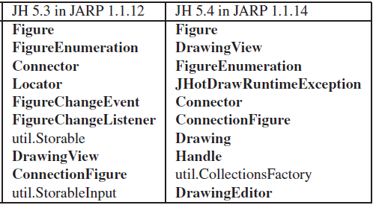
Transition of Component Rank - JHotDraw(Framework)

Slide 29
Transition of Component Rank - JHotDraw(Framework)
Component rank is useful for detecting core components in the framework.
Some components are joined into core components during development.
Half of core components are still on the list.
Because interface of framework is not changed.

Slide 30
Results of Experiments
General Information
Major evolution periods in JARP development
The evolution of outgoing edges
The evolution of incoming edges
The transitions of component rank
The impact of framework upgrading
The impact of incoming edges from application classes

Slide 31
The impact of Framework Upgrading
If the framework is upgraded, some application component would be modified for adjusting.
Research question:
What component’s component rank is changed?
What kind of components should be reviewed?
We list JARP components whose rank goes up when JHotDraw is upgraded.
affected components

Slide 32
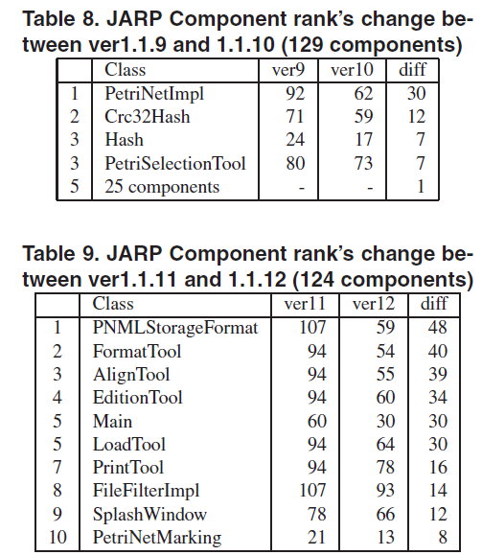
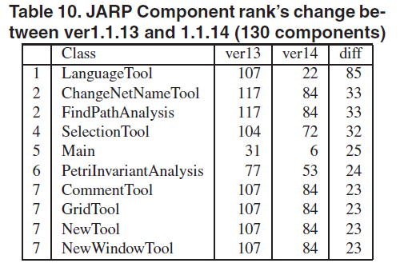
The impact of Framework Upgrading
Tool
Main
Utility class

Slide 33
The impact of Framework Upgrading
Components which use framework class, such as tool classes, are affected.
Direct use relation changed.
Some of them have almost the class same structure.
Main and utility classes are also affected.
Direct and Indirect use relation changed.

Slide 34
Results of Experiments
General Information
Major evolution periods in JARP development
The evolution of outgoing edges
The evolution of incoming edges
The transitions of component rank
The impact of framework upgrading
The impact of incoming edges from application classes

Slide 35
The Impact of Incoming Edges
Research question:
Are frequently used components in framework different when external use relations are considered?
We compared these two rankings:
Component rank based on JHotDraw classes only.
Component rank based on both JHotDraw and JARP classes.
Only JHotDraw classes are extracted.

Slide 36
The Impact of Incoming Edges
Handler
Command
Connector

Slide 37
The Impact of Incoming Edges
Many command classes went up in ranking.
Some components are not used in the framework.
These components implements specific function.
Direct use relations from application
Handler and connector also appears.
Indirect use relations from application
There is a little difference between components used in the framework and components used in the application.
This information is useful for reorganization.

Slide 38
Summary: The Effectiveness of Use Relation Analysis
Use relation between components assists to grasp the entire of software.
The change of use relation is closely related to the activities in the development.
The change of use relation highlights other characteristics of software.
Component rank is useful to assess the change.
To grasp newly implemented functions roughly.
To detect core component.
To confirm the affected components by the update.

Slide 39
Conclusion
In this research, we observed the evolution of use relation between components between framework and application
Metrics about use relation is useful to grasp the overview of software.
The change of use relation is closely related to the activities in the development.
Component rank is also a good sources of information.

Slide 40
Future Works
To observe an impact of application in another situation.
If the existing API of framework is changed?
If the framework itself is completely replaced?
To estimate the cost of upgrading of framework.
Which application components are really modified?
Can we estimate needed effort roughly?
Use relation analysis in an another theme.
evaluation of a refactoring method based on aspectization.

Slide 41
Thank you

