Slide 1
A Prototype of Comparison Tool for Android Applications Based on Difference of API Calling Sequences
Tetsuya Kanda, Yuki Manabe, Takashi Ishio, Makoto Matsushita, Katsuro Inoue
Graduate School of Information Science and Technology, Osaka University, Japan

Slide 2
Many Applications in the World
Many applications are available
from Android Market
from Apple App Store ...
We focused on Android applications.
Some applications have similar features
About 3,000 “calculator” applications in Android Market (May 2011)

Slide 3
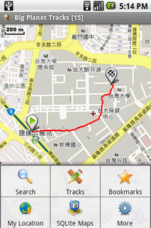
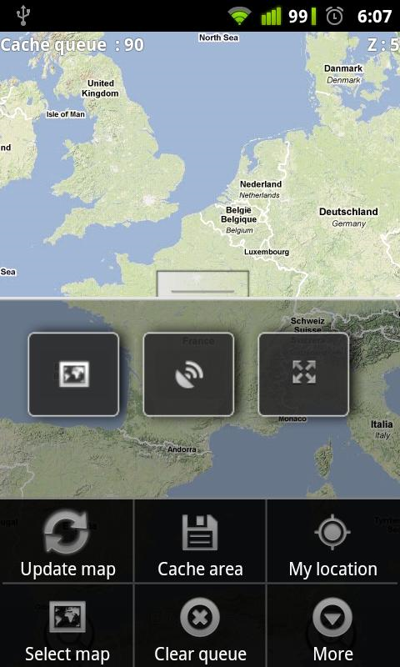
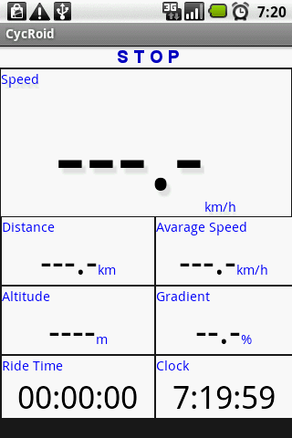
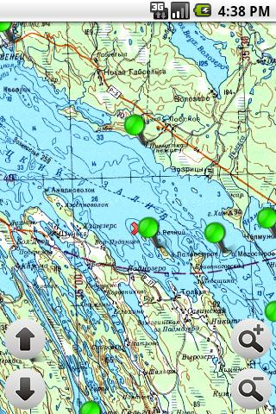
Similar Applications
Screenshots of Android applications labeled “Map” in Google Code

Slide 4
Similar Applications
Screenshots of Android applications labeled “Map” in Google Code
What is the difference of these applications?

Slide 5
Differences of the Applications
Make comparison chart to clarify differences
ID | App A | App B | App C | App D
Alert Dialog | ✓ | ✓ | ✓ | ✓
Get Latitude and Longitude |  | ✓ | ✓ | ✓
Show Toast (pop-up message) | ✓ |  | ✓ | ✓
Set Latitude and Longitude |  |  |  | ✓

Slide 6
How to Compare Applications
Trial use of applications
Can’t test ALL features in applications
Users can’t test the feature they don’t know.
Takes a lot of time
Reading documents
Some documents are too long to understand.
Some documents have too little information.
Some applications have no documents.
Comparing source code

Slide 7
Comparing source code
Source code explains almost all behavior of the applications.
Can’t compare directly
Almost all of source code will be extracted as differences.
Comparing two twitter client applications
+ if (colIndex > -1) {
+ inReplyTo = mCursor.getString(colIndex);
+ if (inReplyTo != null && "null".equals(inReplyTo) == false) {
+ inReplyTo = String.format(Locale.getDefault(), getText(R.string.tweet_source_in_reply_to).toString(), inReplyTo);
}
- terp_handler = new Handler() {
- public void handleMessage(Message m) {
- switch (m.arg1) {
- case -1:

Slide 8
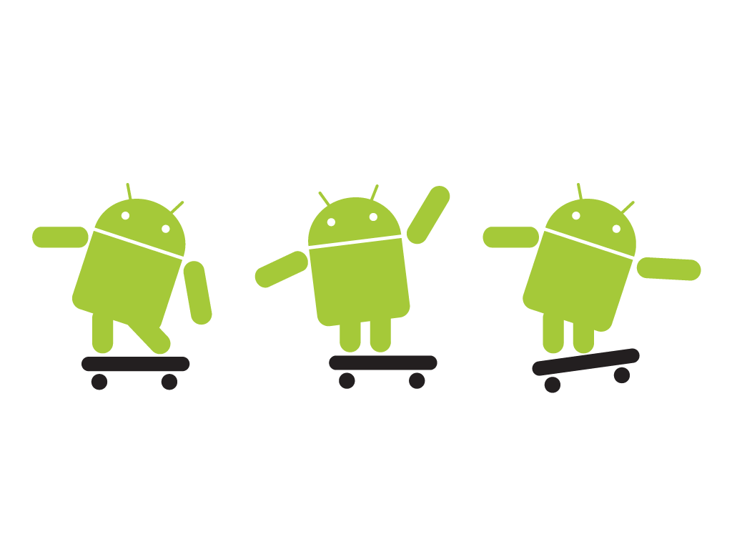
Android
A platform for mobile devices
Android smartphones have many characteristic devices.
Wi-Fi adaptor
GPS
Touch panels
Gravity sensors
Cameras
etc…

Slide 9
Features and Devices
Features correspond to devices.
Devices
Application
Display a map of current location
Features
GPS
Get current location
Touch panel
Scroll Map

Slide 10
Features, APIs and Devices
Application controls devices by calling APIs.
Devices
Application
SDK
Display a map of current location
Features
APIs for controlling a GPS device
GPS
Get current location
Touch panel
APIs for controlling a touch panel
Scroll Map

Slide 11
Idea
A feature calls APIs to control devices.
An API calling sequence corresponds to a feature.
an API calling sequence: a sequence of method calls of API classes in a single method
Compare APIs to compare features of applications
The difference of API calls represents the difference of features.

Slide 12
Proposal Method
Applications with similar feature
Applications
Applications
Application
X₁
Application
X₂
Phase1: Making a knowledge-base
Knowledge-base
Phase 2: Comparing applications
Proposal method
X₁ -Feature
X₂ -Feature
Common-Feature

Slide 13
Proposal Method
Applications with similar feature
Applications
Applications
Application
X₁
Application
X₂
Phase1: Making a knowledge-base
Knowledge-base
Phase 2: Comparing applications
Proposal method
X₁ -Feature
X₂ -Feature
Common-Feature

Slide 14
Knowledge-base
Mappings of API calling sequence and its feature name
Example:
Feature name | API calling sequences
Show Toast (pop-up message) | android.widget.Toast.makeText android.widget.Toast.show
Get Latitude and Longitude | android.location.Location.getLatitude android.location.Location.getLongitude

Slide 15
Making a Knowledge-base
COMMON
Applications
Extract API calls
_{A.m1()}
_{B.m2()}
_{B.m2()}
_{C.m1()}
Applications
Applications with similar feature
Filtering
Filtering
Collect applications with similar feature
Extract API calls appeared in two or more applications (COMMON)
Filter COMMON manually and assign a feature name
(Removed)
Feature2
_{A.m1()}
_{B.m2()}
_{B.m2()}
_{C.m1()}
Knowledge-base
Assign a feature name

Slide 16
Making a Knowledge-base
COMMON
Applications
Extract API calls
_{A.m1()}
_{B.m2()}
_{B.m2()}
_{C.m1()}
Applications
Applications with similar feature
Filtering
Filtering
Collect applications with similar feature
Extract API calls appeared in two or more applications (COMMON)
Filter COMMON manually and assign a feature name
(Removed)
Feature2
_{A.m1()}
_{B.m2()}
_{B.m2()}
_{C.m1()}
Knowledge-base
Assign a feature name

Slide 17
Extract API Calls
Each method is translated into an API calling.
Extract only Android API calls
We define Android API as:
Whose fully qualified names start with “android” or “com.google.android”
Ignore control statement

Slide 18
Example of extracting API Calls
Source Code
public void onClick(View v) {
String s = str.substring(2);
Intent intent=new Intent(this,com.example.edit.class);
startActivity(intent);
｝
1
2
API Calling Sequence
android.content.Intent.android.content.Intent
android.app.Activity.startActivity
1
2

Slide 19
Making a Knowledge-base
COMMON
Applications
Extract API calls
_{A.m1()}
_{B.m2()}
_{B.m2()}
_{C.m1()}
Applications
Applications with similar feature
Filtering
Filtering
Collect applications with similar feature
Extract API calls commonly appeared (COMMON)
Filter COMMON manually and assign a feature name
(Removed)
Feature2
_{A.m1()}
_{B.m2()}
_{B.m2()}
_{C.m1()}
Knowledge-base
Assign a feature name

Slide 20
Filtering(1/2)
Manually remove API calling sequences that are not explaining a specific feature
Criteria:
Control or get information using devices
Showing notification (dialog)
Using Intent (call for another application)
Feature name | API calling sequences
??? | android.widget.TextView.setText android.view.View.setVisibility
??? | android.location.Location.getLatitude android.location.Location.getLongitude

Slide 21
Filtering(2/2)
Manually remove API calling sequences that are not explaining a specific feature
Criteria:
Control or get information using devices
Showing notification (dialog)
Using Intent (call for another application)
Feature name | API calling sequences
??? | android.widget.TextView.setText android.view.View.setVisibility
Get Latitude and Longitude | android.location.Location.getLatitude android.location.Location.getLongitude

Slide 22
Proposal Method
Applications with similar feature
Applications
Applications
Application
X₁
Application
X₂
Phase1: Making a knowledge-base
Knowledge-base
Phase 2: Comparing applications
Proposal method
X₁ -Feature
X₂ -Feature
Common-Feature

Slide 23
Comparing Applications
Application X₁
Extract API calls
_{A.m1()}
_{B.m2()}
_{B.m3()}
_{C.m1()}
_{D.m4()}
_{A.m1()}
_{B.m2()}
_{D.m2()}
_{B.m3()}
API Calling Sequences
Application X₂
Extract API calls
Compare
Knowledge-base
DIFF-X1
COMMON
DIFF-X2
Check
Check
Check
X₁ -Feature
Common-Feature
X₂ -Feature
23

Slide 24
Comparing Applications
Application X₁
Extract API calls
_{A.m1()}
_{B.m2()}
_{B.m3()}
_{C.m1()}
_{D.m4()}
_{A.m1()}
_{B.m2()}
_{D.m2()}
_{B.m3()}
API Calling Sequences
Application X₂
Extract API calls
Compare
Knowledge-base
DIFF-X1
COMMON
DIFF-X2
Check
Check
Check
X₁ -Feature
Common-Feature
X₂ -Feature
24

Slide 25
Compare API Calling Sequences (1/3)
A.m1()
B.m2()
B.m3()
C.m1()
D.m4()
B.m3()
A.m1()
B.m2()
D.m2()
B.m3()
API calling sequence from Application X₁
API calling sequence from Application X₂

Slide 26
Compare API Calling Sequences (2/3)
A.m1()
B.m2()
B.m3()
C.m1()
D.m4()
B.m3()
A.m1()
B.m2()
D.m2()
B.m3()
API calling sequence from Application X₁
API calling sequence from Application X₂
Compare
COMMON
A.m1()
B.m2()

Slide 27
Compare API Calling Sequences (3/3)
A.m1()
B.m2()
B.m3()
C.m1()
D.m4()
B.m3()
A.m1()
B.m2()
D.m2()
B.m3()
API calling sequence from Application X₁
API calling sequence from Application X₂
Compare
DIFF-X1
COMMON
DIFF-X2
B.m3()
C.m1()
D.m4()
A.m1()
B.m2()
B.m3()
D.m2()
B.m3()

Slide 28
Compare Two Applications
Application X₁
Extract API calls
_{A.m1()}
_{B.m2()}
_{B.m3()}
_{C.m1()}
_{D.m4()}
_{A.m1()}
_{B.m2()}
_{D.m2()}
_{B.m3()}
API Calling Sequences
Application X₂
Extract API calls
Compare
Knowledge-base
DIFF-X1
COMMON
DIFF-X2
Check
Check
Check
X₁ -Feature
Common-Feature
X₂ -Feature
28

Slide 29
Check with a Knowledge-base
Knowledge-base
DIFF-X1
COMMON
_{A.m1()}
_{B.m3()}
_{B.m2()}
Feature1
Not Match
A.m1()
B.m2()
Match
_{A.m1()}
_{B.m2()}
B.m2()
B.m3()
C.m1()
D.m4()
Feature2
DIFF-X2
Match
_{B.m2()}
_{B.m3()}
_{C.m1()}
_{D.m2()}
_{B.m3()}
Feature3
_{D.m2()}
_{B.m3()}
Match

Slide 30
Prototype Tool : Startup Window
Select target applications

Slide 31
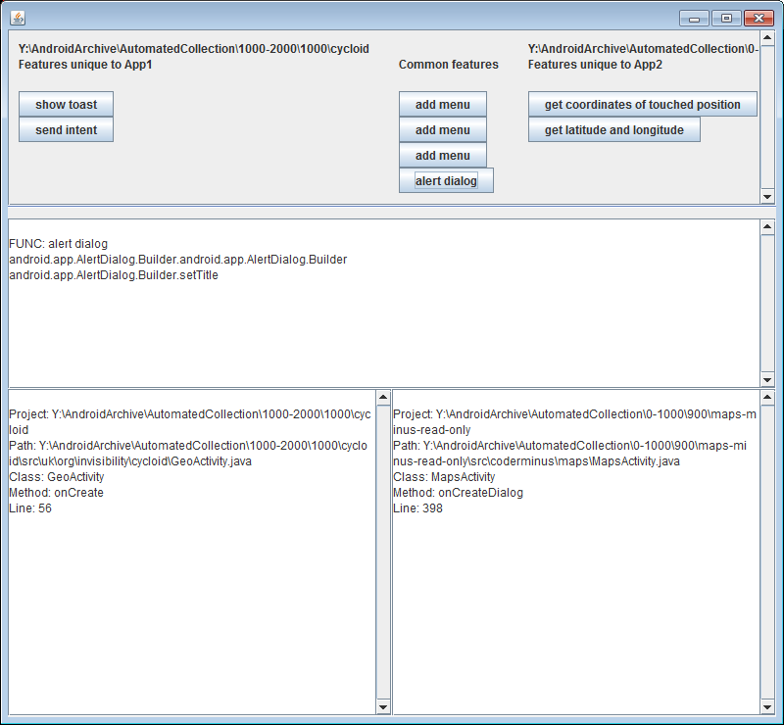
Prototype Tool : Showing Result
Extracted X₁-feature
Extracted Common-feature
Extracted X₂-feature
Select one
Feature name and API calling sequence
Information about each API calling sequence

Slide 32
Case Study
Goal : To answer the following questions
RQ1 Does an API calling sequence correspond to a feature of an application?
RQ2 Is our prototype tool able to clarify differences of two applications?
Target :
11 applications labeled “MAP” in Google code

Slide 33
Process
Make a knowledge-base with 6 applications
Check rest 5 applications with the knowledge-base
Compare two applications using our prototype tool
For making a knowledge-base

Slide 34
Process
Make a knowledge-base with 6 applications
Check rest 5 applications with the knowledge-base
Compare two applications using our prototype tool
Check with the knowledge-base

Slide 35
Process
Make a knowledge-base with 6 applications
Check rest 5 applications with the knowledge-base
Compare two applications using our prototype tool
Compare using our prototype tool

Slide 36
Knowledge-base
Feature name | API calling sequences
Alert Dialog | android.app.AlertDialog.Builder.<Comstructor> android.app.AlertDialog.Builder.setTitle
Get Latitude and Longitude | android.location.Location.getLatitude android.location.Location.getLongitude
Show Toast (pop-up message) | android.widget.Toast.makeText android.widget.Toast.show
Set Latitude and Longitude | android.location.Location.setLatitude android.location.Location.setLongitude
Submenu | android.view.Menu.addSubMenu android.view.SubMenu.setIcon
23 API Calling sequences are stored into a knowledge-base.

Slide 37
Result (1/4)
ID | App1 | App2 | App3 | App4 | App5
Alert Dialog | ✓ | ✓ | ✓ | ✓ | ✓
Get Latitude and Longitude | ✓ |  | ✓ | ✓ | ✓
Show Toast (pop-up message) | ✓ | ✓ |  | ✓ | ✓
Set Latitude and Longitude | ✓ |  |  |  | ✓
Submenu |  |  |  |  | ✓

Slide 38
Result (2/4)
ID | App1 | App2 | App3 | App4 | App5
Alert Dialog | ✓ | ✓ | ✓ | ✓ | ✓
Get Latitude and Longitude | ✓ |  | ✓ | ✓ | ✓
Show Toast (pop-up message) | ✓ | ✓ |  | ✓ | ✓
Set Latitude and Longitude | ✓ |  |  |  | ✓
Submenu |  |  |  |  | ✓
All five applications have “Alert Dialog” Feature

Slide 39
Result (3/4)
ID | App1 | App2 | App3 | App4 | App5
Alert Dialog | ✓ | ✓ | ✓ | ✓ | ✓
Get Latitude and Longitude | ✓ |  | ✓ | ✓ | ✓
Show Toast (pop-up message) | ✓ | ✓ |  | ✓ | ✓
Set Latitude and Longitude | ✓ |  |  |  | ✓
Submenu |  |  |  |  | ✓
Application 2 doesn’t have “Get Latitude and Longitude” feature

Slide 40
Result (4/4)
ID | App1 | App2 | App3 | App4 | App5
Alert Dialog | ✓ | ✓ | ✓ | ✓ | ✓
Get Latitude and Longitude | ✓ |  | ✓ | ✓ | ✓
Show Toast (pop-up message) | ✓ | ✓ |  | ✓ | ✓
Set Latitude and Longitude | ✓ |  |  |  | ✓
Submenu |  |  |  |  | ✓
API calling sequence shows the features of applications

Slide 41
Output of the Tool (1/3)
App 2
App 4

Slide 42
Output of the Tool (2/3)
App 2
App 4
Both applications have “Alert Dialog” Feature

Slide 43
Output of the Tool (3/3)
App 2
App 4
Information about each API calling sequence
GeoActivity.java
Class: GeoActivity
Method: onCreate
Line: 56

Slide 44
Conclusion and Future Work
Conclusion:
A prototype tool to compare two Android applications using API calling sequences
Performed a case study
API calling sequences are usable for comparing applications
Future work:
Support to give an appropriate name to a sequence of API calls
Portions of this presentation are reproduced from work created and shared by Google and used according to terms described in the Creative Commons 3.0 Attribution License.

